Slide 1
IEM Access & Free GIS
  Daryl Herzmann
  Department of Agronomy
  Iowa State University

Slide 2
Outline
IEM Background Info
Free GIS components
  PostGIS
  UofM Mapserver
  OpenGIS
IEM GIS Efforts
  IEM Access

Slide 3
IEM Overview
Collect, compare, disseminate, and archive environmental data in Iowa
Currently tracking over 650 sites in the Midwest US.
Our goal is to bridge the gap between those that need data and those that have data.

Slide 4
Why GIS?
Provides a framework for data management, analysis and display
Provides a large community of folks able to use GIS datasets
OpenGIS & FreeGIS provides standards to fit our software philosophy

Slide 5
Free GIS
“Free software” is a matter of liberty, not price. To understand the concept, you should think of “free” as in “free speech” or “free markets,” not as in “for free” (gratis).
IEM GIS development fits under the FreeGIS umbrella (software & data)
http://www.freegis.org

Slide 6
'Free' Components
PostgreSQL (Relational Database)
PostGIS (Spatial Blade for PostgreSQL)
UofM Mapserver (Internet Mapping Server)
PHP (Application logic)
Apache (Web Server)
Grass (Desktop GIS)

Slide 7
Proprietary Free
Oracle
ArcSDE
ArcIMS
ASP
Microsoft IIS
ArcGIS
PostgreSQL
PostGIS
Mapserver
PHP
Apache
Grass

Slide 8
IEM Access
Project name for our internal data management system.
'Access' refers to the ability for applications to seamlessly get at these data sources.
At the simplest, it is a publicly available spatial database.

Slide 9
What does IEM Access hold?
Latest observation
Daily Summaries
Monthly Summaries
Growing Season Summaries
Yearly Summaries
Climatologies (soon)

Slide 10
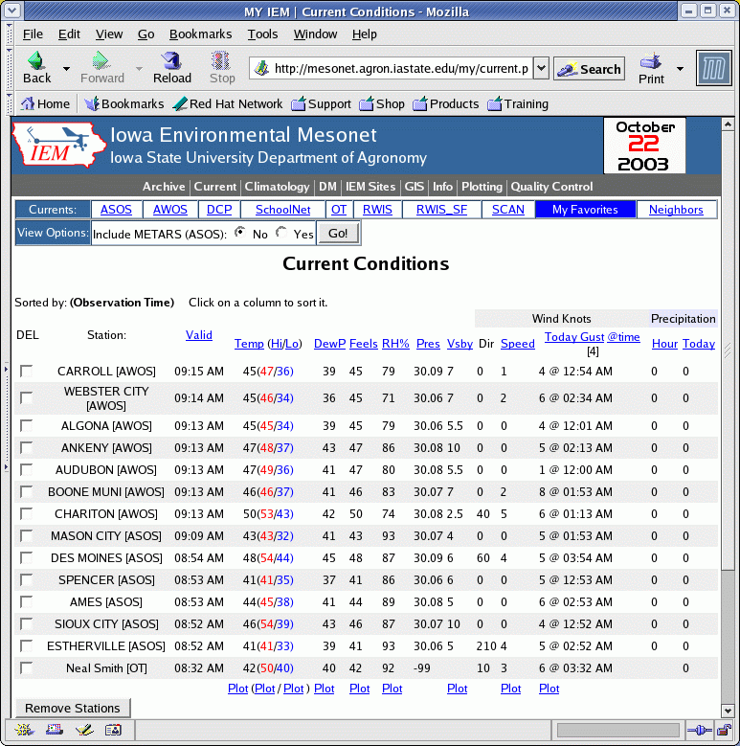
Ex App: Current Sortables
PHP generates a custom view of sites you are interested in
Mapserver can generate a plot of whatever you like.

Slide 11
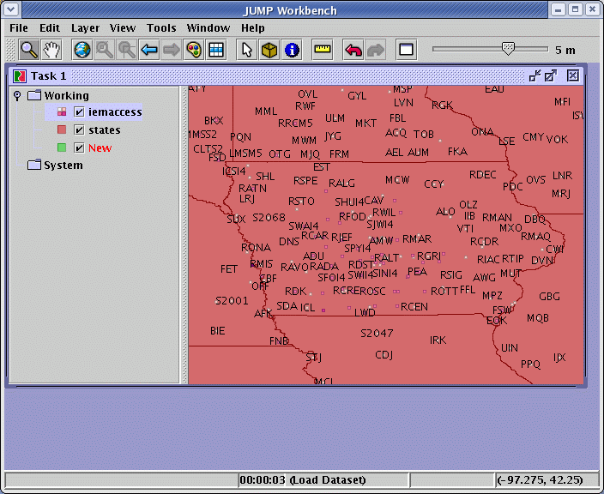
Ex App: Shapefile download
One-click to download a dynamically generated shapefile with the current conditions in it.
Shown plotted in JUMP (Free GIS)

Slide 12
Other Applications
Give the database your current position and ask for the nearest observation.
Ask the database to take a site observation and compare it to its 10 nearest neighbors. (QC)
Aggregate to some other polygon layer, ex) counties, states

Slide 13
PyIMS Fascade
Allows Mapserver to appear as an ArcIMS service
Homepage: google for 'PyIMS'
Currently only supports RASTER
IEM's PyIMS server is here
db1.mesonet.agron.iastate.edu
Serve nationwide NEXRAD (4326)

Slide 14
Mapserver WMS
First publicly accessible RADAR WMS?
URI:
mesonet.agron.iastate.edu/wms/radar.php?
Currently serves UTM Zone 15 North (epsg: 26915)

Slide 15
Current Challenges
Including time within GIS
Dynamic refreshes with desktop GIS
Inefficiencies of WMS
'Interoperability'

Slide 16
Time for demos?
ArcExplorer
  Talk with pyIMS server
  Talk with WMS
    Ortho server and Mapserver
Website
  Current Sortables
  Dynamic Plotting

Slide 17

I'm done, questions?
Daryl Herzmann
3010 Agronomy
294-5978
akrherz@iastate.edu

