Slide 1
Using GIS to serve Environmental Data in Iowa
  Daryl Herzmann¹
  Raymond Arritt¹
  Dennis Todey²
  ¹Iowa State University
  ²South Dakota State

Slide 2
Outline
What is GIS?
Why use GIS?
Who uses GIS?
How the IEM utilizes GIS?
Where are we going with GIS?
When will I stop talking?

Slide 3
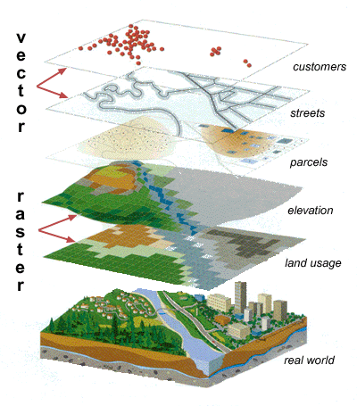
What is GIS?
a GIS is a system of hardware, software and procedures to facilitate the management, manipulation, analysis, modeling, representation and display of georeferenced data to solve complex problems regarding planning and management of resources(NCGIA, 1990)

Slide 4
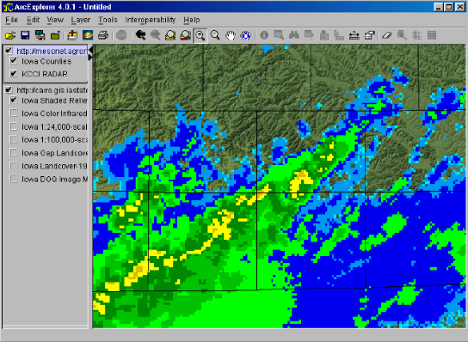
Why use GIS?
Interface with many datasets
Interface with many disciplines
Tools to do 'portable' research
RADAR layer from the IEM
with topography from ISU GIS Lab

Slide 5

Who uses GIS?
Most of you probably do
Just about everyone else does too!
GIS framework moving into non-spatial areas.

Slide 6



How the IEM uses GIS?
PostGIS, spatial blade for PostgreSQL
Mapserver, Internet Mapping Server
GRASS, desktop GIS

Slide 7
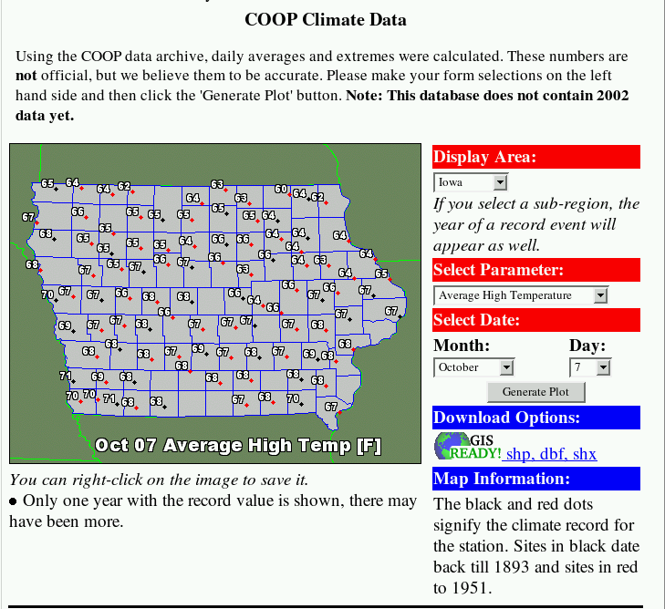
Internet Mapping Example
Generate dynamic plots of climate data
The data for the plot is immediately available in GIS format for download.

Slide 8
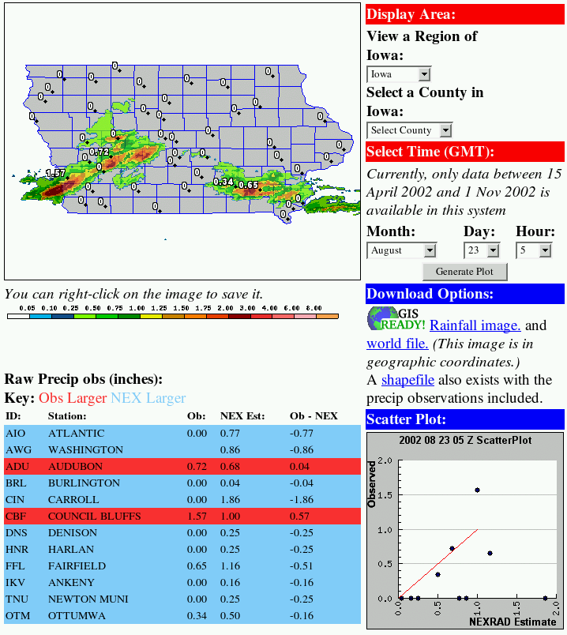
Analyzing Rainfall
Combine NEXRAD estimates with automated observations.
All data shown is immediately available for download.

Slide 9
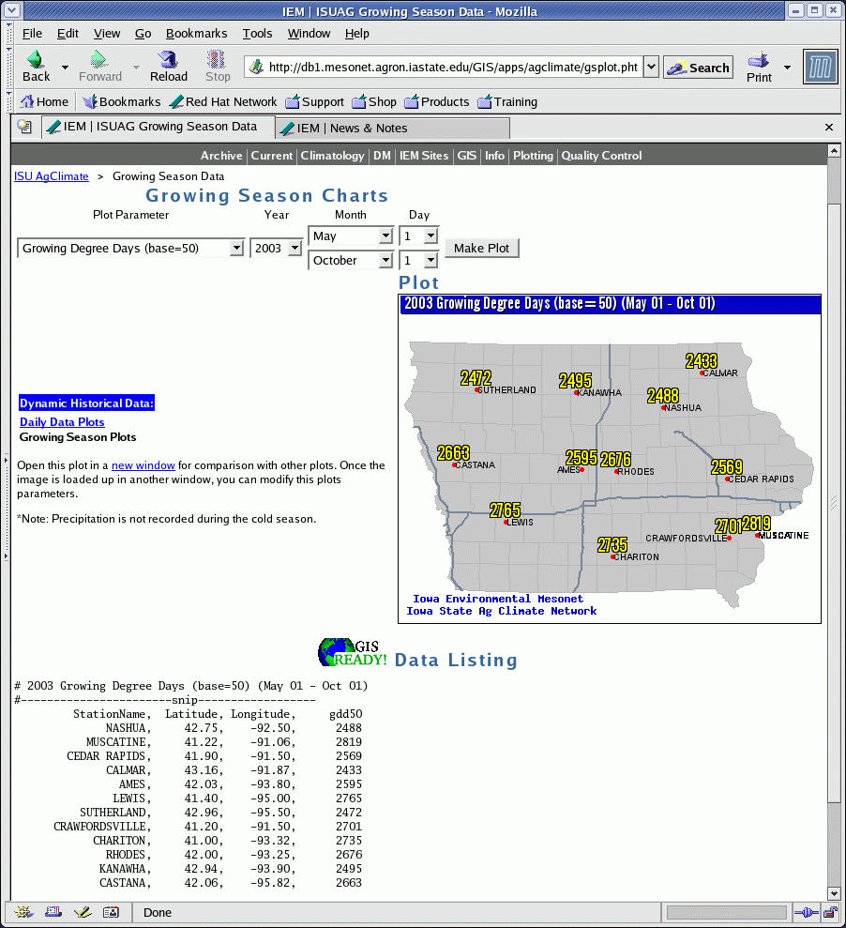
Custom Growing Season Data
Typical growing season data does not fit actual planting dates.
Users pick timespan and parameter.
Data immediately available for Excel or GIS in CDF format.

Slide 10
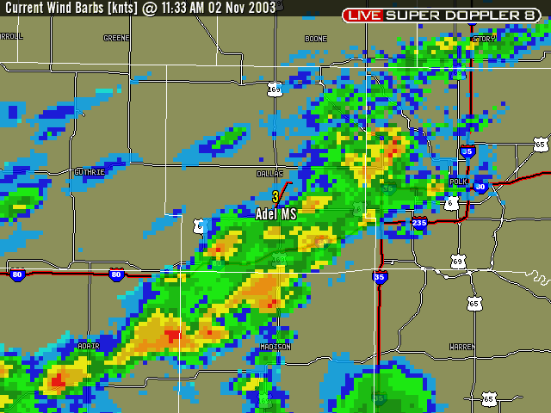
Pulling RADAR into GIS

Slide 11
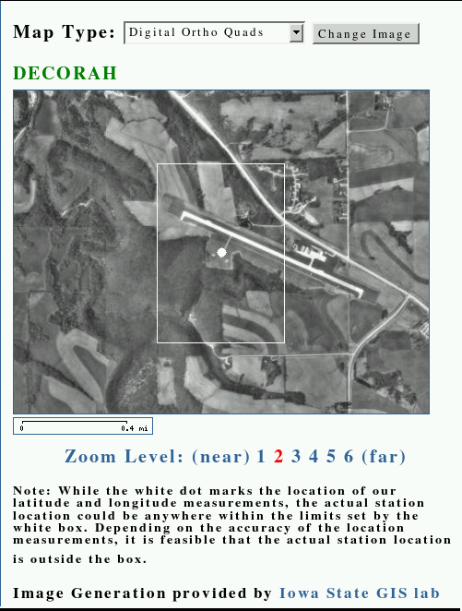
OGC Web Services
Open GIS Consortium (OGC) develops standards for GIS systems to inter-operate
  Web Map Service (WMS)
  Web Feature Service (WFS)
Dynamically bring in Ortho Quads from the ISU GIS Lab
All generated with Open-Source software and Open GIS standards

Slide 12
GIS Data Services Available
Today's NWS COOP observations
Climate data
Station locations
Current & Historical RADAR composites
Various WMS services
High resolution rainfall (coming soon)

Slide 13
Where are we going with GIS?
Expand our Web Map Service (WMS) and Web Feature Service (WFS).
  Currently have a RADAR WMS
  Will have a WFS before next year
See how we can get weather and climate data to the GIS community in a Free/free and open matter.

Slide 14
When will I stop talking?
NOW!,
but I will start again
after the break!

Slide 15

I'm done, questions? http://mesonet.agron.iastate.edu
Daryl Herzmann
3010 Agronomy
515 294-5978
akrherz@iastate.edu

