Slide 1
Implementing Weather and Climate Data Networks for Agriculture
  Daryl Herzmann¹
  Raymond Arritt¹
  Dennis Todey²
  ¹Iowa State University
  ²South Dakota State

Slide 2
Outline
Motivations for a Mesonet
The Iowa Environmental Mesonet (IEM), a different approach
Agricultural Applications

Slide 3
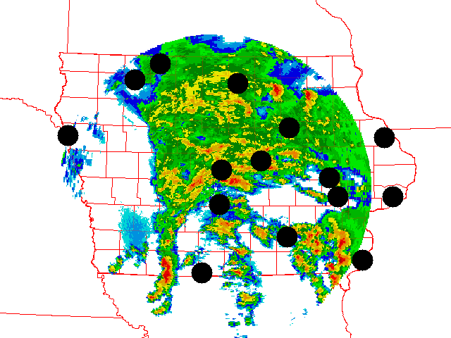
Spatial Variability
As you know, weather and climate occurs on all spatial and temporal scales. How can we representively monitor these environments?
AND, on a budget?
Example NEXRAD plot showing
ASOS coverage.

Slide 4
Build a Mesonet!
Meso – Spatial Scale, Net – Network
Spatial scale from ~1 to 100s of km
Tradiationally, mesonets have been built from scratch, which is very expensive!

Slide 5
The Iowa Environmental Mesonet, a new approach
We realized that the state was already full of environmental observing platforms.
Why not centrally collect these networks to produce a low-cost, high-return mesonet?

Slide 6
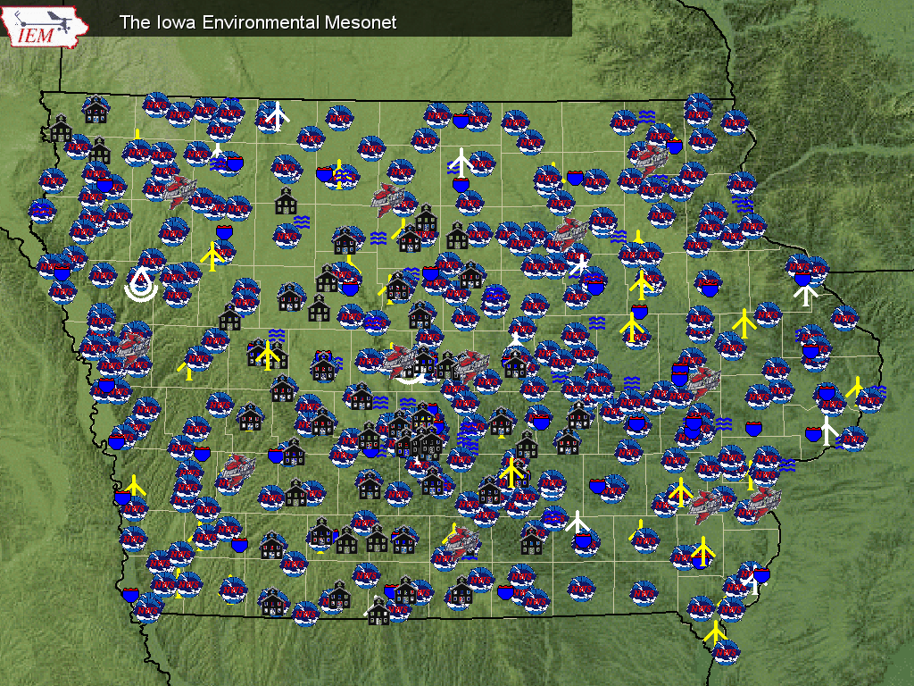

Slide 7
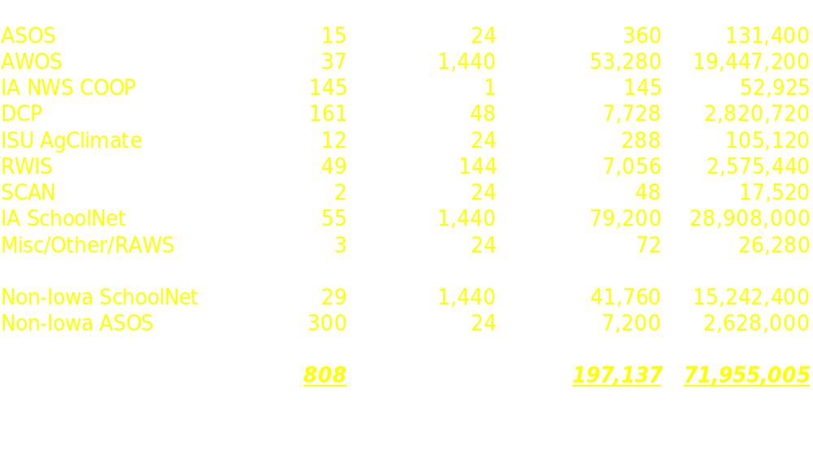
Data Processed Daily

Slide 8
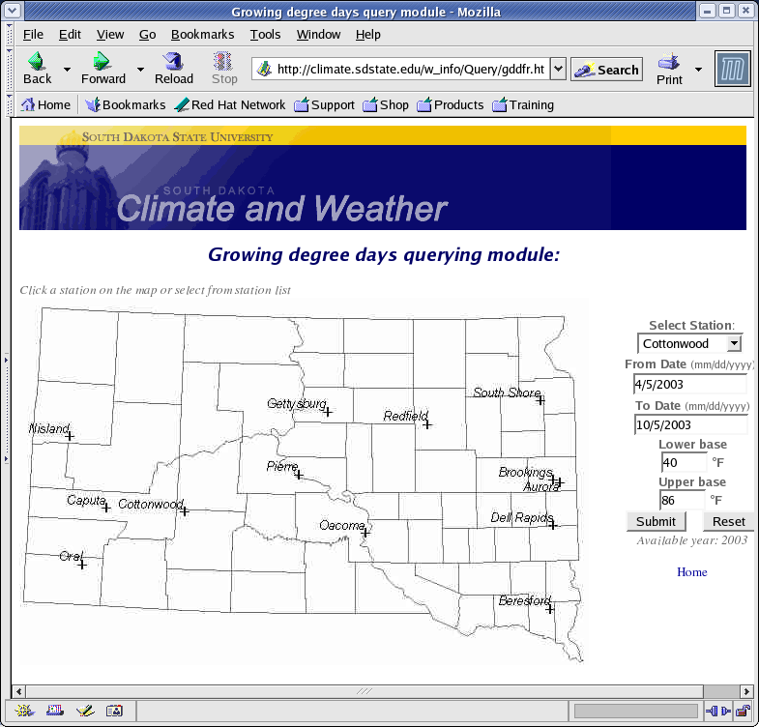
Filling Ag Data Requests
User defined query
User defined Growing Degree Day criteria
Updated daily with observed data

Slide 9
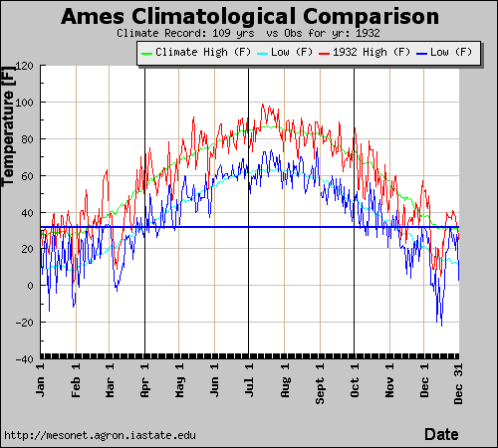
Climatological Differences
Interactively query the NWS COOP climate database.
Example, compare daily temperature climatology versus what actually happened that year!

Slide 10
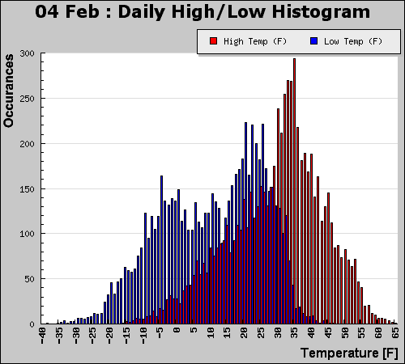
Daily Temperature Spreads
Accumulate all high / low temperatures for a day and produce a histogram
Dynamically generated on the website

Slide 11
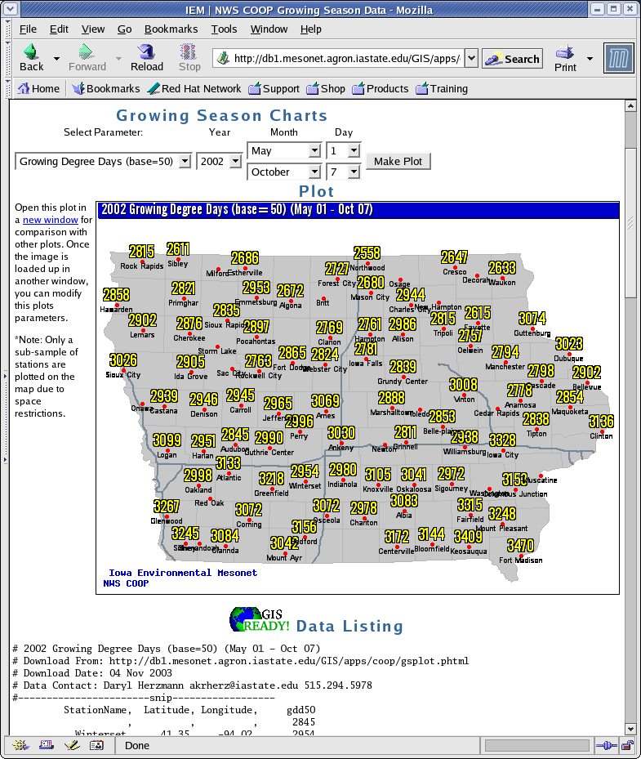
Historical GDD data
Dynamically generate GDD, SDD from the COOP climate archive
Customized Period
Dynamically generated output plot.
GIS Ready dataset presented immediately below

Slide 12
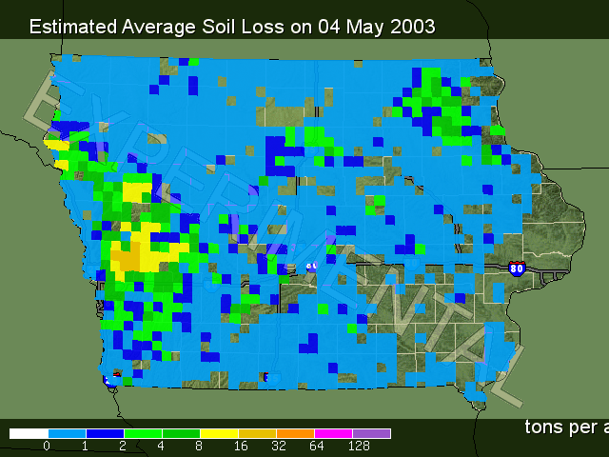
Iowa Soil Erosion Project
PI: Rick Cruse, ISU
Collaborators:
  ISU Agronomy
  U of Iowa Hydrology
  National Soil Tilth Lab
  NSERL @Purdue
  ISU Statistics
  South Dakota State

Slide 13
Erosion Project Ingredients
National Resources Inventory (NRI)
  Provides detailed information used to produce soil, management, and crop data files
Rainfall data from IIHR @ U of Iowa
  15 minute ~4km resolution
IEM provides climate summary data
WEPP Soil Erosion Model

Slide 14
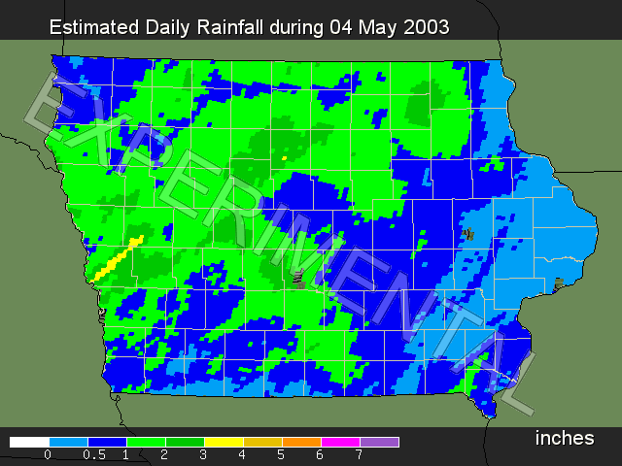

Slide 15
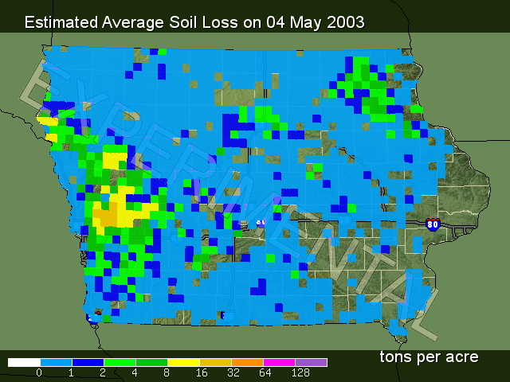

Slide 16
Comparing Input to the Output

Slide 17

I'm done, questions? http://mesonet.agron.iastate.edu
Daryl Herzmann
3010 Agronomy
515 294-5978
akrherz@iastate.edu

