Slide 1
History of Weather RADAR
Daryl Herzmann
Meteorology 590d
5 Feb 2004

Slide 2
Outline
What I am not going to talk about.
Development of the RADAR
Application to Meteorology
Pre-Doppler Activities
Doppler Activities
The Future
Wait a second, this is history class

Slide 3
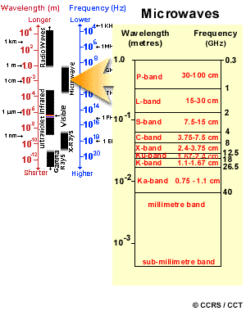
EM Spectrum

Slide 4
German Air Attacks during WWI
24 Dec 1914: German seaplane bombed England without warning. This was not a good thing.
13 June, 7 July 1917: Raids on London were devastating. Germans were well outnumbered, but the unorganized Brits did nothing.
Lt Gen Jan Christian Smuts wrote two critical reports of this event. They lead to the formation of the LADA (London Air Defence Area)
The LADA was more effective, but night vision was not possible.

Slide 5
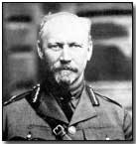
There is no hope....
'Our aeroplanes afford no means of defense at night as they find it impossible to see the enemy machines even at a couple of hundred yards. They might as well remain on the ground.'
- Jan Christian Smuts

Slide 6
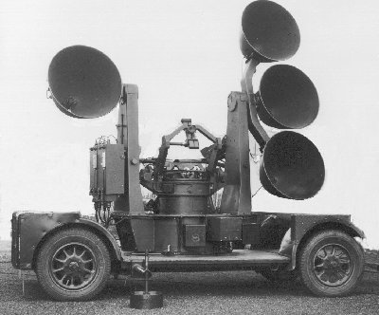
Remotely Sensing Air Planes
Use large 'sound mirrors' to listen for the German planes
< 10km range
Any environmental noise decreased sensitivity
Wind wasn't good either.

Slide 7
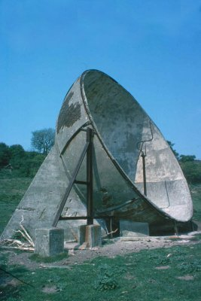
Mega Sound Mirror
~65m wide
Said to detect aircraft 40km away under prefect conditions
Large dish was needed to focus large wavelengths (rumbles of distant planes)
Semi-effective, but they had problems buying land to place the mirrors on.

Slide 8
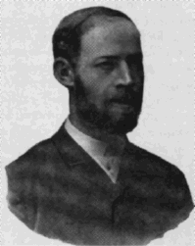
Discovery of RADAR (Death Ray)
1887 Heinrich Hertz(man) proved Maxwell's theory of EM at frequencies lower than light
The boom of RADIO focused research and energy at large wavelengths
Shorter wavelength research lead to the discovery of the ionosphere. It was also discovered that the shorter wavelengths needed line of sight in order to work.

Slide 9
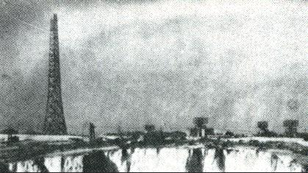
In the beginning, there was RAF's
RDF (Radio Detection Finding)
Death-Ray contest. Kill a sheep at 100m! Lots of entries...
Finally, 1935 Robert Watson-Watt is credited with the first successful RADAR, but it was extremely crude.
Failures on both sides kept the system secret before WWII
Many believe that RADAR won the war for the Allies and not the nuclear bomb

Slide 10
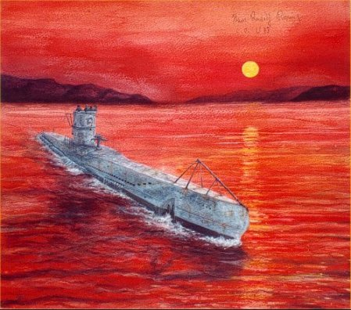
Joseph O. Fletcher
While on U-boat patrols off the American coast, he noticed the sensitivity of microwave radar to rainstorms.
Proved that deriving winds was possible using reflective targets on balloons.

Slide 11
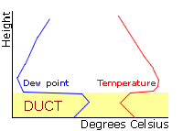
Fletcher's trapping inversion
While calibrating RADARs along the coast, he noticed no signal above 25m
Nearly crashed the plane while investigating this phenomena just meters above the ocean
An inversion was probably to blame for RADAR missing a bombing raid on Bari, Italy during WWII

Slide 12
Fletcher's weather radar program
Used a converted Night Club, 'Sea Girt Inn' to experiment and train folks in the use of RADAR for observing weather
Tricked field commanders to get more time on the RADARs to sample winds
  Need to calibrate the RADARs
  Need to train the RADAR operators
  Test out the balloons
Worldwide use was very effective in WWII

Slide 13
Doing research while they trained
1944-1946
Worked on the theory of storm and cloud detection
Make slide shows of storm evolution with picture cameras
Worked to classify and identify different forms of AP
Tried to explain the “angels” that were seen on RADAR during optically clear days

Slide 14
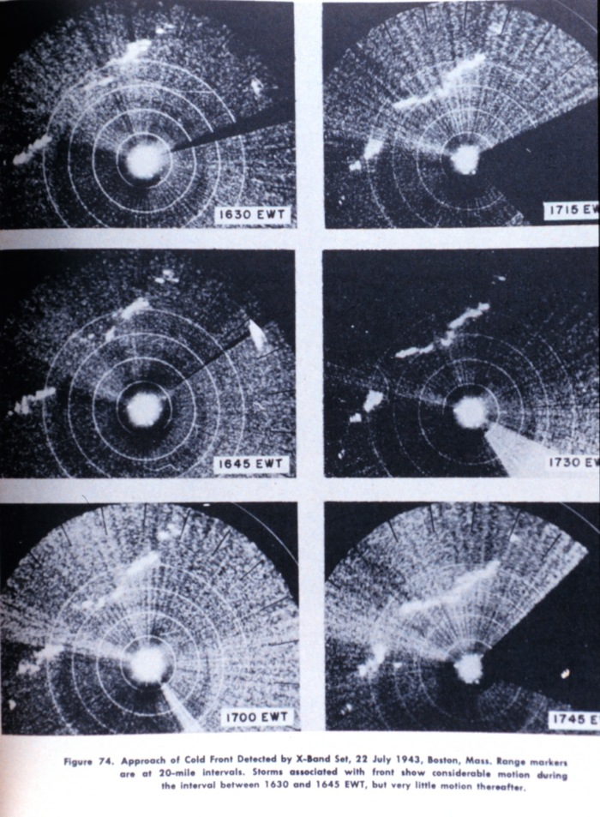

Slide 15
And the allies win WWII....

Slide 16
Army Air Corps funded three RADAR projects 1945
Wind Finding RADAR
  To be air transportable
Storm Detection RADAR
  To be air transportable
Cloud Base and Top Detector
  Must be physically small, so large antenna needed to be transportable

Slide 17

APQ-13A
First RADAR for general weather use
Was adopted from military RADAR with only slight modifications for weather surveillance
Deployed at 3 Air Force Bases in the Southern US

Slide 18
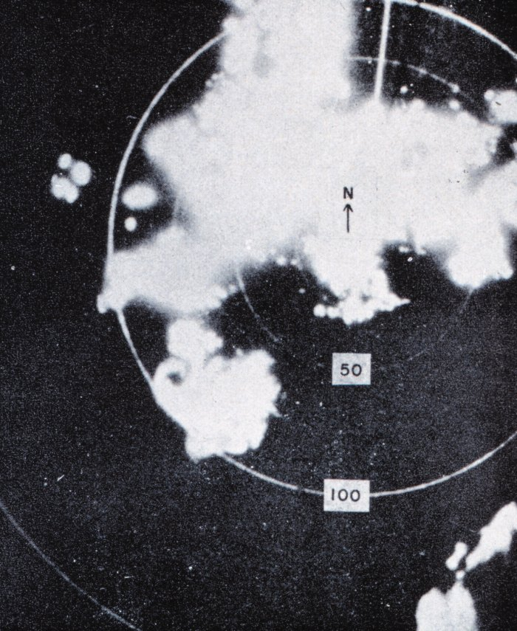
CPS-9
Raytheon Cooperation
Design accepted by the Air Force in 1953
First RADAR specifically designed for weather detection
Picture of severe convection on 1 July 1959 in Alabama

Slide 19
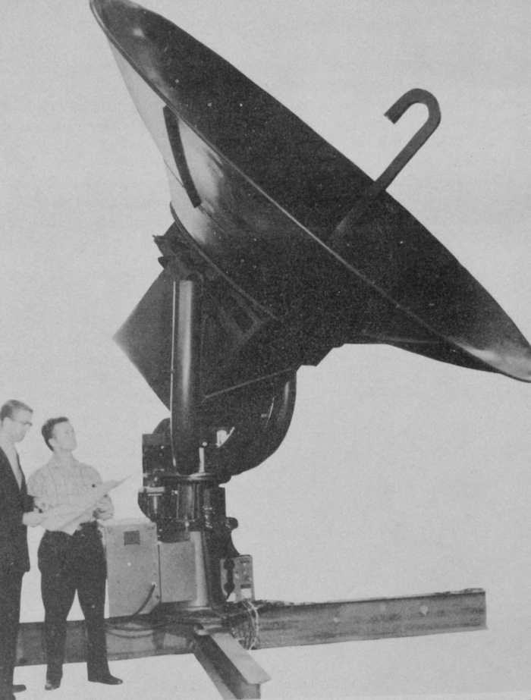
WSR-57
Nationwide deployment at Airports and other locations
Last one decommissioned 2 Dec 1996 in North Carolina.
Greatly advanced the science, but had limitations.

Slide 20
Scientific Applications

Slide 21
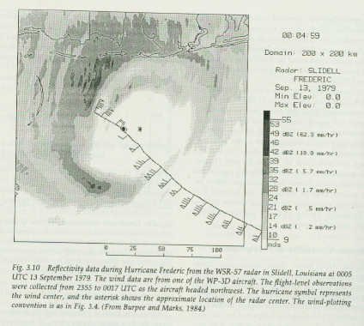
Hurricane Tracking, Sept 1944
Large hurricane traveled up the East Coast past MIT
The azimuth drive was broke on the RADAR, so D.E. Kerr pushed the RADAR along inside of the radome!
National Hurricane Center would eventually do lots of great things with ground based and airborne RADAR.

Slide 22
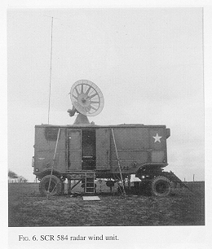
1945-1946: Thunderstorm Project
Byers and Braham carried out field projects in Florida and Ohio
Most important discovery was that RADAR could be used to guide aviation away from turbulence

Slide 23
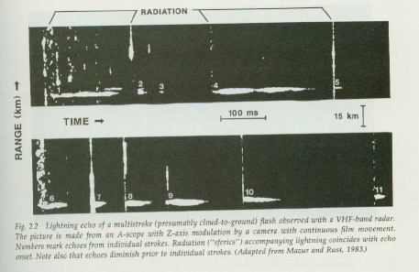
Lightning Detection 1953
Minor modification to the radar and display to detect lightning. Wanted to identify the electrically active storms.
Much was and still is not known about lightning today.

Slide 24
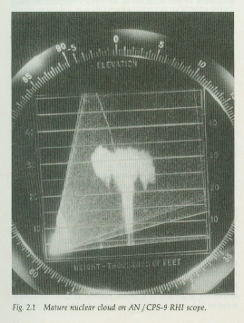
Nuclear Cloud Detection 1958
Needed to detect and predict the movement of nuclear fallout for the Army.
Had to take great care to remove the evidence of the mushroom clouds from the data logs.
A lot of the research was classified and thus not available to the research community

Slide 25
Ingesting data for modeling
Halstead and Clayton (Texas A&M) got a contract to ingest the RADAR data into a computer that solved an Eulerian set of equations for a baroclinic atmosphere.
Found that they could make accurate boundary layer predictions with more skill than a persistence model.
Major military benefits for ordinance delivery.

Slide 26
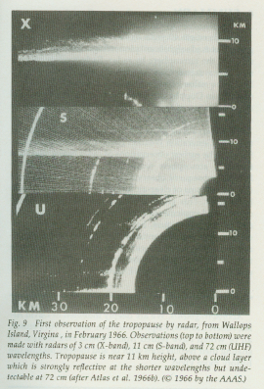
Tropopause Detection
The vertical refractive index is effectively a function of stability.
Tropopause can be easily found by a vertically pointing RADAR.
The importance of the tropopause was just being understood for hail prediction.

Slide 27
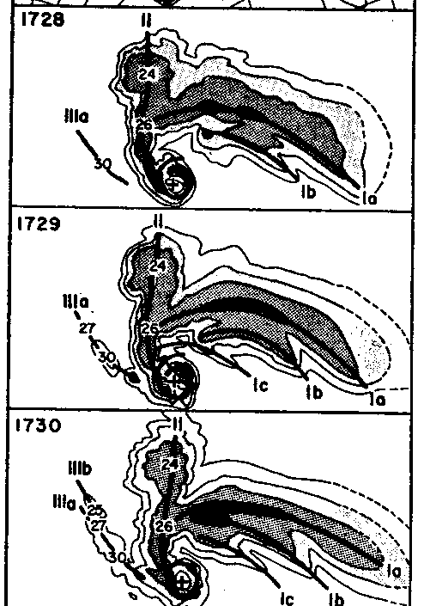
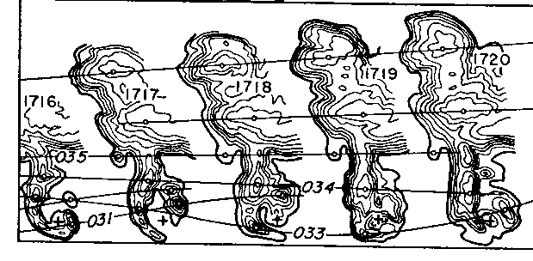
Fujita's Work

Slide 28
NCAR Projects
MAYPOLE “May Polarization Experiments” 1983
CLAWS “Classify, Locate, and Avoid Wind Shear” 1984
MIST “Microburst and Severe Thunderstorm” 1986
CINDE “Convective Initiation and Downburst Experiment” 1987

Slide 29
NSSL 1960s
Increasing air traffic was encountering severe local convection. Weather Bureau responded by forming SELS (Severe Local Storms Forecast Unit).
NSSP (NSSL) grew out of SELS as a research project with their own WSR-57
The rise of Doppler RADAR had high priority at NSSL. Being able to sense velocity and water at the same time had many applications.

Slide 30
1965: Project Rough Rider
A host of aircraft to penetrate storms and take various readings
5 RADARs staffed with highly trained personal
During the 1960s, ~1000 flights were made
Major findings
  How storms modify their environment
  in-situ data for effects on aviation
Even with a massive increase in air travel during the 1970s, convection related accidents went down.

Slide 31
1970s: RADAR and aviation
While mid-tropospheric accidents went way down, low attitude problems persisted.
NSSL & FAA worked closely to diagnose the gust front and its threat to aviation
It was decided that an automated network of anemometers would be needed at each of the airports to augment the RADARs
Low Level Windshear Alert System (LLWAS)

Slide 32
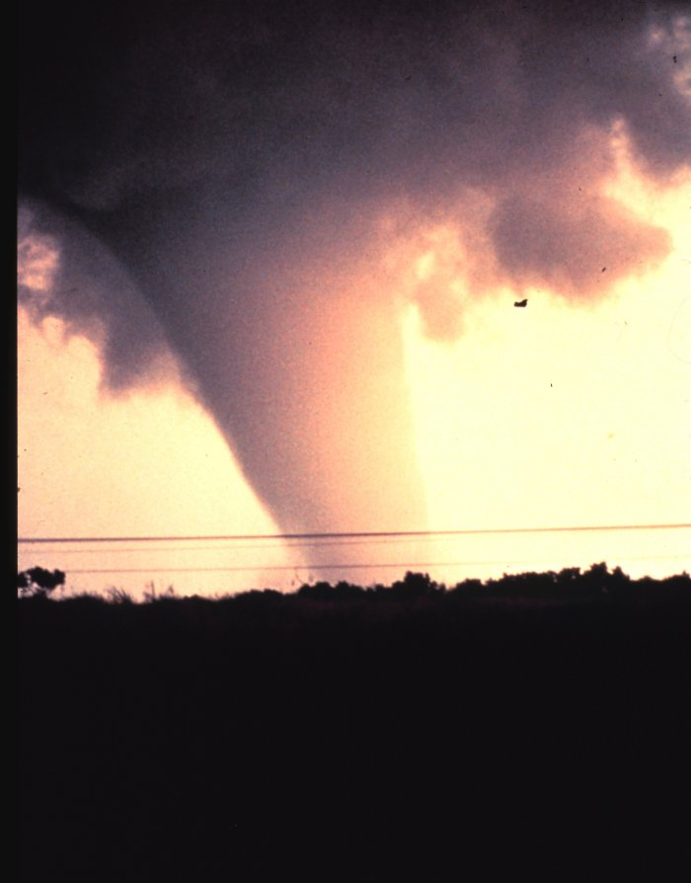
24 May 1973: Tornadic circulation
Massive tornado struck Union City and was visible from the NSSL facility
Very strong gate-to-gate sheer was clearly visible.
First capture of the complete life-cycle
TVS – Tornadic Vortex Signature was noted on the RADAR. Later formalized by Leslie Lemon et al

Slide 33
JDOP: The precursor to NEXRAD
WSR-57 was aging fast and doppler technology was proving to be the logical successor
Joint Doppler Operational Project (JDOP) 1976 to test NSSL Doppler RADAR operationally
Final Report in 1979 proved that Doppler RADAR can be used to issue more timely and accurate warnings
Governments response was NEXRAD

Slide 34
SESAME: The Big One!
Severe Environmental Storms and Mesoscale Experiment was operated by NSSL 1979
18 government agencies, 17 universities studied all sorts of things with 6 Dopplers
They caught the famous 10 April 1979 Wichita Falls, Texas tornado.
Lots of data and new understanding came from this research

Slide 35
Research groups around the world

Slide 36
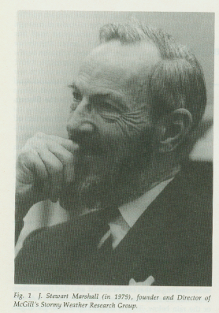
Stormy Group: (Canadians)
Founded 1943 under Stewart Marshall
Invented CAPPI (Constant Altitude Plan Position Indicator) -> Volume scanning
Late 1950s, worked on hail detection
1967: Chisholm described BWER and UWER
1968: McCormick used polarized RADAR to determine hydrometers

Slide 37
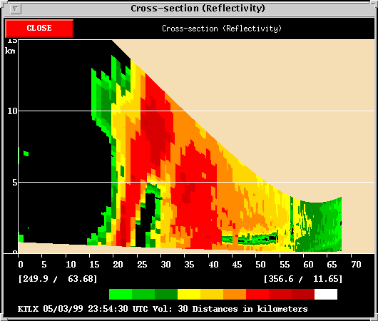
BWER

Slide 38
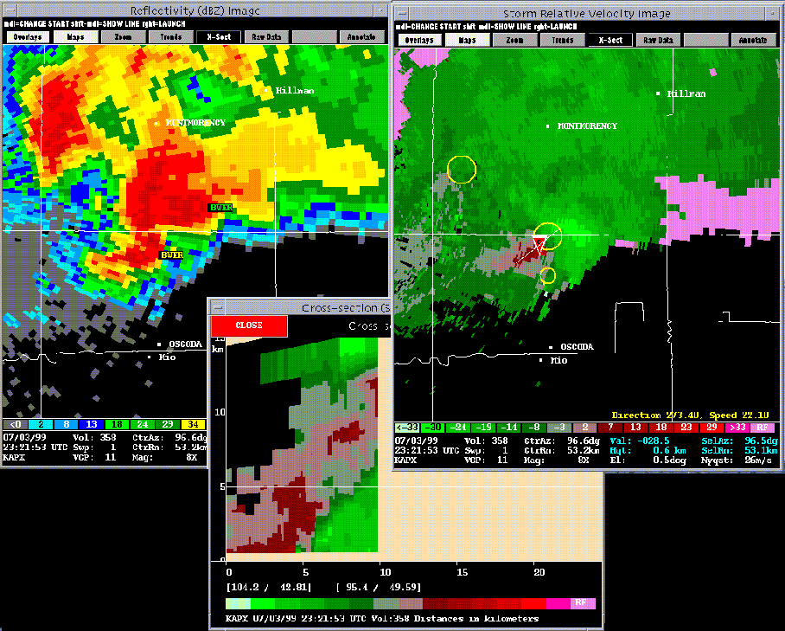

Slide 39
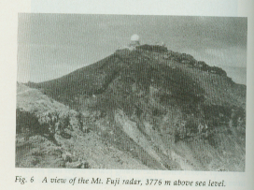
Japan: Typhon Research Lab
1954: Installed X-band RADAR near Tokoyo
Tracked thunderstorms and typhoons
Notable Finds
  Relationship between echo tops and thunderstorms
  1966: Yanagisava noticed a certain echo type was favored in certain synoptic conditions
  1968: Banded structure of Typhoons

Slide 40
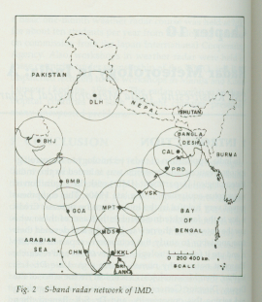
Indian Meteorological Department
Surplus RADARs after WWI got them started
Early 1950s, deployed a network of C & X band RADARs
Mostly imported technology, first homegrown system was 1970.

Slide 41
China
First imported two RADARs in 1958. They were installed in Shanghai & Beijing
Most research focused on Typhon detection and prediction
Du-Cheng Zhou (1981) adopted the Archimedes Spiral to locate the center of “Hollow Typhoon” using RADAR

Slide 42
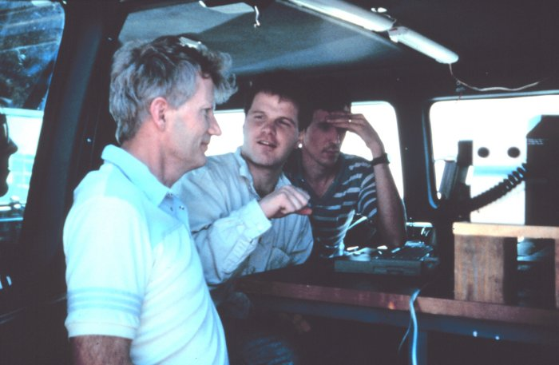
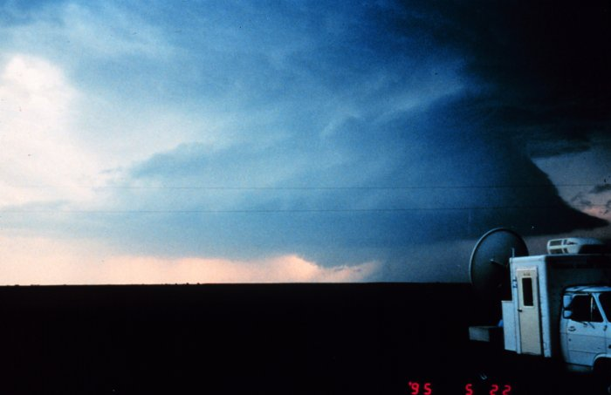
Project VORTEX
Verification of the Origins of Rotation in Tornadoes Experiment

Slide 43
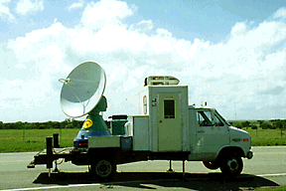
DOW: Doppler on Wheels
Joshua Wurman OU
4 days after being deployed for VORTEX, it caught a tornado on the ground for 45 minutes near Hanston, KS. 16 May 1995
May 3rd 1999
  Josh Wurman's Doppler on Wheels scanned a tornado in Oklahoma and recorded a wind speed of 318 mph

Slide 44
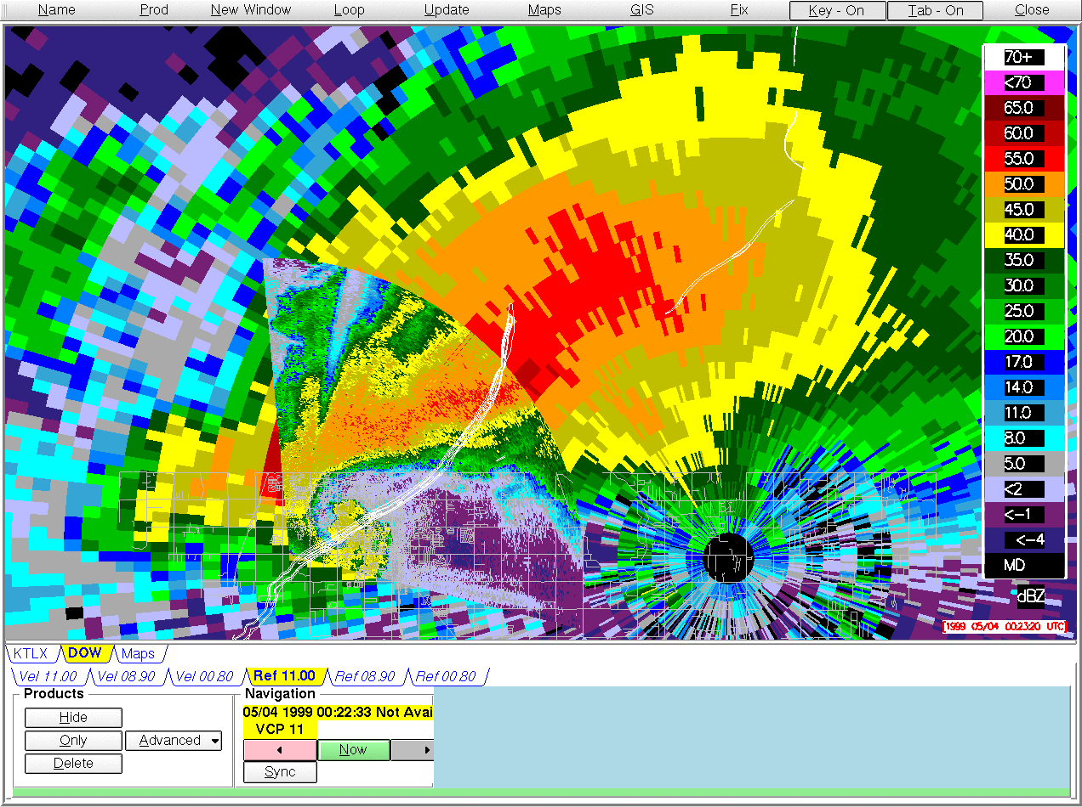

Slide 45
Look how far we have come

Slide 46
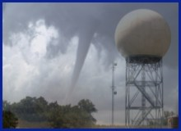
WSR-88D: NEXRAD
D is for Doppler
Advantages over WSR-57
  Improved Sensitivity
  Volume Scanning
  Algorithms
  Resolution
Nationwide deployment a part of the modernization effort

Slide 47
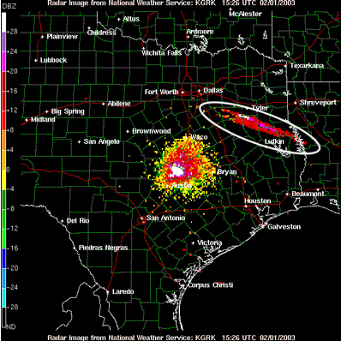

Slide 48
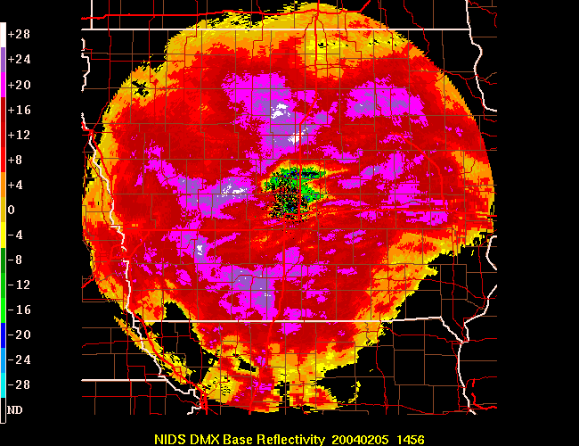

Slide 49
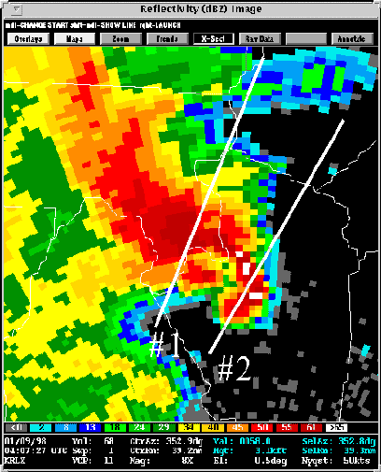
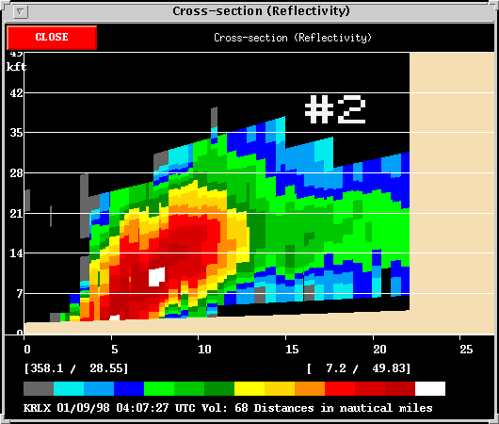
Low Top Super Cell

Slide 50
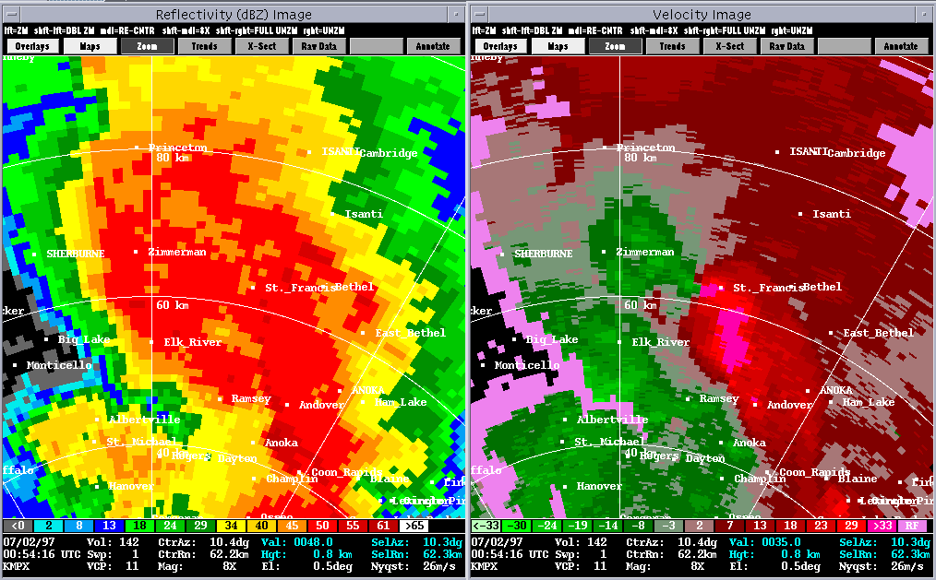

Slide 51
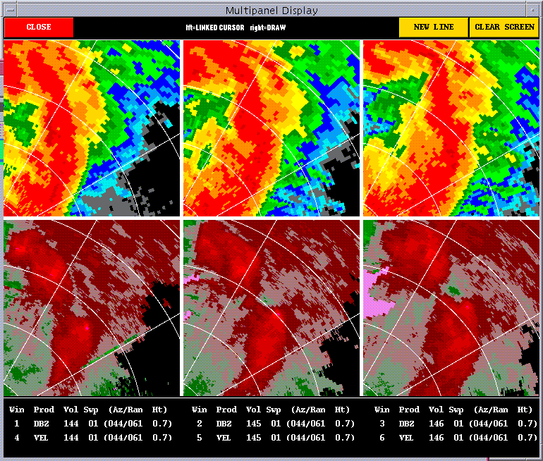

Slide 52
I'm done...

Slide 53
Internet References
http://www.unesco.org.uy/phi/libros/radar/art01.html
http://website.lineone.net/~rhsadmirals/08%20mark%20VIII%20.JPG
http://www.firstworldwar.com/bio/smuts.htm
http://users.whsmithnet.co.uk/colin.martin/radio/ducting.html
http://snrs.unl.edu/amet451/garner/rac.html
http://www.skywarn.ampr.org/radar3b.htm
http://www.radarworld.org/england.html
http://www.subart.net/german/U48sunset.htm
http://www.ccrs.nrcan.gc.ca/ccrs/learn/tutorials/stereosc/chap5/chapter5_4_e.html

Slide 54
Book References
Atlas, David. RADAR in Meteorology. American Meteorological Society. 1987.
(insert the others here)

