Slide 1
Everything you need to know about everything summarized in 40 minutes.

Slide 2
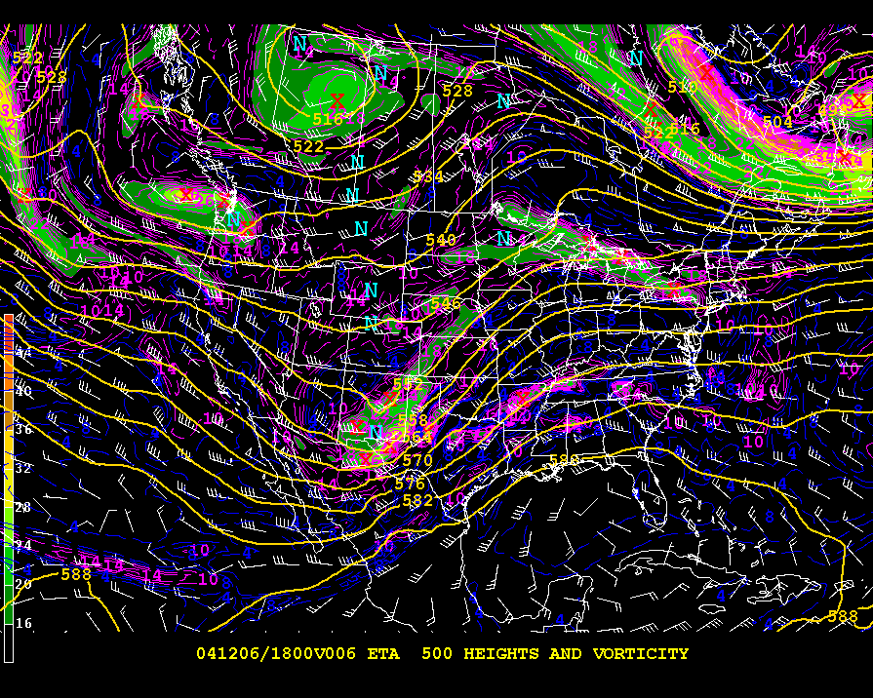

Slide 3
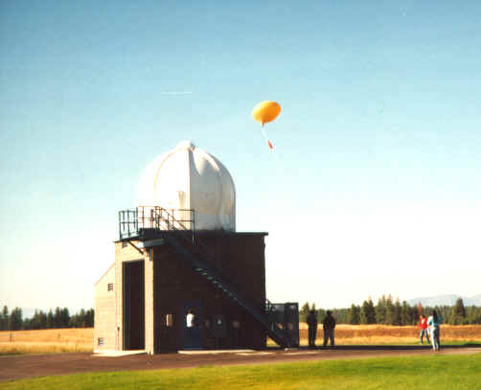
Data Source: Upper-Air Program
Some NWS WFOs have an upper-air program
Jobs:
  Maintenance
  Data QC
  Operations

Slide 4
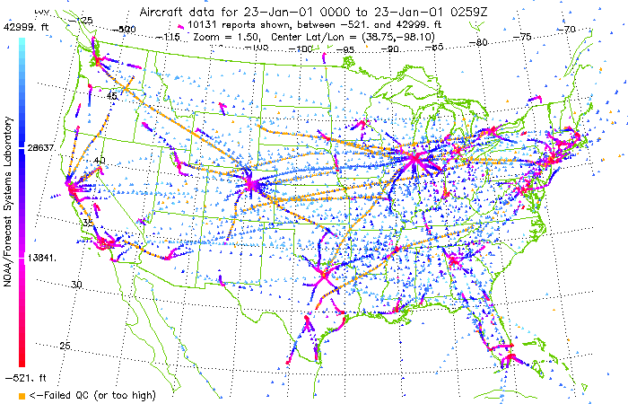
Data Source: ACARS (Aircraft reports)
Weather obs reported from commercial airliners.
Jobs:
  FSL Data Processing
  NCEP Data Processing
  Aviation Forecasting!

Slide 5
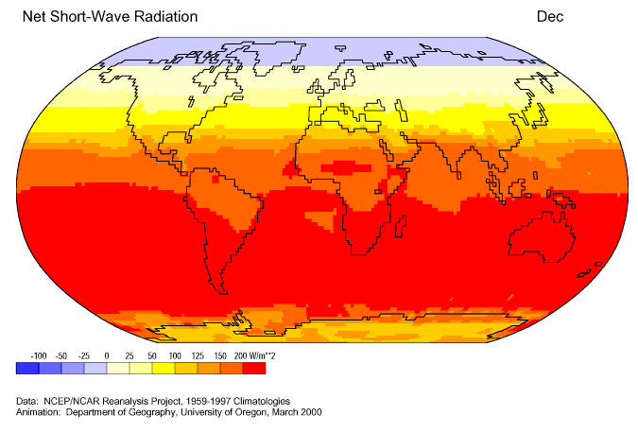
Data Source: Climatology
Climatology is used as baselines for weather prediction
Jobs:
  NCEP
  NCAR
  Other research groups

Slide 6
All of this data arrives at NCEP, then what
People are still needed to do manual QC of the data and oversee the automated QC.
Programmers are needed to build these automated QC systems and support the assimilation into numerical models.
Once the data is in the model, somebody has to babysit the process on the super-computer.

Slide 7
Our model cranks out lots of data
The data is routed to the NCEP internet server farm.
The data is routed to the National Weather Service Telecommunications Gateway for dissemination onto the Satellite Broadcast Network.
The data is routed to Internet2 for reception by research institutions.
The data is sent to National Climatic Data Center for archival.

Slide 8
Possible formats of our model output
Grib – Mostly standard format for 3-D model data. Binary packed data.
Grib2 – Extension to Grib format that uses the JPEG2000 compression scheme
NetCDF – Platform independent data format for all sorts of scientific data.
GEMPAK – Old school binary format for Met data
Others: HDF, Vis5d, GINI, and more!

Slide 9
For Iowa State
NCEP's data is sent onto the NWS satellite broadcast and then downlinked in Boulder Colorado (UCAR).
A machine at UCAR, then takes the data (Grib format) and then sends it over the Internet to Iowa State.
Once the data hits a computer here, the Grib data is converted to GEMPAK format via a decoder.

Slide 10
We now have our model data file
A script is executed via a 'cron' job that looks for this new model data file and automatically generates images if the data file is found.
These images are then copied over to our web server and made available to anybody on the internet.
Or, you can launch a GEMPAK program and view these data files interactively via GARP or ....

Slide 12
So Deryll, I am interested in computers and meteorology. Where do I start?

Slide 13
Darrell asks, 'What are you interested in?'
Data Visualization
Programming Numerical Models
Data Assimilation / Data Mining
General Programming (Hacking)
Systems Administration
Internet Programming
Integrated Devices (low level hardware stuff)
To-know-a-little-about-everything to supplement what I am really getting paid for.

Slide 14
You answer, “Well, I don't know?”
Darly looks at his watch and begins to formulate an excuse about how busy he is
Seriously, start poking around on the Internet for various topics. The internet is a magical place.

Slide 15
Some tips for your surfing...
Always ask Google
If interested in HTML, check out 'Page Source' function of your Mozilla based browser
READ THE WEBSITE, don't look just at pictures
Maintain a list of bookmarks on neat websites organized by topics you are interested in
Join email lists, don't post though until you are a bit older than a newbie...

Slide 16
Set goals.
Your discovery process is not being dictated by some professor. You are trying to satisfy a curiosity....
Don't give up if you can't figure it out. Ask around AFTER you have made an honest attempt to complete the task. Folks are very willing to help here and out on the Internet, if you have made an attempt.
Document, Document, Document (bad Deril!)

Slide 17
Open Discussion

