Slide 1
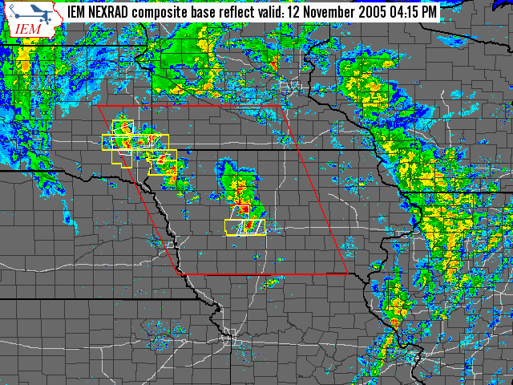
4:15 PM (2215Z)

Slide 2
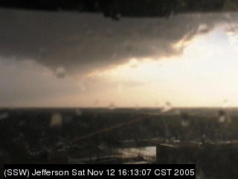
[4:14:38] kcciwx jefferson circulation now less defined on webcam

Slide 3
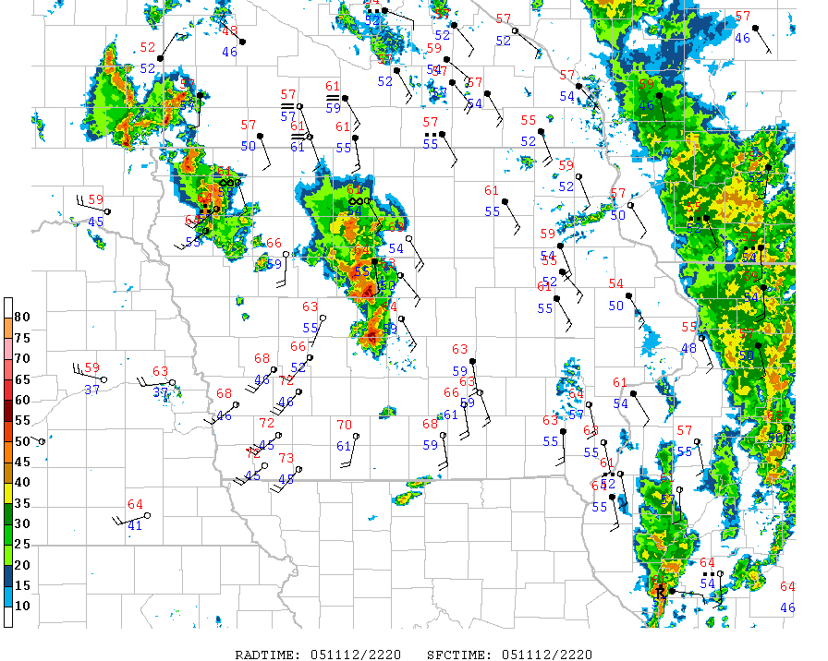
4:19 PM (2219Z)

Slide 4
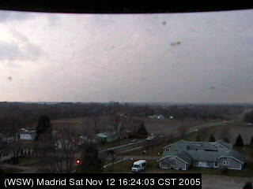
4:24 PM (2224Z)
[4:23:56] kcciwhite daryl are you able to move madrid
[4:24:13] iowamesonet I have been, nothing much to be seen at this point

Slide 5
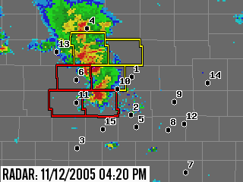
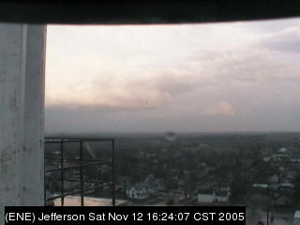
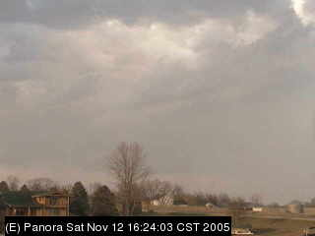
[4:25:51] iembot 1 S Linden [Dallas Co, IA] storm chaser reports HAIL of 2.50 INCH at 04:14 PM CST --
[4:27:35] iembot DMX expires Tornado Warning for Greene [IA]
#6
#11

Slide 6
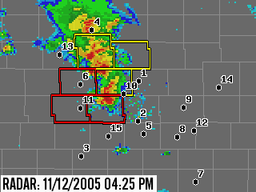
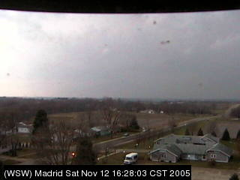
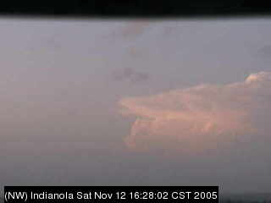
4:28 PM (2228Z)
#10
#5

Slide 7
Is the day over?

Slide 8
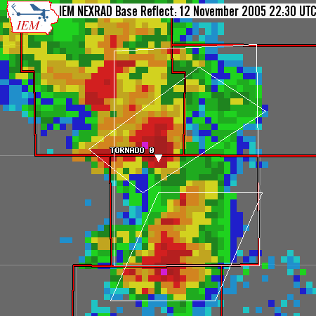
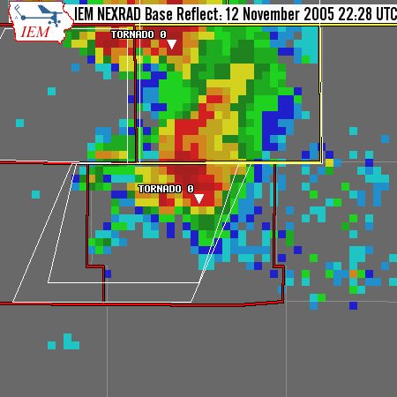
[4:29:18] nwsdmx1 Tornado on ground 3 w of pilot mound
[4:30:04] iembot DMX issues Tornado Warning for Boone, Hamilton, Webster [IA] till 5:00 PM CST
[4:30:12] nwsdmx6 tornado on ground 1 northeast of minburn
[4:30:46] iembot DMX issues Tornado Warning for Boone, Dallas [IA] till 5:00 PM CST

Slide 9
4:32 PM (2232Z)

Slide 10
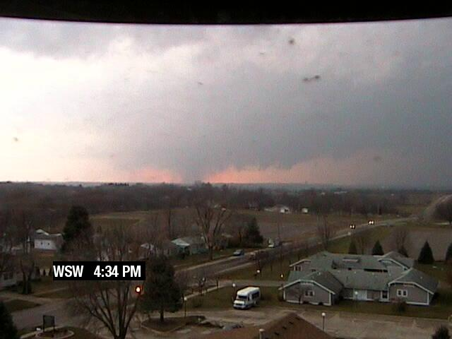
[4:34:51] iowamesonet check out Madrid webcam. Something looks ugly

Slide 11
Insanity Ensues
[4:35:04] iembot 4 W Pilot Mound [Boone Co, IA] law enforcement report TORNADO at 04:27 PM CST -- tornado on ground moving north
[4:35:07] nwsdmx1 Tornado continues on ground sw of stratford
[4:35:26] kcciwhite gertz sees tornado on ground getting ready to cross 141
[4:35:30] kcciwhite he's live... webcam...
[4:35:43] iowamesonet definite tornado on Madrid webcam

Slide 12
4:36 PM (2236Z)

Slide 13
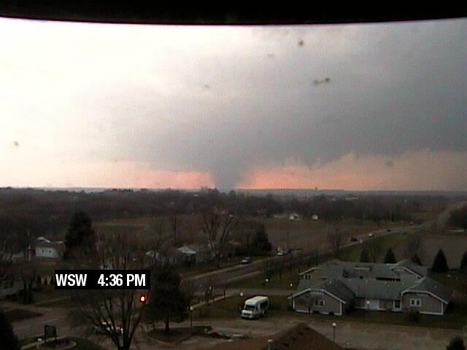
[4:36:11] kcciwhite large tornado near woodward

Slide 14
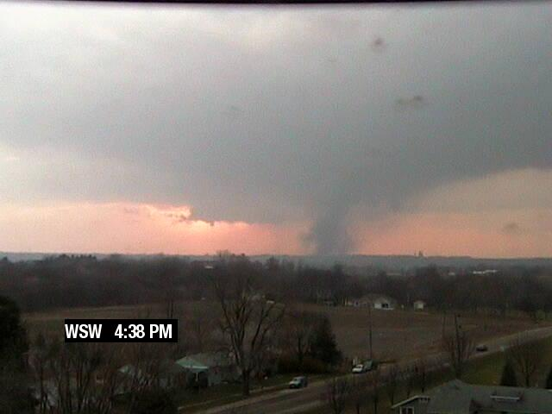
[4:37:45] kcciwhite tornado on madrid webcam....zoom in daryl!!!

Slide 15
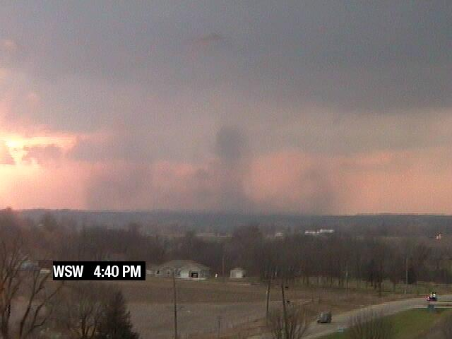
4:41 PM (2241Z)

Slide 16
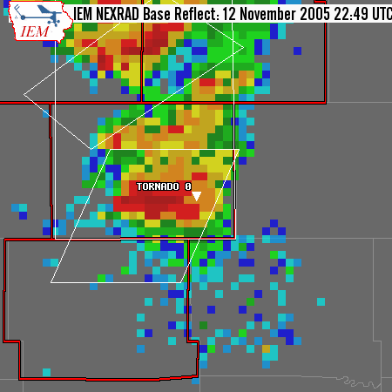
4:45 PM (2245Z)
[4:48:35] iowamesonet half way between luther and madrid tornado on ground now

Slide 17
4:49 PM (2249Z)
[4:50:27] iowamesonet nickels now (My House)
[4:50:49] iowamesonet 1 mile SE luther tornado on ground, ISU spotters
[4:52:16] kcciwhite viewer confirms funnel/tor. report in luther area
[4:52:19] iowamesonet 2 mile south of luther, farm house heavily damaged
[4:52:44] nwsdmx6 ham radio reports luther tornado has begun to rope out

Slide 18
4:53 PM (2253Z)
[4:55:34] iowamesonet ISU spotters say former Luther tornado has dissipated
[4:56:06] nwsdmx6 tor wrng for story co coming

Slide 19
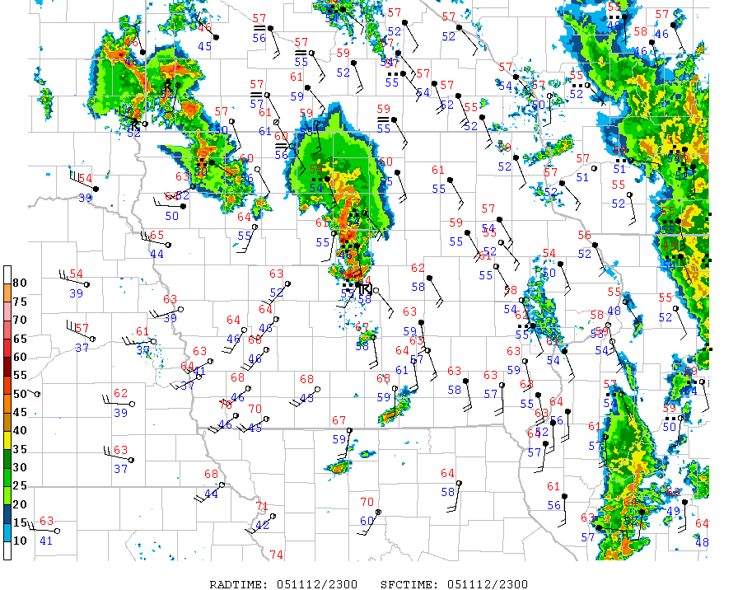
5 PM (23Z)

Slide 20
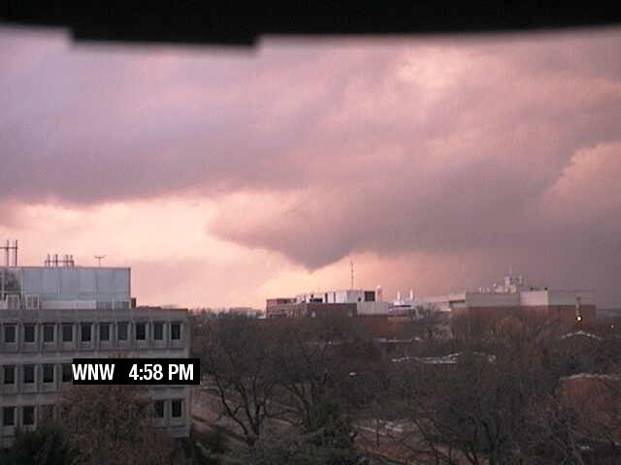
4:58 PM (2258Z)
[4:59:09] iowamesonet funnel on Ames cam

Slide 21
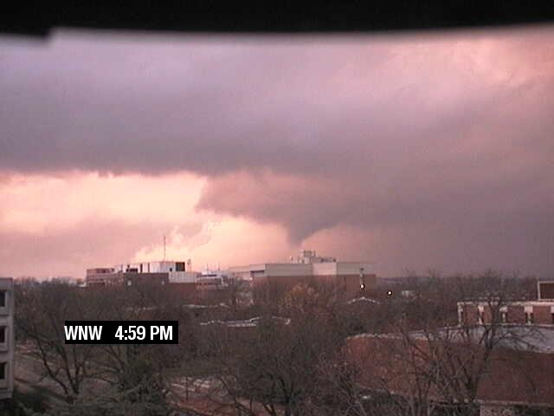
[4:59:52] iowamesonet almost down
(It was actually down at this point)

Slide 22
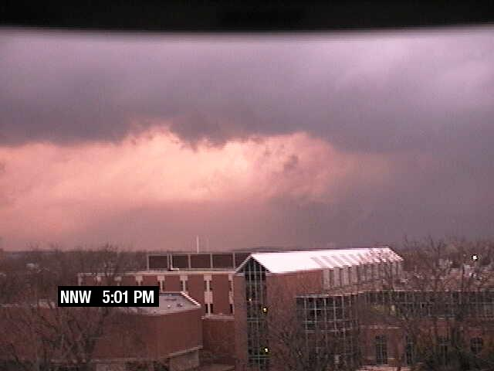
5:02 PM (2302Z)
[5:02:00] wmt_am got a citizens report of a tornado that touched down briefly just north of lincoln way in ames

Slide 23
5:06 PM (2306Z)
[5:06:44] iembot DMX issues Tornado Warning for Hamilton [IA] till 5:30 PM CST
[5:09:41] kcciwhite Chris Maiers reports home destroyed on N. Dakota in Ames

Slide 24
5:11 PM (2311Z)
[5:13:53] kcciwhite report from stratford of home damaged w/beauty shop attachedrd of home damaged w/beauty shop attached
[5:14:13] kcciwhite gas leaks in stratford
[5:15:10] kcciwhite power lines down nw side of ames.... ham radio...
[5:15:39] nwsdmx6 1st three blocks on south side of woodward have some damage, possibly significant due to tornado. Emergency management checking.
[5:16:44] kcciwhite kurtis says cars were flipped and one building removed from foundation...

Slide 25
5:15 PM (2315Z)
[5:22:53] kcciwhite piotrowski reporting a block wide of damage (relaying reports) in stratford... one home completely gone on east side of stratford... derbis in the field from stratford northwest all the way to highway 17... continues south of webster city

