Slide 1
KCCI SchoolNet8
Website Guide
Daryl Herzmann
Iowa Environmental Mesonet
Iowa State University

Slide 2
Motivation
Show what is available on the website
Provide details on Science Discovery for the resources
Explain some example plots and charts

Slide 3
Web Guide Topics
Comparing Observations
Solar Radiation
Sortable Current Conditions
One Minute Data Traces
Web Cameras

Slide 4
Web Guide Topics
Live Super Doppler8 App
Using RADAR with Obs and Warnings
Orthophotography
Wind Barbs
Navigating SchoolNet8.com

Slide 5
2. Solar Radiation

Slide 6
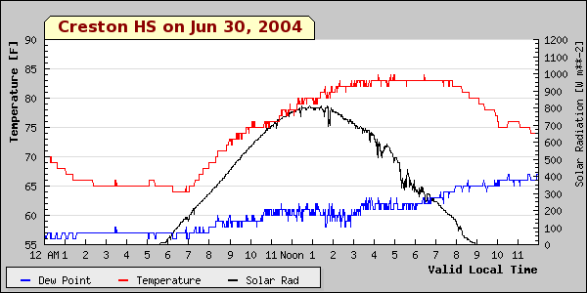
A Sunny Day

Slide 7
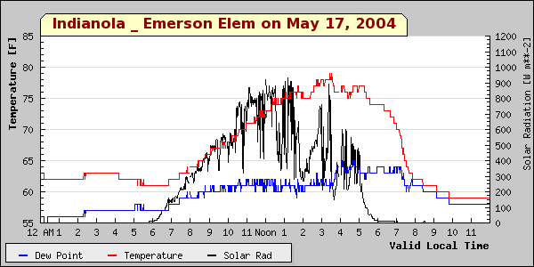
Sun, clouds, sun, clouds

Slide 8
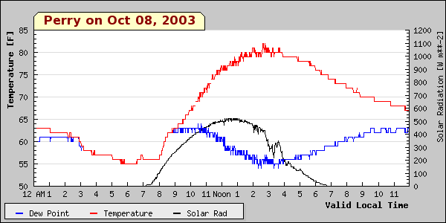
A sunny fall day

Slide 9
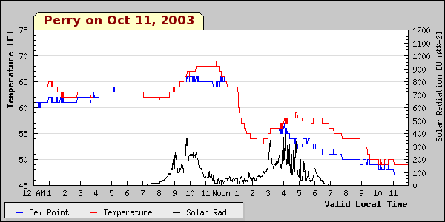
A cloudy fall day

Slide 10
Web Cameras

Slide 11
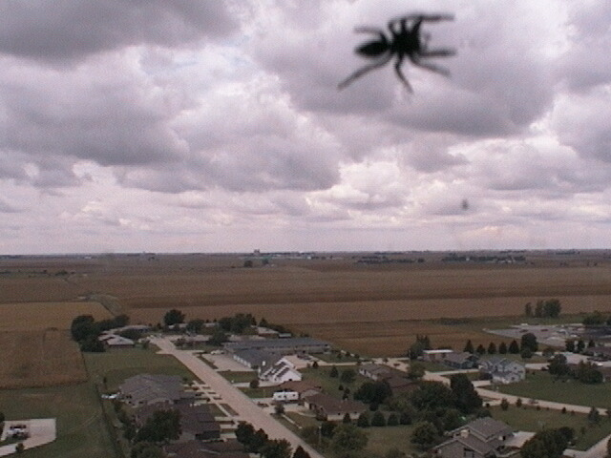
Can be used for Zoology

Slide 12
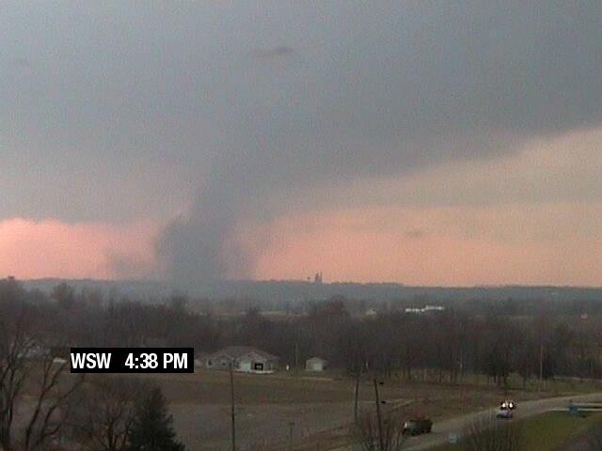
Show High Impact Weather

Slide 13
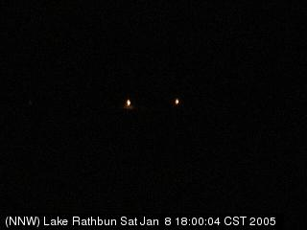
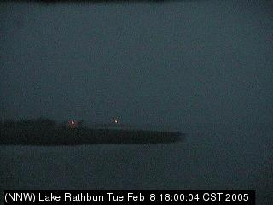
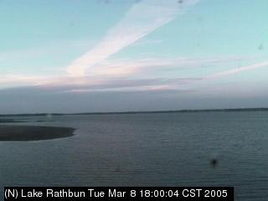
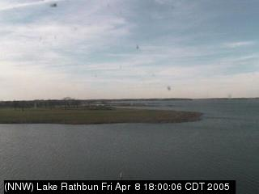
How the days lengthen...
JAN
FEB
MAR
APR
All images at 6 PM

Slide 14
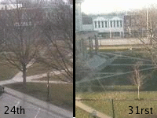
Spring green up!

Slide 15
Other suggestions
Use the historical function to observe differences in space and time
Look at how clouds change in form over a day
Look at winter images for signs of snow and how deep it may be (tire tracks)

Slide 16
Website Activity:
Getting comfortable with the Live Super Doppler8 App

Slide 17
Website Activity:
Make a plot of high temps

