Slide 1
KCCI SchoolNet8
Java Viewer
Daryl Herzmann
Iowa Environmental Mesonet
Iowa State University

Slide 2
Requirements
Java 1.3 or higher. (http://www.java.com)
800x600 display
Internet connection
Known to run on all flavors of Windows, Mac OS-X, and Linux

Slide 3
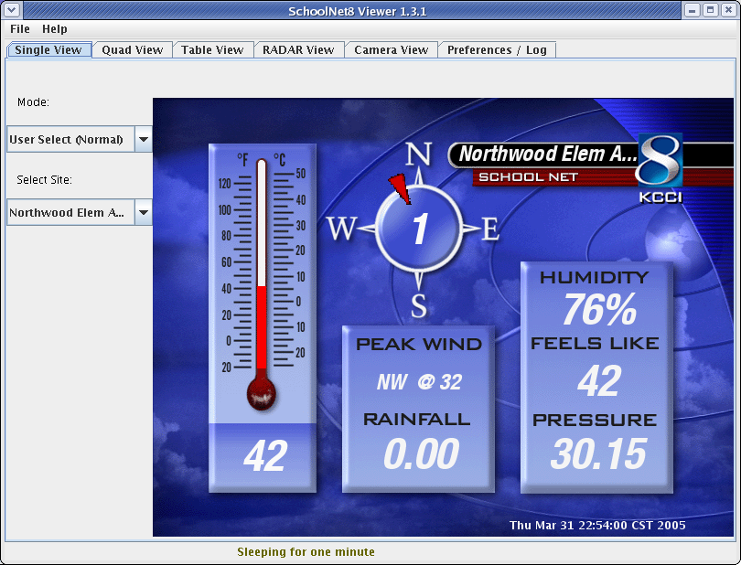
The Interface

