Slide 1
KCCI SchoolNet8 Workshop
Daryl Herzmann
Iowa Environmental Mesonet
Iowa State University

Slide 2
Schedule
6:30 – Welcome and this slide!
6:40 – SchoolNet8 equipment
7:00 – SchoolNet8 Project Details
7:30 – Break
7:40 – Using SchoolNet8 Part I
8:45 – Break
8:50 – Using Schoolnet8 Part II
9:30 - Done

Slide 3
Introductory Stuff
CIPCO/IEM/KCCI/NWS partnership
Who is using your data?
IEM Tracker

Slide 4


Our Partnership
Process Feedback
IEM
NWS
Custom Data Products
Data Services
Operations Support
Project Support
Improved Products
KCCI -TV

Slide 5
Iowa Environmental Mesonet 411
What does ‘mesonet’ mean?
  ‘meso’ - Spatial scale, ‘net’ - network
Why ‘environmental’?
  We are interested in air quality, water quality and other non-weather datasets
Abbreviated 'IEM'

Slide 6
More on the IEM
Project of the Department of Agronomy at Iowa State University
We are data pigs.
Look to meet the growing data needs of users in the State and elsewhere.
KCCI SchoolNet is one of the many networks that send data to us.

Slide 7
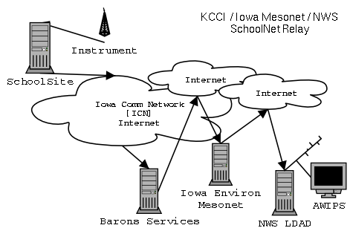
Data Flow

Slide 8
Data Formatting
C 074 Min 02/17/03 ENE 00MPH 000K 460F 007F 084% 30.08" 00.00"D 00.07"M 00.00"R
D 074 Max 02/17/03 ENE 10MPH 050K 460F 021F 100% 30.20" 00.00"D 00.07"M 00.00"R
E 074 12:01 02/17/03 ENE 03MPH 046K 460F 020F 099% 30.09F 00.00"D 00.07"M 00.00"R
Your site produces roughly 6 obs per minute!

Slide 9
SchoolNet8 Data Users

Slide 10
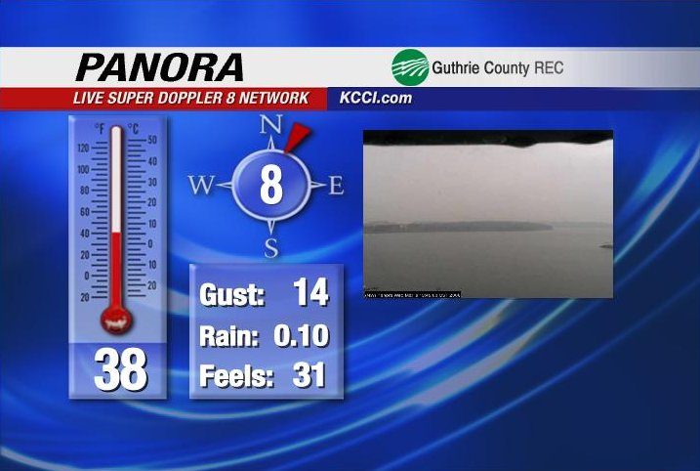
KCCI uses it!

Slide 11
SchoolNet8 Data Users
Storm Prediction Center [SPC]
  Norman, Oklahoma
  In charge of providing timely forecasts of extreme weather.
  Use schoolNet8 data to help identify mesoscale boundaries critical in severe weather forecasting

Slide 12
SchoolNet8 Data Users
River Forecast Center [RFC]
  Chanhassen, MN
  In charge of analyzing and forecasting river flood conditions. Hydrological data.
  Use SchoolNet8 precipitation totals for their water analysis.
  The SchoolNet8 network has doubled the hydrological observing sensors in Central Iowa.

Slide 13
SchoolNet8 Data Users
Forecast Systems Laboratory [FSL]
  Boulder, Colorado
  Data collected under the MADIS project.
  Data is used in very detailed and heavily quality controlled surface analysis programs.
  This data is then included in some operational weather forecasting models run in D.C.

Slide 14
SchoolNet8 Data Users
National Weather Service [NWS]
  Des Moines, IA
  Receiving data in three different formats
  Use data in hydrological applications, surface analysis, severe weather awareness, winter weather awareness.
  Are automatically alerted of 50+ MPH wind gusts and heavy rainfall.

Slide 15
NWS Auto Alerts
The IEM automates a process to instantly send the National Weather Service reports of severe wind and rain.
In many locations, the SchoolNet8 site is the only automated live sensor in the community.

Slide 16
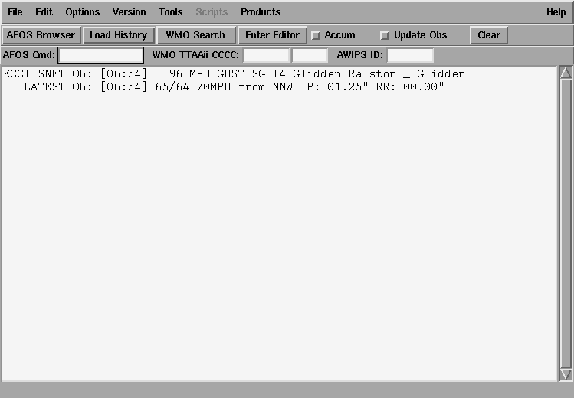
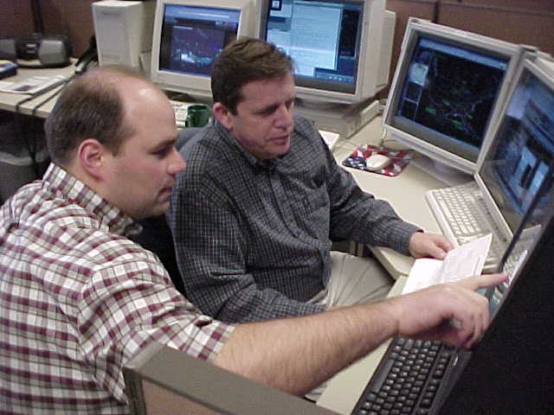
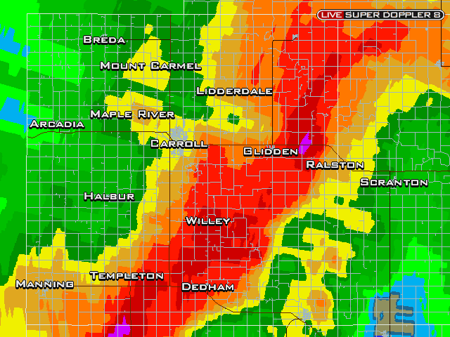
NWS AWIPS alerts

Slide 17
18 June 2003:
Nevada SchoolNet
A good example of how data from your school can make a difference in your community.

Slide 18
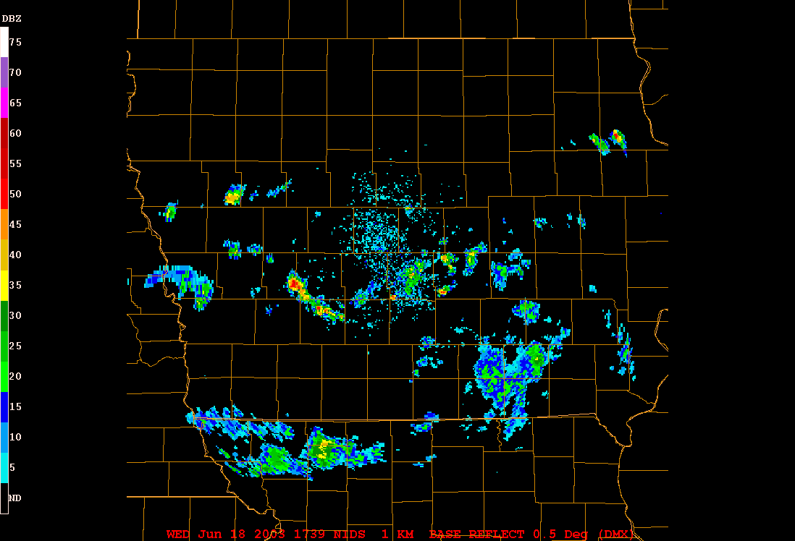
RADAR Loop

Slide 19
At 1:34 PM, an alert is generated
=======================
KCCI SchoolNet8 Wind Gust Alert
-------------------------------
Time: 01:34 pm -- 18 June 2003
Site: NEVADA COMMUN
Gust: 58 MPH

Slide 20
At 1:37 PM, the NWS warns
137 PM CDT WED JUN 18 2003
THE NATIONAL WEATHER SERVICE IN DES MOINES HAS ISSUED A
* SEVERE THUNDERSTORM WARNING FOR...
EASTERN STORY COUNTY IN CENTRAL IOWA
* UNTIL 230 PM CDT
7 MILES WEST OF COLLINS AROUND 150 PM AND
NEAR MAXWELL AROUND 155 PM.
DAMAGING WINDS OF 60 TO 70 MILES AN HOUR ARE LIKELY IN THE WARNED
AREA. THE KCCI SCHOOLNET SITE IN NEVADA REPORTED 58 MPH WINDS AT 134 PM.

Slide 21
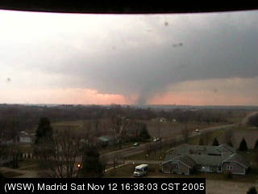
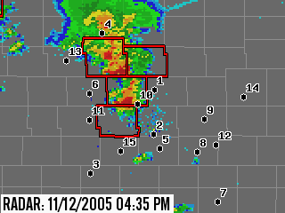
Web Cameras
Live images from all over Central Iowa
Many applications
Integrated on the website.

Slide 22
Uses of the Web Cameras
Spot high impact weather
Showcase community events
People with interest in the community can check in
There are even educational uses (that is coming up! )

Slide 23
IEM Tracker

Slide 24
IEM Tracker
System to manage metadata about sites
Most of you have probably gotten the emails from “Iowa Environ Mesonet”
Since the system came online on 25 June 2002, it has generated over 9,000 tickets for SchoolNet
Most of these tickets are generated from the automated data tracking system

Slide 25
What are offline alerts?
When ‘online’, your site is streaming observations to the Internet at roughly 6 obs per minute.
A process on the IEM server monitors this feed and once the most recent ob is 30 minutes old, a trouble ticket is generated and site contacts are emailed.

Slide 26
Understanding the Ticket.
---------------------------------
| *** IEM TRACKER REPORT *** |
------------------------------------------------------------
ID : SCOI4
Station Name : COLO ELEM _ COLO
Status Change : [OFFLINE] Site is NOT reporting to the IEM
Trouble Ticket# : 3704
Last Observation : 2003-02-17 23:53:00.00

Slide 27
More about the tickets
Probably 50% of the tickets are network related and out of your hands.
5% of the tickets are responded to with further information
IEM tracker has improved network performance for each of the networks it monitors.

Slide 28
SchoolNet8 Performance
Fewest Tickets
  8 BCLUW
  8 Fort Dodge
  12 Ogden
Highest Online %
  99.81 BCLUW
  99.77 Oskaloosa
  99.6 Algona
Most Tickets
  171 Colo
  159 Lamoni
  153 Glidden
Lowest Online %
  79 Glidden
  85 Mallard
  88 South Hamilton

Slide 29
Year by year
  Year Sites Online %
2002 46 85%
2003 53 87%
2004 63 91%
2005 67 93%
2006(ytd) 67 97%

Slide 30
Keep those clocks set!
Data on the website is given a timestamp of the current IEM system clock and NOT the timestamp on the observation.
The precipitation counters are adversely impacted by drifting clocks.
It makes it a bit more difficult to calculate daily precipitation totals.

Slide 31
Download Data Archive

Slide 32
Data Archives
1 minute data archive exists since 12 Feb 2002, this is available on-line
Since 10 Jul 2002, every observation is archived, but not readily available. I can fill these data requests if you send me an email.

Slide 33
WWW Resources

Slide 34
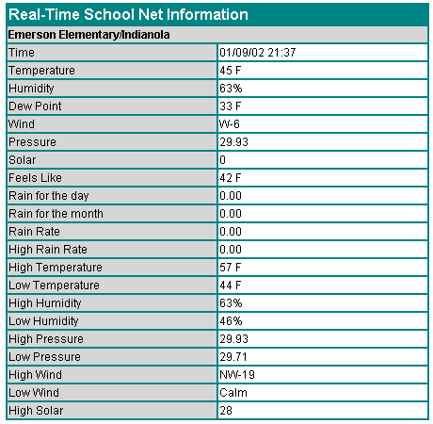
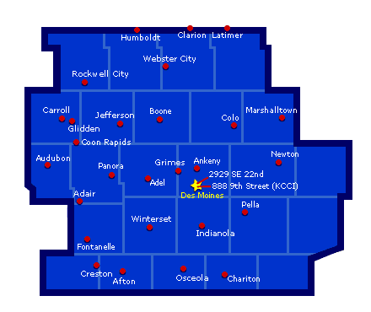
Circa 2001

Slide 35
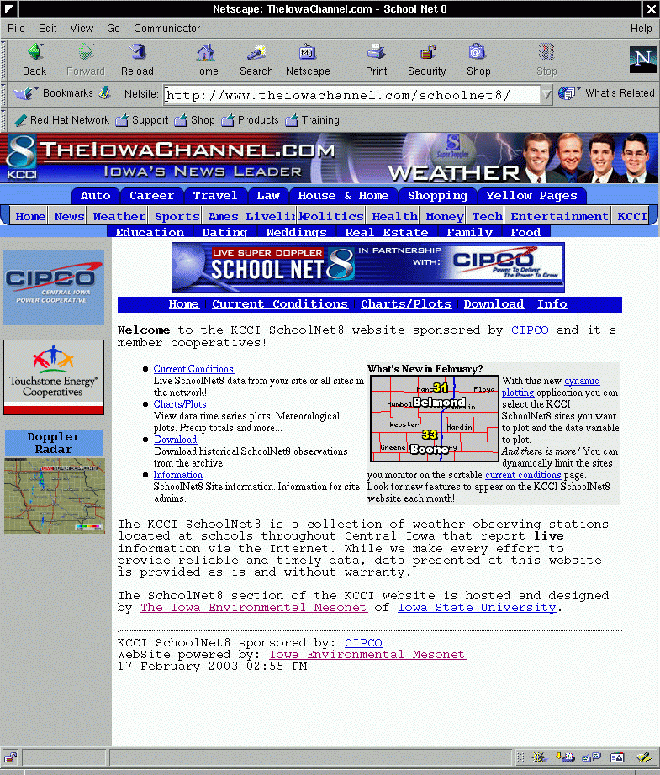
Circa 2002

Slide 36
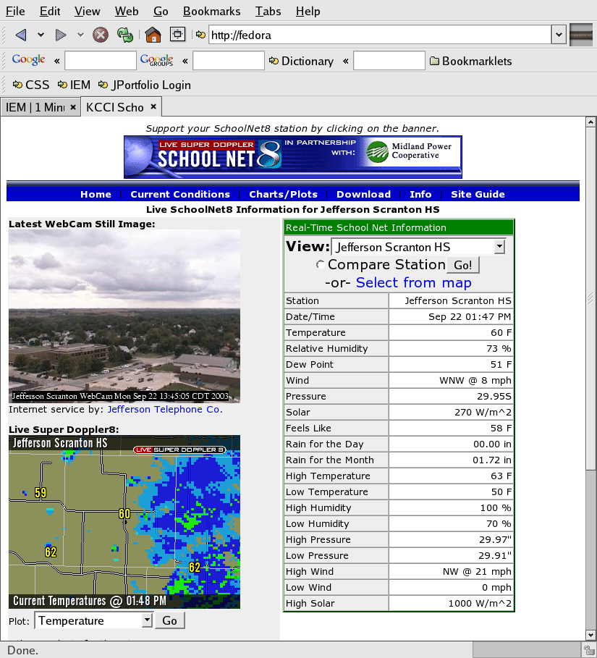
Circa
2003

Slide 37
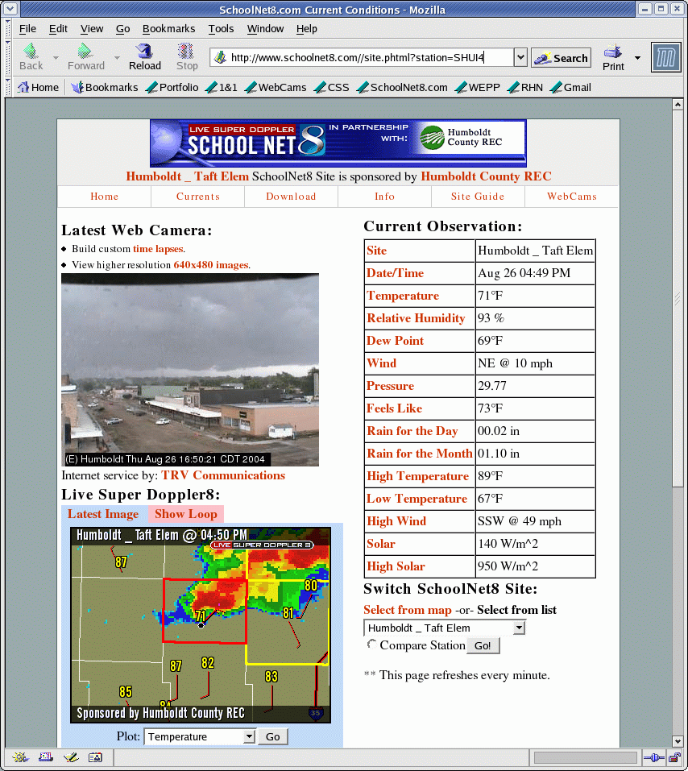
Today

Slide 38
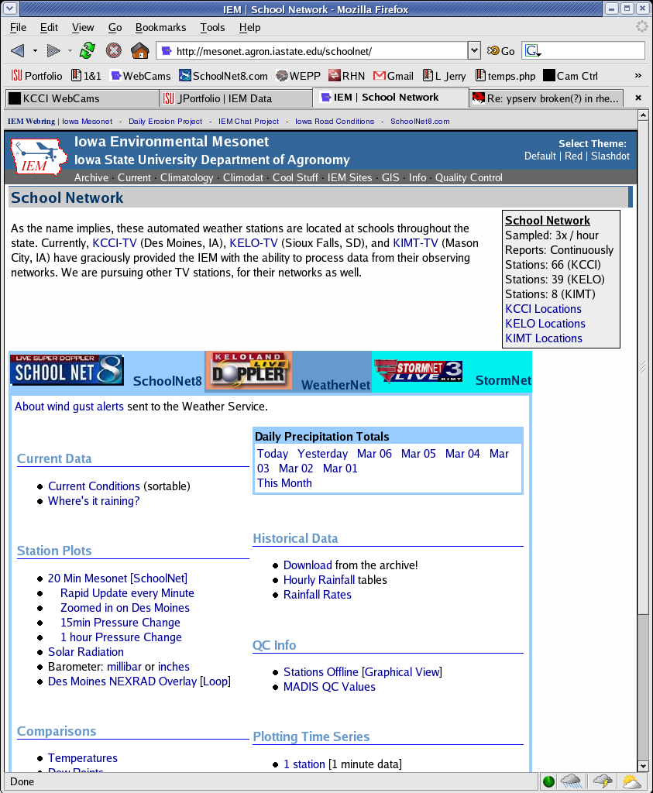
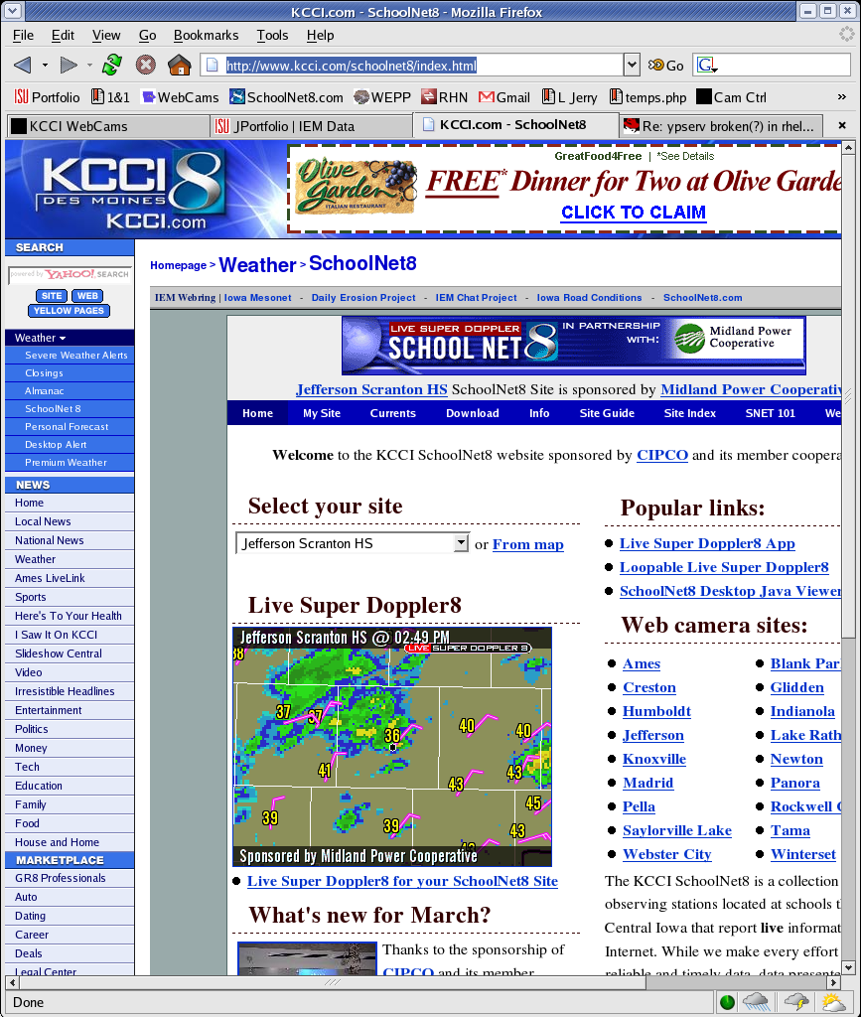
Which website is which?

Slide 39

Questions?
Daryl Herzmann
3010 Agronomy Hall
Ames, IA 50010
515.294.5978
Cell: 515.451.9249
akrherz@iastate.edu

