Slide 1
RADAR Workshop
12 March 2006
John McLaughlin
Chief Meteorologist
KCCI-TV Des Moines, IA
Daryl Herzmann
Iowa Environmental Mesonet
Iowa State University, Ames, IA

Slide 2
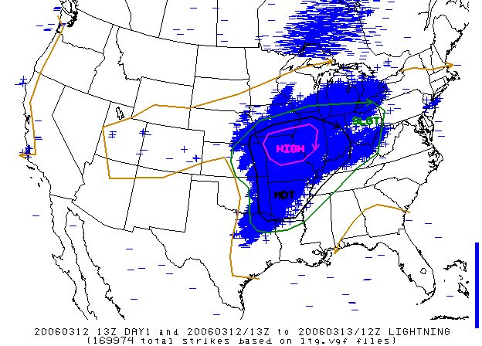
It was only two weeks ago...

Slide 3
Morning AFD from St Louis
EVERY EMERGENCY MANAGER...EVERY SPOTTER...EVERY MEDIA SOURCE THAT HAS WEATHER COVERAGE...AND EVERY PERSON SHOULD MAKE WEATHER THE TOP PRIORITY. LAW ENFORCEMENT PERSONNEL SHOULD PLAN TO HAVE EXTRA PEOPLE ON TAP TO HANDLE EMERGENCY SITUATIONS. SEVERE THUNDERSTORMS WITH DAMAGING LARGE HAIL...STRONG WINDS...AND STRONG LONG-TRACK AND POTENTIALLY DEADLY TORNADOES ARE LIKELY TODAY AND TONIGHT.

Slide 4
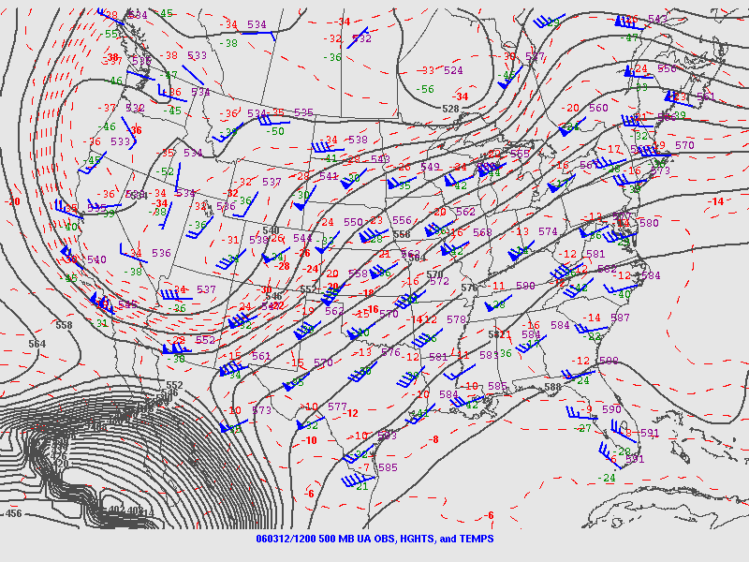
12UTC 500hPa

Slide 5
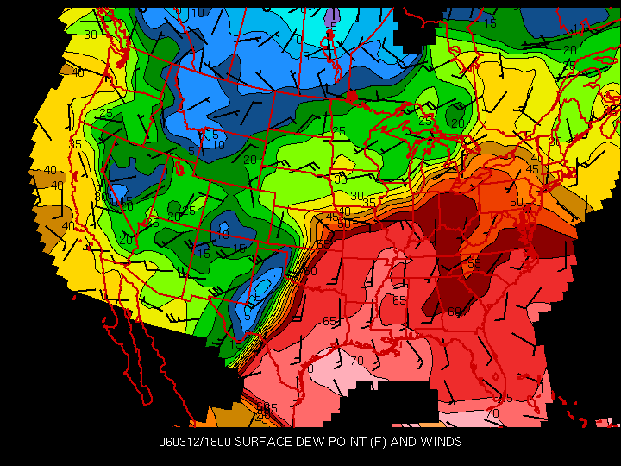
18UTC Surface Dew Point & Winds

Slide 6
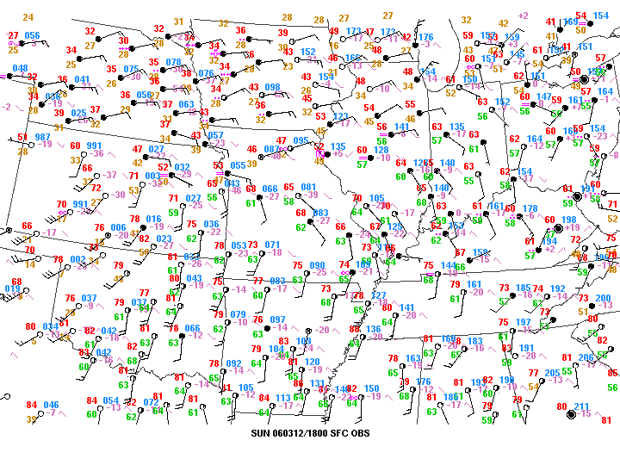

Slide 7
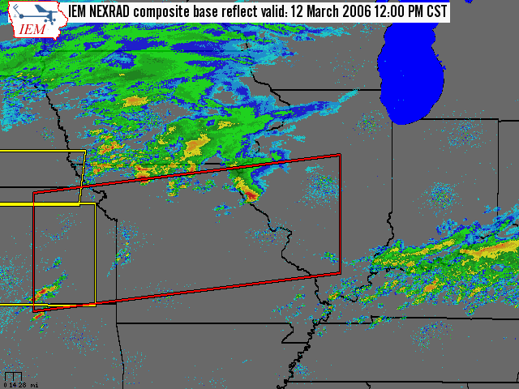

Slide 8
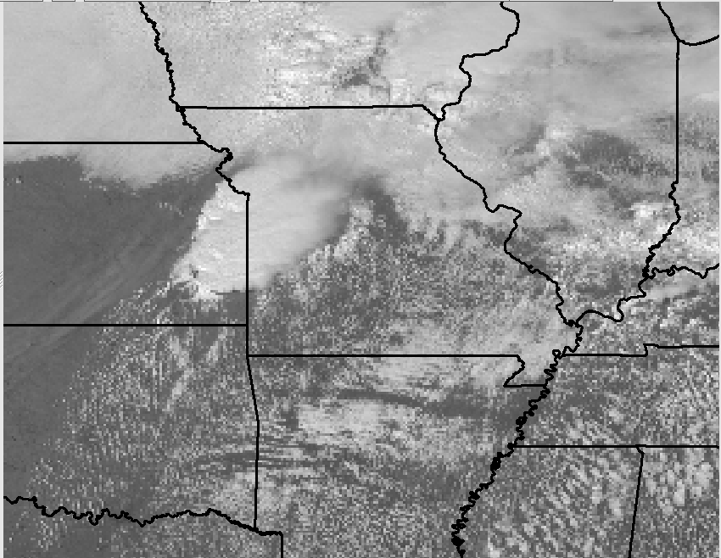
1915 UTC Visible Sat

Slide 9
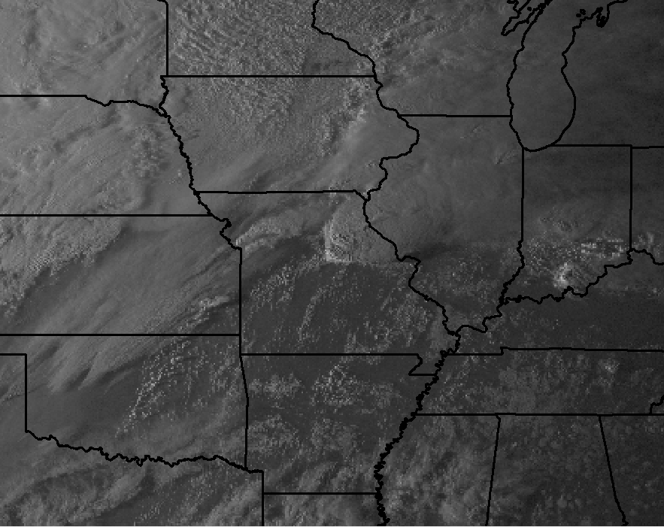
2315 UTC Visible Sat

Slide 10
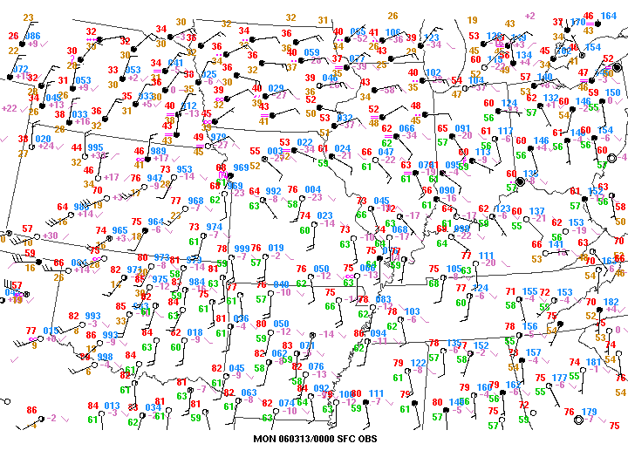

Slide 11
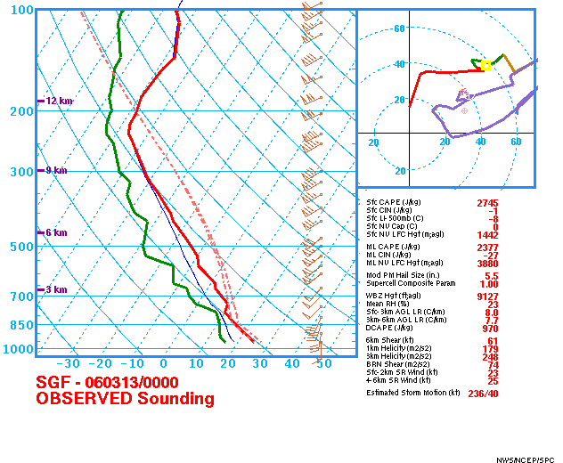

Slide 12
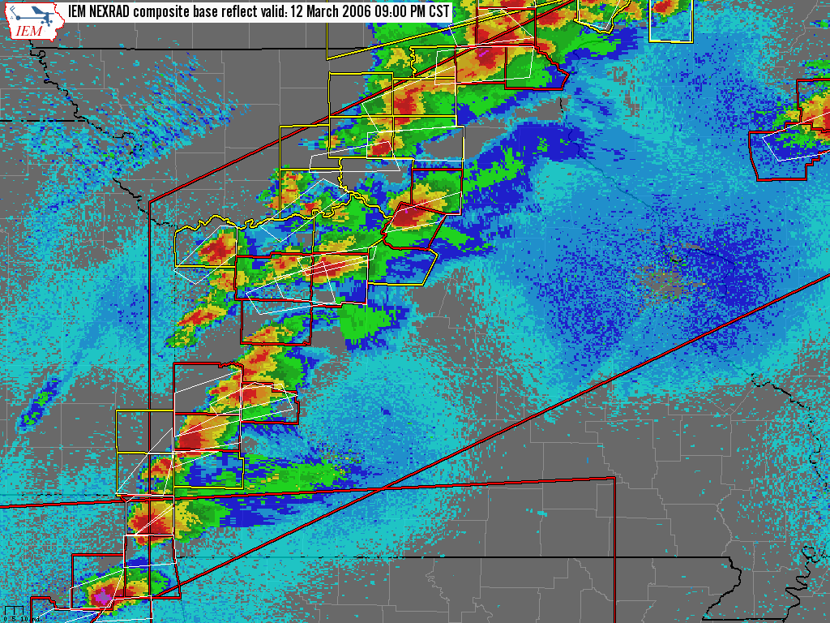

Slide 13
Lets start at 9 PM (3 UTC)

Slide 14
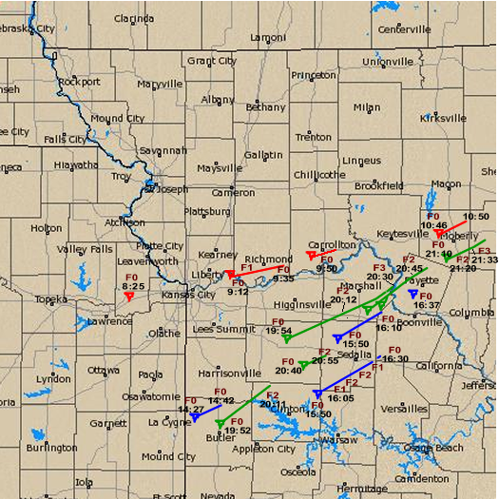

Slide 15
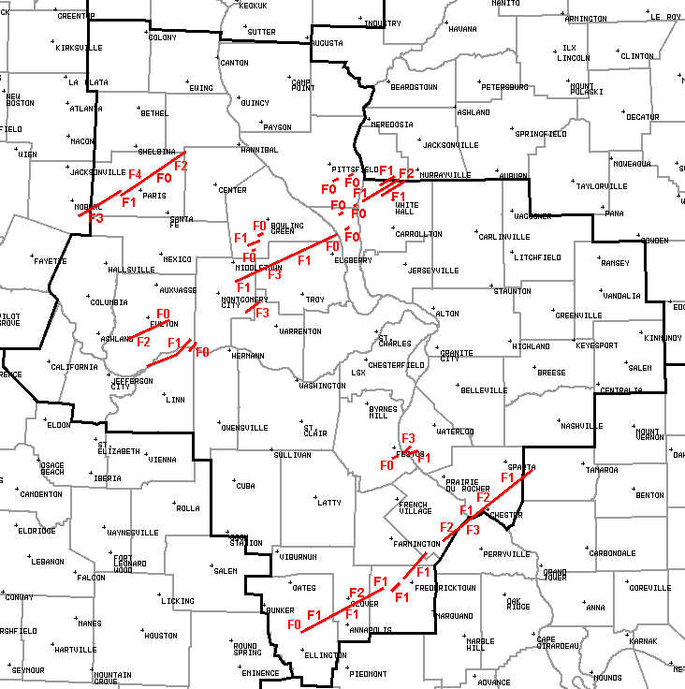

Slide 16
