Slide 1
NC1018: Iowa Update
Daryl Herzmann
Iowa Environmental Mesonet (IEM)
27 Oct 2006

Slide 2
Motivation for the IEM
Spring 2001: To build a centralized clearing house for environmental data in the state
  Collect, process and archive data from pre-existing networks
  Build two-way partnerships with data providers and data consumers
  Foster multi-disciplinary collaboration and research
Fall 2006: I’m still at it, so we must be doing something right!

Slide 3
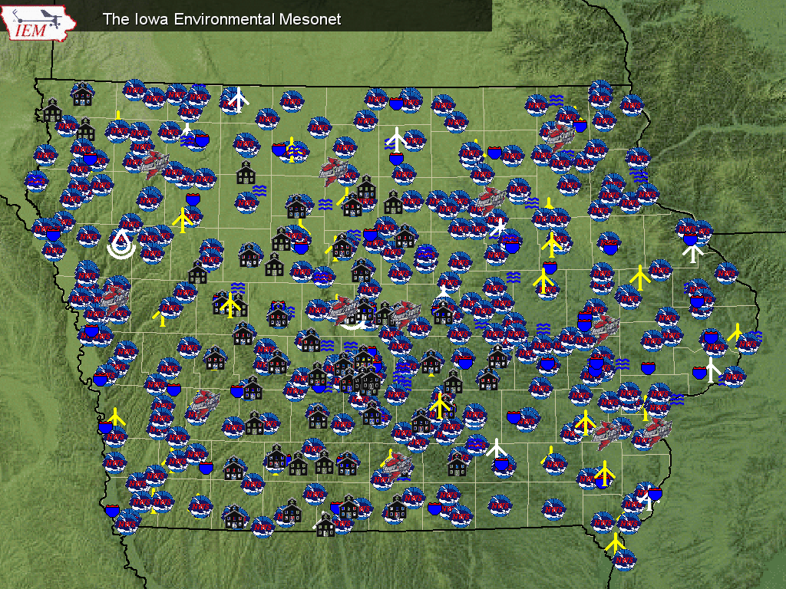
Sensor Locations

Slide 4
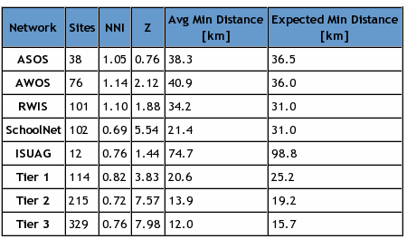
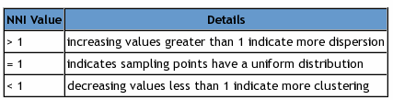
Nearest Neighbor Index
The NNI is a simple ratio between the mean minimum distance and expected distance by chance of sampling points over some sampling area.
Tier 1 is a combination of the ASOS and AWOS networks.

Slide 5
Daily Data Processing
On 4 October, the IEM ingested 304,121 observations (~111 million per year)
SchoolNet data is sampled once per minute, the IEM ingests 1+ million obs per day to produce the sub-sample.
20 GB of compressed Level2 NEXRAD data is processed.
10,000+ Level3 NEXRAD radar attribute files are ingested into the spatial database
Thousands of NWS issued text products are processed to extract data and information.
99% of processing done in real-time.

Slide 6
Observation Archive
 | Begins | Current Stations | Obs Stored
ASOS | 1945 | 17 | 1,323,570
IA AWOS | 1995 | 37 | 191,017,657
IA RWIS | 1994 | 53 | 15,015,105
SchoolNet | 2002 | 131 | 166,626,011
NWS COOP | 1893 | 185 | 3,107,343
Ag Climate | 1998 | 14 | 1,003,436
Other |  | Lots | ~20,000,000
 |  |  | ~400 million

Slide 7
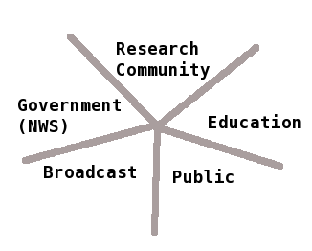

IEM Projects fostering collaborations
Daily Erosion Project
Pollen Dispersion
Squaw Creek Flood Model
Pavement Project
SchoolNet8
IEM Chat

Slide 8
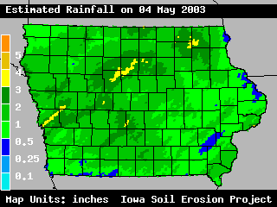
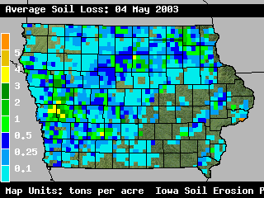
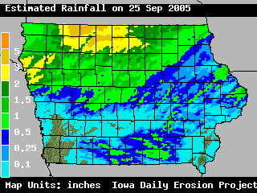
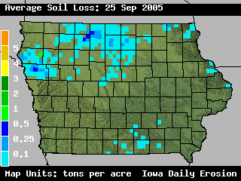
4 May 2003, heavy rains on freshly tilled soils
25 Sep 2005, heavy rains on mature crops

Slide 9
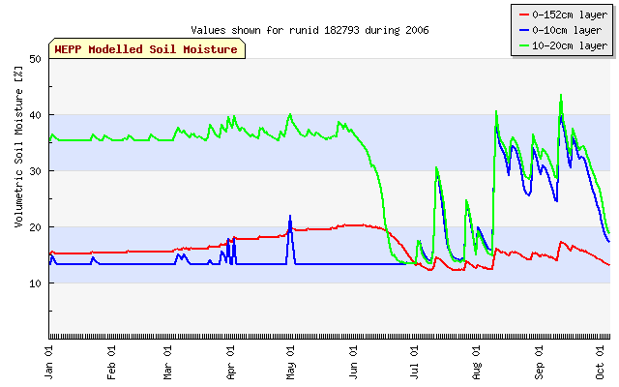
Modeled soil moisture data
10-20 cm
Root Zone
0-10cm

Slide 10
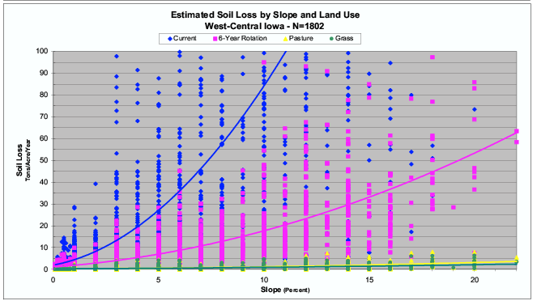
Estimated Soil Loss by Slope and Land Use

Slide 11
Coupling Lagrangian Stochastics and Large Eddy Simulation to Predict Long Distance Dispersal of Pollen
Mark Westgate
Raymond Arritt
Susana Goggi
Jeff Wolt

Slide 12
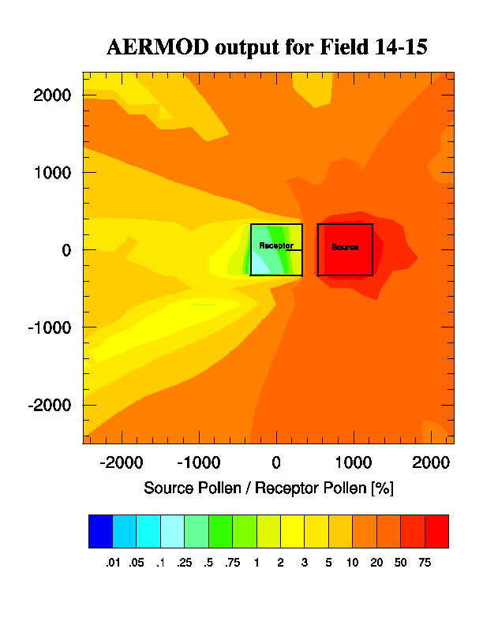
Presented is a simple ratio of pollen from source (adventituous) versus receptor fields.
The line in the receptor field is the transect used for validation.

Slide 13
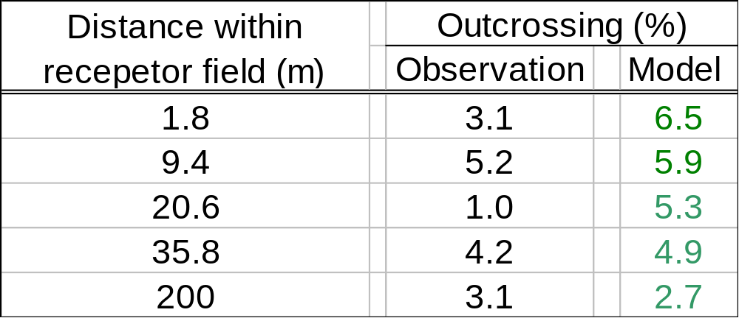
Validation – A work in progress
Field “14-29” – 130 m isolation distance
With no major modification AERMOD predicts directionally correct, order of magnitude correspondence to field observations – Thus, with further calibration AERMOD can be adapted as a first tier model

Slide 14
IEM Climodat:
Answering the most common data questions
Precipitation Events per Climate Week
Twelve Significant Rainfall Events
Growing Degree Days
Daily Record Highs and Lows
Daily Maximum Precipitation
Daily Record Hi and Low Ranges
Daily Mean Highs and Lows
Number of Days Each Year Min >= 32
Last Spring/First Fall/Length of Season Base=32
Last Spring/First Fall/Length of Season Base=30
Last Spring/First Fall/Length of Season Base=28
Last Spring/First Fall/Length of Season Base=26
Last Spring/First Fall/Length of Season Base=24
Monthly Average Maximum Temperatures
Monthly Average Minimum Temperatures
Monthly Average Mean Temperatures
Monthly Precipitation Totals + Averages
Monthly Heating Degree Days
Monthly Cooling Degree Days
Heat Stress Variables
Monthly Rainy Days
First Fall Freeze Probabilities
Last Spring Freeze Probabilities

Slide 15
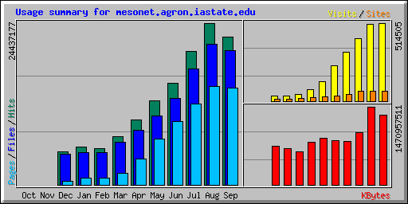
Traffic / Hits
5x growth
this year
Average 800,000 hits per day!
Estimated 5,000 people per day view IEM delivered content.
#1 website on ISU campus for bandwidth

Slide 16
Honorable mention
Pavement design project, ISU & DOT
  Modeling pavement conditions using IEM climate data
Iowa Agro-Ecozones
  Carol Williams, ISU
XML databases
  Shashi Gadia et al, ISU
IEM delivered Road Conditions
  Shameless display of IEM logo on local TV stations

