Slide 1
IEM Chat and other things that should interest the audience
Daryl Herzmann
Iowa State University
akrherz@iastate.edu
http://mesonet.agron.iastate.edu

Slide 2
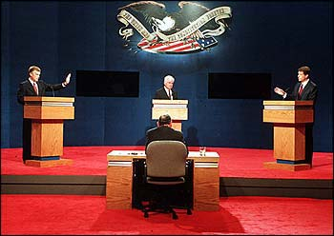
Who am I and Why am I here?
Bachelors in Meteorology 2001
Built and maintain the IEM since
Enjoy working with the NWS on the WFO level
And I was invited here! Thanks!

Slide 3
What will I talk about?
A whole bunch on Instant Messaging
  IEM Chat
  IEM Bot
Other Tools for the NWS
  Automated Polygon Verification
  Online applications
  GIS data
  Archives
Some eye candy: 2005-2006 Watch/Warnings

Slide 4




Instant Messaging Background
NWS IM with media partners has been around for a while (2000?) and well regarded
Implementation / Policy widely varies with WFO
In 2004, we started a Yahoo! Chat between media, IEM, and DMX and had decent success, but...

Slide 5
Problems with Yahoo!
The Yahoo! supported chat client is adware.
Chat rooms are limited to 50 users (?)
Yahoo! protocol only supports participation in 1 chat room at once.
Yahoo! chat not allowed on some WANs
Securing chat rooms from unathorized access. How? Dealing with chat rooms in general.....
Nobody likes getting Yahoooooo'd!!!!
Commercial chat protocols are becoming a major vector for spam, viruses, and worms

Slide 6
We looked for a new solution
Jan 2005: DMX, CRH, and myself looked into alternatives
Spring 2005: ARX,DMX,DVN began using something called ‘nwscr-chat’ with very good success
15 June 2005: Project formalized as ‘iemchat’ and we started accepting other WFOs

Slide 7
IEM Chat Project Features
End to end encryption (logins, chats)
1 preconfigured & persistent chat room for each WFO
Practically no room size limit (1000s of users)
Users can join multiple rooms (multiple WFOs)
Rooms have recent history when you join them. Users get caught up quickly.
Standards based XML protocol (Jabber/XMPP). Open Source client (Gaim).

Slide 8
iemchat.com website features
Good (?) documentation on installation and configuration of Gaim
Documentation and tools specifically for the setup of iemchat on typical NWS office network config
Automatic chat room logging, available on website for download
Java applet based chat client
Anonymous real-time chatroom monitor

Slide 9
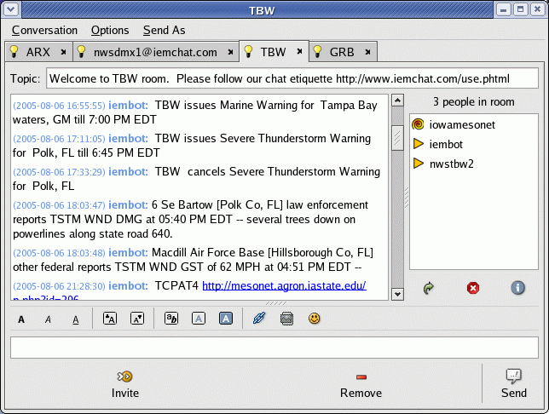

Slide 10

Hello, iembot!
Iembot is the code name for a chat “bot”
A bot is a program that participates in chats and acts like just another user
Iembot is a good bot! He relays NWS text products into WFO specific chat rooms.

Slide 11
Why is a chat bot needed?
NWS forecasters shouldn't have to redundantly generate a warning in Warngen and then retype it in a chatroom
Iembot provides near instant verification that a product is going out and is being ingested by a computer.
On-air media can simply read from the chatroom and not get lost in other displays or paper printouts.
Helps with complex VTEC products.

Slide 12
Iembot is smart and fast!
TBW issues Marine Warning for Tampa Bay waters, GM till 8:45 PM EDT
MHX issues Severe Thunderstorm Warning for Onslow, NC till 11:15 AM EDT
GGW cancels Lake Wind Advisory for Central and Southern Valley, MT and Garfield, MT and McCone, MT
TULSA,OK (KTUL) ASOS reports gust of 41 knots from NNW @ 0919Z
Storm Prediction Center issues Mesoscale Discussion #1836
2 W Harrison [Douglas Co, SD] public reports HAIL of 1.75 INCH at 06:58 PM CDT --
National Hurricane Center issues ADVISORY #32 for HURRICANE GORDON
SPC issues TORNADO watch till 06:00Z http://www.spc.noaa.gov/products/watch/ww0821.html, new watch replaces WW 819, WW 820
NESDIS issues Satellite Precipitation Estimates

Slide 13
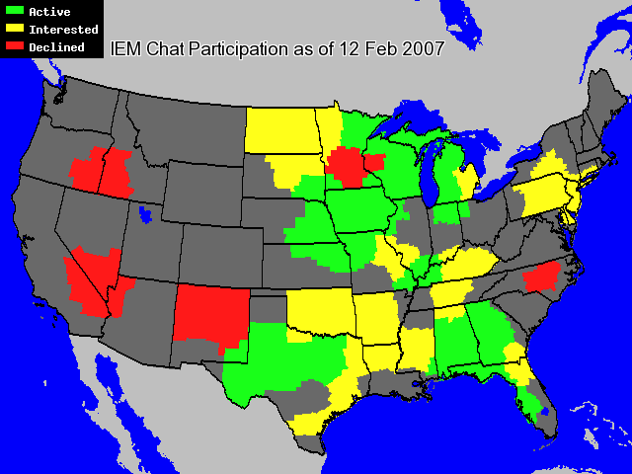

Slide 14
NWS Region iemchat status
Central
  WFOs are free to use iemchat if they wish
Southern
  Purchased proxy solution to allow enterprise wide use. Offices will be encouraged to use it.
Eastern
  Evaluating at region level, offices not allowed to use
Western
  Planning some sort of deployment this fiscal year

Slide 15
Building for a sustained future
Redundant chat server setup deployed 3 Jan
Server administration team formed to:
  Oversee technical changes
  Provide 24/7 support during high impact weather
  Make sure iemchat survives without me
Looking at other options, non-for-profit (?)

Slide 16
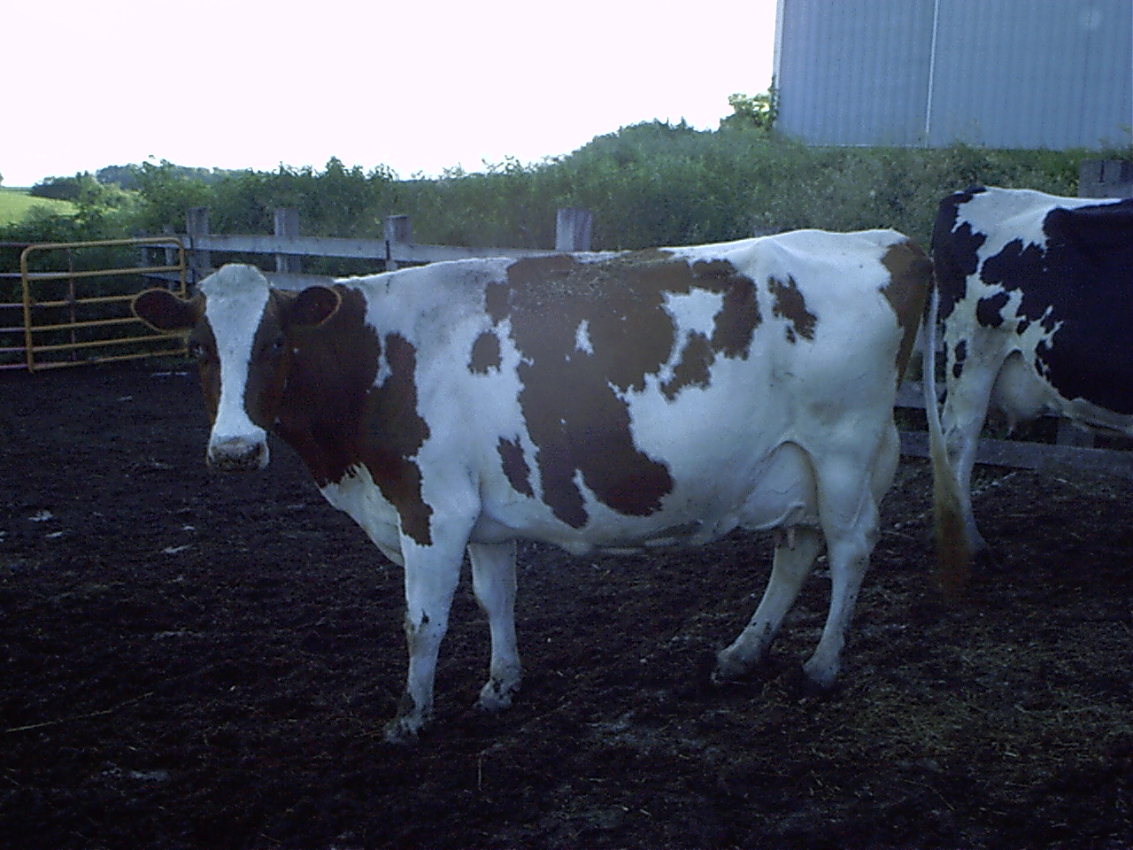
IEM Cow

Slide 17
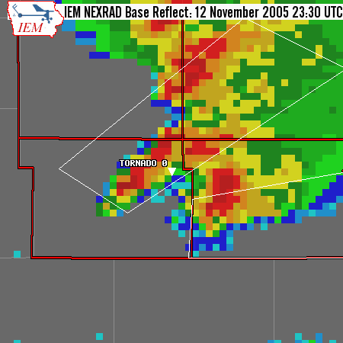
IEM Cow: Polygon Verification
Concept is simple. Lets merge:
  NEXRAD
  LSRs realtime, stormdata archive
  Polygon warnings
Produce verification stats
  POD, FAR, CSI and lead time

Slide 18
Caveats galore!!!
Yes, not many offices are issuing polygons operationally
Yes, LSR reporting is inaccurate and incomplete (Not my fault :) )
No, I am not trying to make certain WFOs look bad or advance agendas.
No, I am not fully following NWS verification “rules” like the 15/15 rule.

Slide 19
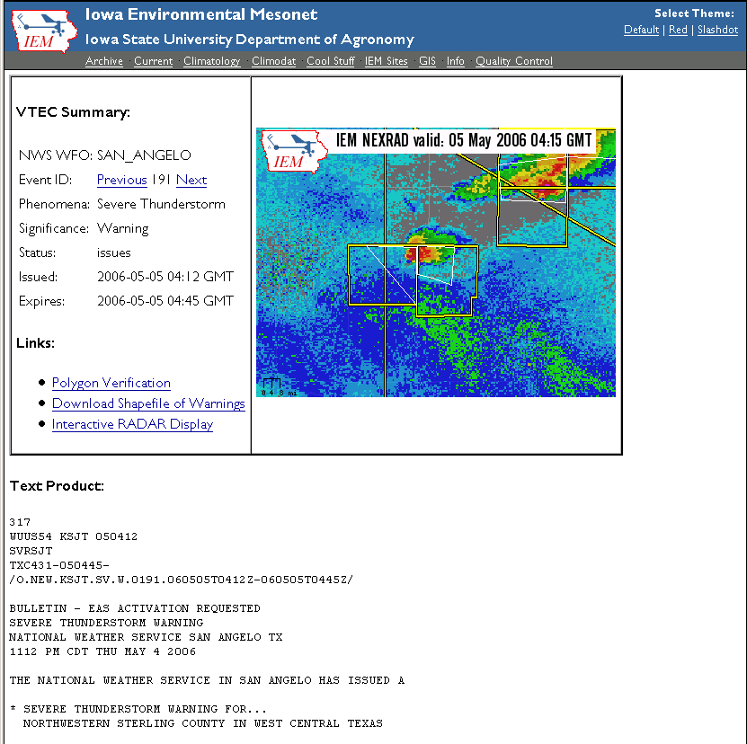
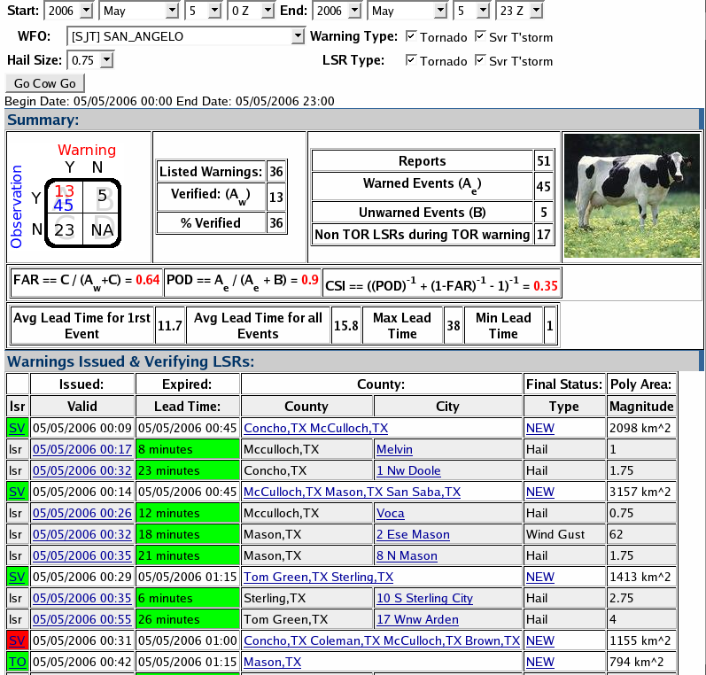
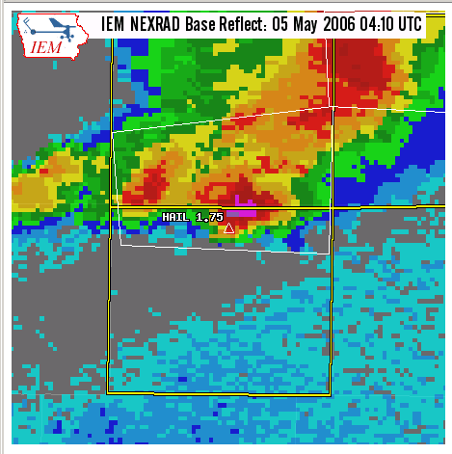

Slide 20
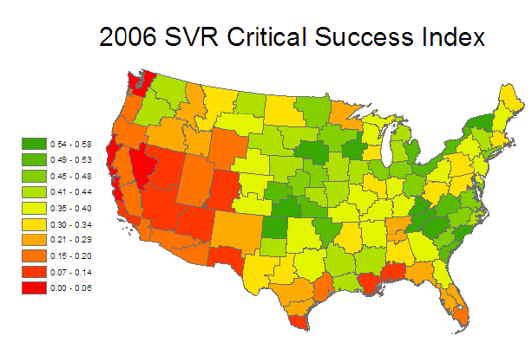

Slide 21
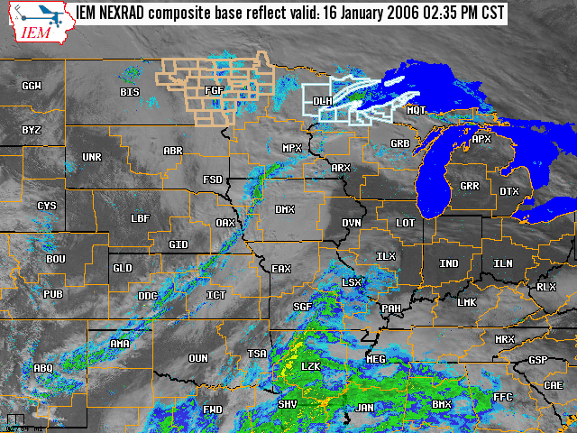
GIS based mapping
Combine realtime+archived imagery
Dynamically select layers to display
Automatically refreshes.
Supports multiple time zones.
Download lapses in animated GIF format.

Slide 22
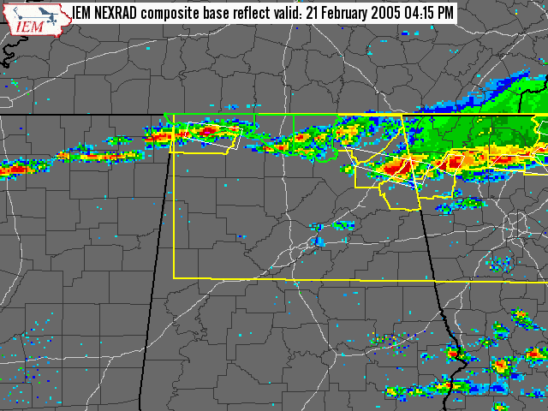
Static archived maps
Every 5 minutes dating back to 3 Nov 2004 (could backfill more)
Predictable URLs make it fairly easy to script and build movies for presentations.

Slide 23
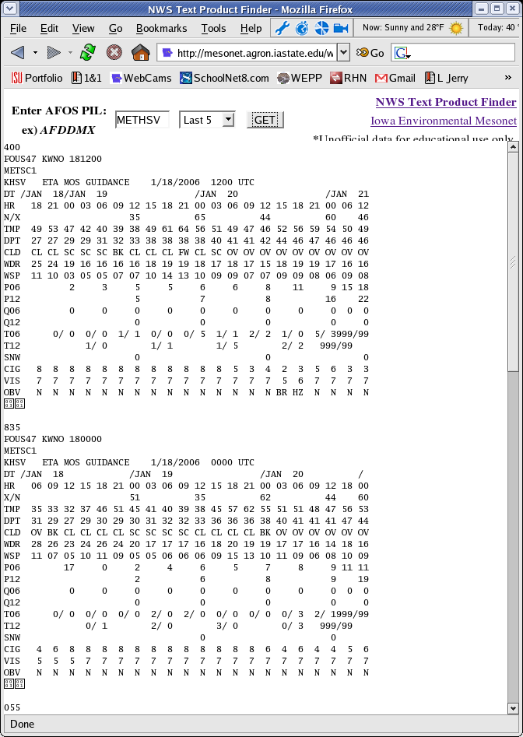
Text Product Finder
Find products by AFOS like PILs.
Also make MOS searchable by PILs like MAVHSV
14 day archive

Slide 24
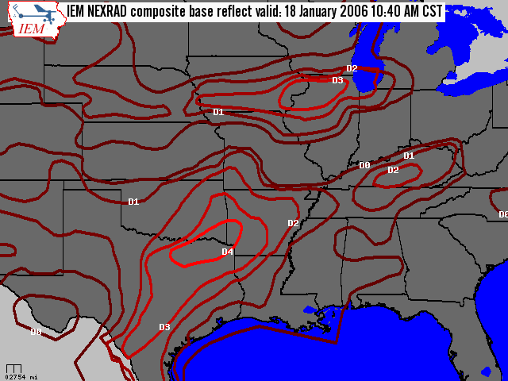
GIS: US Drought Monitor
Provide easy to use shapefiles with current US Drought Monitor polygons
Archive as well!

Slide 25
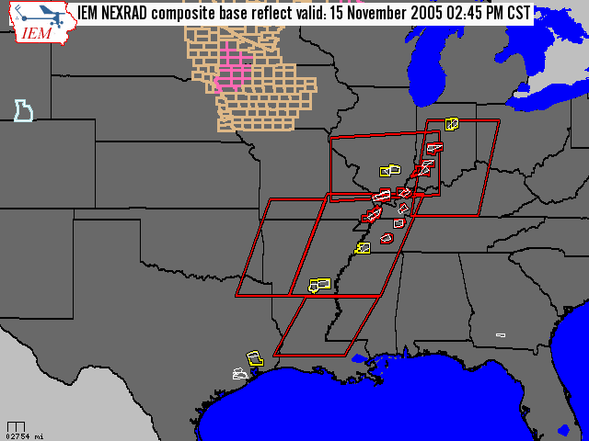
GIS: Watch/Warning Shapefiles
Generate a shapefile every 5 minutes with all VTEC products in it
Available via LDM, manual download, or OGC WFS
Easily download shapefile for time period of our choice.

Slide 26
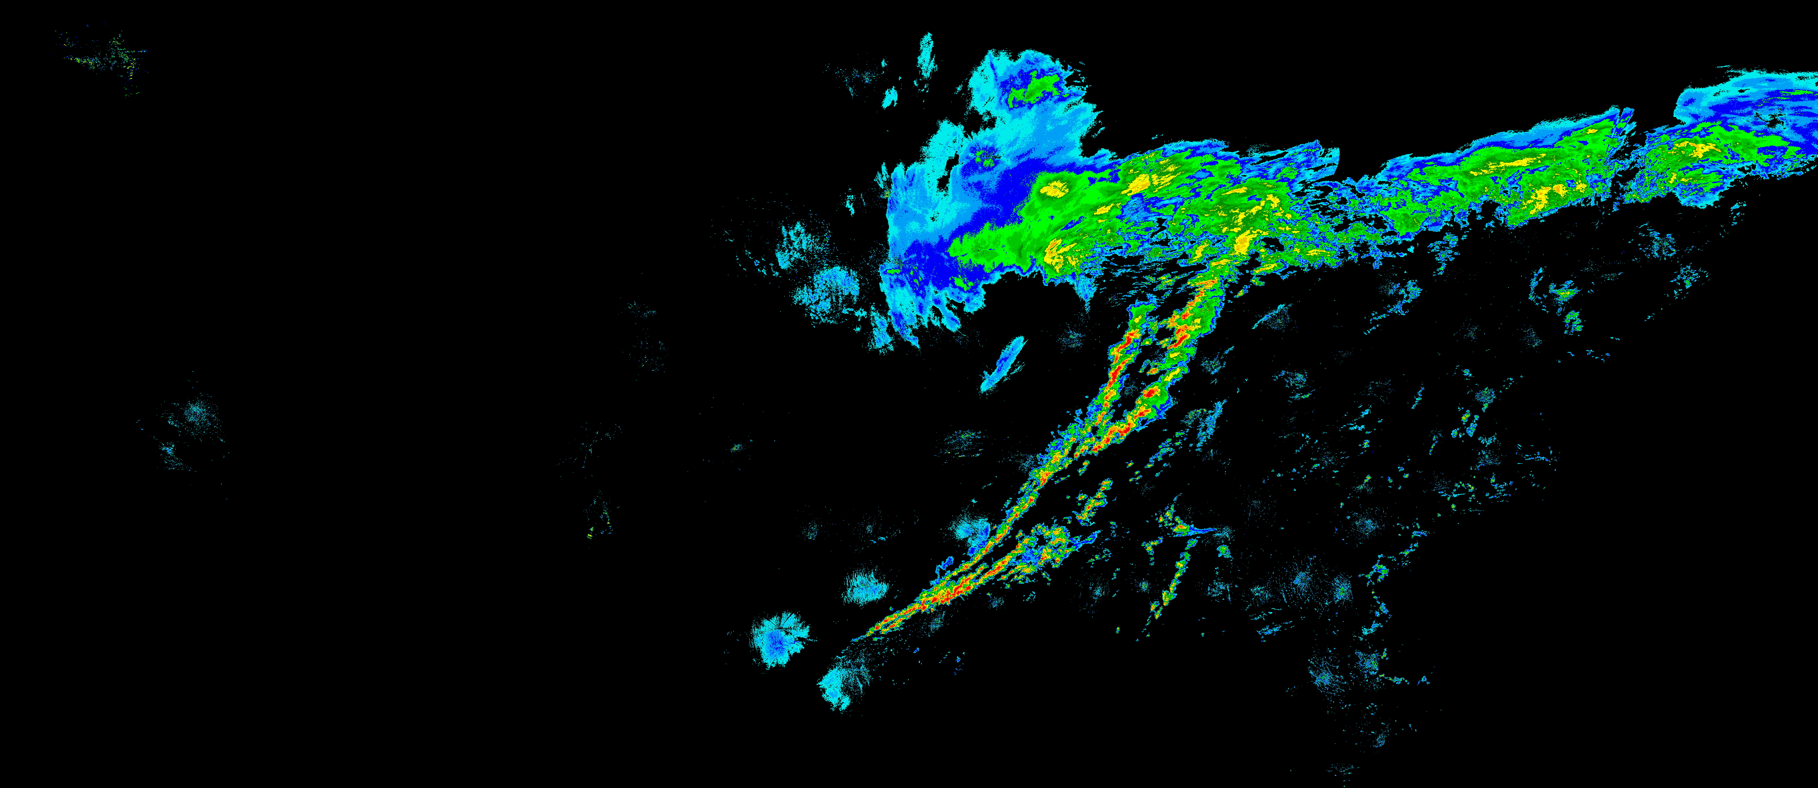
GIS: Raw NEXRAD composites
GIS Ready format (geo-referenced PNG)
Every 5 minutes dating back to 1 Aug 2003

Slide 27
About polygon size

Slide 28
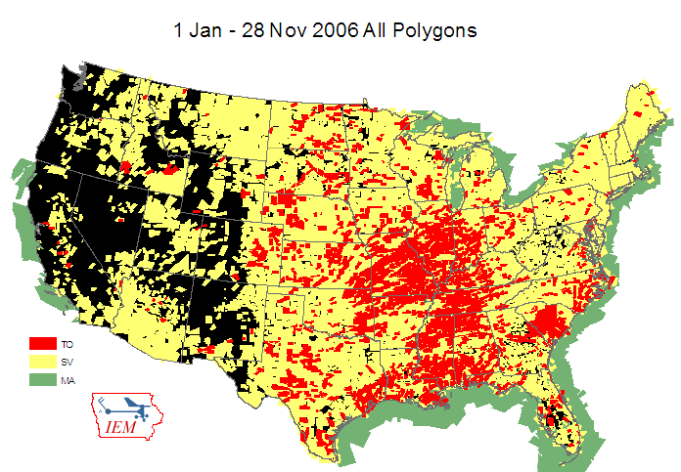

Slide 29
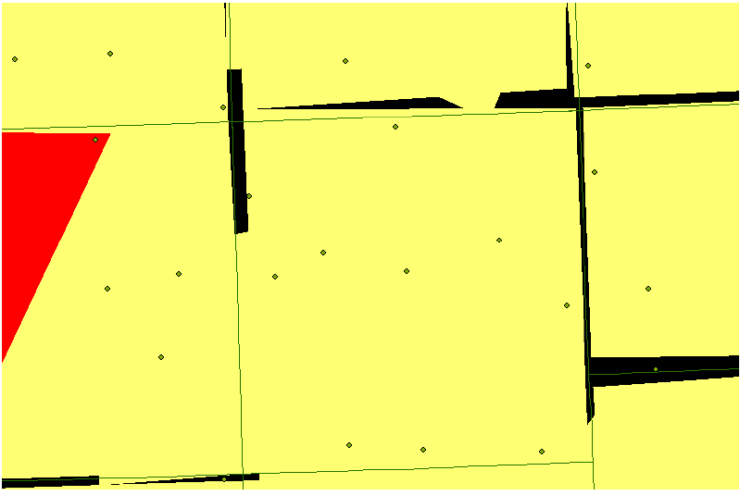
2006 Unwarned areas due to lat/lon precision and county borders

Slide 30
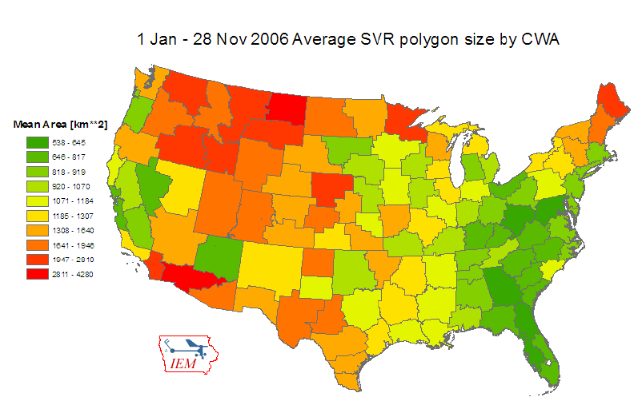

Slide 31
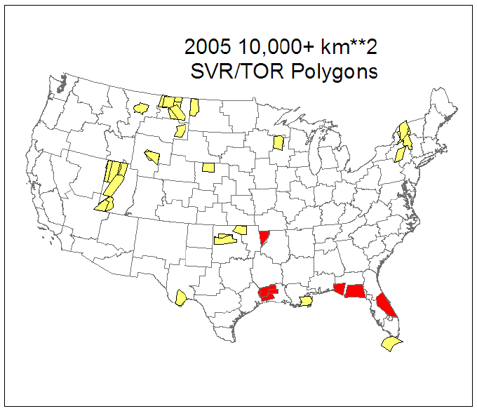

Slide 32
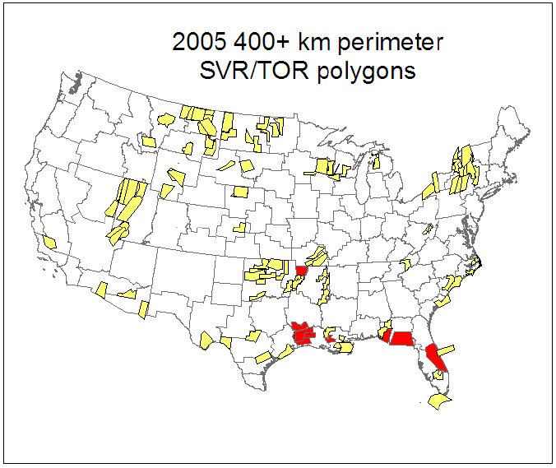

Slide 33
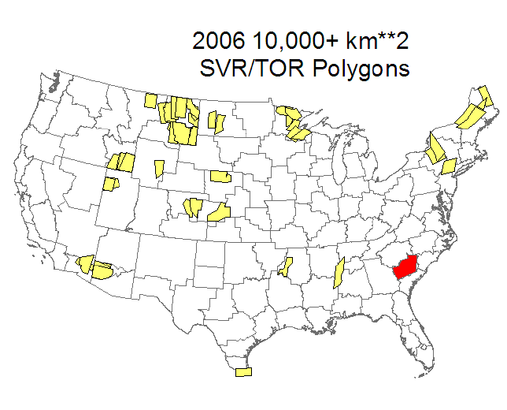

Slide 34
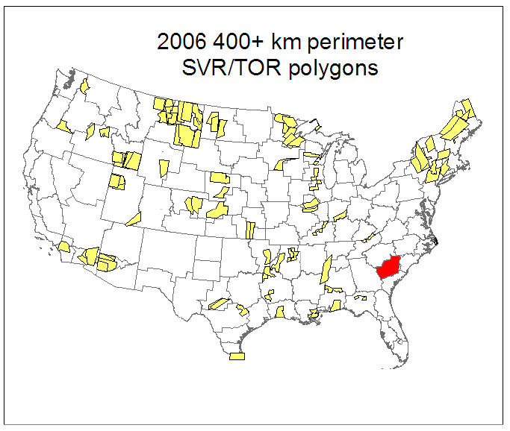

Slide 35
Average areas per warning
 | County Based | Polygon Based | Ratio
2005 SVR | 4,314 | 1,293 | 30.0%
2005 TOR | 3,564 | 1,037 | 29.1%
2006 SVR | 3,935 | 1,175 | 29.8%
2006 TOR | 3,078 | 897 | 29.1%
Values in square kilometers
For 2006, warnings from 1 Jan – 28 Nov
If a warning was for multiple counties, the total county
area is summed and then used in the average.

Slide 36
Last VTEC status value for 2006 county warnings
 | Severe T’storm | Tornado
Issues (NEW) | 17.9% | 17.0%
Continues (CON) | 25.9% | 29.5%
Expire (EXP) | 32.7% | 27.5%
Cancel (CAN) | 23.5% | 26.0%
 | 33,642 | 3,994
1 Jan – 1 Dec 2006 warnings included
Most disturbing number here is that roughly 17% of the counties warned
never get a follow-up statement (no SVS issued!).

Slide 37

I'm done! Any questions?
Daryl Herzmann
Office: 515.294.5978
Cell: 515.451.9249
akrherz@iastate.edu
http://mesonet.agron.iastate.edu
https://iemchat.com

