Slide 1

Iowa Environmental Mesonet: Supporting the real-time and research needs of the national severe weather community
Daryl Herzmann

Slide 2
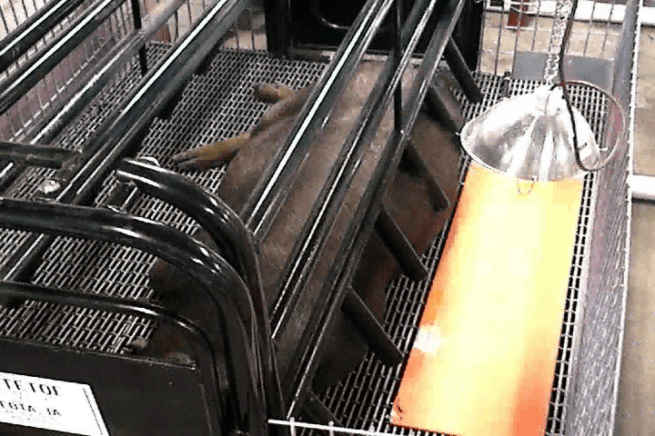

Slide 3
What are you interested in?
 | Real-time | Archived
Level 2 NEXRAD | 134 sites ONDAS compliant | NCDC 30 day TAMU
NWS Warnings | Maps & full text GIS Shapefiles | Same apps have archive function > 1 Jun 2003
Local Storm Reports (LSR) | Maps GIS Shapefiles | Same apps have archive function > 1 Jan 2003
Bufkit Soundings | NWS websites | Iowa+ > 1 Jan 2006 NAM,GFS,RUC
Model data | Lots of places | GEMPAK Archive
Surface data | Yeah, IEM ☺ | Boatloads > 1945
Satellite | GIS rasters | NOAA CLASS
Sounding data | Lots of places | GEMPAK > 1950s

Slide 4
All done, have a nice day!
Oh, I have more time?

Slide 5
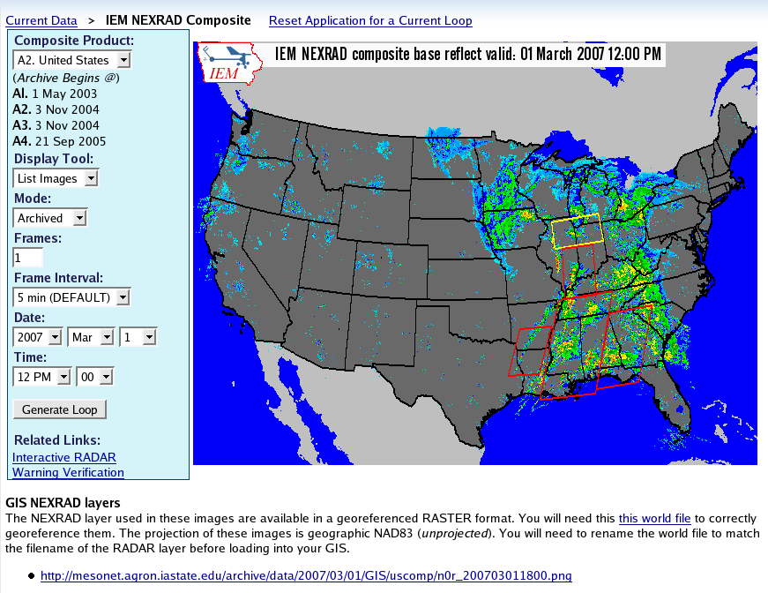

Current/Archived Composite
NEXRAD display

Slide 6
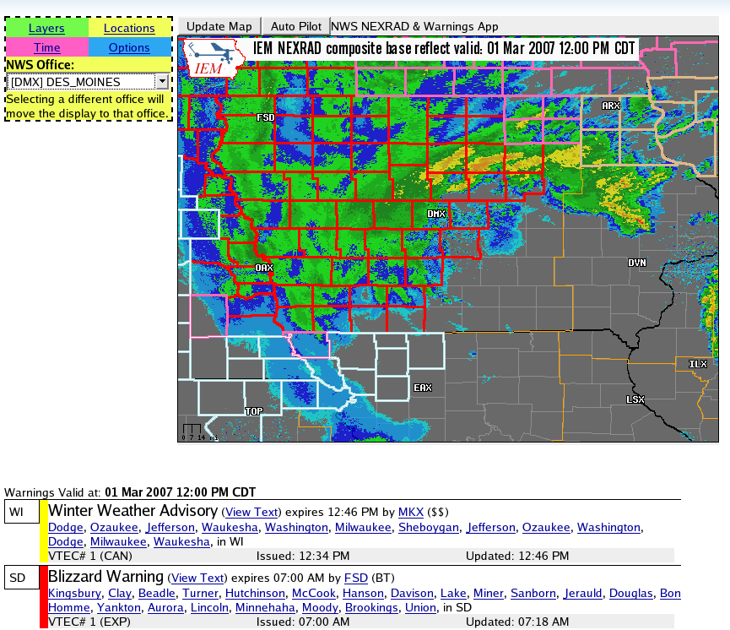
Interactive Current/Archived
NEXRAD display

Slide 7
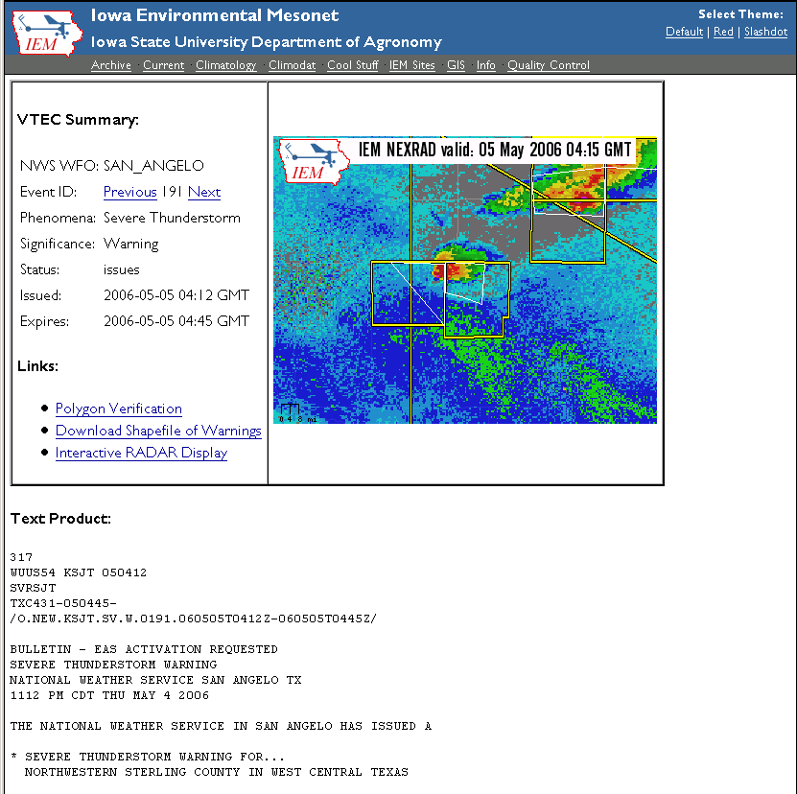
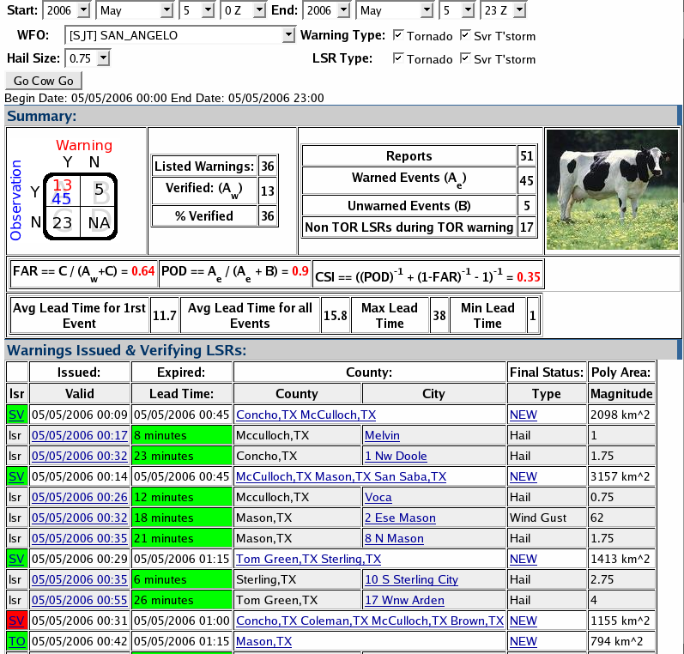
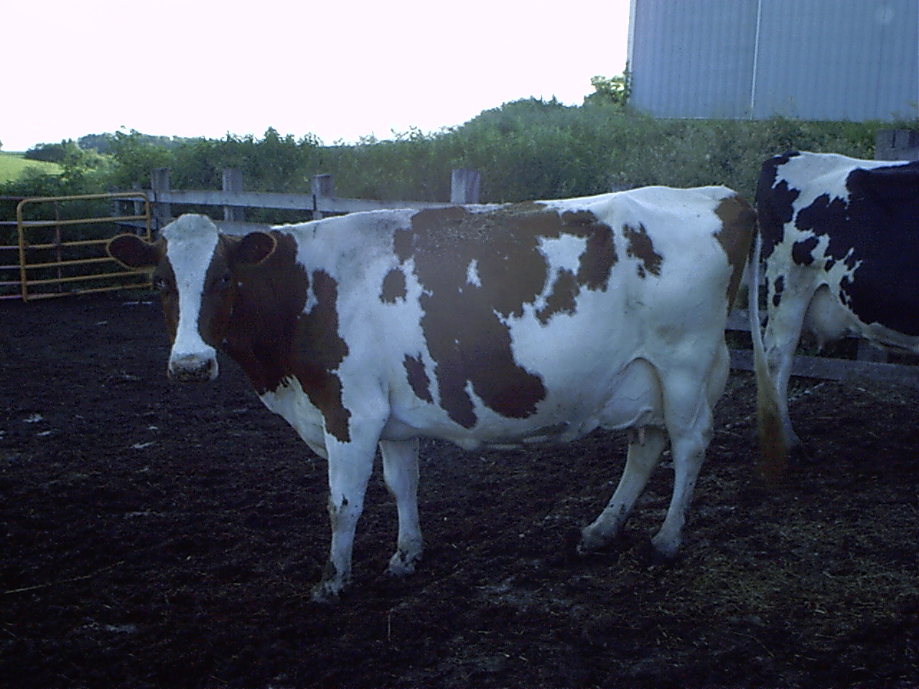
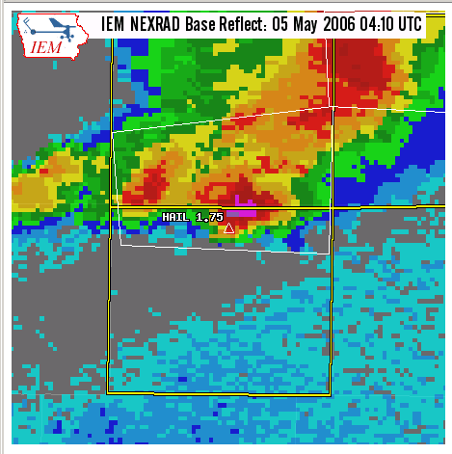
Interactive Storm Based Warning
Verification - “IEM Cow”

Slide 8
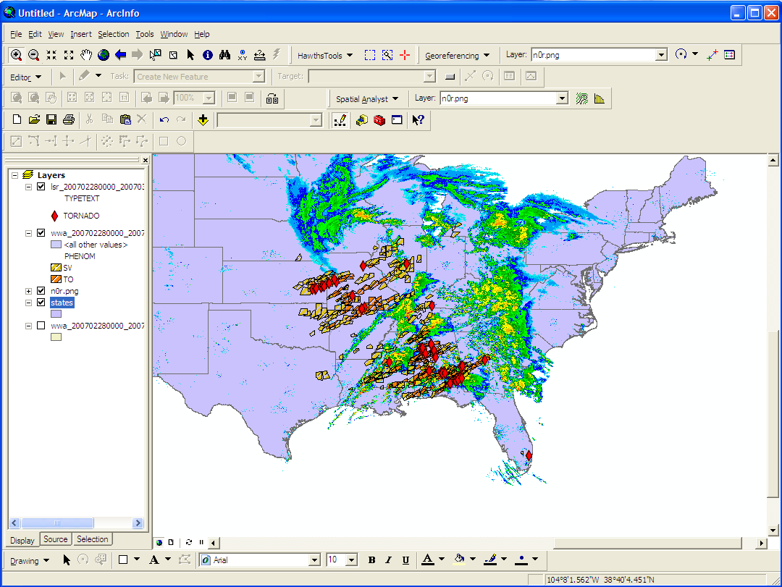
Download RADAR, LSRs,
Watch/warnings in GIS format

Slide 9
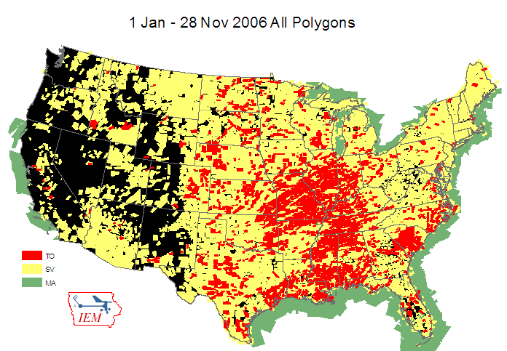

Slide 10
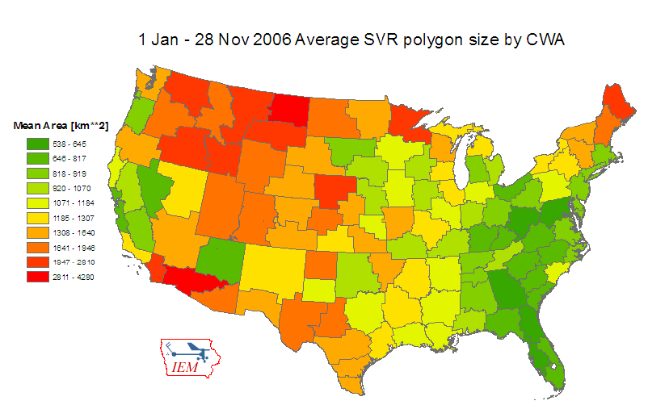

Slide 11
Of course, IEM Chat
A system to support the real-time collaboration of operational meteorologists and emergency management
Standards based, open source software to do instant messaging
Project launched June 2005
850+ accounts, ~200 TV stations, and 41 WFOs are currently using it

Slide 12
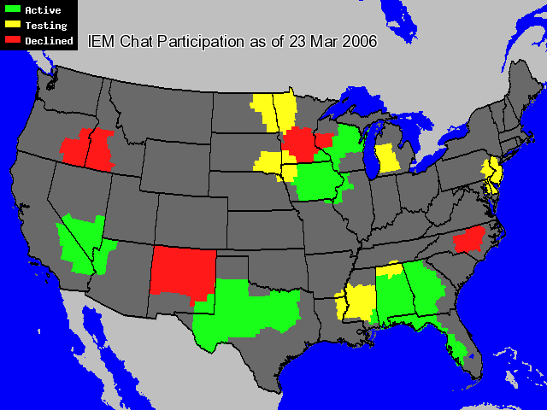

Slide 13
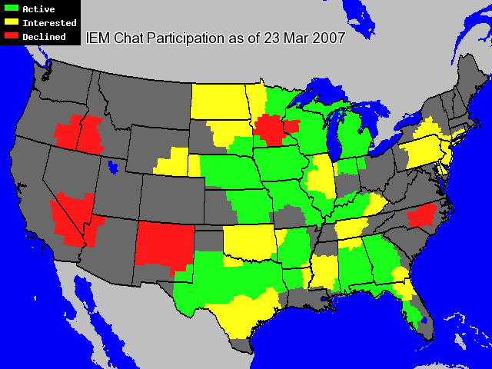

Slide 14
Chatroom interaction (11/12/05)
[22:52:16] kcciwhite viewer confirms funnel/tor. report in luther area
[22:52:19] iowamesonet 2 mile south of luther, farm house heavily damaged
[22:52:44] nwsdmx6 ham radio reports luther tornado has begun to rope out
[22:53:23] iembot 3 S Stratford [Hamilton Co, IA] trained spotter reports TORNADO
at 04:36 PM CST --
[22:55:19] iembot 1 E Woodward [Dallas Co, IA] county official reports TORNADO
at 04:41 PM CST --
[22:55:34] iowamesonet ISU spotters say former Luther tornado has dissipated
[22:56:06] nwsdmx6 tor wrng for story co coming
[22:56:24] iembot DMX issues Tornado Warning for Story [IA] till 5:30 PM
CST
[22:57:58] iembot DMX issues Tornado Warning for Franklin, Hamilton, Hardin,
Wright [IA] till 5:45 PM CST
[22:59:09] iowamesonet funnel on Ames cam
[22:59:52] iowamesonet almost down
[23:00:34] iembot Webster City [Hamilton Co, IA] public reports HAIL of 0.75
INCH at 04:50 PM CST --
[23:02:00] wmt_am got a citizens report of a tornado that touched down briefly
just north of lincoln way in ames

Slide 15
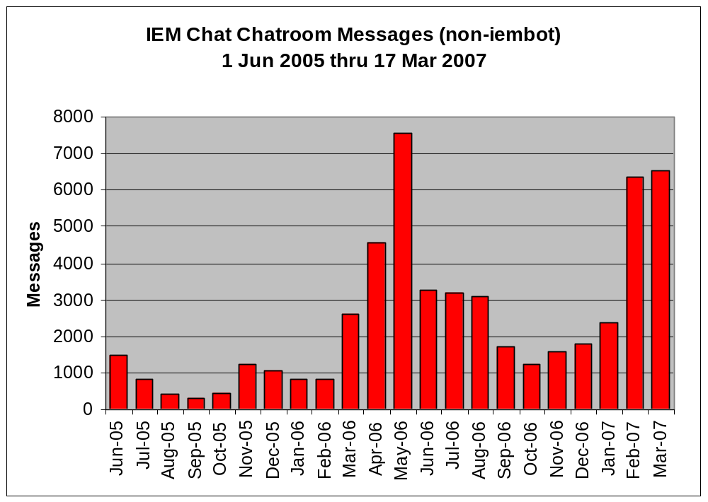

Slide 16
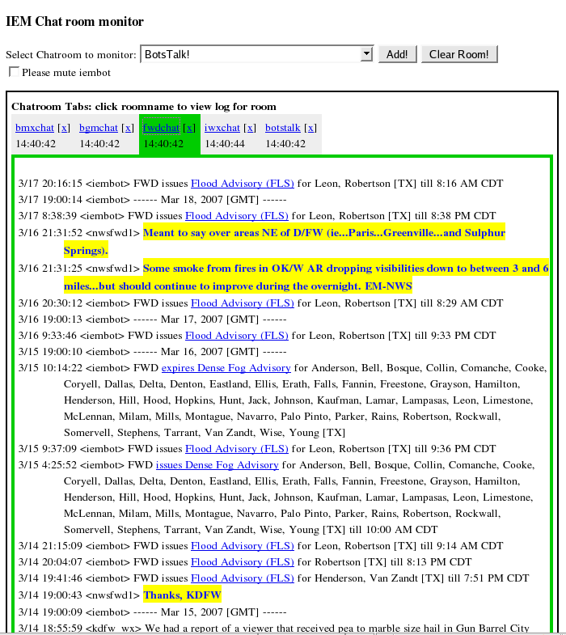
Anonymous chatroom monitor

Slide 17
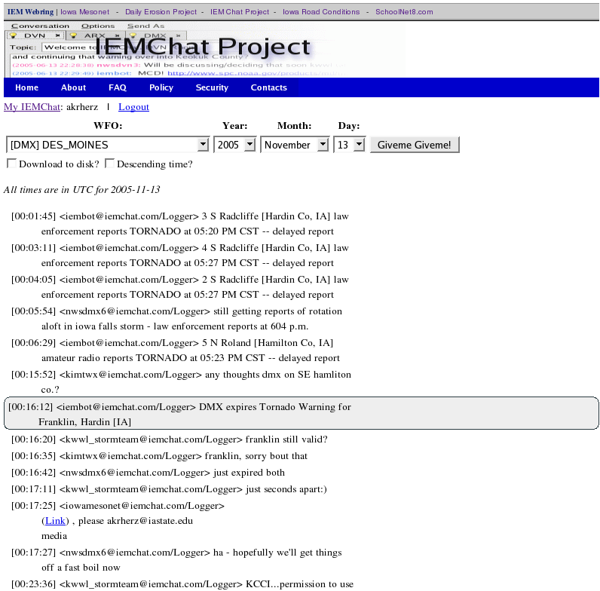
Download historical chat logs

Slide 18
About Historical Logs
IEMbot messages are shown at the time the product was issued by the NWS
All links to IEM / SPC products should work
Historical logs are “live”, can download up to the minute

Slide 19
You can’t read this:
IEM Website
http://mesonet.agron.iastate.edu
IEM Chat website
https://iemchat.com
NOAA Class
http://class.noaa.gov
Static Composites
http://mesonet.agron.iastate.edu/current/mcview.phtml
Interactive Display
http://mesonet.agron.iastate.edu/GIS/apps/rview/warnings.phtml
GIS downloads (LSRs / warnings / radar)
http://mesonet.agron.iastate.edu/GIS/
Live Level2 NEXRAD data
http://mesonet.agron.iastate.edu/data/nexrd2/raw/
IEM Cow
http://mesonet.agron.iastate.edu/cow/
Texas A&M 30day Level2 NEXRAD cache
http://mesonet.tamu.edu/products/RADAR/nexrad/CRAFT/
NCDC HAS (archived level2 and level3 nexrad)
http://hurricane.ncdc.noaa.gov/pls/plhas/has.dsselect
IEM Archive page
http://mesonet.agron.iastate.edu/archive/

Slide 20
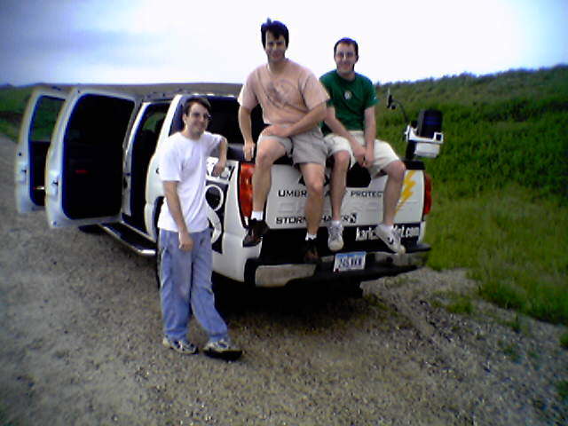
I'm done! Any questions?
Daryl Herzmann
Office: 515.294.5978
Cell: 515.451.9249
akrherz@iastate.edu

