Slide 1

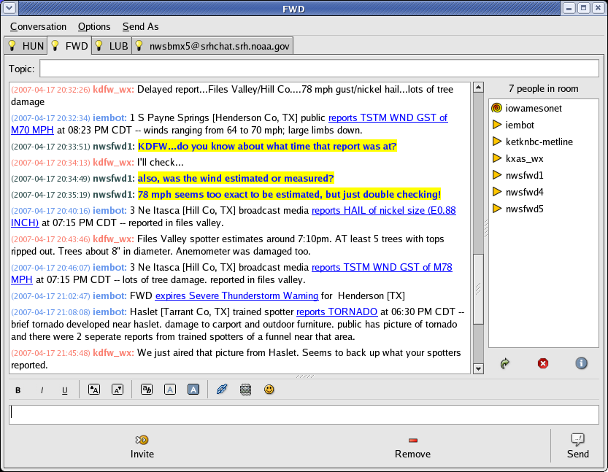
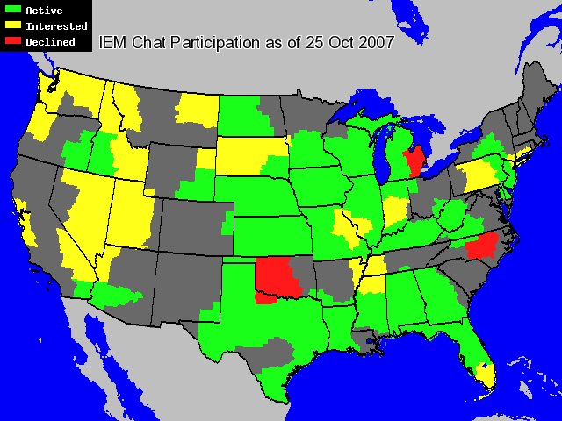
https://iemchat.com
Instant messaging has been in use within NWS since 2000, the primary client software was Yahoo!. After numerous limitations were found with Yahoo!, the Des Moines WFO and the Iowa Environmental Mesonet (IEM) set out to develop a scalable solution in 2005. Today, there are 70+ WFOs and 250+ media outlets (totaling over 1,750 users) now signed up with this system.
Terminology:
Instant Messaging – instant exchange of data between two users.
Chatroom – A virtual meeting place where data is exchanged from 1 user to many instantly.
Bot – a computer program that participates in instant messaging.
Pidgin – preferred chat client, but many other clients supported.
Features:
End-to-end encryption
Open-standards, open source, works on Mac,Linux, Windows
After initial setup, near zero overhead for WFOs to use.
Important NWS products are automatically relayed to chatrooms by a bot (named “iembot”)
Automatic logging of chatroom messages
“Pidgin” software interface showing Fort Worth chatroom
Technical Steering Committee:
Daryl Herzmann, Project Leader, Iowa State University
akrherz@iastate.edu , 515.294.5978
Shane Searcy, NWS Des Moines
Michael Davis, NWS Nashville
Darone Jones, NWS Birmingham
Jason Kelly, WJHG-TV Panama City,FL
Rob Dale, WLNS-TV Lansing, MI
Nate Johnson, Baron Services
Jeff McAdams, Appriss Inc
Herzmann, D., B. Small, J. McLaughlin, 2005. IEM Chat: A Public and Private Partnership using the Next Generation of IM/Chat Software. NWA Electronic Journal 2005-EJ8.

