Slide 1

Iowa Environmental Mesonet
Daryl Herzmann
Iowa State University

Slide 2
What’s a “mesonet”?
“meso” is a meteorological term describing a spatial scale. (mesoscale)
  ~1 to 100s of kilometers
  Single clouds to large storm systems
“net” is just a network.
A mesonet is a network of observation platforms setup to observe phenomena on the mesoscale.

Slide 3
Why is having a “mesonet” important to ISU / Agronomy?
Support Cross Discipline Research
  A majority of research projects require weather/climate information.
Provide Leadership
  Need local expertise on acquisition and use of environmental data.
Advance the Science
  Support numerous modeling efforts requiring fine resolution depictions. (Approaching field scale!)
Land Grant University
  Benefit Iowa’s Ag Industry with a self service website and phone/email support.

Slide 4








Data, data, everywhere data

Slide 5
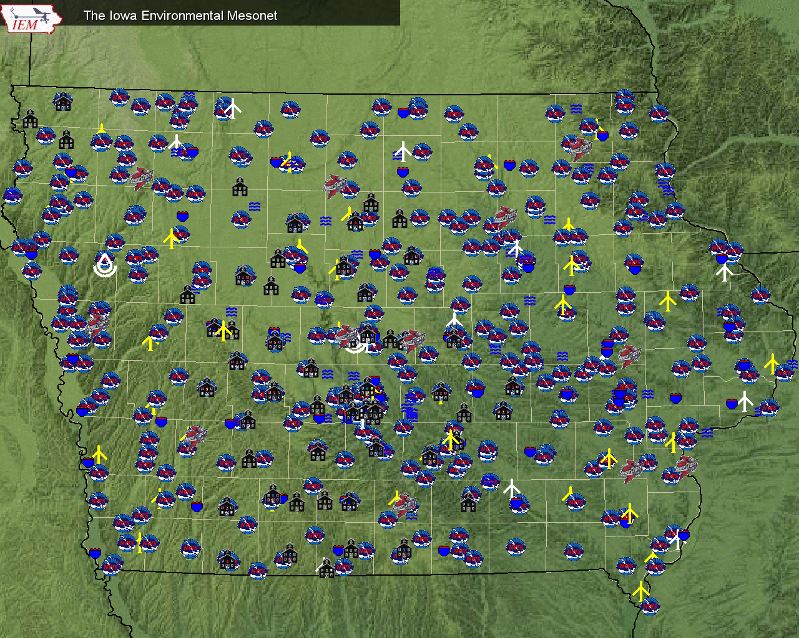

Slide 6
Observation Archive
 | Begins | Current Stations | Obs Stored
IA ASOS | 1945 | 15 | 12,725,000
IA AWOS | 1995 | 41 | 211,000,000
IA RWIS | 1994 | 57 | 17,500,000
SchoolNet | 2002 | 157 | 223,000,000
NWS COOP | 1893 | 185 | 3,500,000
Ag Climate | 1998 | 14 | 1,100,000
Other |  | Lots | ~25,000,000
 |  |  | ~500 million

Slide 7
About Climate Data
Climate (generally 30+ years) is based off of the NWS COOP network.
Dr Shaw, Dr Carlson, and Dr Todey maintained an archive dating back to 1893 which somewhat differs from NCDC/NWS.
Since 1951, we have 100+ locations in Iowa which most of the IEM’s products are based on.
Since 2000, we now use data provided by the Iowa State Climatologist (Harry Hillaker)
  This data takes ~60 days to reach us each month

Slide 8
What are products you need?
How much did it rain?
Are we above/below/at “normal” for rain, GDD, etc…
Characteristics of our climate
Growing season reports

Slide 9
IEM “Climodat”:
Answering the most common data questions
Precipitation Events per Climate Week
Twelve Significant Rainfall Events
Growing Degree Days
Daily Record Highs and Lows
Daily Maximum Precipitation
Daily Record Hi and Low Ranges
Daily Mean Highs and Lows
Number of Days Each Year Min >= 32
Last Spring/First Fall/Length of Season Base=32
Last Spring/First Fall/Length of Season Base=30
Last Spring/First Fall/Length of Season Base=28
Last Spring/First Fall/Length of Season Base=26
Last Spring/First Fall/Length of Season Base=24
Monthly Average Maximum Temperatures
Monthly Average Minimum Temperatures
Monthly Average Mean Temperatures
Monthly Precipitation Totals + Averages
Monthly Heating Degree Days
Monthly Cooling Degree Days
Heat Stress Variables
Monthly Rainy Days
First Fall Freeze Probabilities
Last Spring Freeze Probabilities

Slide 10
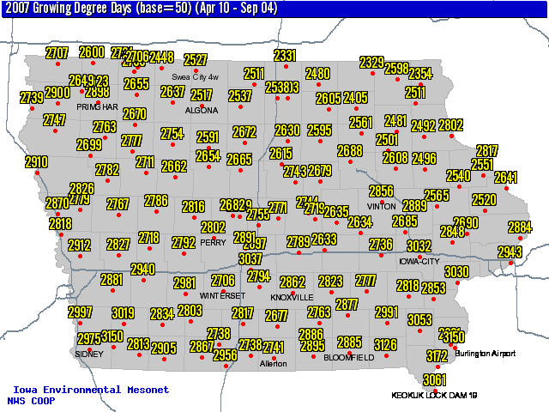
Growing Season Accumulation
Pick a variable and your time period.
A map and the raw data is presented.

Slide 11
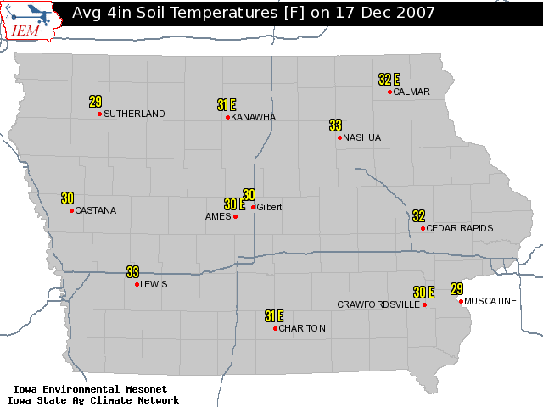
Daily data plotting
Pick a variable and your date.

Slide 12
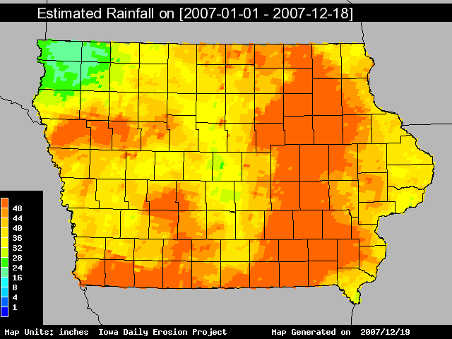
Heavy Rainfall of 2007

Slide 13
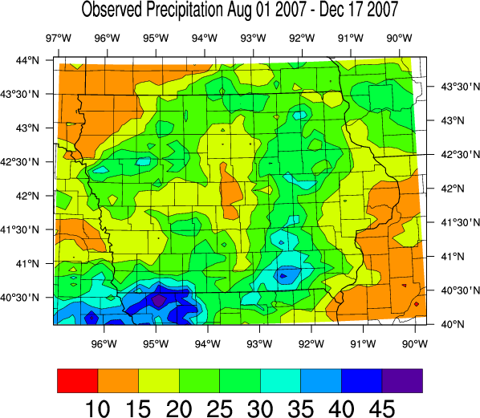

Slide 14
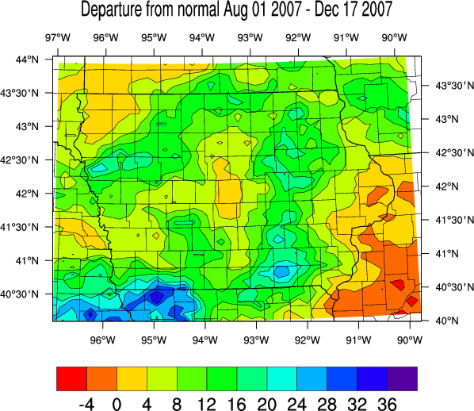

Slide 15
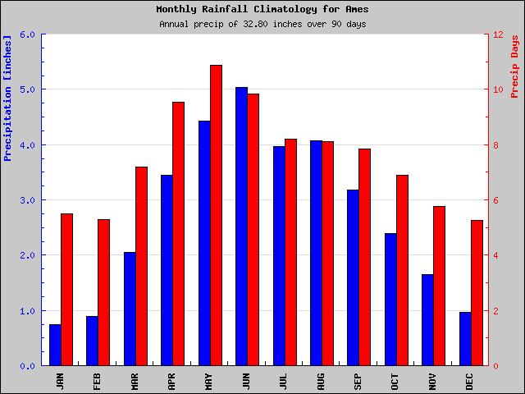
Ames Rainfall Climatology

Slide 16
Ames monthly rainfall reliability
1951-2007
 | 1 Month | 2 Months | 3 Months | 4 Months
Below Normal | 56% | 33% | 21% | 14%
25% below | 40% | 18% | 9% | 5%
1 inch below | 25% | 9% | 4% | 1%
1 std-dev below | 15% | 4% | 1% | 0.1%

Slide 17
Conclusions
Data quality is a never ending battle ☺
We are always looking for feedback on how to better structure products on the website.
Never hesitate to contact me with any doubts you may have.

Slide 18

Enough talking, eating time!
mesonet.agron.iastate.edu
Daryl Herzmann
515.294.5978
akrherz@iastate.edu

