Slide 1
NWSChat
Daryl Herzmann
Iowa State University
Mike Doney, NWS
Darone Jones, NWS

Slide 2
What is NWSChat?
An internet based platform, administered by the NWS, for the secure transfer of data between authorized parties in real time (instant messaging).
What kind of data?
Text based messages (“Hi, it sure is windy here”)
Presence notifications (what I am doing, sleeping)
Most anything else of a digital nature is possible.
NWSChat is the formalization of the “IEMChat” system under NWS control.
It is more than just a “chat server”.

Slide 3
More than just a “chat server”
“What you created with IEMChat is one of the best NWS tools I've used in my 17 years working for the organization…. I guarantee that you saved lives with this.” – NWS WCM
“great communication from all tonight, just incredible...I have no idea how we ever survived without this...would like to "redo" some of events from years past when there was no communication, just to see how they would play out getting and giving good info” – TV Media
“Chat is by far the most valuable tool we have here. Even before warnings came out we knew they would. That was huge. Every office needs to use it. It’s the best thing that ever happened as far as being able to pull everything in one place.” – TV Media
“...it's the best thing since NEXRAD” – TV Media

Slide 4
Powering NWSChat, XMPP
NWSChat is a service implementing XMPP.
Extensible Messaging and Presence Protocol (XMPP) is the standard used to relay “messages” between authenticated clients/servers. These XML messages look like:
<message to=“my_buddy_id”>payload</message>
Where the payload could be:
XHTML marked up text
Simple text message
Encoded data (images, media, etc)
XML data

Slide 5

The Basic XMPP System
Servers share XML messages between each other (called Federation).
1. Client authenticates to the
server and establishes a session.
2. XML messages are
exchanged on demand and as requested during the session.

Slide 6
Advantages of XMPP over: HTTP (web) and SMTP (email)
HTTP is stateless, unidirectional, and initiated from the client side (“Come and get it”)
HTML (webpages) present data with the providers idea of how the data should be displayed. Little separation of data and presentation.
SMTP is “slow”, somewhat tedious to manage, and has a huge SPAM problem.

Slide 7
Disadvantages of XMPP
At the mercy of the client side to present the data. Outside of simple text messages, no “robust” display like web browsers.
Management of accounts, issues with persistent network connections, and issues with perceptions of ‘chat security’.
Messages are sent one at a time (some scalability concerns).

Slide 8
How NWSChat supports Web 3.0
Elimination of Data Silos:
XMPP Federation allows “servers” to talk to each other to deliver clients data
Ubiquitous Connectivity:
Always logged in / presence
Network Computing:
Developing XMPP specs for software as a service. Called server components.
Open Technologies:
Standards based protocol, open source server/client
The intelligent web:
Separation of data and presentation thru the use of XML based datastores.
Open Identity:
Thru XMPP Federation
Intelligent Applications:
XMPP ‘speaks’ in a computer readable language (XML). NWSBot et al….

Slide 9

Information Flow: The Past
SRUS56 KBMX 141414
SVRBMX
SEVERE THUNDER…
THE NATIONAL ….
NWS ISSUES
DECISION MAKER
INTERPRETS
PUBLIC ACTS

Slide 10
Information Flow: The Present with Chat
SRUS56 KBMX 141414
SVRBMX
SEVERE THUNDER…
THE NATIONAL ….
NWS ISSUES WHILE
COLLABORATING WITH
DECISION MAKERS
PUBLIC ACTS

Slide 11

Information Flow: Vision of the future
Single version of the product used by all with clear separation between data and format (XML).
Collaboration and feedback thru the entire product lifecycle in real time by all parties (XMPP).
Seamless Integration of NWS and
Trusted partners in the issuing process.

Slide 12
Practical Example
88D Doppler RADAR tracks a mesocyclone
This storm attribute appears on the forecaster’s AWIPS II Display.
The forecaster right clicks the icon and requests any web cameras to turn to this location.
An XMPP message is sent to a server component, which moves any nearby webcamera in the direction of the storm based on AWIPS II provided location details.
A still image or video is streamed back to the display via XMPP showing the storm and location of the attribute on the image.

Slide 13
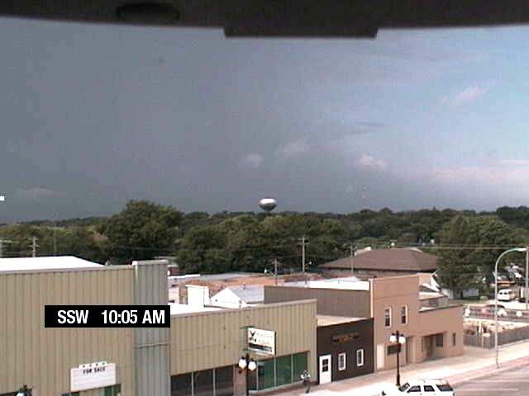

Slide 14


NWSChat’s role in the future vision: Connecting Weather Software Systems
The software system could be an authenticated ‘client’ to the server and ‘chat’ with other software systems. Its all just XML…
Observations
Flight Guidance
Hurricane Hunter
Whiteboarding
Shared workspace
Trusted Third
Party
Memory Usage
Localization
NWS AWIPS II
NCF

Slide 15
NWSChat’s role in the future vision: Relay of CAP via PubSub
HTTP
Publish / Subscribe (PubSub) describes a means to publish and subscribe to feeds within XMPP.
NWS could publish CAP messages, which would be instantly relayed to authenticated subscribers (eliminates HTTP polling every few seconds).
Offline XML storage would relay these messages in a delayed fashion if the customer was not connected at the time of publishing.
XMPP

Slide 16
How could NWSChat fit in with other technologies presented today?
E-spotter, POP
The backend that delivers observations from the collection server to the NWS and partners…
SevereClear
Collaboration component. Sharing application state and whiteboarding between running clients
GIS/KML
Distribution method over internet. Push it to users instead of them pulling it. Provide security layer for sensitive datasets.
IRIS / Mama
Provide a data service backend to the clients. Push alerts out in realtime.

Slide 17
The future is NWSChat
Do we believe XML should be used for a datastore?
XMPP is how you move it around.
Do we wish to integrate external and internal data/software systems together?
XMPP is the language agnostic glue (federation)
Do we wish to build truly interactive web services?
XMPP provides the presence and bidirectional communication route.

