Slide 1

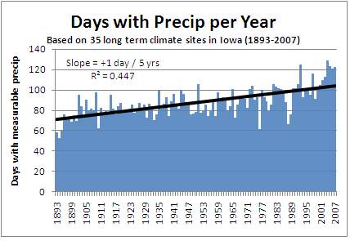
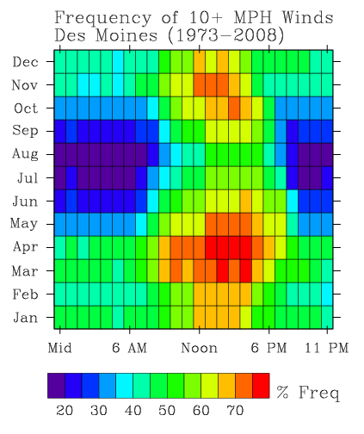
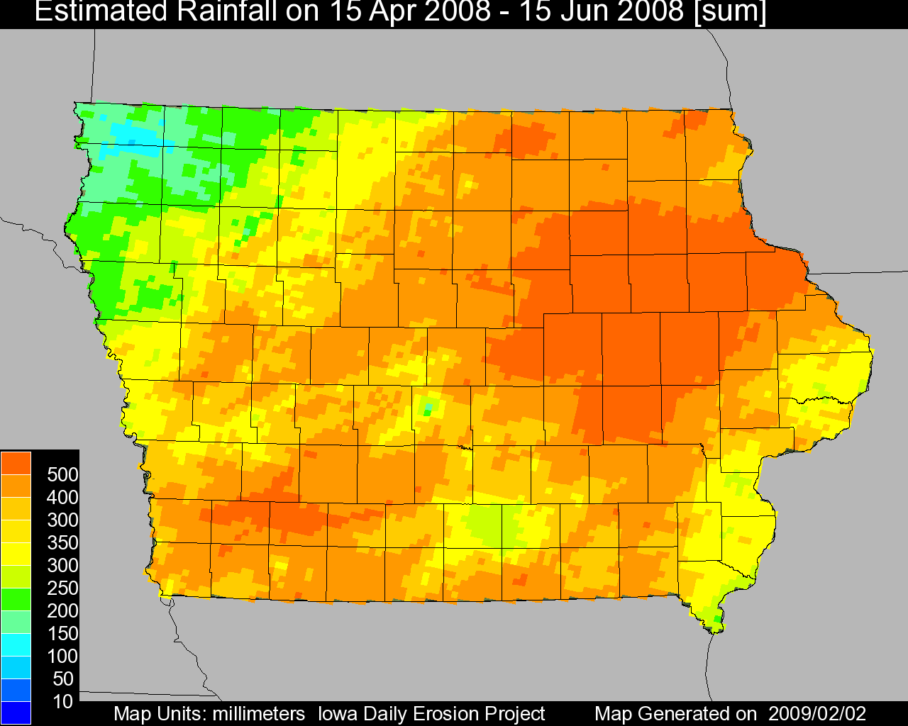
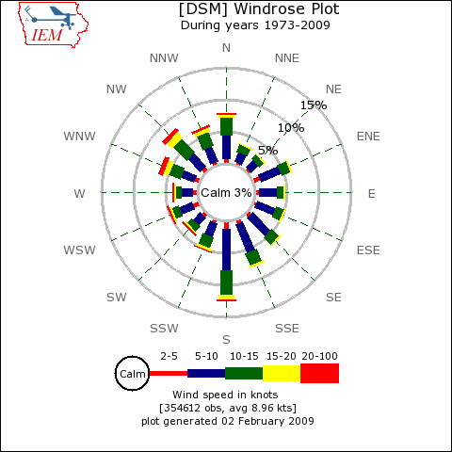
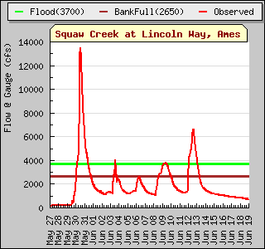
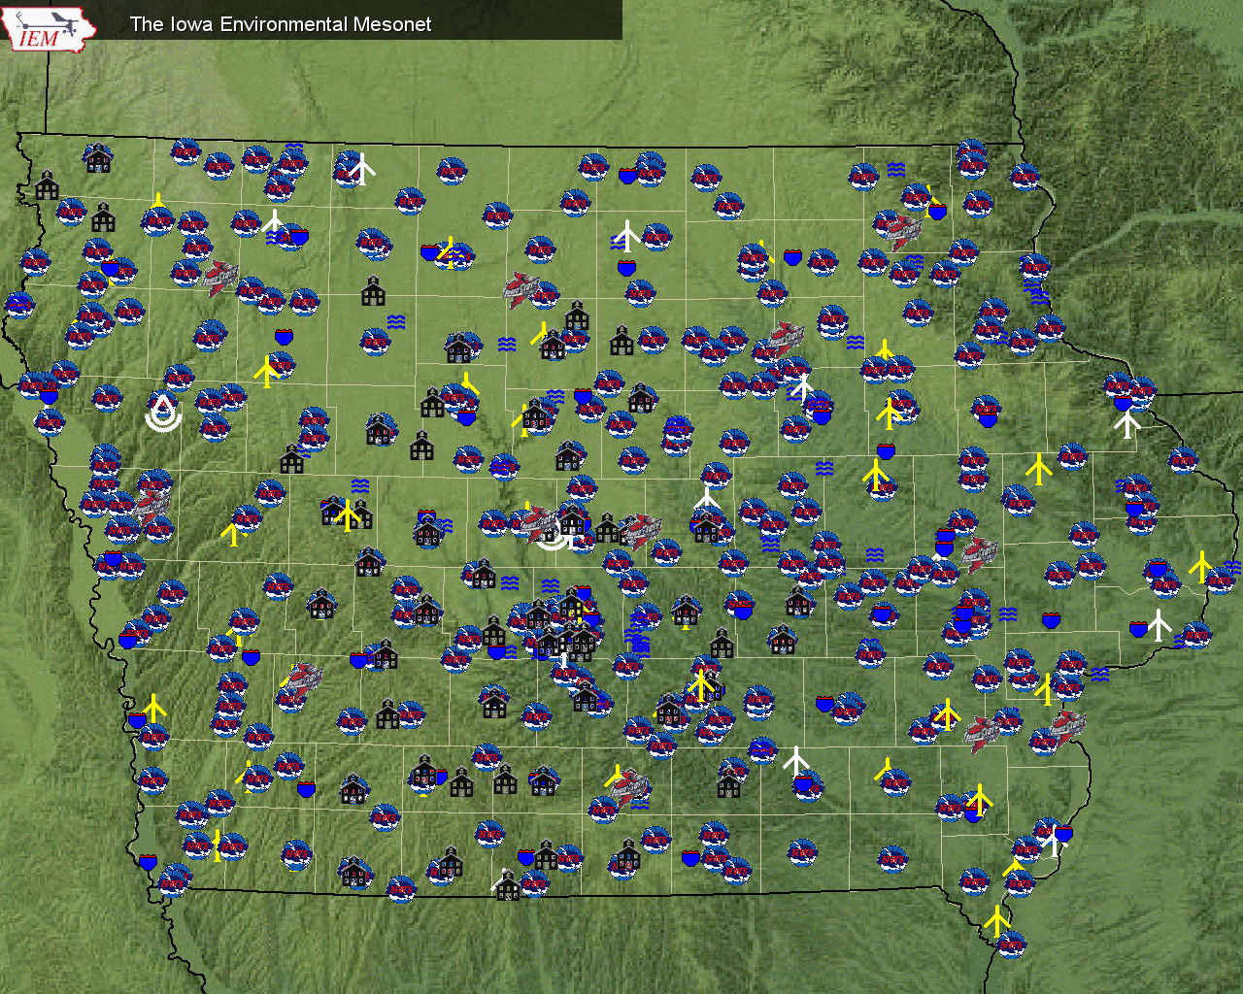









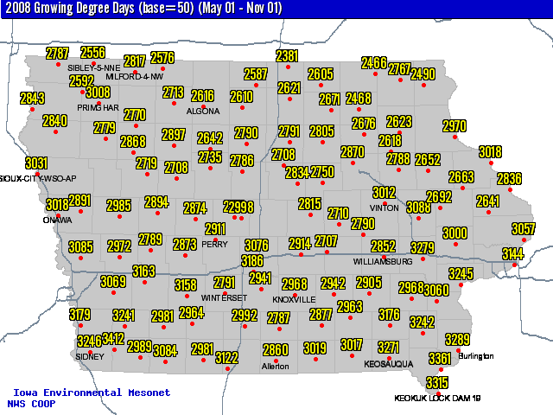
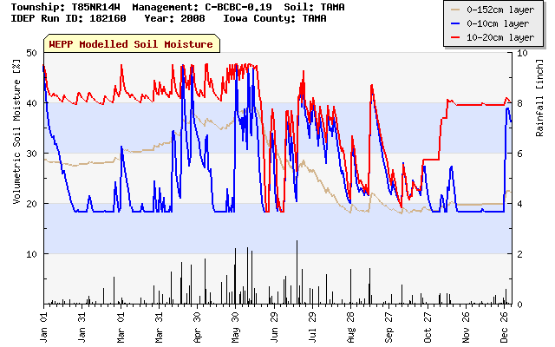
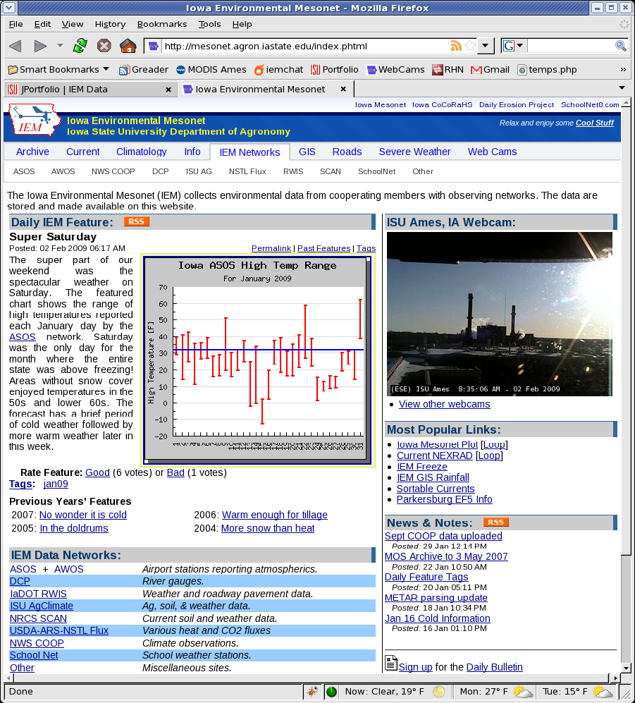
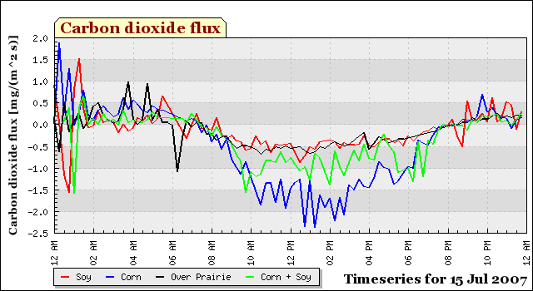
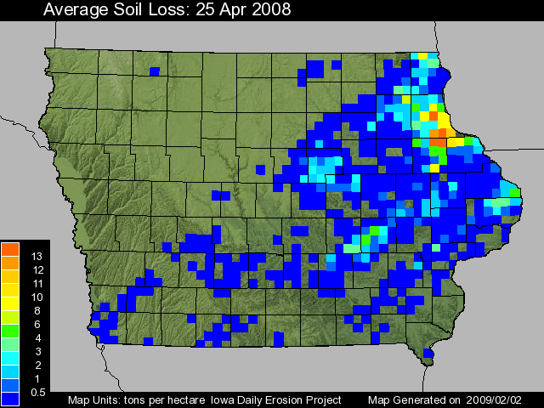
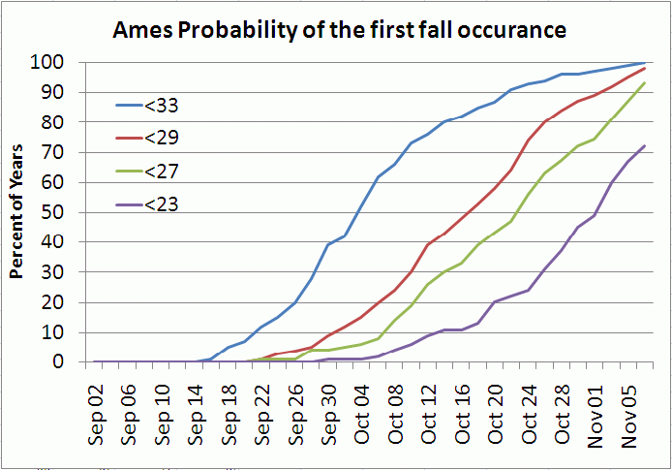
Iowa Environmental Mesonet (IEM): Capturing Iowa’s Weather and Climate Variability
Daryl Herzmann and Raymond Arritt, Department of Agronomy
Wind
Water
The IEM is an environmental data warehousing project seeking to capture weather and climate datasets to support multi- disciplinary research at ISU and beyond. The IEM builds these datasets through partnerships with data providers generating well over 300,000 observations per day from hundreds of platforms spread throughout the state.
Live Green: By leveraging pre-existing monitoring resources, the IEM has been able to deliver research quality datasets at a fraction of the cost of building out a high resolution observational network (millions of dollars).
The IEM gathers and archives observations of wind from automated platforms reporting as temporally fine as every 6 seconds. This archive can be used to provide assessments of Iowa’s wind climatology.
The IEM maintains a long term archive of rainfall observations dating back to 1893. These observations show that the number of days each year with rain or snow is increasing.
Background
Iowa’s hourly wind climatology has a very strong diurnal and annual cycle. This has major implications for wind power production as winds are not always reliable on a hourly or yearly basis. Plot shown is for 10 meter AGL winds from the Des Moines Airport.
The IEM provides a real time high resolution gridded analysis of rainfall available in GIS formats. This image shows the tremendous total amount of rainfall during a portion of the Floods of 2008 in Eastern Iowa.
Wind roses are commonly used to quickly show preferred wind speeds and direction. Plots like this one can be generated on the website for over 100 locations in Iowa.
The IEM also collects stream flow information providing an online downloadable archive. This hydrograph shows the Ames Squaw Creek flood events in 2008.
The Meso-Network
Soil
Air
The symbols represents the diversity of stations providing near real time data.
The Iowa Daily Erosion Project (IDEP) is a near real-time modeling effort to analyze soil erosion potential based on high resolution inputs of rainfall, soils, and management practices.
The website allows customized generation of maps based on daily high and low temperature observations. In this map, a common agricultural unit of Growing Degree Days is presented.
A model run is made for each point of a representative sample of Iowa soils, hill slopes, and management on a township level. Each run generates a time and depth profile of soil moisture.
IEM server stats:
15,000 users per day
1.2 billion point observations
1 terabyte of data available on demand
500 megabytes archived per day
IEM Daily Feature:
Once per day blog of current weather and climate info in Iowa
The IEM collects soil and atmospheric flux information provided by advanced observation equipment operated by the National Soil Tilth Lab. This plot shows plant respiration.
Website
Using spatial statistics, the individual runs are aggregated to the township scale. A statewide raster analysis of soil displacement is show here for an intense rainfall event in April.
Based on over 100 years of observations, probabilities of freeze/frost events can generated.
http://mesonet.agron.iastate.edu

