Slide 1
Linux IP Virtual Server
Daryl Herzmann
Department of Agronomy
Iowa Environmental Mesonet
akrherz@iastate.edu

Slide 2
Standard Caveats
My degree is in Meteorology, so if you routinely believe Meteorologists, it is your own fault.
Linux IPVS is not a full HA solution stack
There are many ways to accomplish what I will show and I don't claim IPVS to be the best, but this one is Free/free
Multi-port, UDP, and TCPv6 services are possible, but not shown
Sorry John Rose, selinux was disabled for the demo

Slide 3

Why did I need Linux IPVS?
Needed horizontal scalability
  Website traffic is doubling every year
Needed availability
  Reduce single points of failure for network services
Limit downtime for upgrades (lose data)
  IP Virtual Server

Slide 4
Linux IPVS Terminology
director: the node that runs the ipvs code. Clients connect to the director. The director forwards packets to the realservers. The director is nothing but an IP router with special rules that make the LVS work.
realservers: the hosts that have the services. The realservers handle the requests from the clients.
forwarding method:
  LVS-NAT (network address translation)
  LVS-DR (direct routing)
  LVS-Tun (tunneling)
scheduling: the algorithm the director uses to select a realserver to service a new connection request from a client.

Slide 5
IPVS Scheduling Types
rr, wrr: round robin, weighted round robin
lc, wlc: least connection, weighted least connection (the director has a table with the number of connections for each real-server).
persistent connection
lblc(r): a persistent memory algorithm, way to balance out loaded servers and add new ones in
dh: destination hash

Slide 6
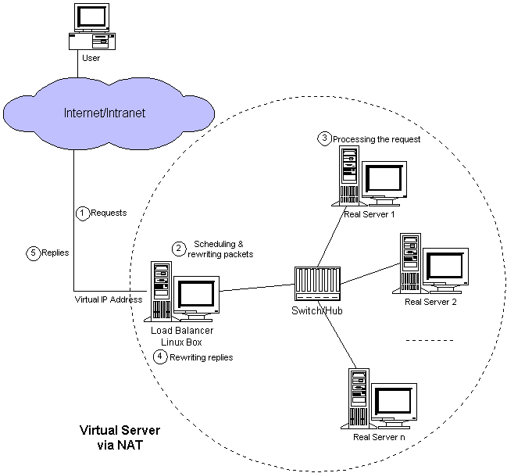

Slide 7
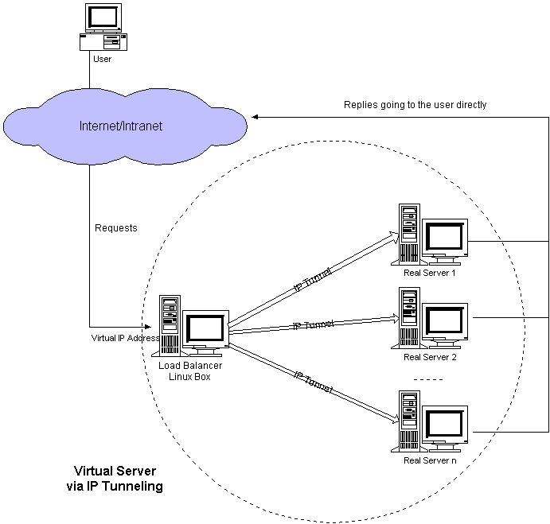

Slide 8
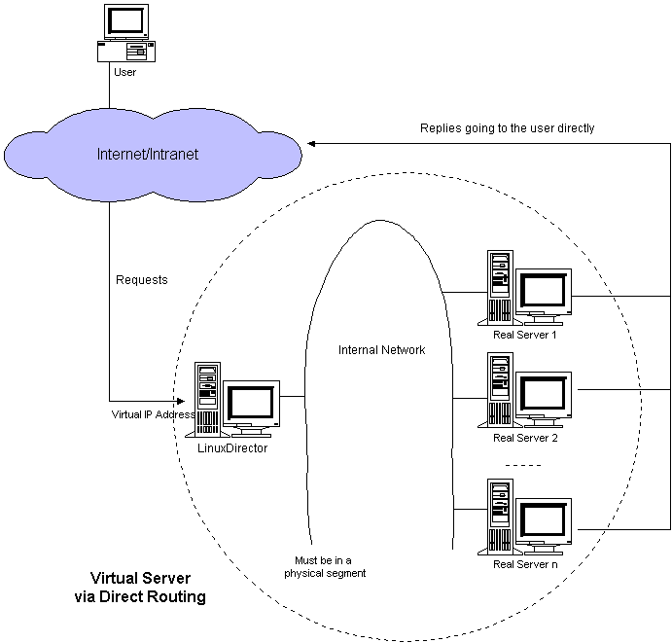

Slide 9
Linux IPVS Software Components
Kernel IPVS support
  Built into Linux kernel since v2.0.x (?)
ipvsadm
  Setup/Manage/View the IPVS kernel table
  /etc/sysconfig/ha/lvs.cf (on RHEL systems)
pulse
  Daemon used to monitor LVS director nodes and manage processes like nanny and ipvsadm
Piranha
  Web interface to pulse, ipvsadm, nanny
nanny
  Monitors fail over services

Slide 10
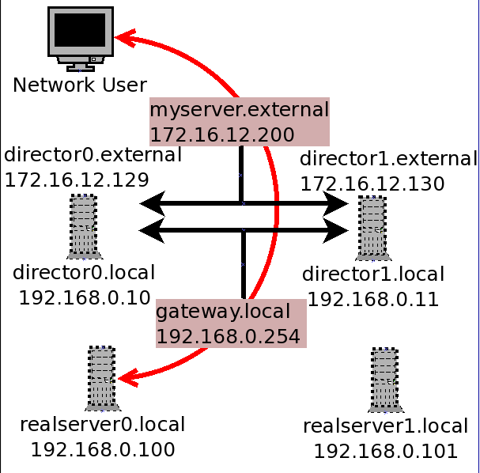
Example IPVS Network Topology

Slide 11
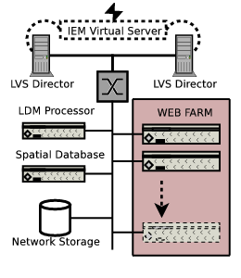
Iowa Mesonet IPVS Setup

Slide 12
Install Notes
[all] Updated /etc/hosts
[all] Registered with RHN
[all] installed httpd php
[dir] Downloaded/Installed piranha and ipvsadm from CentOS
[dir] net.ipv4.ip_forward = 1
[dir] piranha-passwd
[dir] http://director0.external:3636
[dir] setup iptables for forwarding
[all] chkconfig httpd on
[dir] chkconfig pulse on

Slide 13
Lessons learned from 4 years of use
No issues with crashing or kernel traces
No issues with server load (non-existent) on directors
Getting FTP to work correctly was a bit of a challenge
Don't expect perfect load balancing

Slide 14
It is Demo Time!

