Slide 1
Iowa Environmental Mesonet Tools
CR Observation Services Conference
7 Feb 2023

Slide 2
What’s going on here?
Iowa ?
Is the website limited to just Iowa data? A: No
Environmental ?
Is the website limited to just environment data? A: Depends
Mesonet ?
Is the website limited to just mesoscale observations? A: No
Daryl has some explaining to do!

Slide 3
Subversive and Academic Altruistic Goals (Summarizing past ~21 years of work)
Realized having just Iowa data was insufficient to support paying grant work on ISU research projects.
Realized the best way to stop the daily email deluge is to update my website with each email to prevent it from coming again from another person.
Realized most weather websites are great for real-time, but have no archive capabilities.
Realized weather.gov does not support NWS users.

Slide 4
So the result of my realizations
A website with massive number of portals (~160), api services (~60), auto-plots (237), and spinning disk archives (~250 TB).
A website with intentionally stable URIs and predictable (maybe) interfaces to link against.
A website with all code on github.com/akrherz with an open license.
A website with about ~250k users per day, 99.9% of them have no idea they are using it (via third parties).

Slide 5
Datasets Curated (or how many abbreviations fit on one slide)
ASOS 1 Minute Data
AWC / CWSU products
Bukfit Profiles
CLI/CF6 Data
Global METAR
HML (River Stage)
Iowa+ Webcams
Local Storm Reports
MADIS / HFMETAR
MRMS
NCEP F000 Models
NEXRAD Attributes
NEXRAD Level II Live
NRCS SCAN
NWS Text Archive
NWS WaWA Map
PIREPs
Public RWIS Networks
RADAR Products (Single/Mosaic)
RTMA
SHEF HADS/DCP/COOP
SIGMETs/CWAs
SPC MCD/Watches/Outlooks
SMOS Satellite
Soundings
TAFs
Text MOS
VTEC WaWA
WPC National High/Low

Slide 6
IEM Max-Pain exists with handling of daily “COOP” data
IEM divides all SHEF data into either “DCP” or “COOP” or dual listed in both “DCP” and “COOP”. Based on my mood for the day.
Downstream is a “Long Term Climate” / “Climodat” dataset that is derived from COOP, but has a 50+ year curation legacy at Iowa State (Drs Shaw, Carlson, Todey, Taylor, and now poor me). This dataset has limited estimating done to create complete archives.
Over the past 5-10 years, I have desperately attempted to align with ACIS, but it remains a work in progress.
Thankful for many interactions with NWS CR folks and I’ll continue the daily grind attempting to fix SHEF products, lolz.

Slide 7
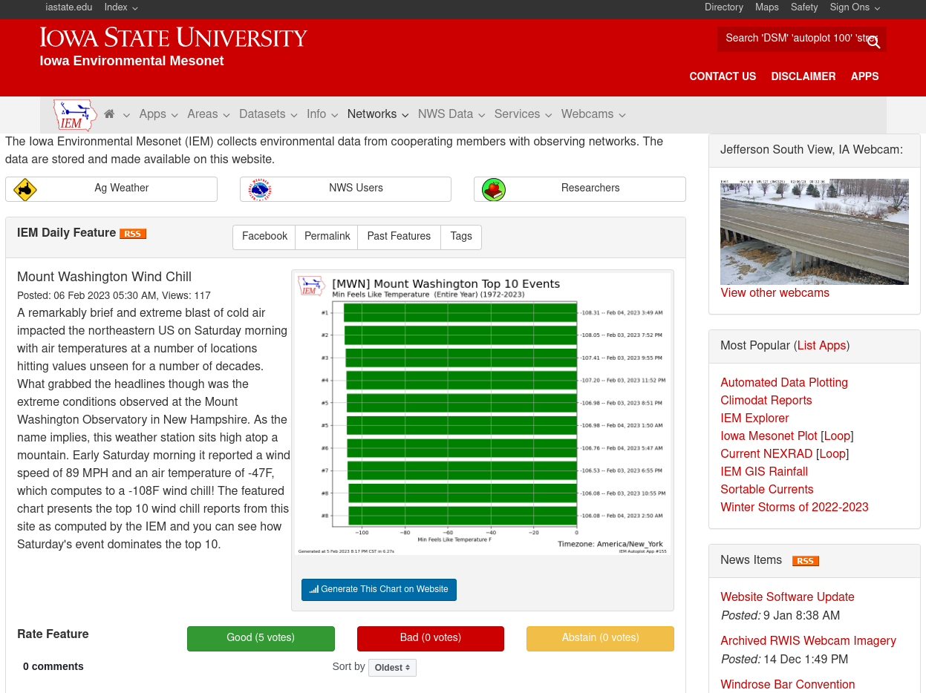

Slide 8
The Upper-right search bar can do some magic
Enter NWSLI , 3-4 char ICAO to land at observing site mainpage. Ex) MSP
Enter IEM Autoplot number to be taken to that autoplot app. Ex) 90
Enter 4-6 character NWS AFOS / AWIPS ID to get the most recent text product. Ex) AFDBIS

Slide 9
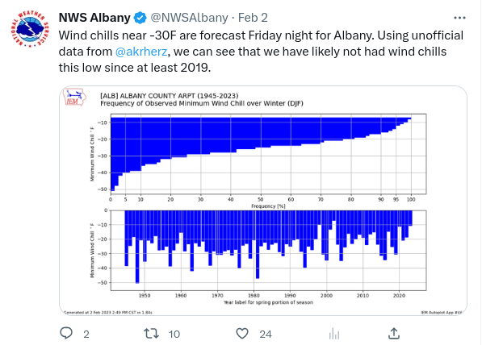
Oooo, I saw something cool on the Twitters, where do I find?
The trick is looking into the lower right corner for the autoplot number.
Then enter that number in on the search bar on the website!
IEM Autoplot 46 in this case!

Slide 10
The moral of today’s talk:
Next time you wonder “I need the Nebraska State Forecast Discussion (SFD) from 7 February 1993, where could I find that?”
Then think “Oh, I bet the IEM has that.”
Then visit my website and thrash about for 5 minutes, cussing the entire way because you have no idea where I buried such data.
Then email Daryl akrherz@iastate.edu and see how fast I can turn around your email.
Daryl then internally giggles/smiles that such a workflow just happened. What a time to be alive!

Slide 11
Alright, Q&A Time!

