Slide 1
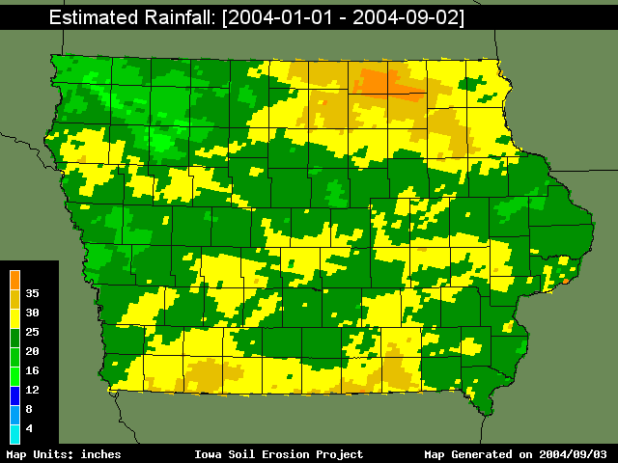
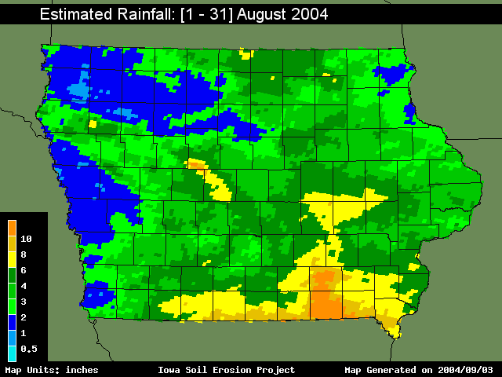
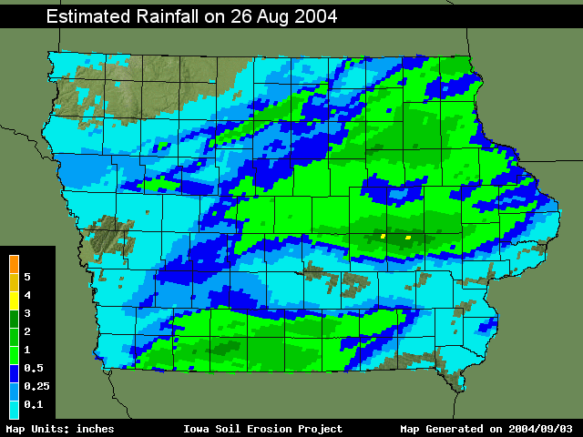
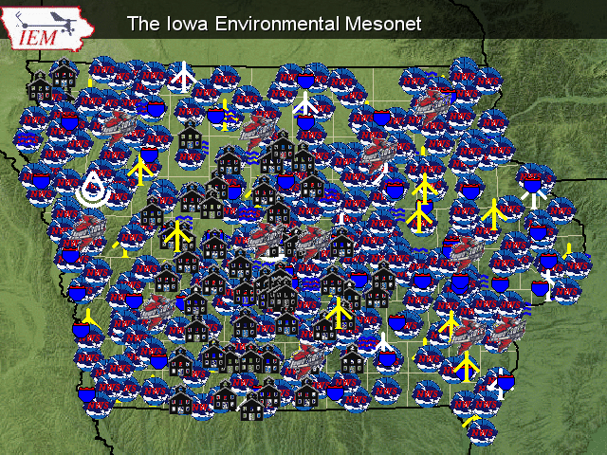
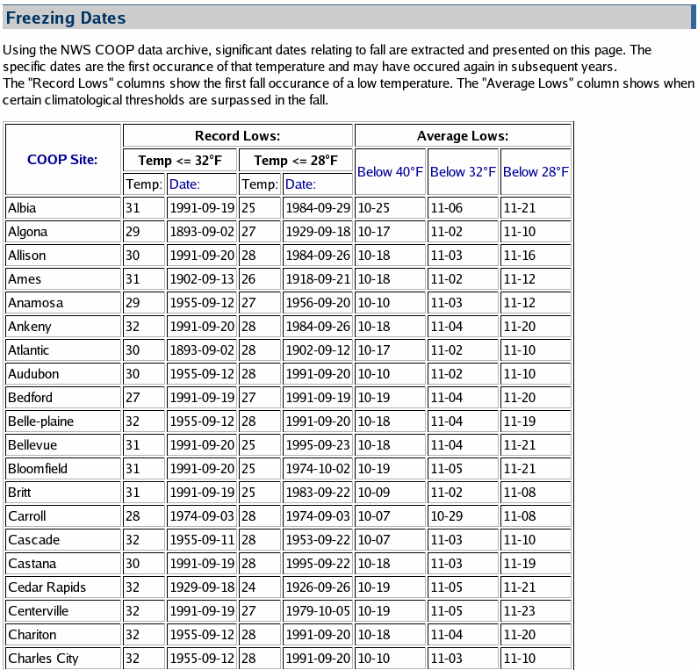
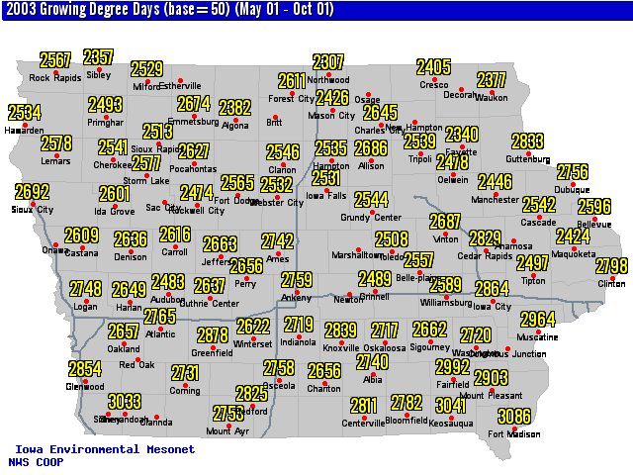
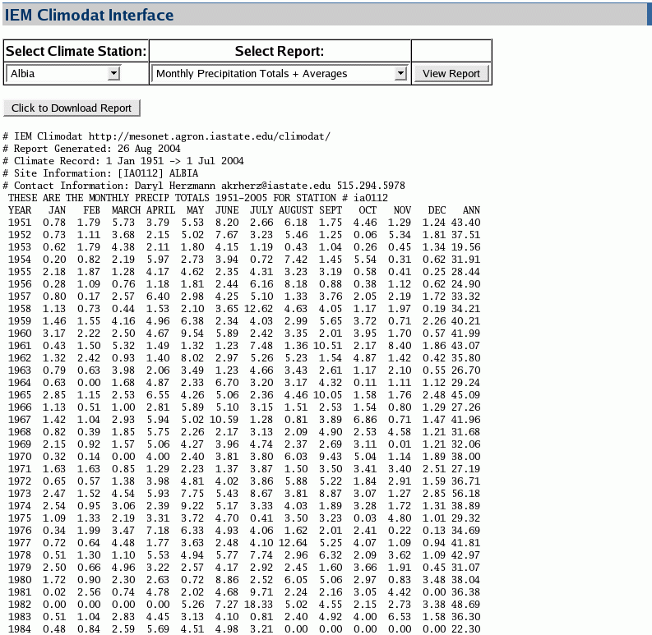
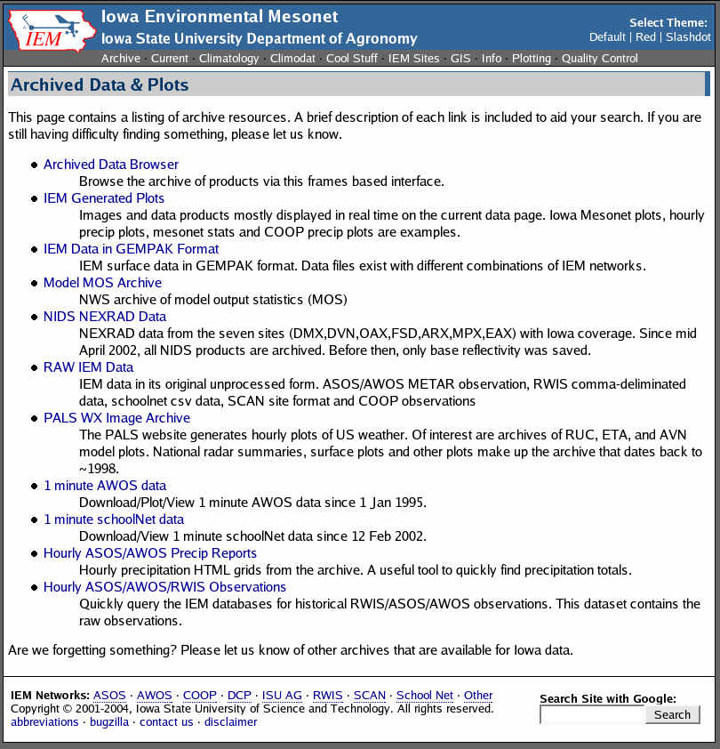
The Iowa Environmental Mesonet: Capturing Iowa's Weather and Climate Variability
Daryl Herzmann and Raymond Arritt
Department of Agronomy, Iowa State Unversity
Introduction
High Resolution Near-Realtime Rainfall Data
The Iowa Environmental Mesonet (IEM) is an award winning partnership between
federal, state, and local entities with interests in observing the weather and climate system
in Iowa. Our project is a partnership within the Department of Agronomy at Iowa State
University. The term mesonet refers to a collection of platforms capable of observing phenomena on a spatial scale of ~10km and temporal scale of minutes. The IEM has
built this network of observing stations by partnering with environmental monitoring groups with pre-existing networks.
The ongoing result of our project is an improved representation of environmental conditions in Iowa and the facilitation of numerous sponsored research projects using data provided by us.
YEARLY
MONTHLY
DAILY
Data Collection
The IEM produces high resolution depictions of rainfall based on estimates from NWS RADAR and observing platforms. These estimates are provided in near realtime in a variety of formats including ESRI Shapefile for easy use within GIS.
The IEM currently collects data
from over 300 observing systems in Iowa. These systems range from the National Weather Service (NWS) operated airport weather sensors to the United States Geological Survey (USGS) river gaging stations.
The diversity of data collected from these networks allows us to generate products with applications to many disciplines.
Analyzing Iowa's Climate
Data Archiving
The IEM's database currently stores over 400 million point observations along with 100s of Gigabytes of remotely sensed data. Most of this information is made available for immediate download on our website in formats that are convenient for data users.
Example climate analysis products.
The IEM houses a large climate dataset of daily observations dating back to 1893. Using these reports, we attempt to meet the needs of the research community as well as the inquisative public.
http://mesonet.agron.iastate.edu

