Slide 1
IDEPv2 Status
daryl herzmann

Slide 2
Executive Summary
Within the past few weeks, a first draft of all necessary inputs to IDEPv2 were collected (Hooray For Deadlines!)
The climate files from IDEPv1 were copied over as a baseline for IDEPv2 refinement.
We don’t have high-res precip prior to 2012 at this time (we will eventually)
The IDEPv2 modelling suite was run once up until 15 June and that data is used today for the comparison.
Real-time runs are currently not done for IDEPv2.
IDEPv1 continues to run in “realtime”
We expect these IDEPv2 numbers to change!

Slide 3
Comparing Versions
 | IDEP | IDEPv2
Climate Precipitation | NOAA Stage IV with RADAR downscaling (4km / 15min) 1997-yesterday 7,988 files @460KB each | Iowa Flood Center + NOAA MRMS Q3 (1km /2-5min) 2007-yesterday 113,876 files @900KB each
Management | NRI 1994-1997 Fixed number of rotations 4,374 files | James,Gelder Database Dynamic rotations 201,222 files
Slope | 18,020 files | 201,222 files
Soils | 18,020 files | 201,222 files
Daily WEPP Runs | 90,484 | 201,222
Daily Run Wall Clock Time | 3.25 hours | 13-18 hours
System Disk Space Usage | ~ 300 GB | ~ 1.4 TB

Slide 4
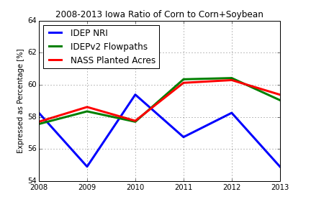

Slide 5
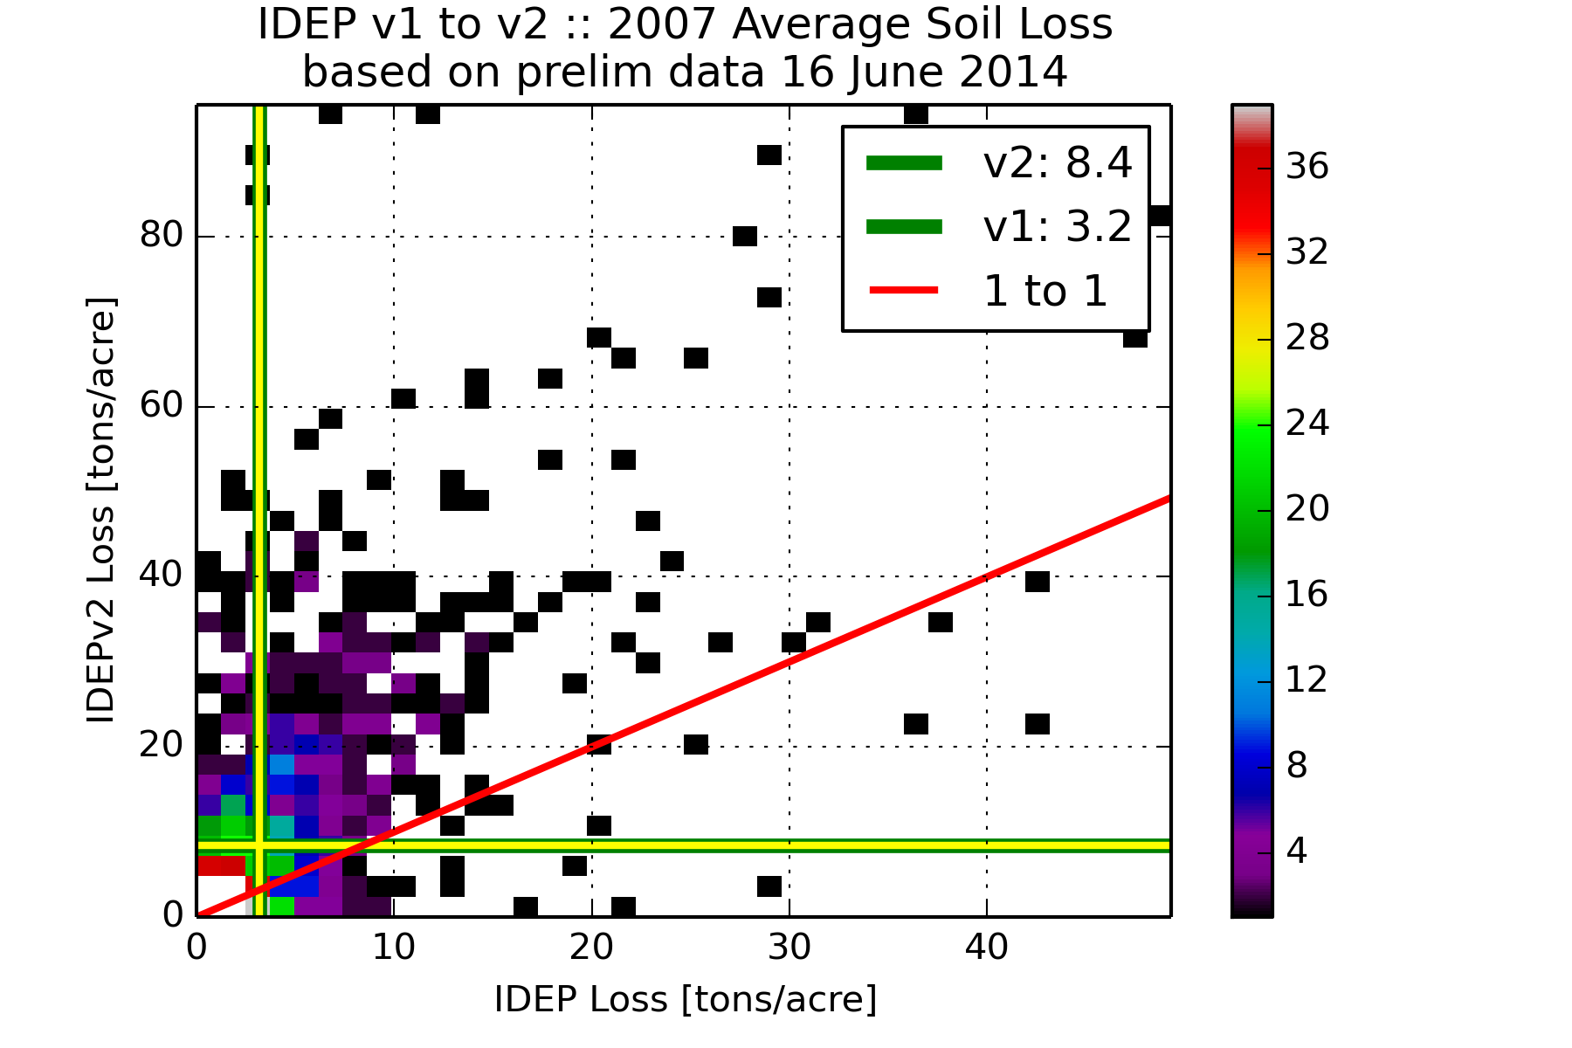

Slide 6
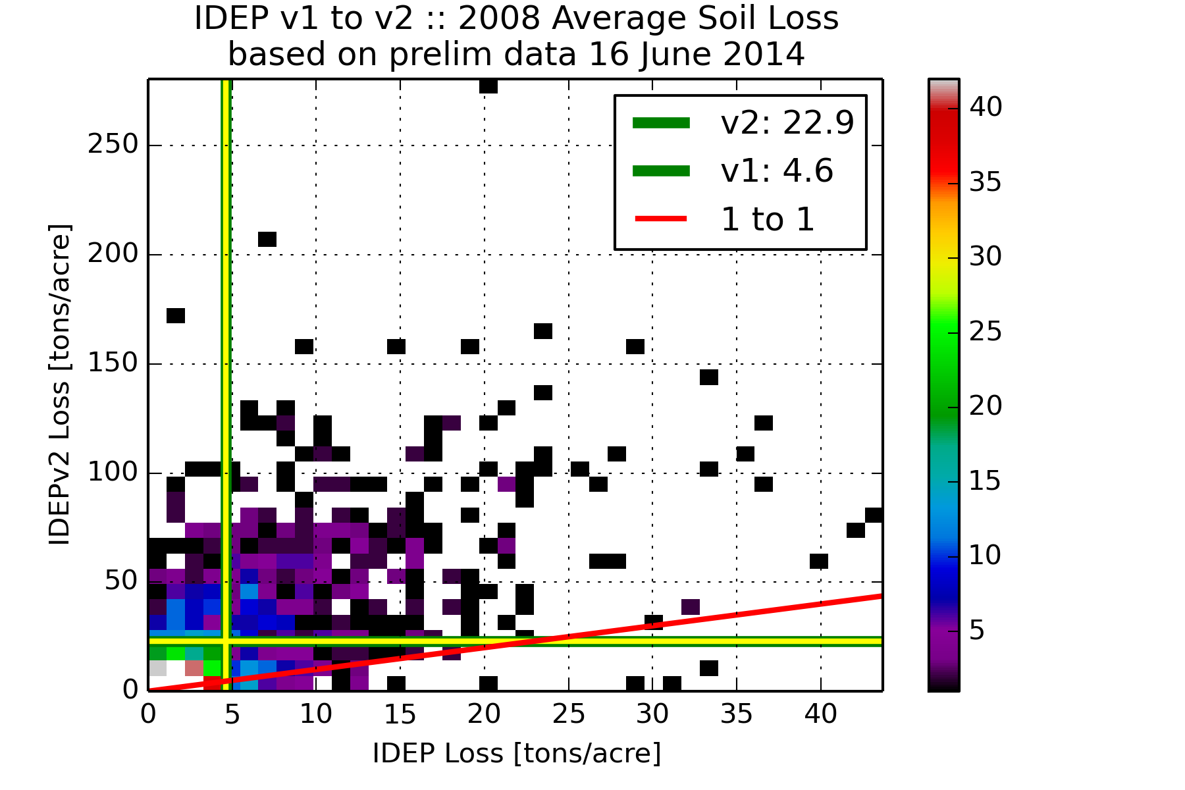

Slide 7
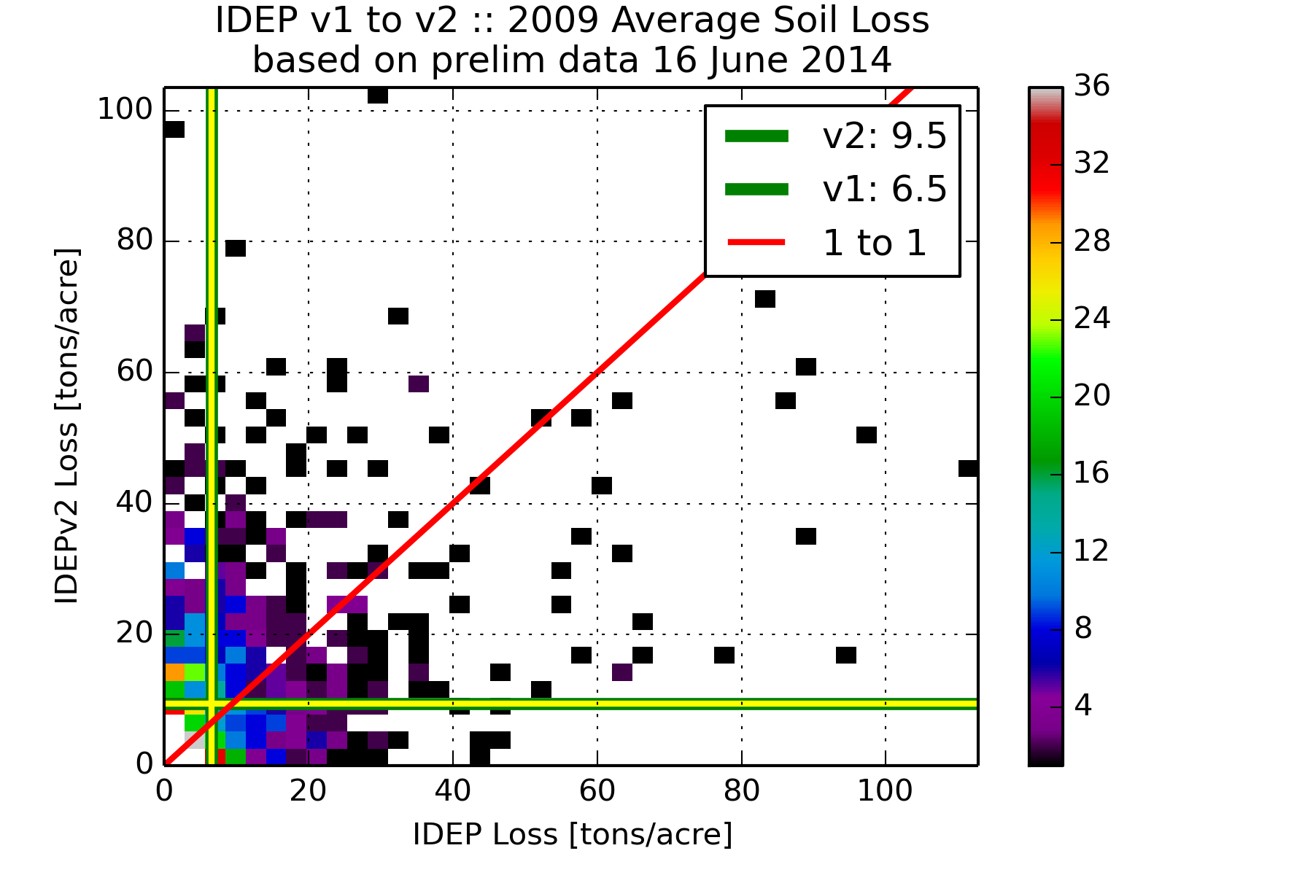

Slide 8
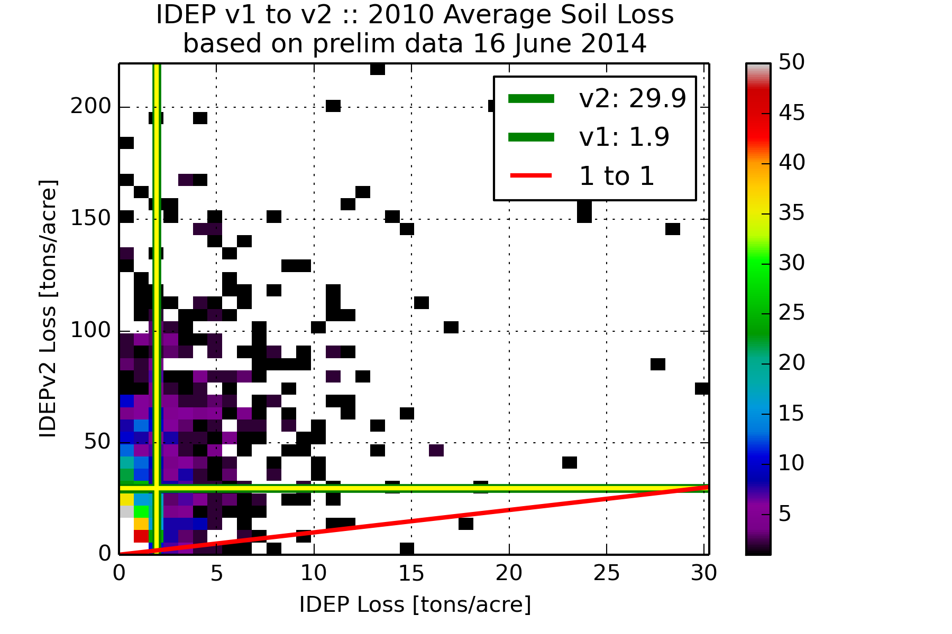

Slide 9
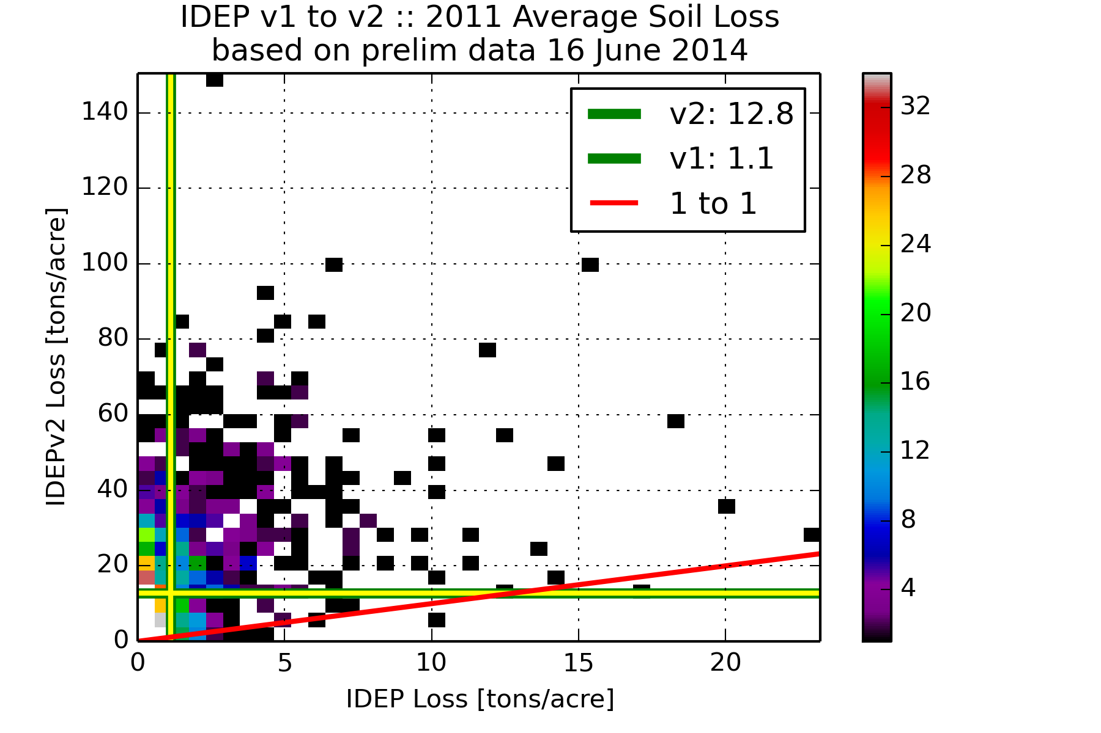

Slide 10
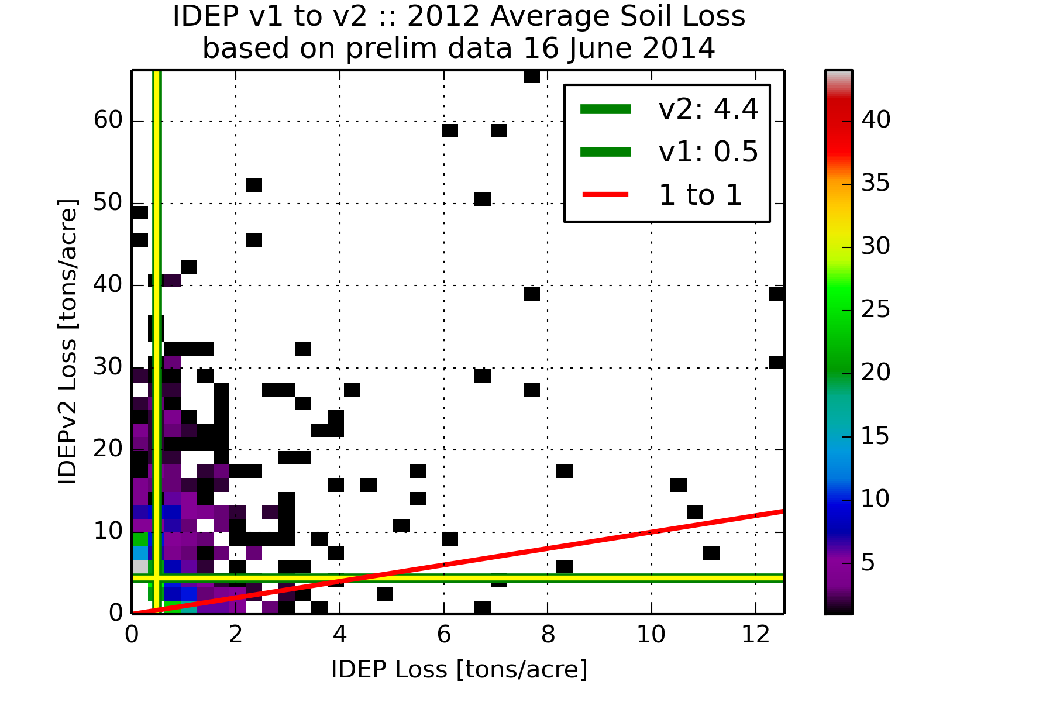

Slide 11
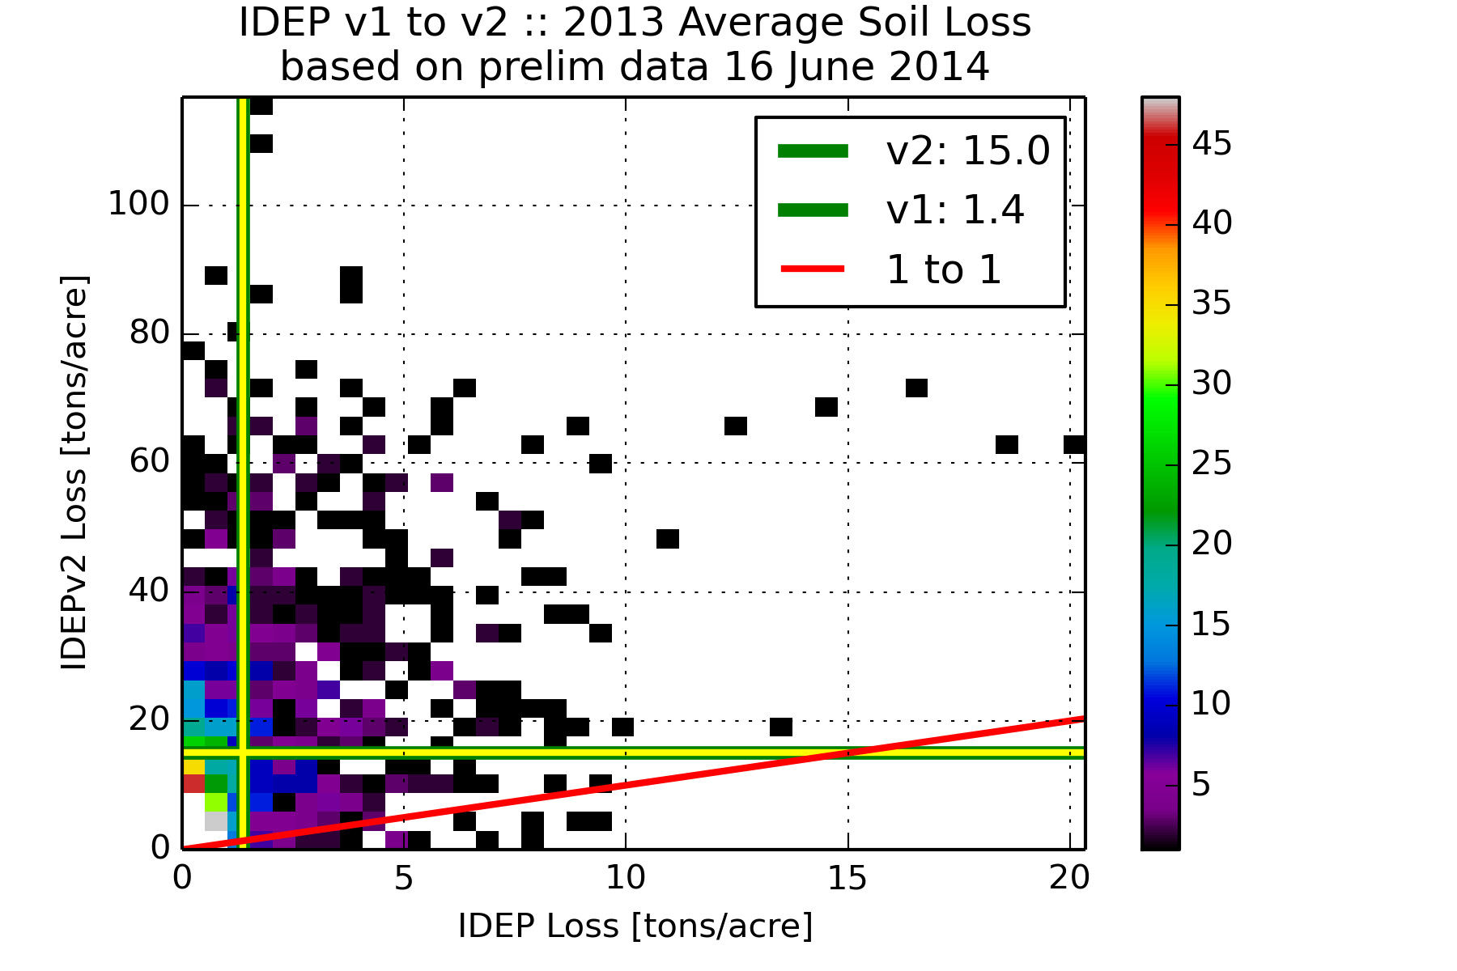

Slide 12
Yearly Average Soil Loss [tons/acre]
 | IDEPv1 | IDEPv2
2007 | 3.2 | 8.4 | 8.3
2008 | 4.6 | 22.9 | 22.4
2009 | 6.5 | 9.5 | 9.0
2010 | 1.9 | 29.9 | 29.1
2011 | 1.1 | 12.8 | 11.9
2012 | 0.5 | 4.4 | 4.2
2013 | 1.4 | 15 | 13.8

Slide 13
Future Idea: Dynamic Tillage/Planting
IDEPv2 has flowpath & yearly explicit management (no fixed rotations)
WEPP outputs soil moisture on a daily time step, so an algorithm could judge suitability for field work
Establish a time window, prescribe a rate over some area, and a cut off to do the rest. Example)
We’ll plant corn between 15 Apr – 15 May
We can do 15% of a county in a suitable day
Once we get to 15 May, we just put everything in the ground unplanted up till then
Would be interesting to retrospectively test this against NASS

Slide 14
But firstly, TODO / Bug List
More quality control on IDEPv2 inputs
What do use for managements in 2007 and whatever the current year is (2014)
Look into the huge loss events
Reduce Runtime (target is 6-8 AM)
12:15 AM to 2 AM :: Climate File Updating ☹
2 AM to 4-6 PM :: Run WEPP (8 threads) ☹
Improve website based on friendly testing
http://idep.agron.iastate.edu

