Slide 1
DEP Update
daryl herzmann
9 July 2015

Slide 2
Sources of Weather Variables
High + Low Temperature, Dew Point, Wind Speed
~24km Midwest analysis of automated airport stations
Wind Direction is always 0 (unused)
Solar Radiation
Combination of Model Analyses, use of the NOAA HRRR model for realtime, which is later replaced by reanalysis data from NASA MERRA and NARR
And then there is precipitation!

Slide 3
Precipitation Routine
Process MRMS Q3 “RADAR Only” QPE
2 minute product on 0.01x0.01 degree grid
Provides the timing of the precipitation
Process MRMS Q3 “Gauge Corrected” QPE
1 hour product on same 0.01x0.01 degree grid
Provides the amount of precipitation (simple bias correction of #1)
Process NCEP Stage IV Analysis
1 hour product on ~4km grid, remapped to 0.01 degree grid
Adjusts downward any data in #2 that is 30% higher and also above 10mm
WEPP breakpoints are then computed
Totals less than 0.1mm are set to zero
Rates of 10mm/hr are retained, others are collapsed into longer periods. (saves file space and processing time)

Slide 4
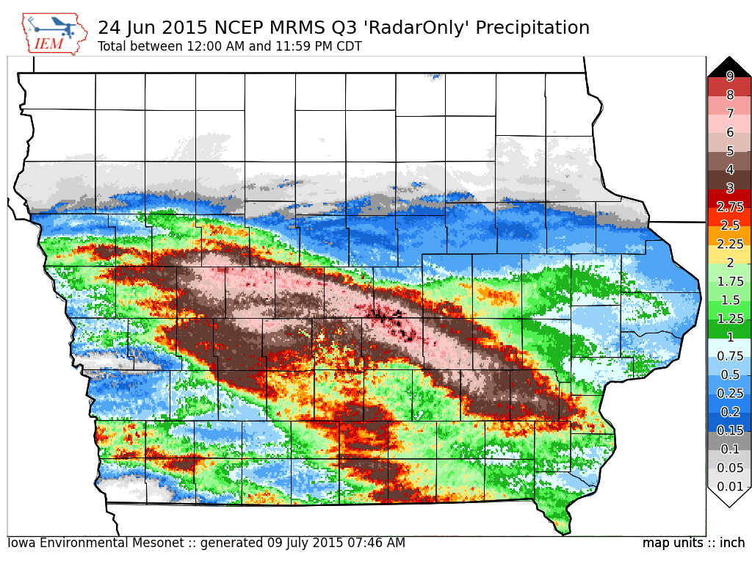

Slide 5
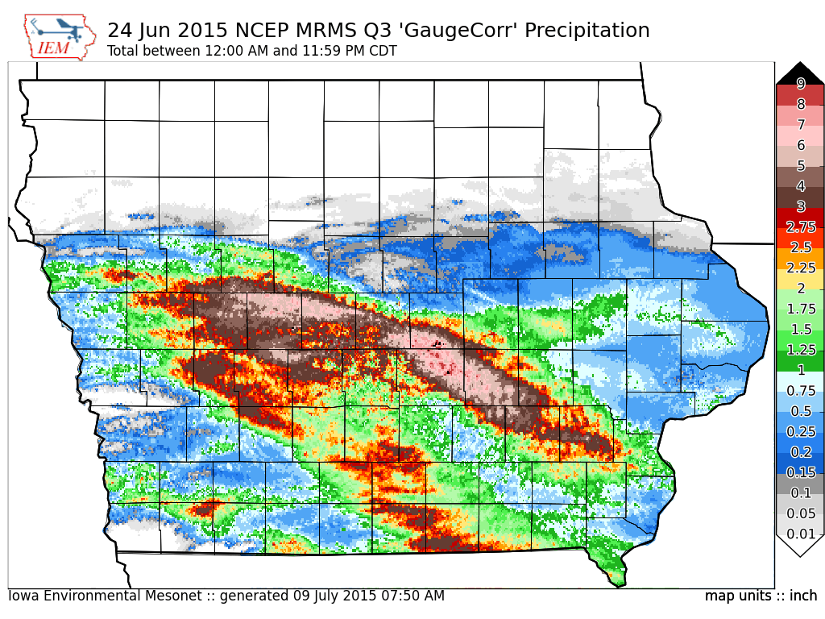

Slide 6
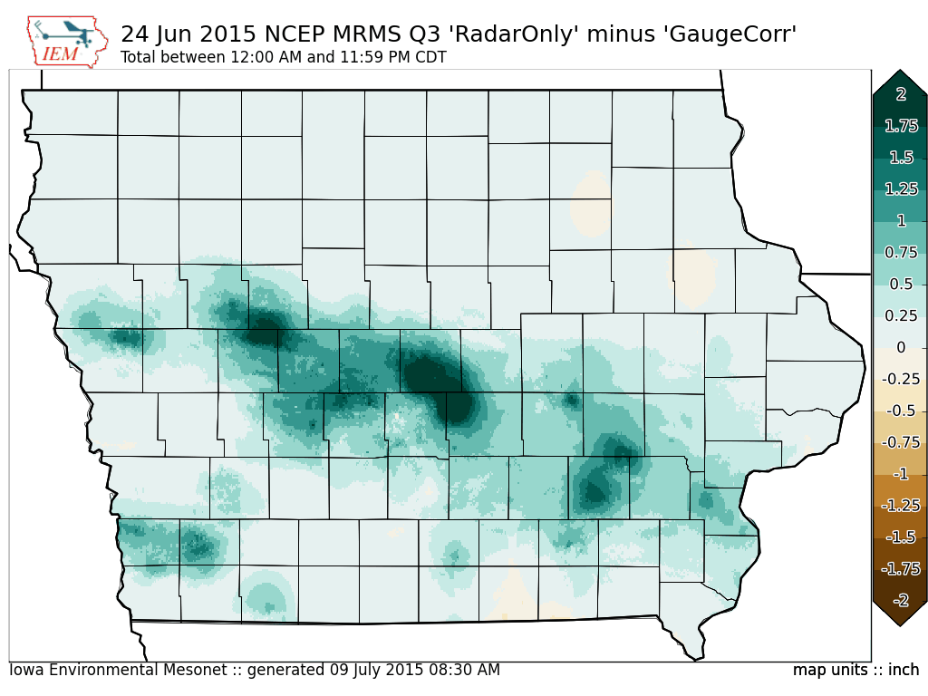

Slide 7
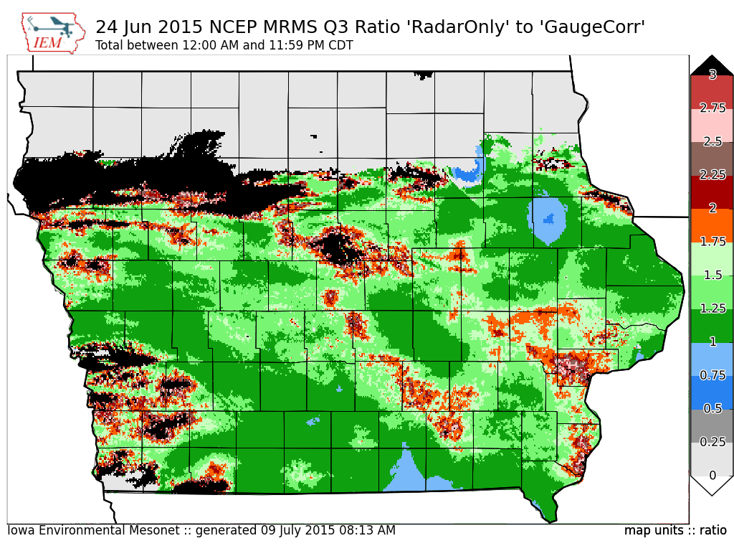

Slide 8
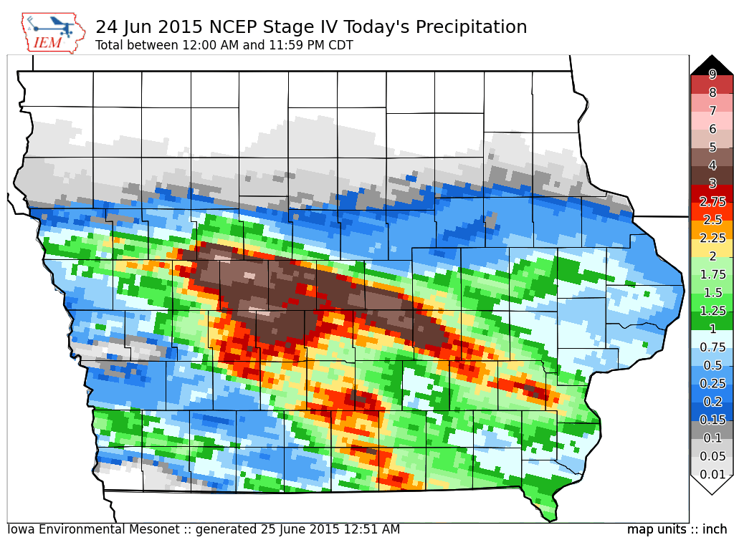

Slide 9
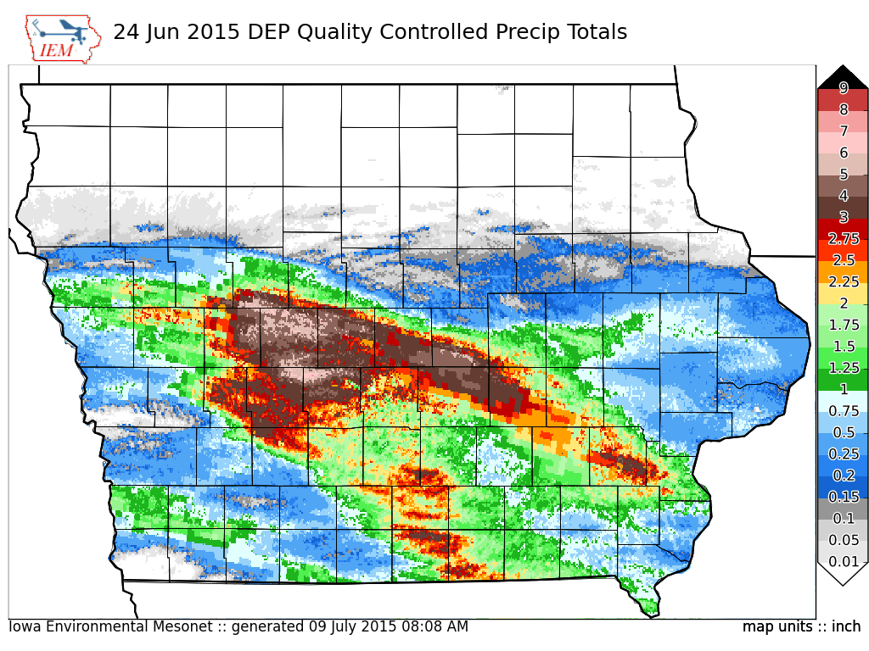

Slide 10
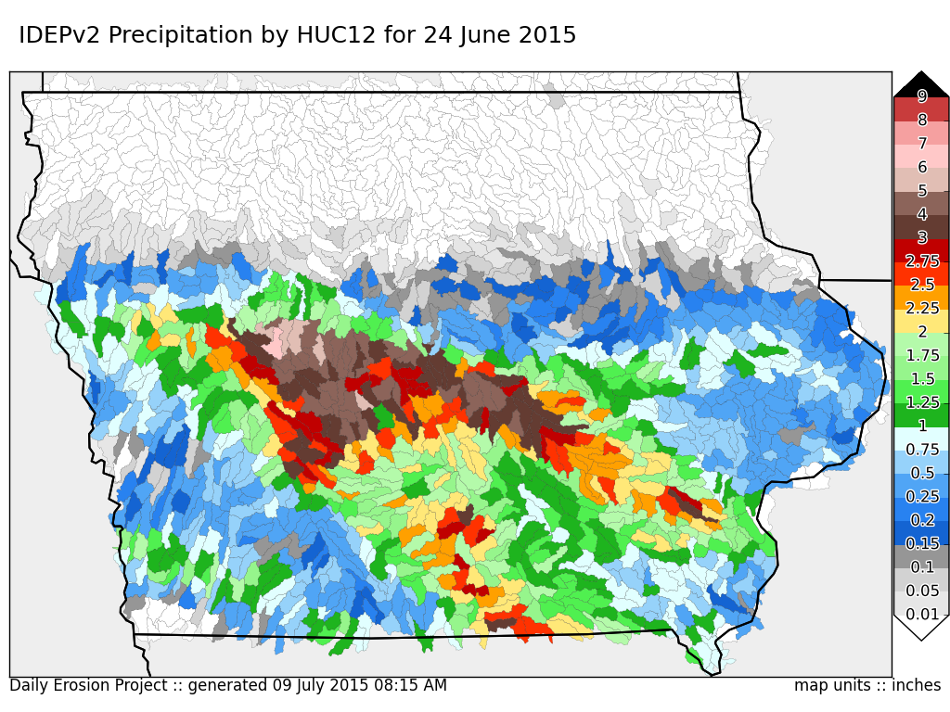

Slide 11
Current DEP Runtime
Time | Task
1:53 AM | Automation script launches
2:33 AM | Editing completes of daily climate files for WEPP (40 minutes)
6:45 AM | 200,384 WEPP runs are completed (4hours 12minutes)
7:05 AM | Harvest of WEPP output files, database updating (20 minutes)
Runs made on a 32 vCPU, 64 GB Red Hat Enterprise Linux 7 Virtual Machine
Hardware is a Dell R820 4x E5-4607 (6 cores + Hyper-threading), 256 GB Memory

Slide 12
KS+MN Expansion Timeliness (How to deliver output by 6 AM)
Δ Time | Idea / Change in Procedure
-90 minutes | Start runs at 12:30 AM using a crude QC control on the 10 PM – Midnight precipitation data.
-30 minutes | Start runs at 1:30 AM using a crude QC for 11 PM – Midnight precip
+15 minutes | Estimated increase in runtime for editing more climate files
No change | Estimated 150,000 more WEPP runs will need to be made, will throw more vCPUs at the task to make runtime stay around 4 hours
+15 minutes | Estimated increase in post-processing time
-120 minutes | (If necessary), run the entire run (~60GB) within ramdisk (/dev/shm), adds 30 minutes in disk copy time upfront, but net 2 hours faster
-60 minutes | Move all data to SSD drives, currently using 6Gbps SAS 15k drives
Bolded items are preferred initial changes

Slide 13
Website Demo Time
http://dailyerosion.org/map/

