Slide 1
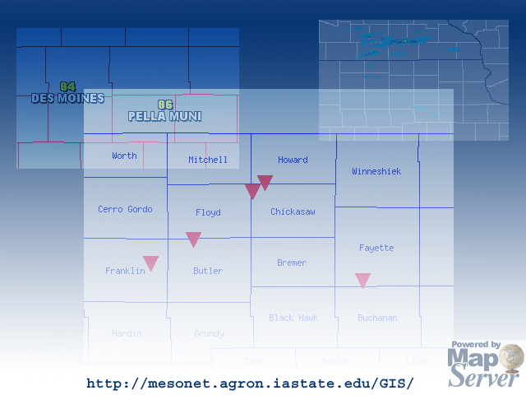
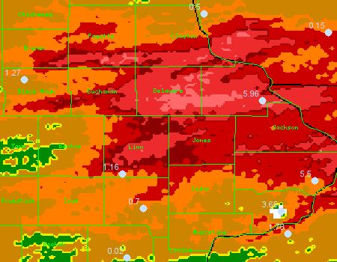
Serving Iowa Mesonet data with
U of Minnesota’s MapServer
Daryl Herzmann
Iowa Environmental Mesonet
31 Jul 2002

Slide 2

Background Info:
Daryl Herzmann
  BS Meteorology 2001 from Iowa State
  Currently, Program Assistant, Department of Agronomy, Iowa State
Iowa Environmental Mesonet
  Gather, compare, disseminate, and archive observations in the state of Iowa.
  Very interested in GIS as a vehicle to distribute / visualize / analyze data.

Slide 3
UNIDATA Affiliation
Weather data relayed over the Internet2 via the IDD. LDM software manages.
GEMPAK provides decoders and visualization packages.
UNIDATA is a community, of which Iowa State is an active part of.

Slide 4
Why GIS?
Well, why not? :)
Our goal is to not just provide data, but provide easily integratable data. GIS is invaluable for this task.
The difficult part is getting the data from our servers to their applications. Website is nice, but not the answer!

Slide 5
Enter MapServer!
Work is done on the server side.
Easily integrate diverse local and remote data sources.
OGC compliant WMS server/client capability for easy CGI access.
Open-Source! Enough said.

Slide 6
What is MapServer?
From website, “MapServer is an OpenSource development environment for building spatially enabled Internet applications.”
Features / Support:
Vector format ( ex: ESRI Shapefiles)
Raster format ( ex: PNG, GIF, TIFF)
Fully customizable output / Mapscript

Slide 7
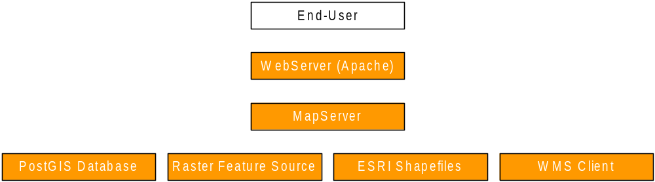
MapServer Data Flow

Slide 8
Basic MapServer Layout
MapServer binary somewhere in cgi-bin
A .map file provides the schema and data sources for the application. Referenced via CGI (&map=path_to_mapfile)
A template HTML file for how the application should be presented
A query template file for results of queries

Slide 9
#1: Spatial Precip Viewer
NEXRAD Storm Total (STP) and one hour precip (N1P) products are gridded, plotted and geo-referenced.
Surface precip observations are ingested and placed in the spatial database.
Great way to qualitatively compare NEXRAD estimates with “ground-truth”

Slide 10
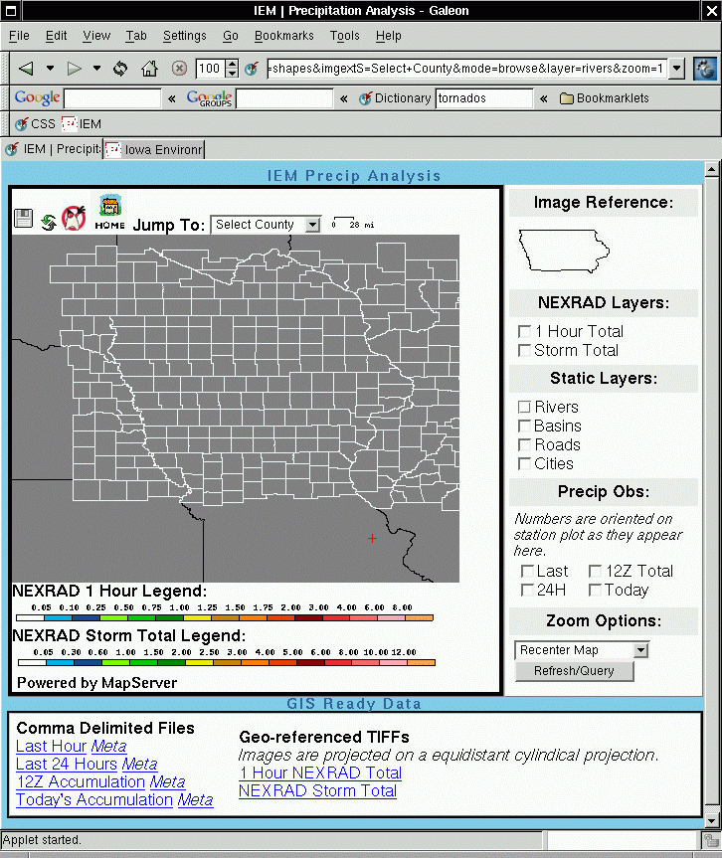
Web
Interface

Slide 11
#2: Iowa Tornado Database
The tornado database was the first step in putting together an “All Hazards” database for Iowa.
Compiled by Chris Anderson at ISU
Entries are placed in a spatial database and queried out by MapServer.
We look to expand the meta-data held in this system. (News clippings, stories…)

Slide 12
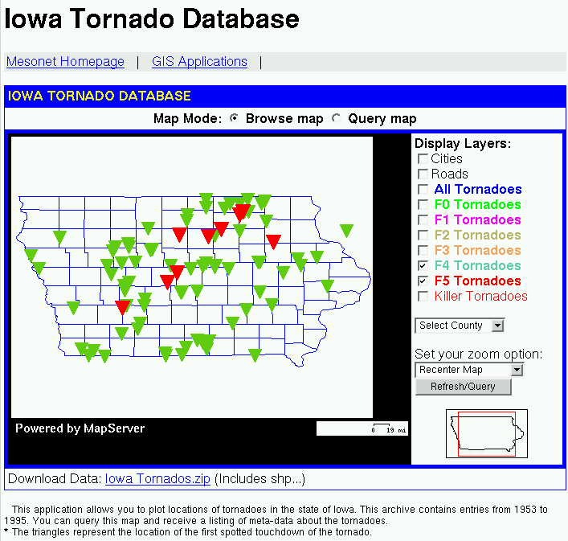
Iowa Tornado Database Interface

Slide 13
#3: NWS Warnings with National RADAR
Geo-reference a national RADAR mosaic
Wrote a text to spatial database decoder for the SVR and TOR products. Polygon and county based warnings are saved.
Combine these data sources with MapServer

Slide 14
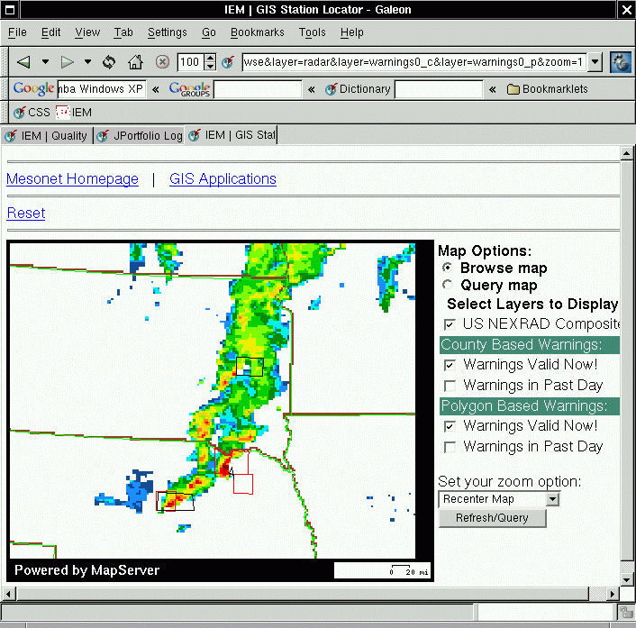
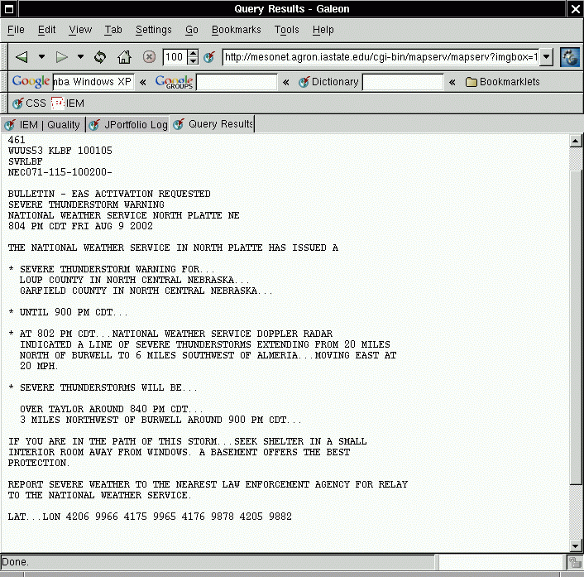
Example

Slide 15
#4: 3-4 June 2002 Flooding
Heavy rainfall event in Eastern Iowa. Localized flooding.
Geo-referenced NEXRAD Storm Totals.
Included surface observations
Used by Iowa Emergency managers as a baseline to identify locations that may have experienced flooding.

Slide 16
Example Image

Slide 17
PHP MapScript
Provides a MapScript interface in PHP
Mostly objection oriented (OO) !!
Provides much needed flexibility from the somewhat cumbersome basic MapServer CGI interface.
IEM will migrate most web GIS applications to this development platform.

Slide 18
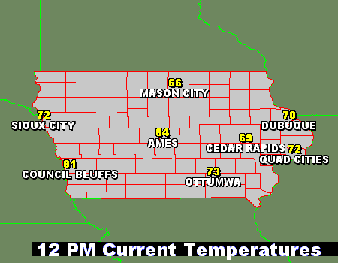
PHP MapScript Example
Dynamically generate a variable plot based on user selected stations.

Slide 19
Conclusions
The OpenSource GIS world has come a long way! Please investigate it before dumping thousands of dollars into closed-source, proprietary systems.
http://www.opengis.org
http://www.freegis.org
http://mapserver.gis.umn.edu

Slide 20

Questions?
I am always willing to help, if I can!
Daryl Herzmann
akrherz@iastate.edu
515.294.5978

