Slide 1





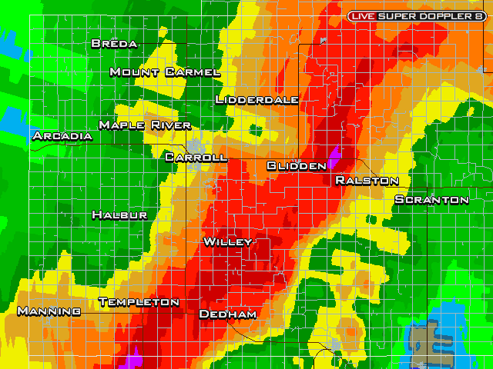
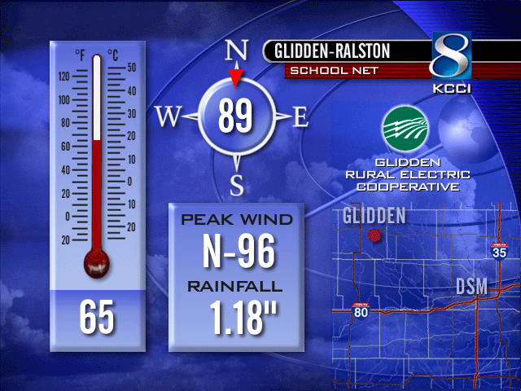
The IEM-KCCI-NWS Partnership: Working Together to Save Lives and Increase Weather Data Distribution

Slide 2

PROJECT REVIEW
KCCI-TV INSTALLED 43 SCHOOLNET WEATHER STATIONS BEGINNING DECEMBER OF 2000 TO PRESENT
EACH STATION REPORTS CONTINOUSLY VIA THE INTERNET.
GENERATING MORE THAN 500,000 INTERNET PAGE VIEWS EACH MONTH
INCREASED KCCI-TV IDENTITY IN RURAL COMMUNITIES.
INCREASED RATINGS DOMINANCE

Slide 3

ON-AIR AWARDS

Slide 4

STUDENT INVOLVEMENT

Slide 5
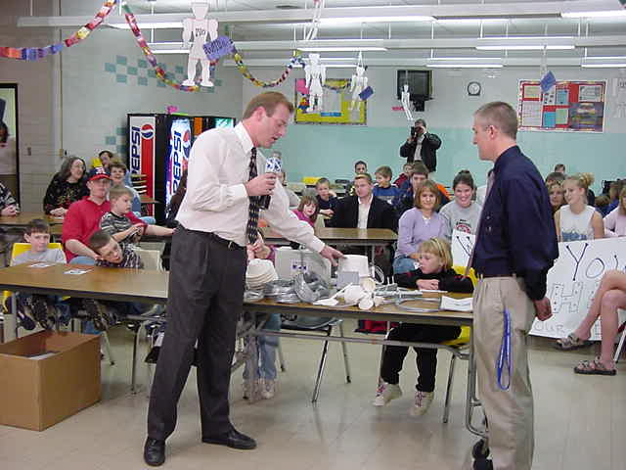
EXPLAINING THE SENSORS

Slide 6
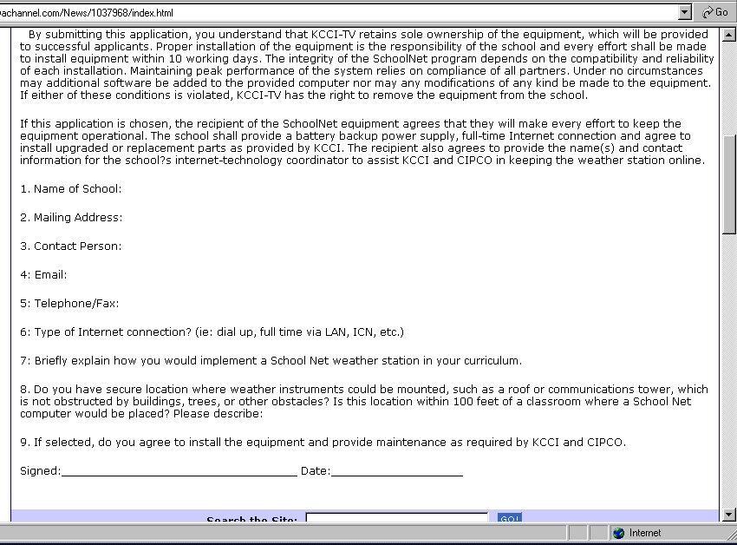

Slide 7
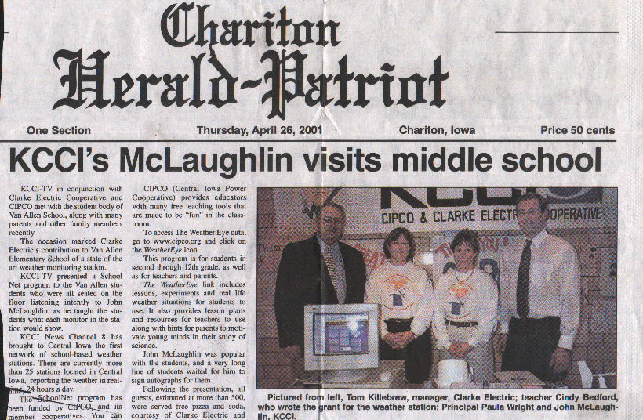
MEDIA COVERAGE

Slide 8
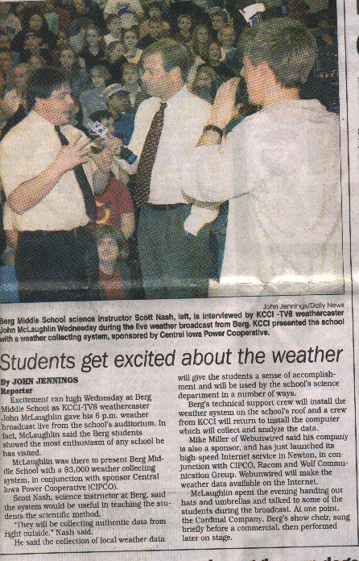
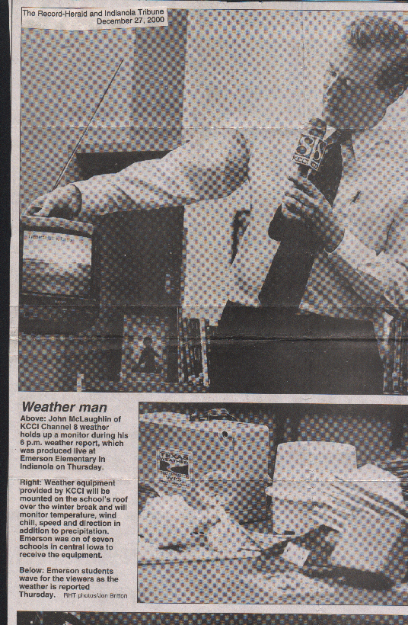
MEDIA COVERAGE

Slide 9
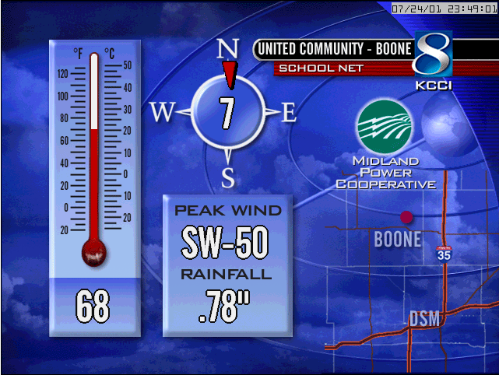
BARON DISPLAY

Slide 10
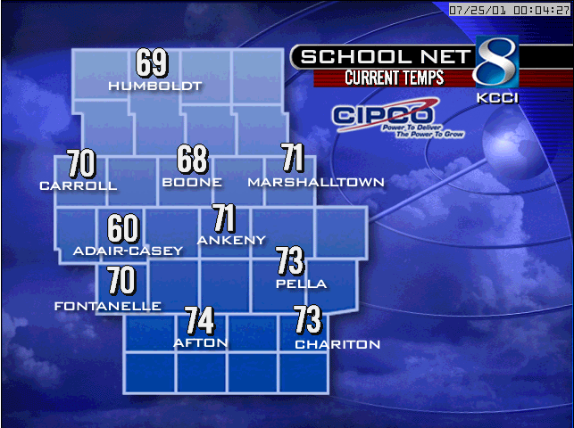
BARON DISPLAY

Slide 11
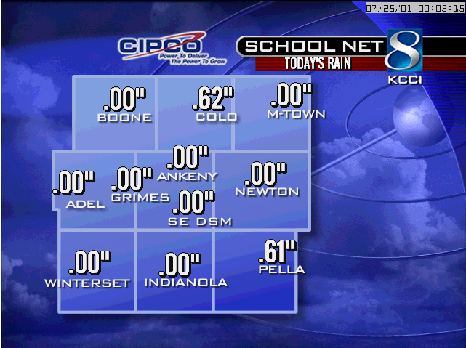
BARON DISPLAY

Slide 12
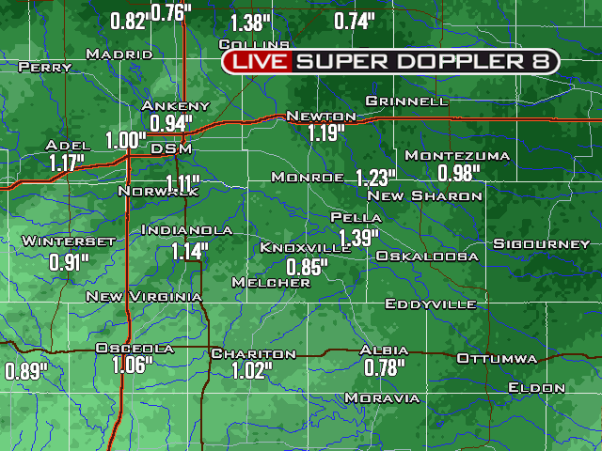
REALTIME RAINFALL AND BARON RADAR HYDRO

Slide 13
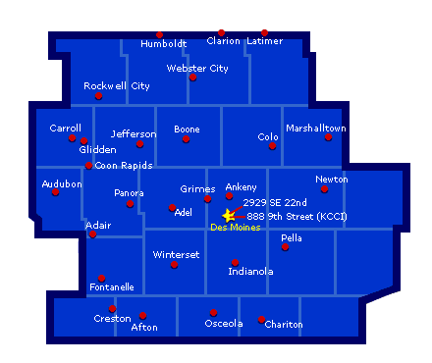
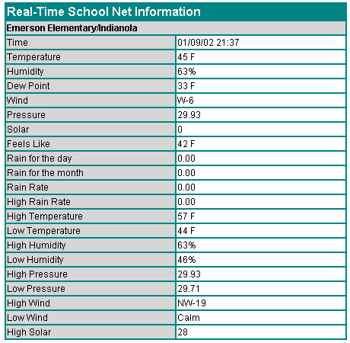

Slide 14
Now What?
Too Much Data too watch at once!
Have to relay information to NWS via radio.
Daily notification of schools for outages.
Then along came Daryl!

Slide 15
Now What?
IOWA ENVIRONMENTAL MESONET PROJECT
Live Feed of SchoolNet Data
Value Added and retransmitted to web & NWS Des Moines.

Slide 16
BENEFITS!
Automatic Email and Awips alert for 50 mph and higher gusts.
Automatic trouble ticket generated and emailed for offline stations.
Archive and plotting.

Slide 17
POSITIVE RESULTS
SEVERE THUNDERSTORMS WILL BE... IN RURAL AREAS OF EASTERN AUDUBON COUNTY. OTHER WARNING LOCATIONS INCLUDE AUDUBON AND BRAYTON.
AT 1206 AM...A KCCI TV WEATHER STATION AT AUDUBON COMMUNITY SCHOOL REPORTED 42 MPH WINDS IN AUDUBON.

Slide 18
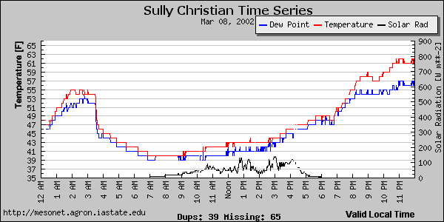
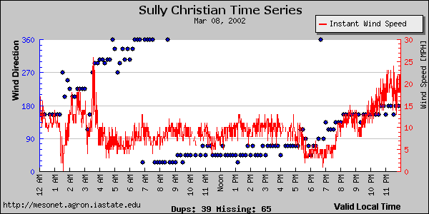

Slide 19
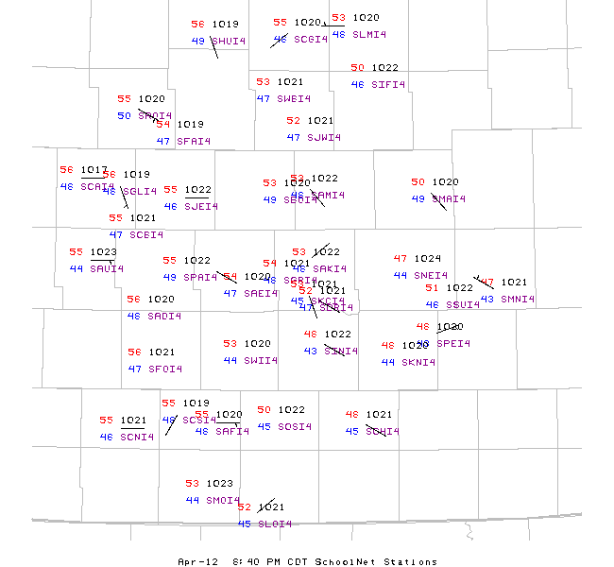
REALTIME MESONET PLOT

Slide 20
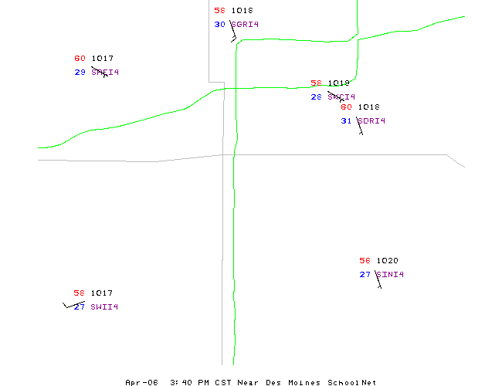

Slide 21
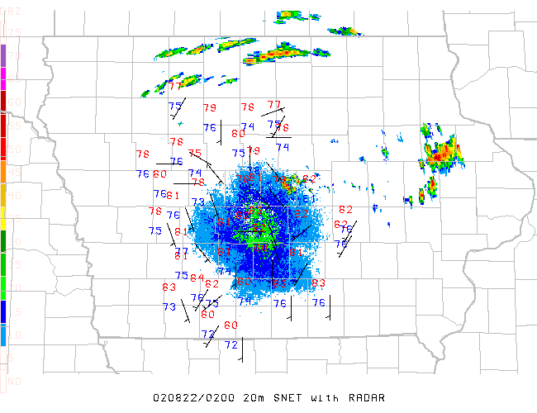
REALTIME SCHOOLNET AND DOPPLER DATA

Slide 22
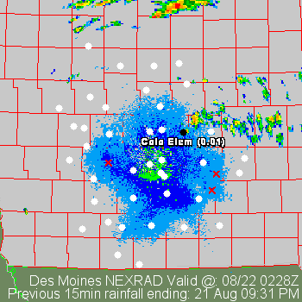
Where is It Raining?

Slide 23
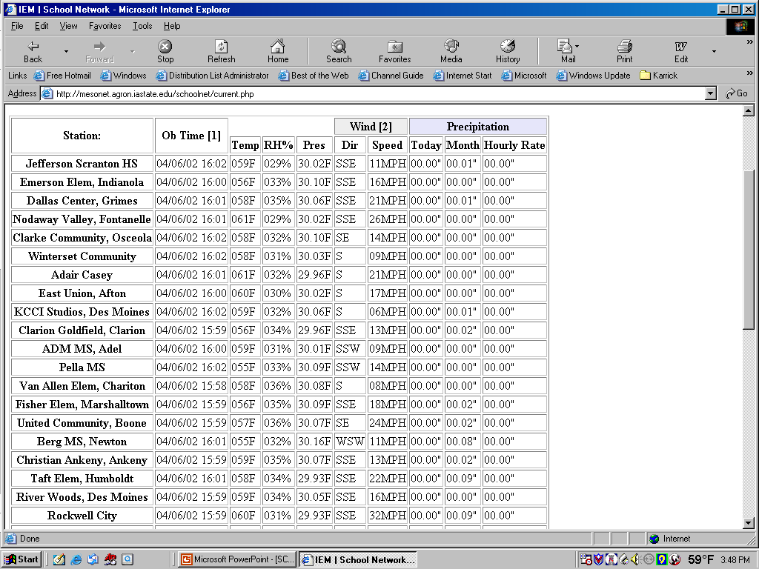
Current SchoolNet Conditions
** This page will automatically refresh every minute.

Slide 24
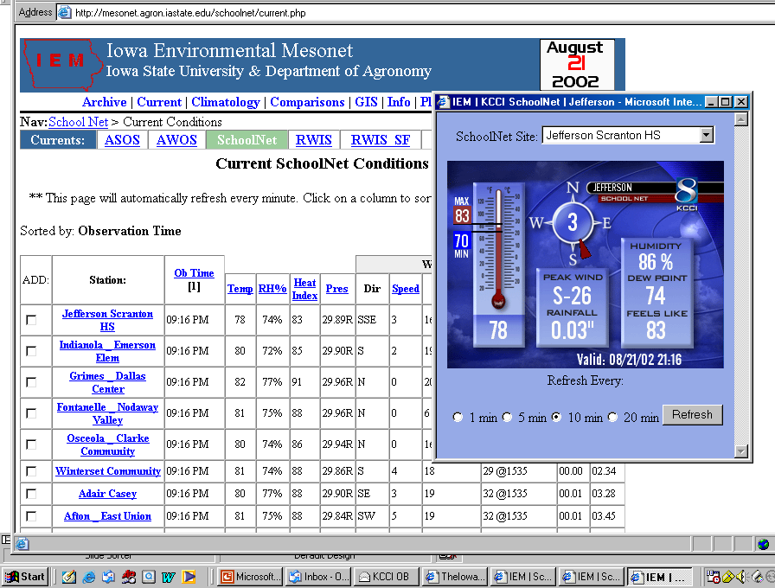

Slide 25
10 JULY 2002
“SURPRISE” PRE-DAWN DAMAGING WIND EVENT IN MARGINAL DYNAMICS
DES MOINES WSR-88D RADAR OFFLINE
MORNING TV METEOROLOGIST ON-AIR AND FOCUSED ON HEAVY RAIN THREAT.
POOR SITUATIONAL AWARENSS AND INTERPRETATION OF REFLECTIVITY STRUCTURE.

Slide 26
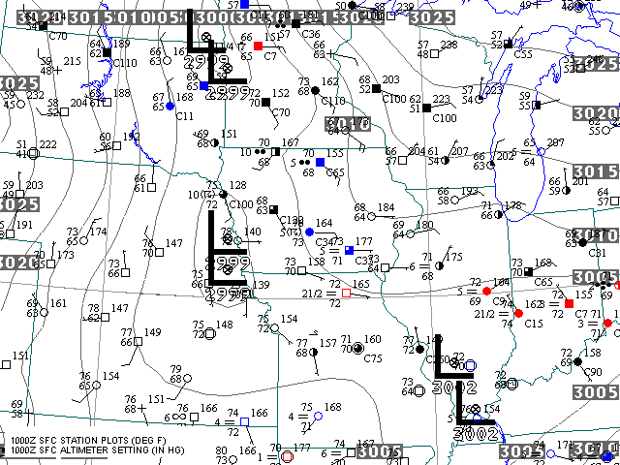

Slide 27
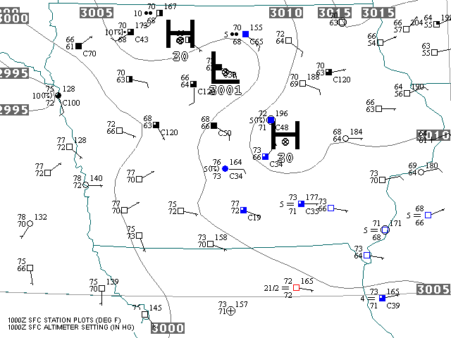

Slide 28
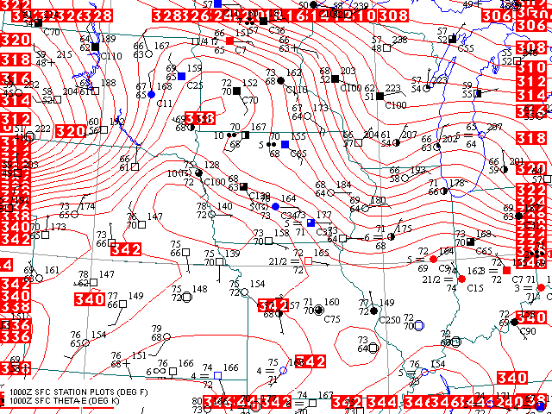

Slide 29
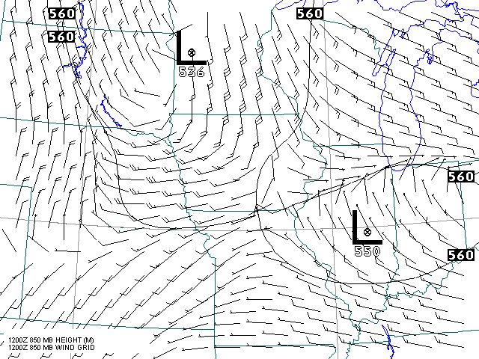

Slide 30
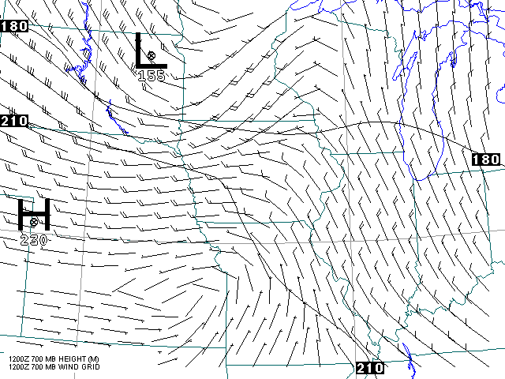

Slide 31
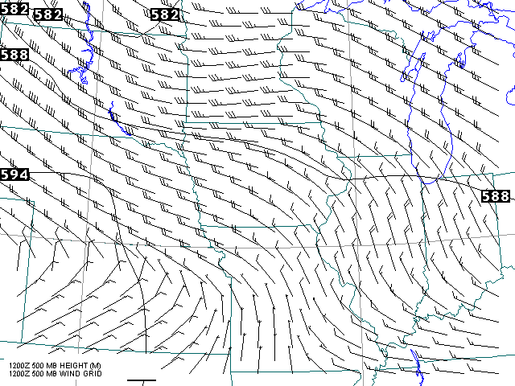

Slide 32
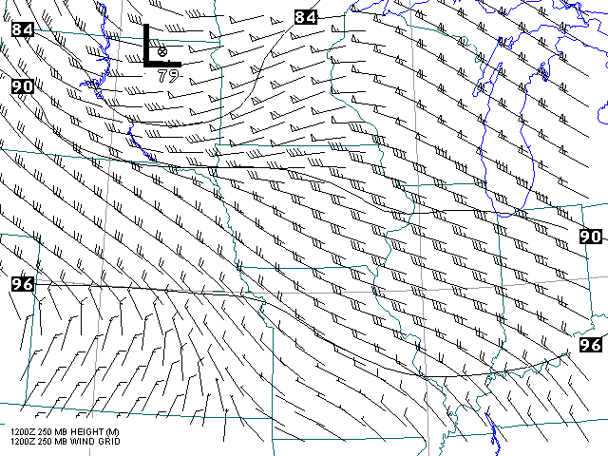

Slide 33
Oops, Didn’t See This While
Focused on the Radar.

Slide 34
IEM SAVES THE DAY!
KCCI SNET OB: [06:54] 96 MPH GUST SGLI4 Glidden Ralston _ Glidden
LATEST OB: [06:51] 65/64 70MPH from NNW P: 01.25" RR: 00.00"

Slide 35
IEM SAVES THE DAY!
Alert Emailed to KCCI weather staff and sent to NWS AWIPS.
Strong Worded Severe Weather Statements Issued!
Broadcaster now aware of major damage-producing storm!

