Slide 1
Iowa Environmental Mesonet
Past, Present, & Future
Dr Dennis Todey
Daryl Herzmann
Department of Agronomy
Iowa State University

Slide 2
Seminar Outline
IEM Past
  Background information
  Building the IEM
IEM Present
  Current impacts in the state and the nation
  Status of project areas
IEM Future
  Potential partnerships
  Augmenting networks

Slide 3
THE PAST!!!

Slide 4
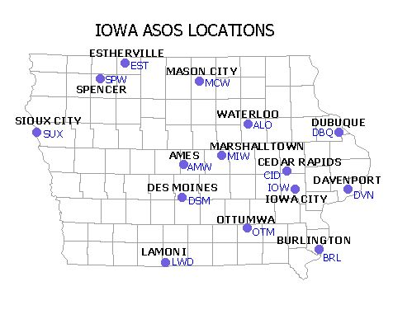
ASOS Network
Larger Airports
15 sites
Flagship network
1+ obs per hour

Slide 5
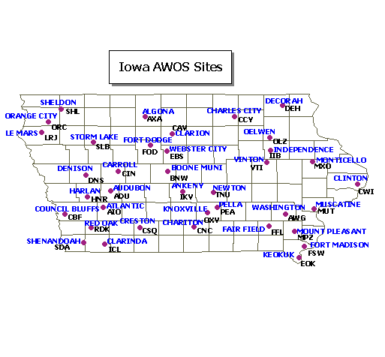
AWOS Network
37 Sites
4 of them just recently added VTI,MPZ,PEA,IIB
FOD and CWI are really ASOSish
3 obs per hour

Slide 6
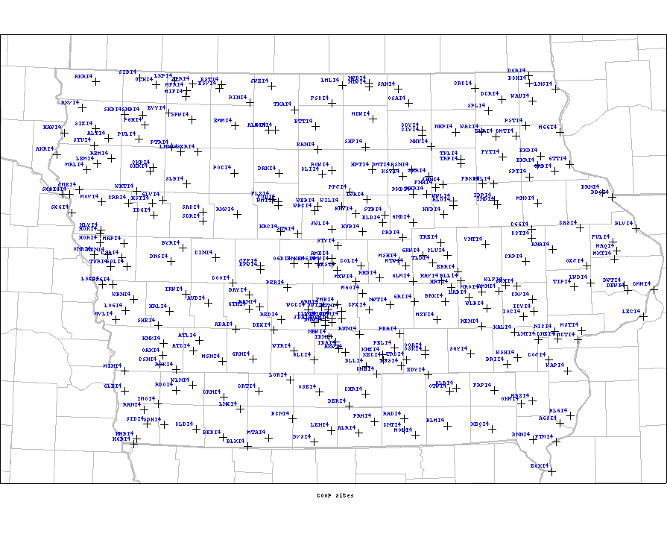
NWS COOP
~160 sites in Iowa.
Report 1x or 2x per day
'Official' observations of climate

Slide 7
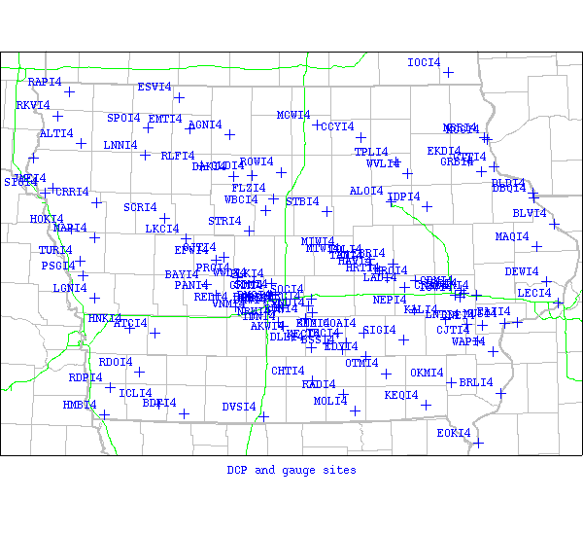
DCP / USGS
> 150 stations
Mostly river gauges, some have atmos
Report every 15-60 minutes, but delayed.

Slide 8
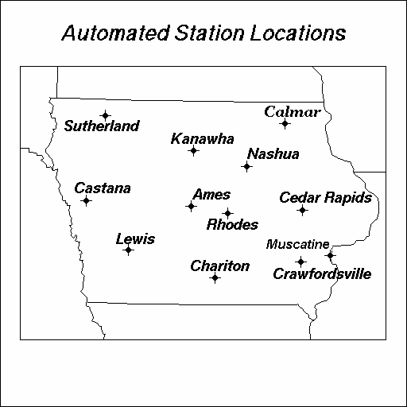
ISU Ag Climate Network
12 sites located at ISU Exp farms
Report hourly, but delayed by one day
Additional soil sensors will be added soon.

Slide 9
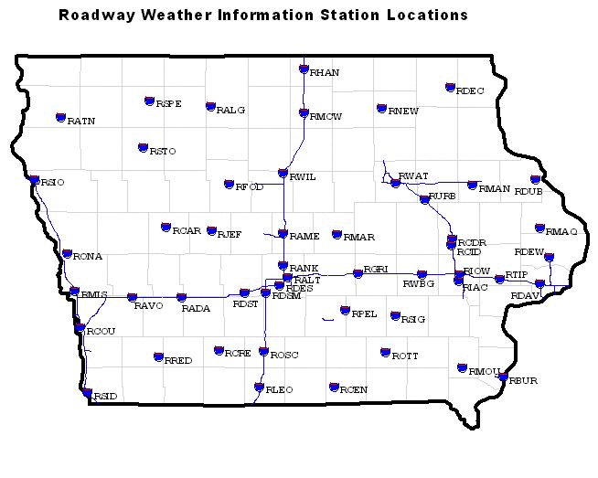
DOT RWIS
50 (48) sites located along roadways
4 obs per hour
Pavement and bridge deck sensors

Slide 10
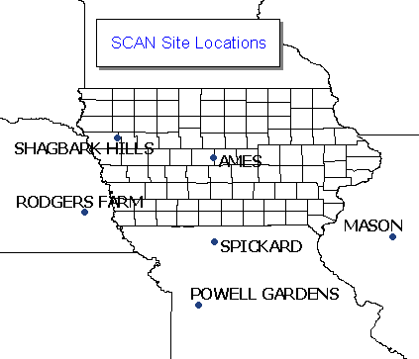
Soil Climate Analysis Network
2 sites in Iowa
Shagbark Hills was recently added.
1 ob per hour
5 soil levels
(High-end ISUAG stations)

Slide 11
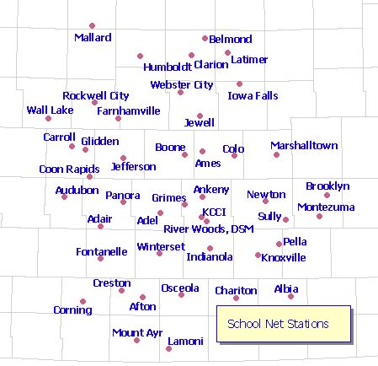
KCCI SchoolNet
Currently, 44 sites.
~400 obs per hour
Instantaneous winds
Very cool applications.

Slide 12
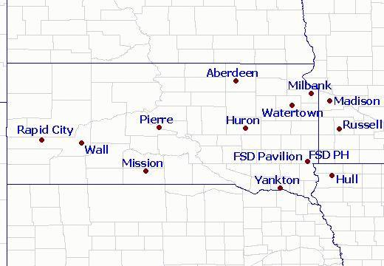
KELO SchoolNet
Currently, 14 sites
Recently added on 12 Sept 2002
~400 obs per hour
5 sites without humidity sensors

Slide 13
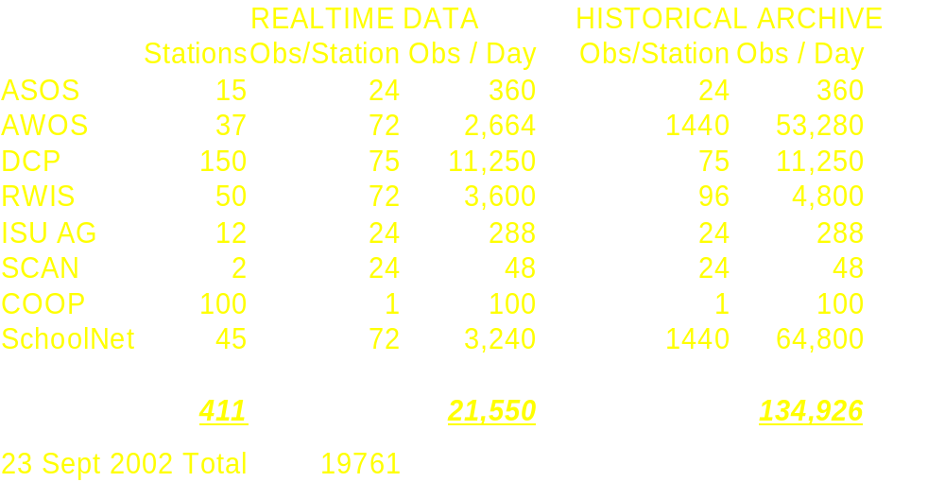
Add them all up...

Slide 14
Recent Conferences
NCAR: 'GIS in Weather, Climate and Impacts'
  12-14 August 2002 -- Boulder, Colorado
  Presented on the IEM's GIS efforts and sat on a discussion panel.
Barons RADAR Training Conference
  23-25 August 2002 -- Huntsville, Alabama
  Presented on IEM work with KCCI's SchoolNet.
  Overwelming response.

Slide 15
THE PRESENT!!!

Slide 16
IEM & GIS
Firstly, what is GIS?
  'Geographic Information Systems'
What is it though?
  GIS is not ESRI, but ESRI is a GIS.
  My definition, 'Intelligent Spatial System'
While most people can't agree on a definition, they can look at a system and deem it as a GIS.

Slide 17
IEM GIS Efforts
Web Applications
  Built on MapServer
  Backend data accessed via PostGIS database
GIS Datasets
  Current school network conditions
  NEXRAD imagery shapefiles, geo-referenced images
  NWS COOP Climate data

Slide 18
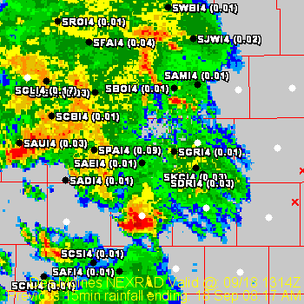
Ex 1. Where's it raining?
Current NEXRAD base reflectivity
15 minute schoolNet precip totals shown
GIS Layers
  Counties / States
  NEXRAD image
  SchoolSites (Spatial DB)

Slide 19
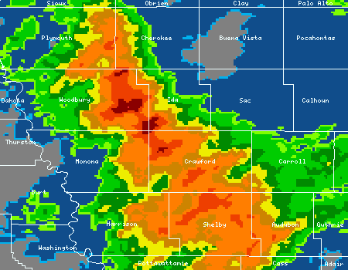
Ex 2: Spatial Precip Viewer
Qualitative comparison of NEXRAD precip and observations.
Incorperates many GIS layers.
Provides links at the bottom to GIS datasets.

Slide 20
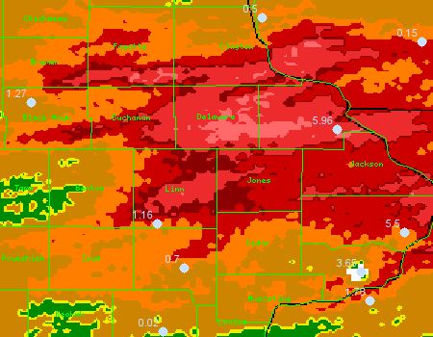
3-4 June 2002: Heavy Rainfall

Slide 21
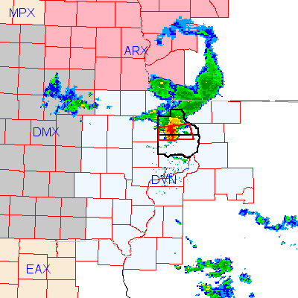
Ex 3: NEXRAD imagery with warnings
Real-time ingestion of warnings into Spatial DB.
Plots both county based and polygon based warnings.
Zoomable and Queriable.

Slide 22
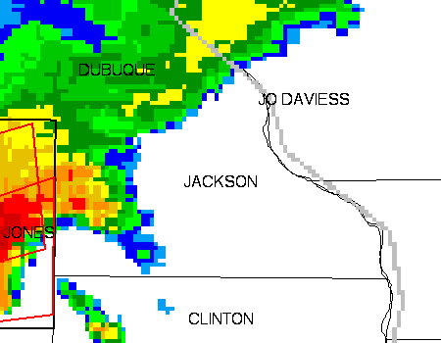

Slide 23
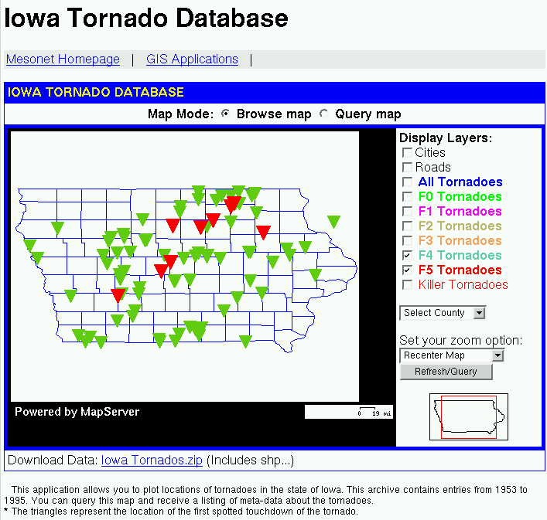
Ex 4: Iowa Tornado Database
Historical tornado reports are mined in the database.
The dataset is querible and visualized with the help of GIS!

Slide 24
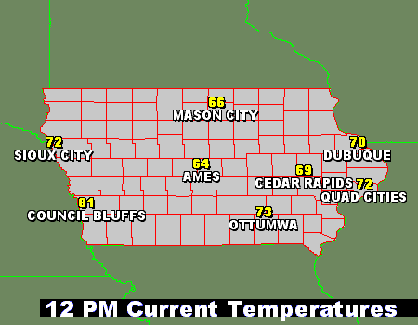
Ex 5: Pretty Plots
With the help of PHP Mapscript, plots such as this one are a breeze!
This plot was dynamicallly generated based on stations of the users choice.

Slide 25
IEM Laundry List
(Things that give me headaches and make me lose sleep at night.)

Slide 26
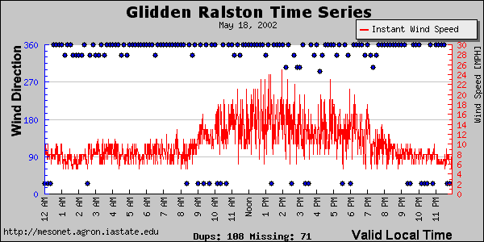
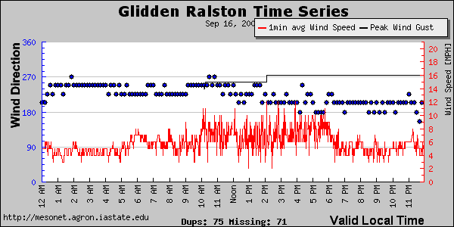
Averaging the schoolNet winds
Wind data sampled
every minute
Wind data averaged
every minute.
(roughly 10 obs)

Slide 27
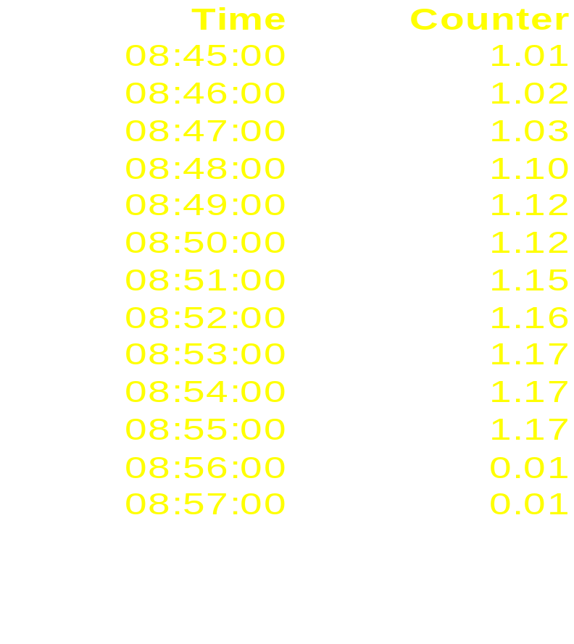
AWOS Precipitation
The observation at :45 after is sent in
the METAR report. The actual total at
:55 after is never reported.
The result is that precip data from
10 minutes out of every hour is
not reported. This is roughly a 17%
under-estimation.
Clarinda's (ICL) precip counter resets
at :45 after, so METAR precip from
the site is not missing data.

Slide 28
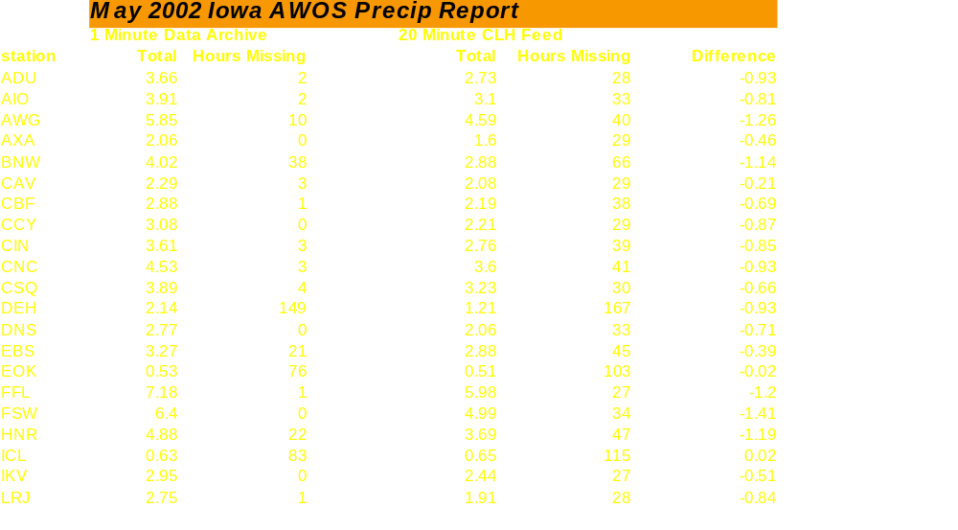
AWOS Precip Comparison

Slide 29
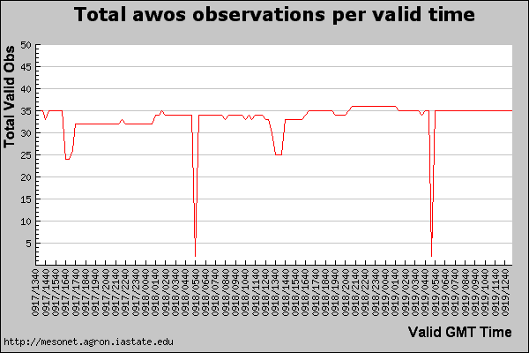
Missing AWOS Data
Around midnight, the DOT's mainframe goes offline for backups.
So does the AWOS data feed.
This data is never recovered in the METAR feed.

Slide 30
NWS Coding standards
'More than 50% of NWS severe weather Watch, Warning, and Adisory products contain coding or formatting errors' - A. Marvin McInnis
Some ASOS Daily Summary Messages (DSM) are not given a correct WMO header, thus the products are dropped at the NWS Gateway.
NWS COOP reporting is done on a per-WFO basis. The reported SHEF data is sent with much different meanings.

Slide 31
COOP RTP Data Reports
Des Moines, LaCrosse
  DH07/TX/TN/PP
Sioux Falls
  RTP product is not SHEF encoded. RR1-3 come in with meaningful timestamps
Davenport
  DH07/TAIRZX/TAIRZN/PPDRZZ/SFDRZZ/SDIRZZ
Omaha
  DH07/TAIRZX/TAIRZN/PPD/SF/SD

Slide 32

IEM Tracker
Built on Portfolio.
Tracks meta-data about IEM sites.
Tracks trouble tickets for site repairs and offline status alerts.
Integrated with the mesonet via the database.

Slide 33
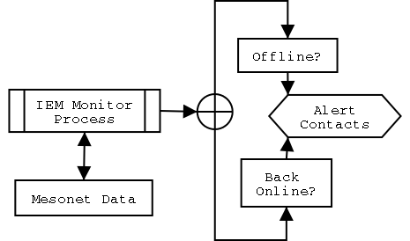
IEM Tracker / Offline Status

Slide 34
Example IEM Tracker Alert
Date: Mon, 16 Sep 2002 07:21:12 -0500
From: Iowa Environ Mesonet <mesonet@mesonet.agron.iastate.edu>
To: akrherz@iastate.edu
Subject: [IEM] Council Bluffs (I-80) Online
############################################
# Iowa Environmental Mesonet #
# - RWIS Network Station Status #
############################################
Council Bluffs (I-80) is back Online! Great!
Last Observation was received at: 2002-09-16 12:07:04.00 GMT
Trouble Ticket ID: 1255 has been cleared.

Slide 35
IEM Tracker Impacts
In 3 months, IEM Tracker has generated ~1200 trouble tickets!!!
~2,400 emails sent to network admins and site contacts.
~2,800 pieces of meta-data entered into the database.
Provides excellent proof of site problems.
Observing network reliability has increased for every network using IEM Tracker.

Slide 36
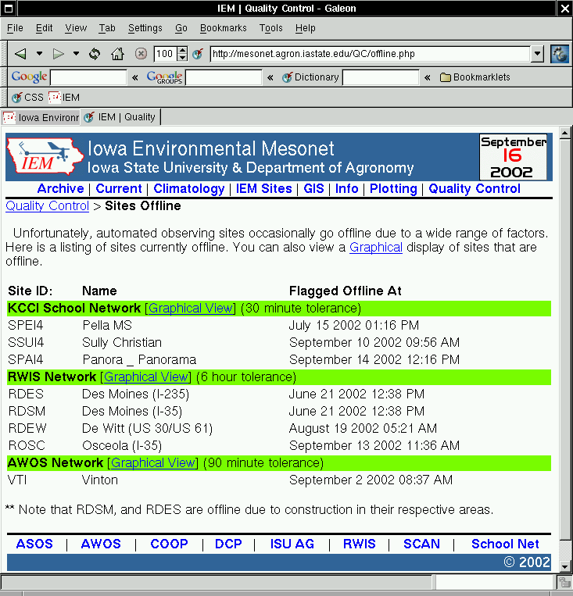
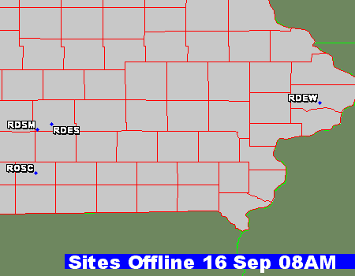
Visual Look at IEM Tracker

Slide 37
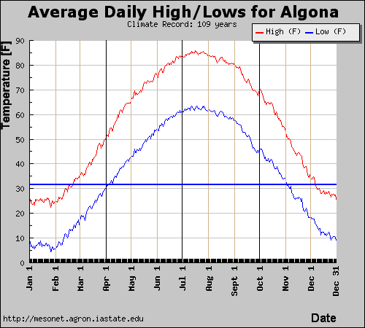
Interactive Plotting Fun.
The IEM utilizes a dynamic PHP plotting package called JpGraph to generate most of its interactive plots.

Slide 38
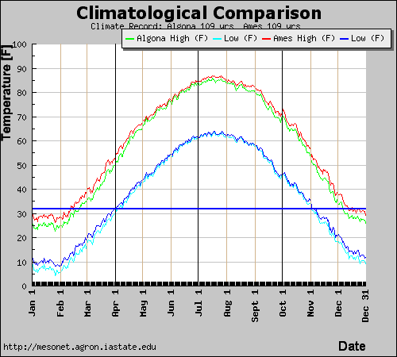
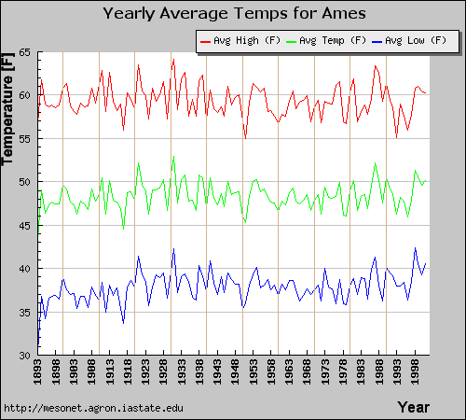
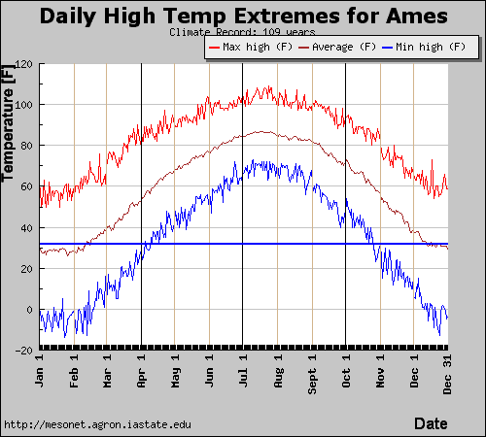
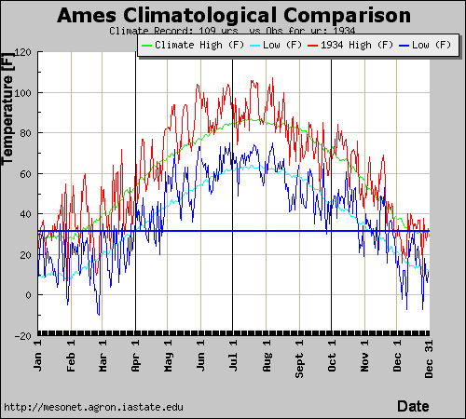

Slide 39
THE FUTURE!!!

Slide 40
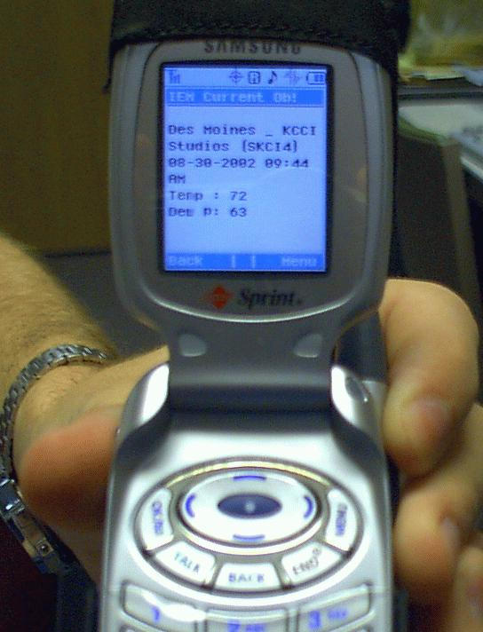
WAP IEM
Building mechanisms to place IEM data on cell-phones, PDAs, GPS units.
Focus of providing just-in-time data for decision support.

Slide 41
Future/Continuing Efforts
IEM-DataVision
  All in one, data viewing/dl/comparing application
QUALITY CONTROL
  Visually on plots and flags in datasets
Web-site streamlining
IEM-Freeze
  Multi-sensor, GIS based, freezing rain identification
GIS, GIS, GIS

Slide 42
Future Conferences.
21-24 October 2002
  National Weather Association Conference
  Will receive the 'Larry R Johnson' award for significant contributions to operational Meteorology.
9-13 February 2003
  American Meteorological Society Annual Meeting
  Will present at the first GIS focused session of the IIPS conference

Slide 43

Questions?
Daryl Herzmann
akrherz@iastate.edu
3015 Agronomy Hall
515.294.5978

