Slide 1
Utilizing your School Network
John McLaughlin
KCCI-TV, Des Moines, IA
Daryl Herzmann
Iowa State University

Slide 2
KCCI SchoolNet8 Overview
51 stations have been installed since Dec 2000
Each station reports continuously to the Internet
Generating over 500,000 page views per month
Increased KCCI's visibility in rural communities and ratings dominance

Slide 3

On-Air Awards

Slide 4

Student Involvement

Slide 5
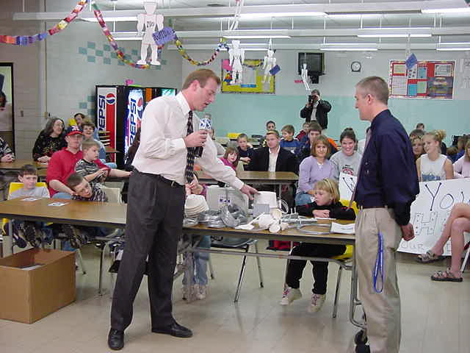
Explaining the Sensors

Slide 6
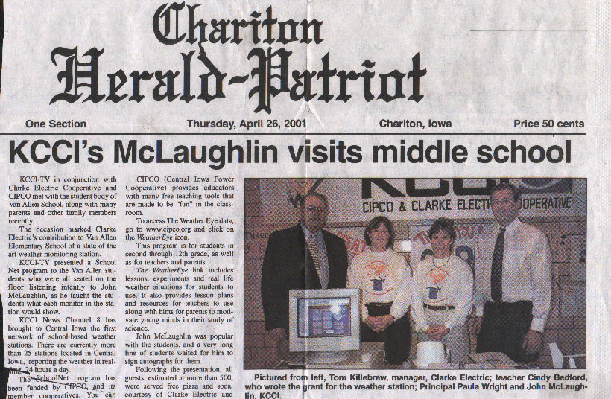
Local Media Coverage

Slide 7
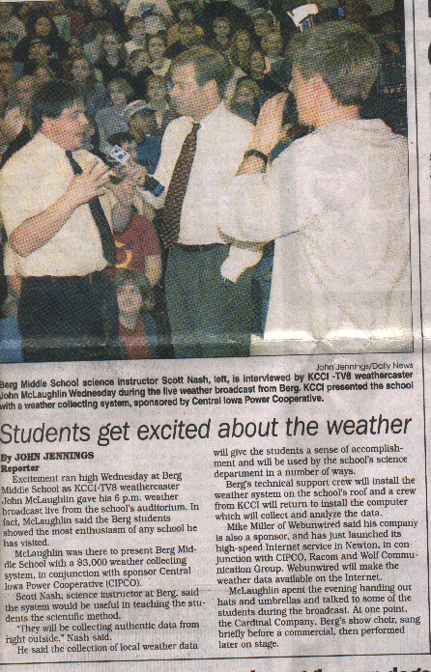
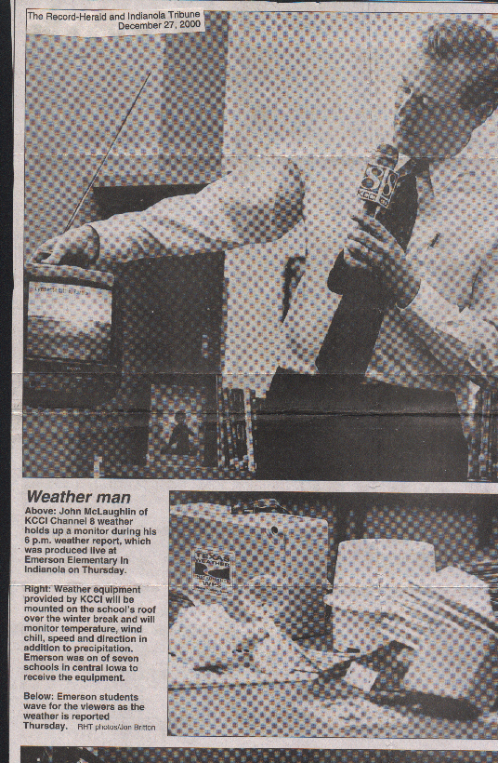
Local Media Coverage

Slide 8
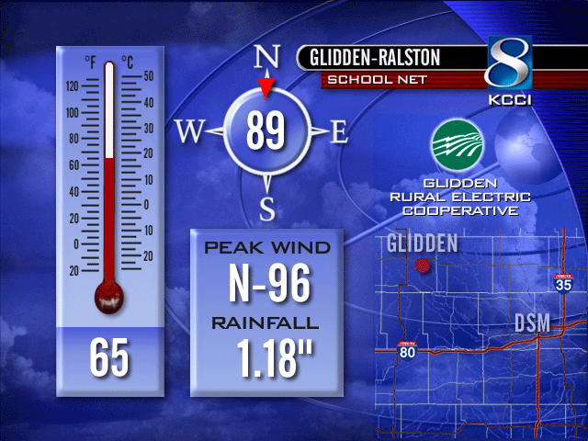
Baron Display

Slide 9
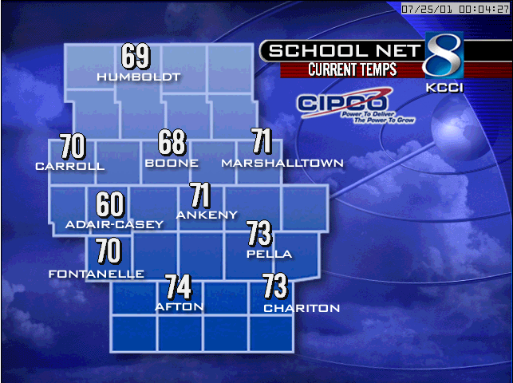
Baron Display

Slide 10
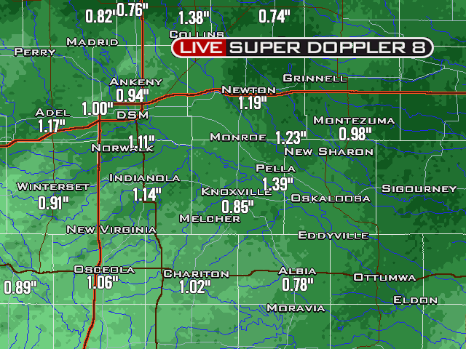
Integration with FasTrac / Baron Hydro

Slide 11
But now what?
Too much data to watch!
Manual relay of information to the NWS difficult during severe weather coverage
Management of the network difficult
Then along came the Iowa Environmental Mesonet.

Slide 12
The Iowa Environmental Mesonet
Project of Iowa State University to collect data from the many observing platforms in the state.
We have built an extensive and diverse real-time monitoring network utilizing existing resources.
KCCI SchoolNet8 is a very important component of our Mesonet.

Slide 13
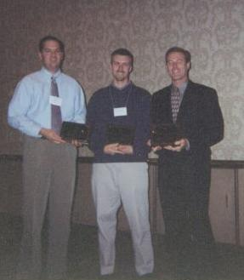



Building our Partnership
Double Hydro-Obs
RealTime Analysis
Wind Gust Reports
Public Sector
Data Processing
Programming
Visibility
Data source
Real-time
Outreach to K12
Private Sector
Academia

Slide 14
Data Formats

Slide 15
Data Distribution
Academic community via UNIDATA LDM
General public via web / HTTP
GIS community
  Downloadable shapefiles
  Publicly available Spatial Database
  WMS/WFS web services

Slide 16
Why share your school data?
Increases visibility for your network
Increases value of site to local community
  Motivates schools to maintain and use the data
  Local community supports and monitors the site via your TV station and website!
Builds goodwill with your collaborators

Slide 17
IEM SchoolNet8: Value added
Average wind data for better analysis
QC the data through FSL MADIS project
Archive every observation, available for download
IEM Tracker, tracks meta-data
Reformat data for wide spread use

Slide 18
IEM SchoolNet8: Value added
Integration with Super Doppler on the web
Wind gusts alerts
  Audible alarm at the studio
  Audible/Text alert at the NWS
  Email alerts for anybody on the internet!
Other unique web applications

Slide 19
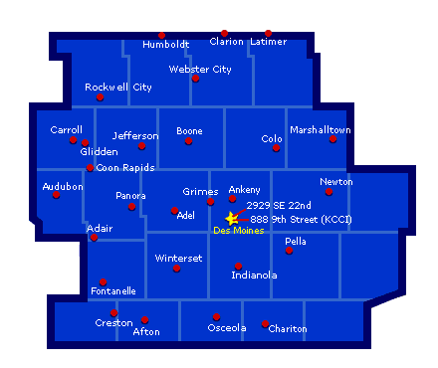
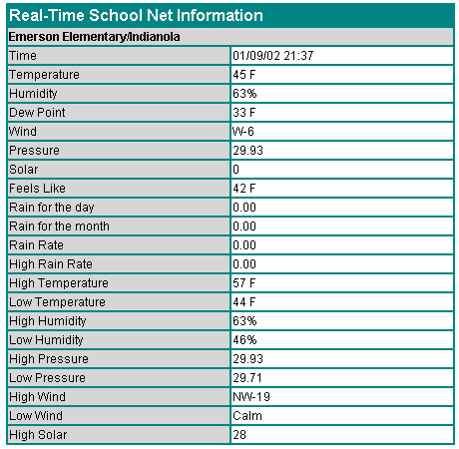
Website before

Slide 20
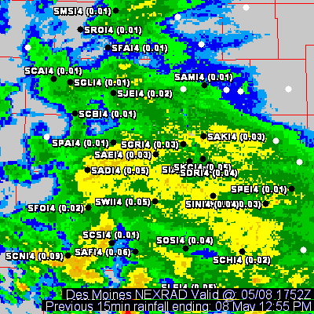
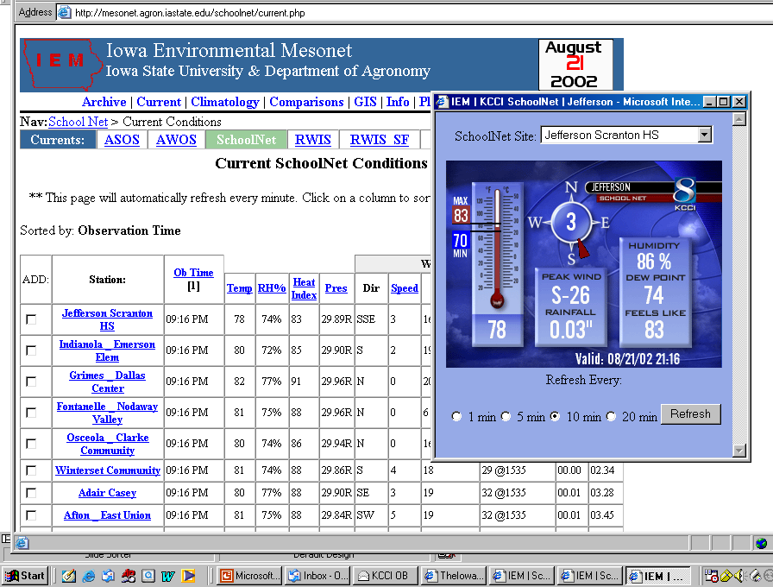
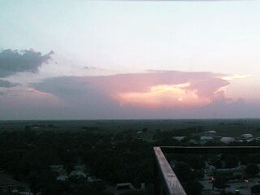
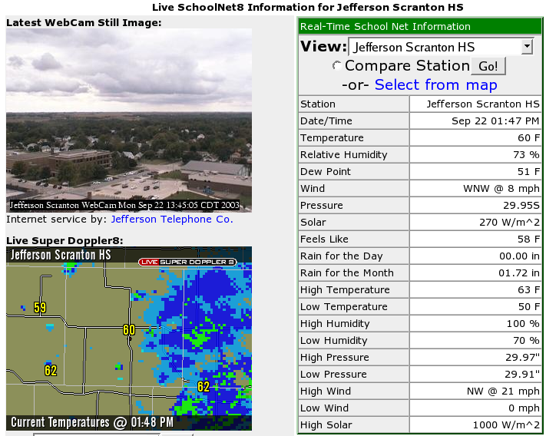
Website after!

Slide 21
CAMERA!
OB!
RADAR!

Slide 22
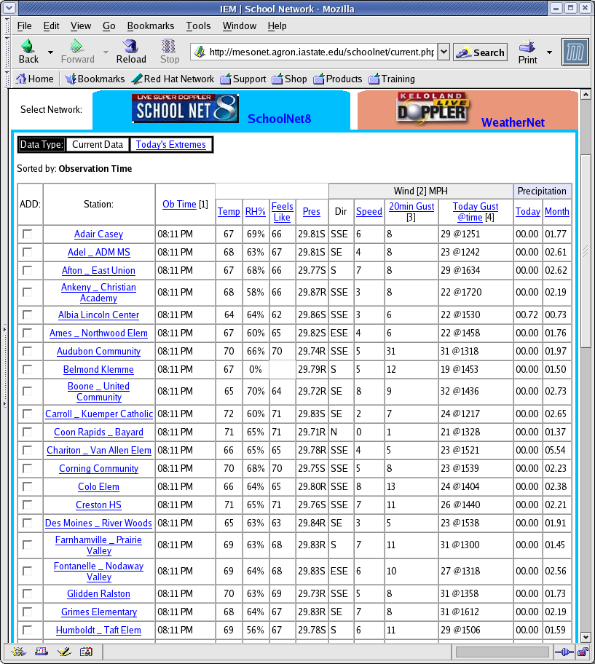
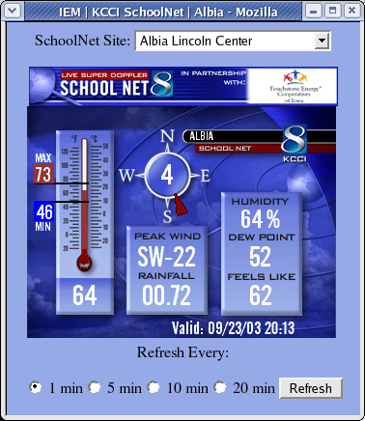
Textual and Graphical
Current Conditions!

Slide 23
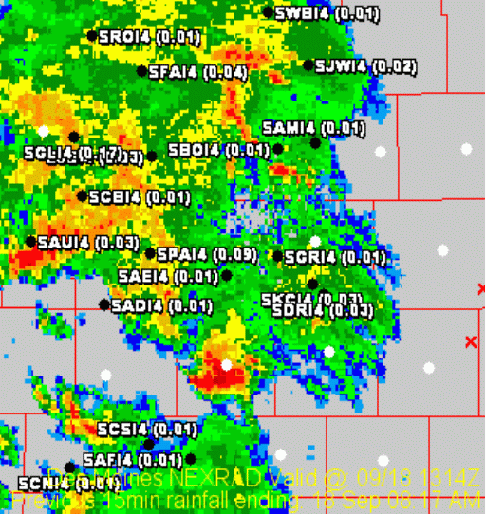
Where is it raining?
Combine live radar with live SchoolNet 15 minute rainfall accumulations.
Great tool for evaluating rainfall intensities.
Great tool for finding sites with plugged tipping buckets!

Slide 24
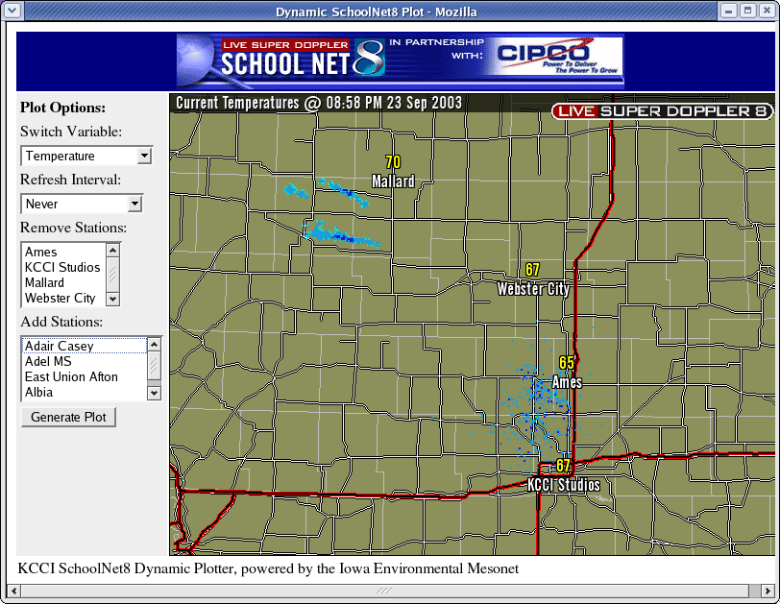
Dynamic RADAR + SchoolNet8

Slide 25
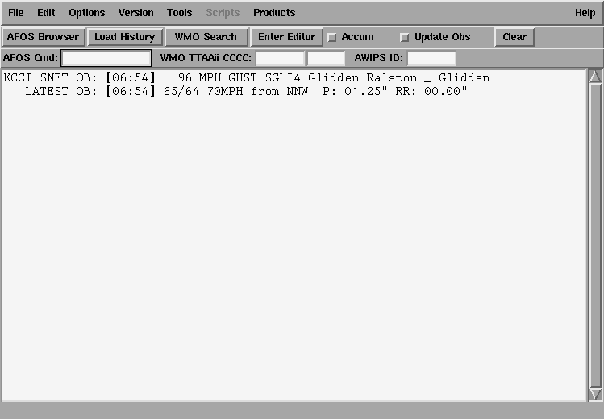
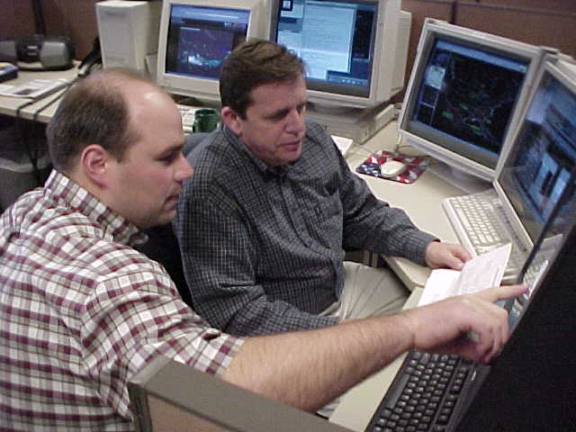
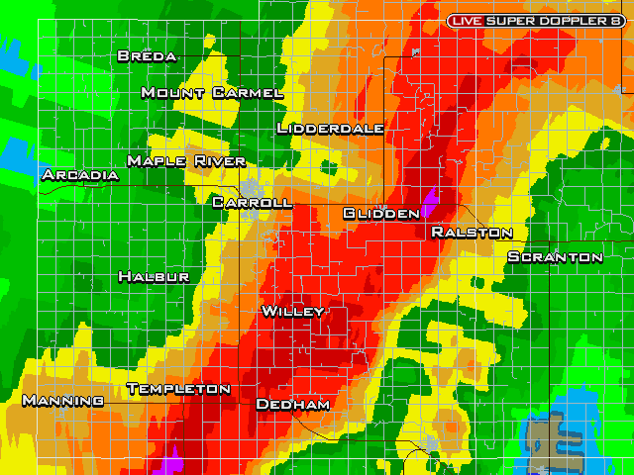
Alerting the NWS

Slide 26
Your SchoolNet @ work
18 June 2003: Nevada SchoolNet
Early afternoon with widespread thunderstorm activity.
Automated wind alert system comes through!

Slide 27
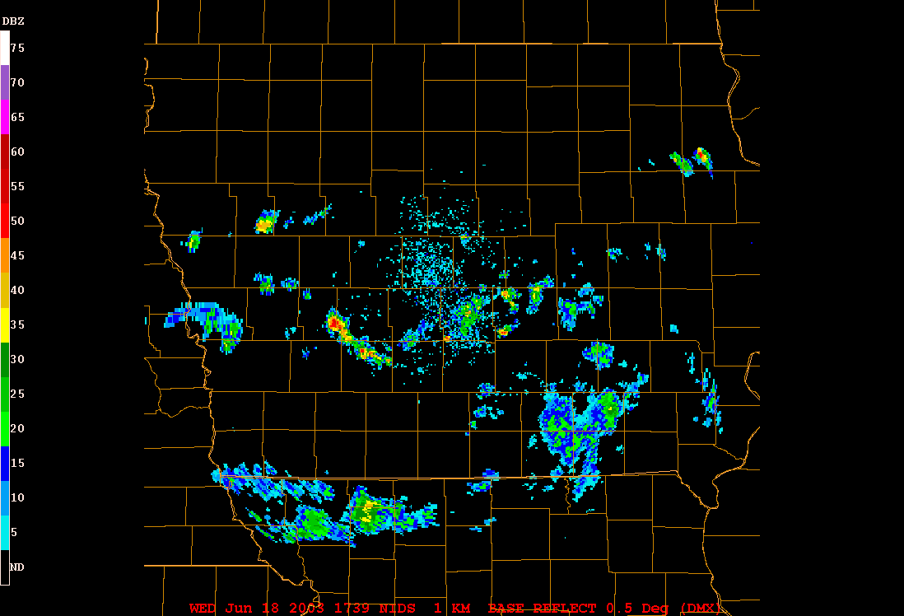
RADAR Loop

Slide 28
At 1:34 PM, an alert is generated
=======================
KCCI SchoolNet8 Wind Gust Alert
-------------------------------
Time: 01:34 pm -- 18 June 2003
Site: NEVADA COMMUNITY
Gust: 58 MPH

Slide 29
At 1:37 PM, the NWS warns
137 PM CDT WED JUN 18 2003
THE NATIONAL WEATHER SERVICE IN DES MOINES HAS ISSUED A
* SEVERE THUNDERSTORM WARNING FOR...
EASTERN STORY COUNTY IN CENTRAL IOWA
* UNTIL 230 PM CDT
7 MILES WEST OF COLLINS AROUND 150 PM AND
NEAR MAXWELL AROUND 155 PM.
DAMAGING WINDS OF 60 TO 70 MILES AN HOUR ARE LIKELY IN THE WARNED AREA. THE KCCI SCHOOLNET SITE IN NEVADA REPORTED 58 MPH WINDS AT 134 PM.

Slide 30
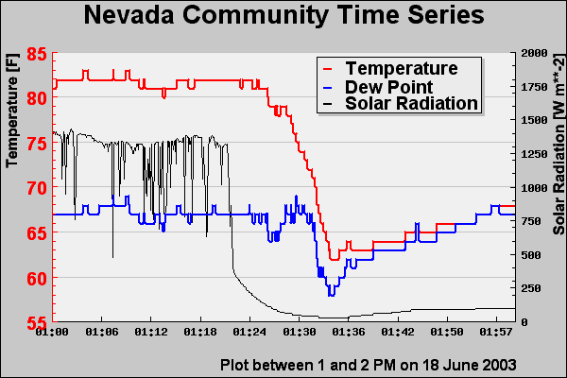
Temperature Trace

Slide 31
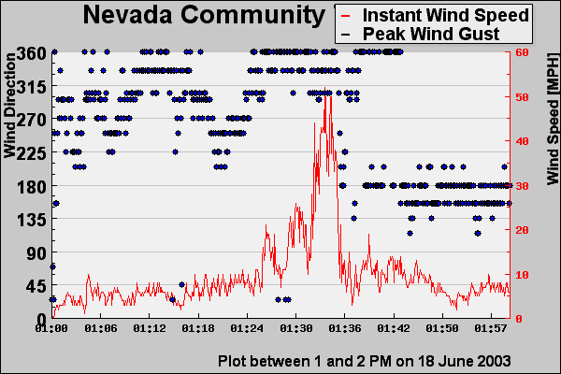
Wind Trace

Slide 32
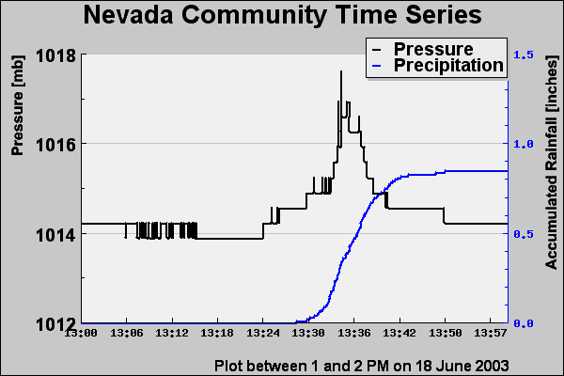
Pressure/Rainfall Trace

Slide 33
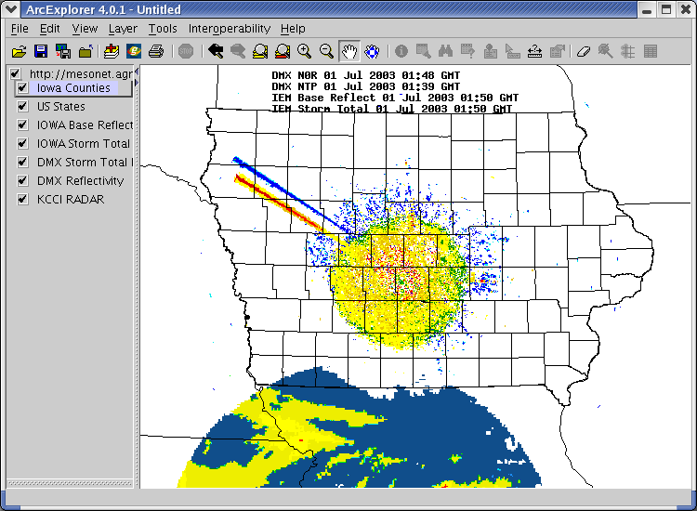

Slide 34
Summary
Get your Baron NWN built
Get FasTrac and plot those sites in real-time on air with your RADAR blowing away your competition.
Partner up to widely distribute the data (I can help here)
Wait, there's more!

Slide 35
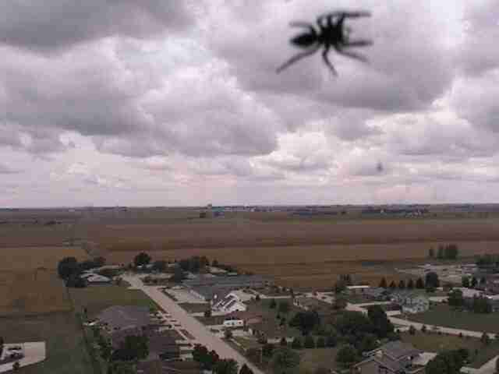
Introducing... InsecTracTM

Slide 36
Web-Cameras
KCCI currently has 3 on-line, more coming
Real-time integration with FasTrac
Some example lapses...

