Slide 1
The Iowa Environmental
Mesonet
  Daryl Herzmann¹
  Dr Ray Arritt¹
  Dr Dennis Todey²
  ¹Iowa State University
  ²South Dakota State University

Slide 2
Outline:
Motivations for our Mesonet
IEM Component Networks
'Super-charging' Networks
Working with the NWS
411 on the KELO WeatherNet
IEM Applications
Conclusions / No Questions

Slide 3
Motivations
The baseline NWS/FAA ASOS network is not spatially or temporally dense enough to resolve many mesoscale phenomena.
Building a new observational network is very expensive.
Building a mesonet of existing networks increases the value, use, and awareness of each member network.

Slide 4
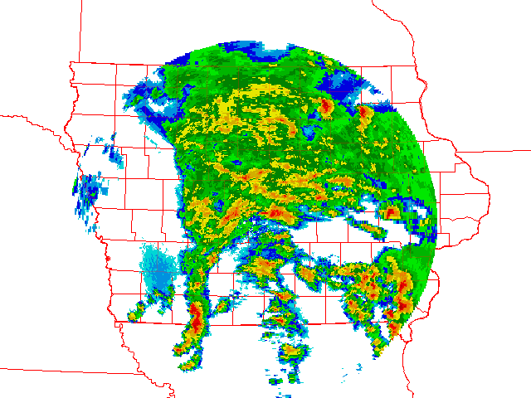
The need for a mesonet
You are a forecaster at the Des Moines WFO. It is 9PM on 8 May 2003. It is dark, so spotters may not be able to help.
What surface observing resources are available to give you situational awareness?

Slide 5
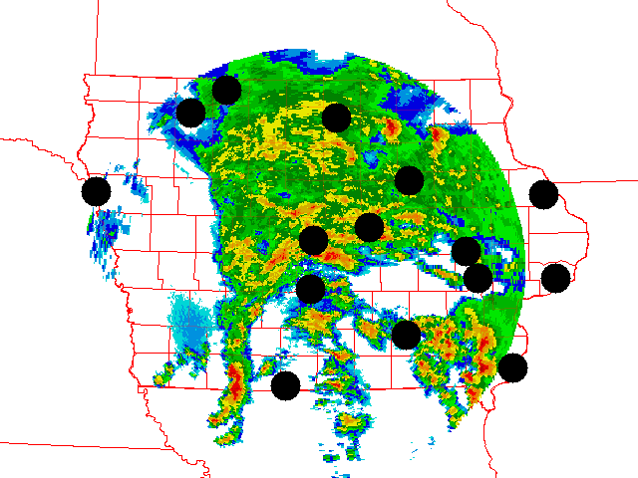
The need for a Mesonet
The baseline ASOS network provides you with hourly and some sub-hourly updates. The storm system is moving fast, so issuing timely warnings relies on timely current data.

Slide 6
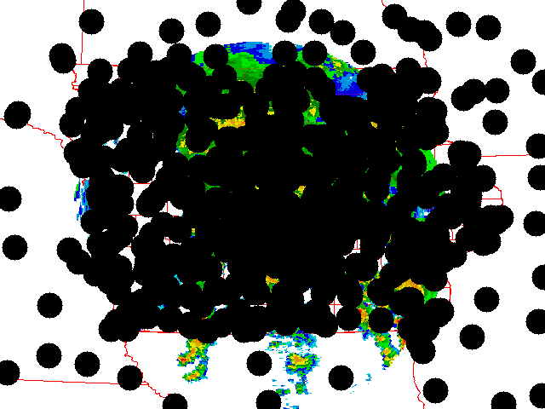
The need for a Mesonet
The Iowa Mesonet collaboration increases your resolution of the near storm environment.
Whoaaa! Dude, where is my RADAR?

Slide 7
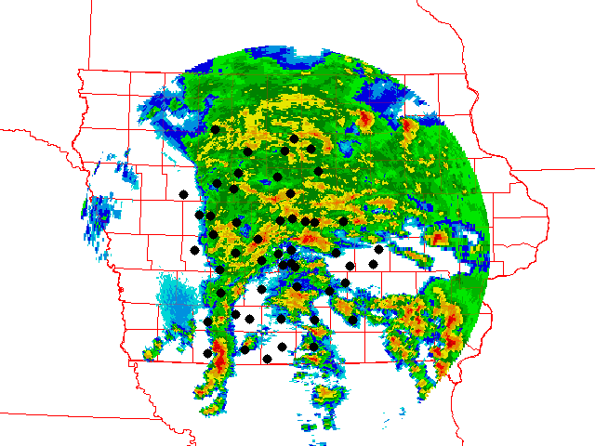
What the Mesonet provided
Newton School
0.6 in / 15min
Various sensors
indicating non-severe
winds with these cells
Most importantly,
51 realtime sensors
recording rainfall just
for the DMX CWA.

Slide 8
IEM Component Networks

Slide 9
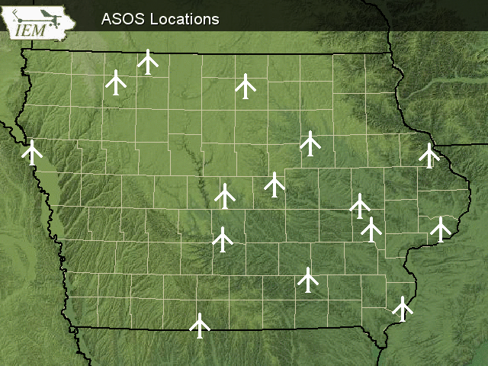
ASOS - Automated Surface
Observing System
Sites
  15 +2 (CWI+FOD)
Location
  Primary Airports
Purpose
  Support aviation

Slide 10
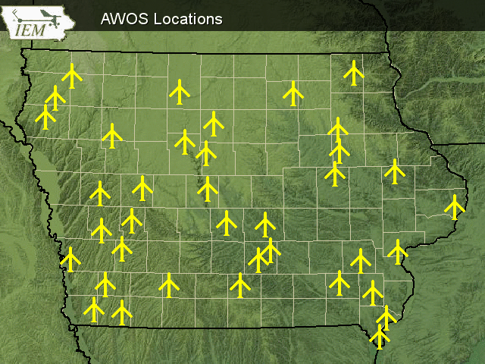
AWOS – Automated Weather Observing System
Sites
  35 +2 (CWI+FOD)
Location
  Smaller Airports
Purpose
  Support aviation

Slide 11
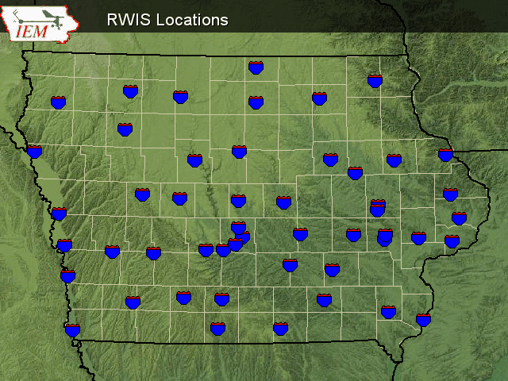
RWIS – Roadway Weather Information System
Sites
  49 Online
Location
  Along major roads near bridges
Purpose
  Road maintenance support in winter

Slide 12
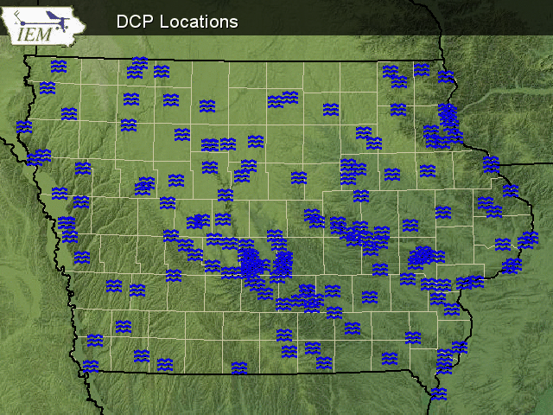
DCP – Data Collection Platforms
Sites
  161
Location
  Along rivers
Purpose
  Monitor river stages

Slide 13
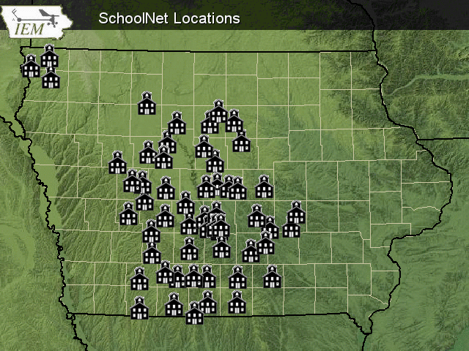
SchoolNet
(KCCI-TV & KELO-TV)
Sites in Iowa
  55 (84 total)
Locations
  Roofs of schools
Purpose
  Support local science curriculum

Slide 14
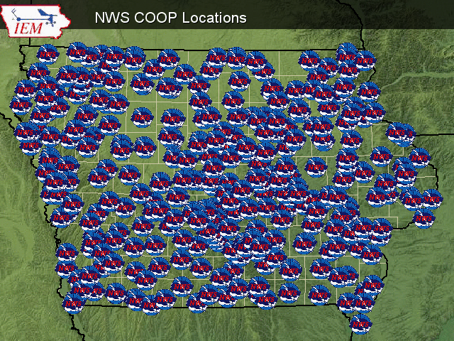
NWS COOP – Cooperative Observing Program
Sites
  145
Locations
  Backyards, fields, about anywhere
Purpose
  Climate and hydro monitoring

Slide 15
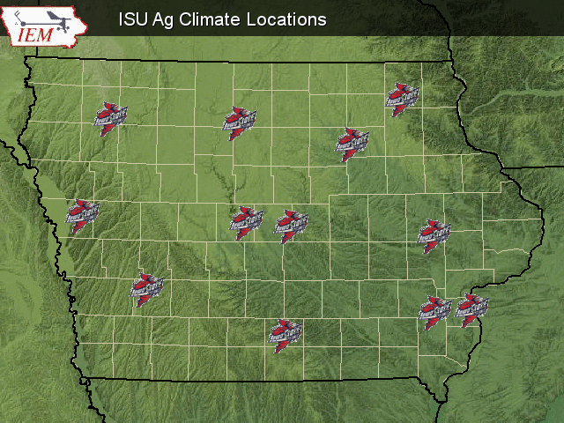
ISU Ag Climate Network
Sites
  12
Location
  Open areas near research farms
Purpose
  Support Ag activities at the farms

Slide 16
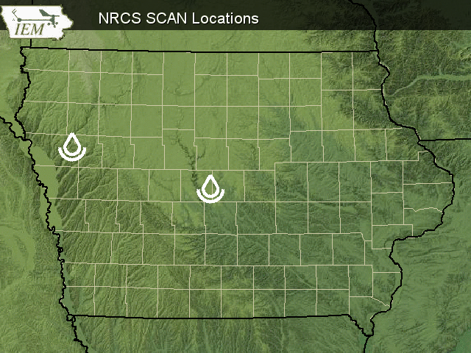
SCAN – Soil Climate
Analysis Network
Sites in Iowa
  2
Location
  Fields
Purpose
  Monitor soil conditions

Slide 17
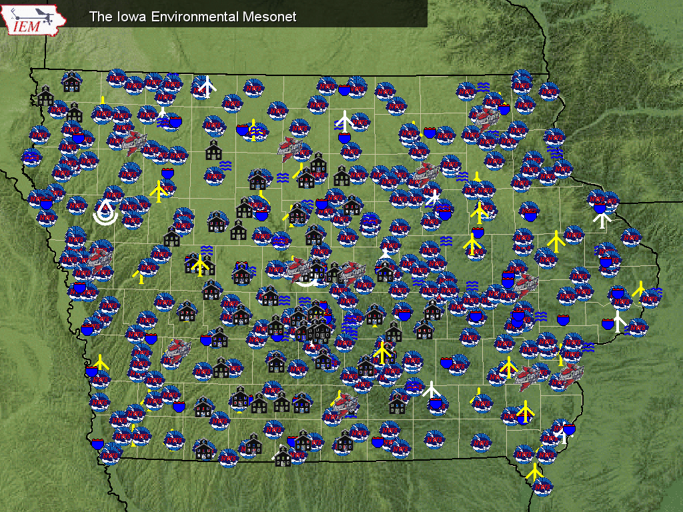

Slide 18
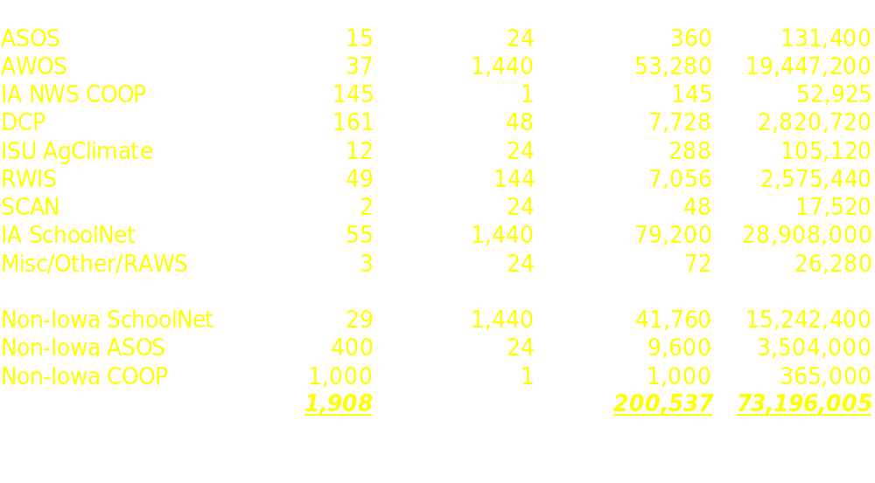
Data Processed Daily

Slide 19
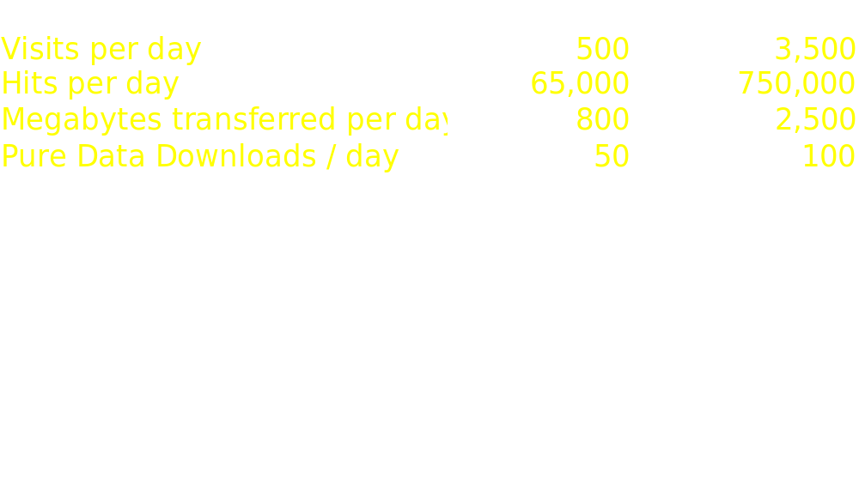
Website Access Stats
While website stats are nice, the IEM is
much more than just another
weather data website!

Slide 20
'Super-Charging' Networks

Slide 21
Value Added Processing
Too many folks just collect data from network X, use data in application Y
We make major efforts to help the various networks out.
  Routing their own data back to them
  Routing other data to them
  Website application development
  Archiving services (download, analysis)
  QUALITY CONTROL!!!

Slide 22
Why work with the networks?
Network operators are typically lacking
  IT support
  An on-staff Meteorologist (a bad thing?)
  QC expertise
We give the networks a reason to keep sending us their data.
We build up their user base to increase the value of their network.

Slide 23

IEM Tracker
9,000 trouble tickets have been generated since June 2002.
All data outages documented.
Very helpful for the SchoolNets
Need to make tickets more visible on the website.

Slide 24
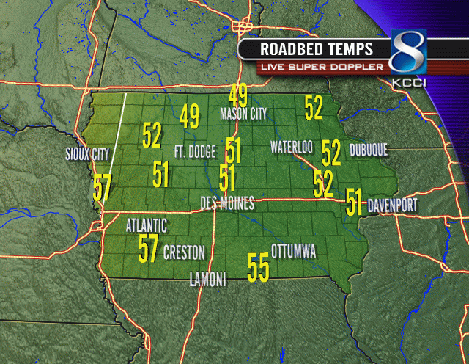
IEM Data Partnerships
On-Air Image generated by KCCI-TV showing IaDOT owned Roadway Weather Sensor (RWIS) information.

Slide 25
Working with the NWS

Slide 26
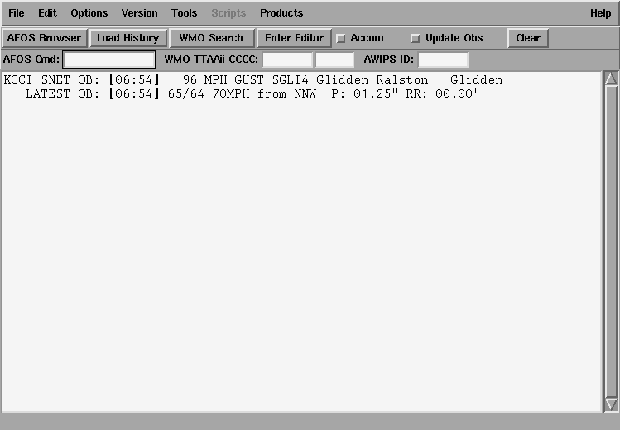
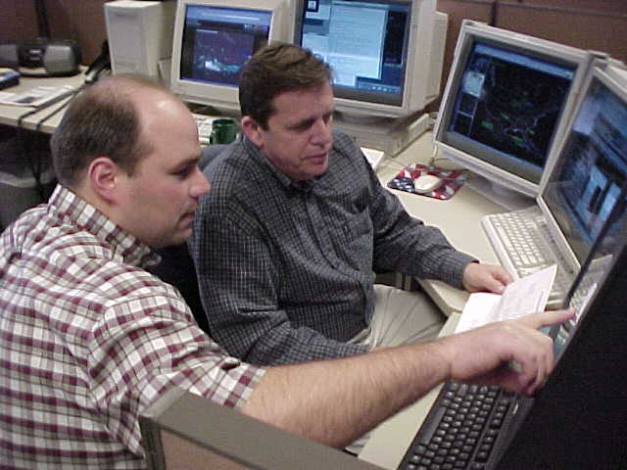
Automated AWIPS Wind Alerts
Des Moines NWS Forecasters using an automated wind alert from the SchoolNet. (Craig Cogil & Gary Forester)

Slide 27
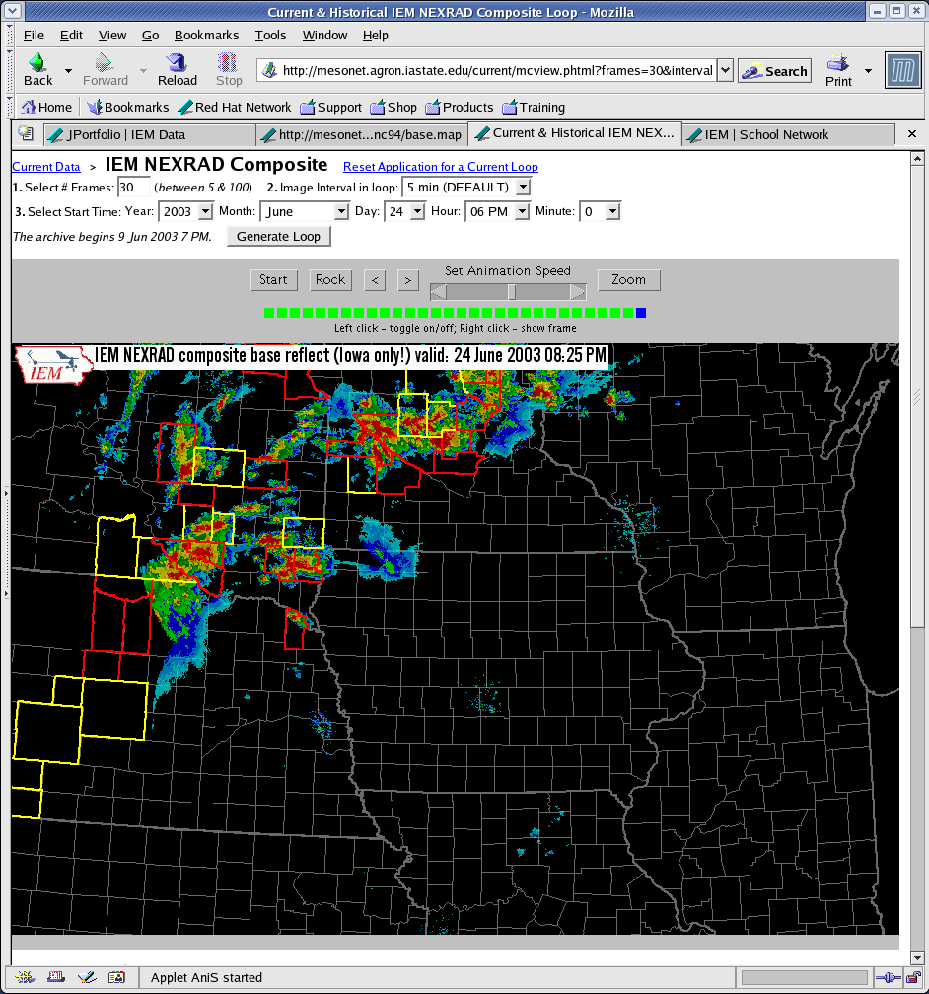
Current/Archived RADAR
5 minute composites since 4 Jun 2003
DMX displays current loop on their projection system during severe weather
Useful for building animations for presentations (hint-hint)
Will backfill archive as requests are made

Slide 28
Formatting Data for AWIPS
Generate LDAD csv files of RWIS data
Generate LDAD csv and SHEF encoded of School data
Wind alerts trigger AWIPS bell
All routed directly to LDAD via LDM
FSD currently gets LDADcsv, SHEF, and wind alerts of KELO SchoolNet

Slide 29
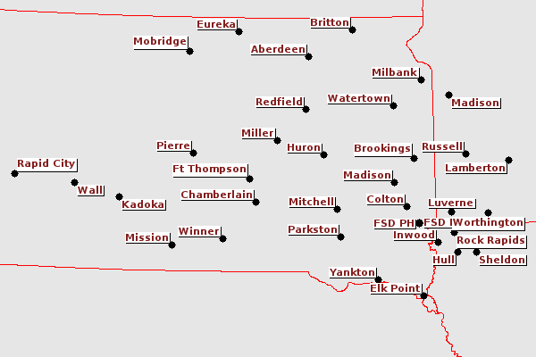
KELO WeatherNet 411

Slide 30
Network Metrics
35 sites
Each site reports: Air Temp, Humidity, Pressure, Instantaneous Winds, Rainfall (not heated), Solar Radiation
Two subnetworks
  Older Texas Weather Instruments
    Report every 6-10 seconds
  Recent addition of Peet Brothers sites
    Report every minute

Slide 31
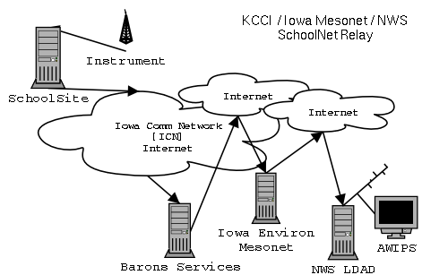
Network Topology

Slide 32
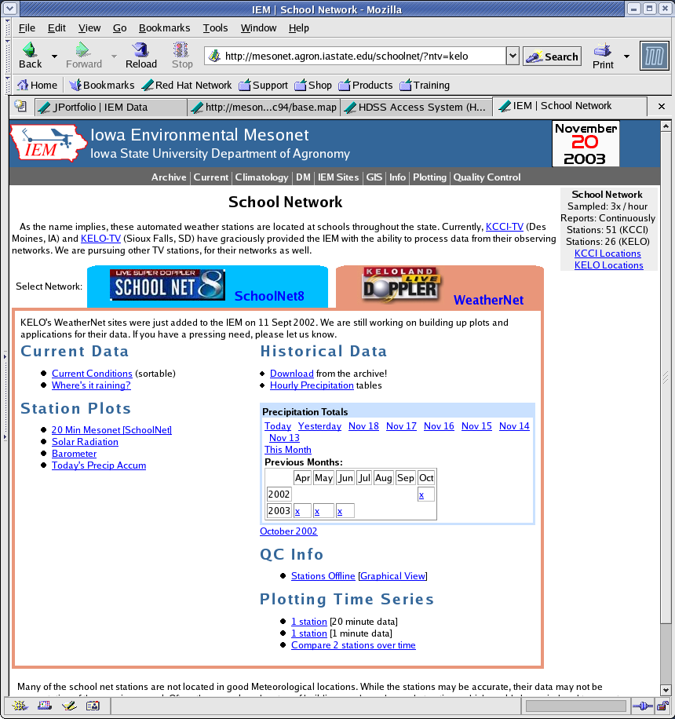
Website Functionality
Data
Download
Current
Sortables
Where's it
raining?
1 minute
data traces

Slide 33
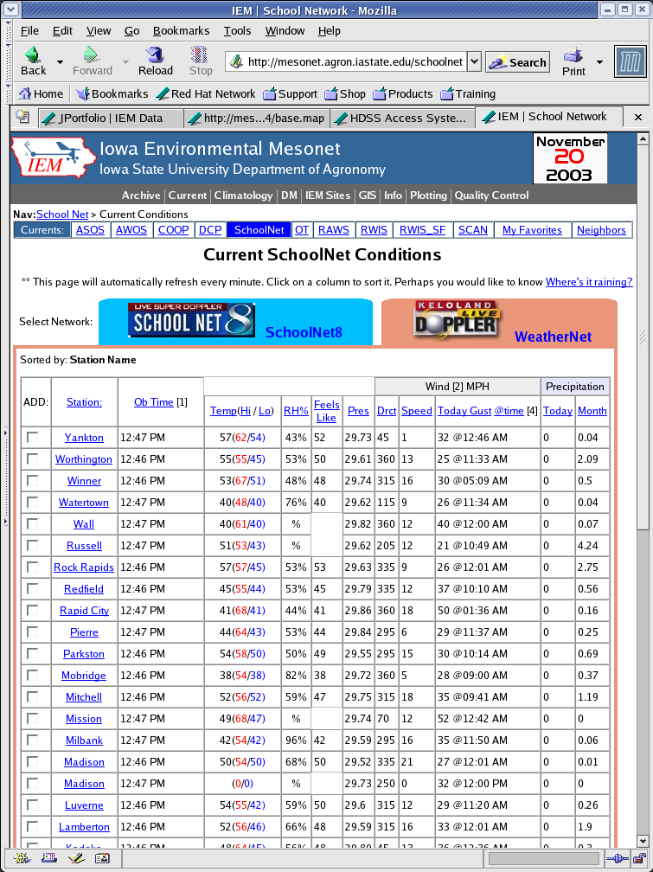
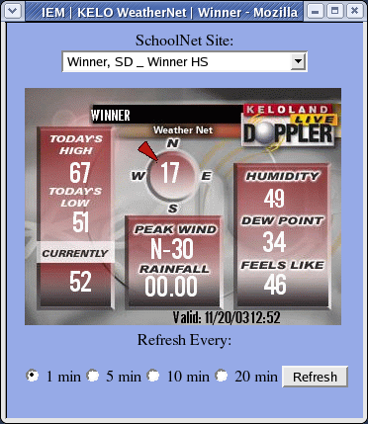
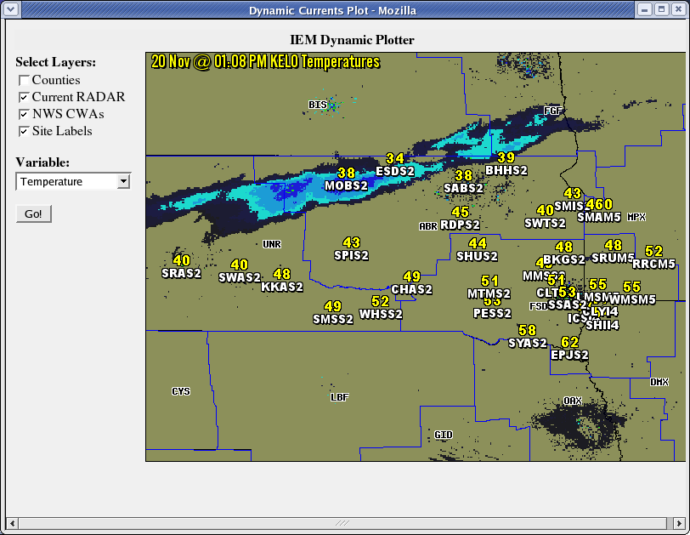
Current Sortables
Variable sorting
Dynamically updates
Add to 'My Favorites' for a custom listing of IEM sites
Dynamic spatial plots of any variable
Replicated On-Air display for any single site

Slide 34
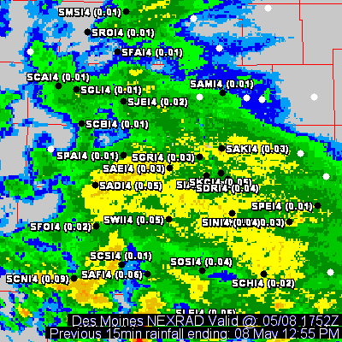
Where's it raining?
'Live' WeatherNet 15 minute rainfall amounts with NEXRAD base reflect
Applications
  Virga detection
  QC sites
  Flash Flood Guidance
  Situational Awareness

Slide 35
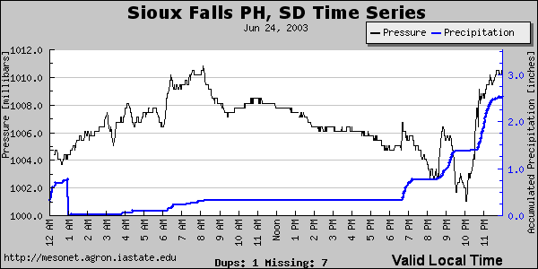
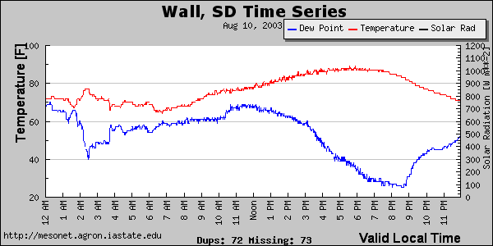
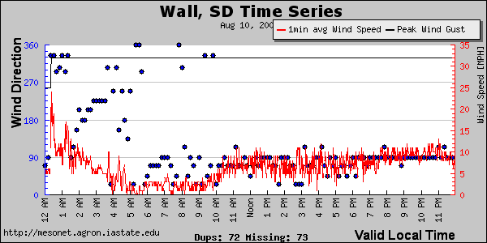
1 Minute Data Traces
Dynamically generated with the latest obs or archived data
So much variability!

Slide 36
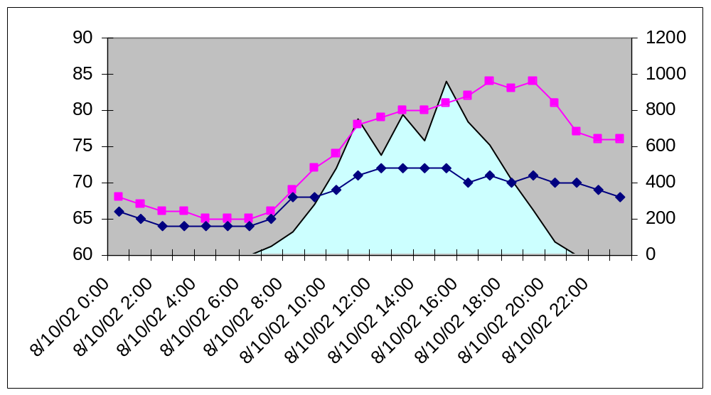
Hourly data
Temperature Dew Point Solar Radation

Slide 37
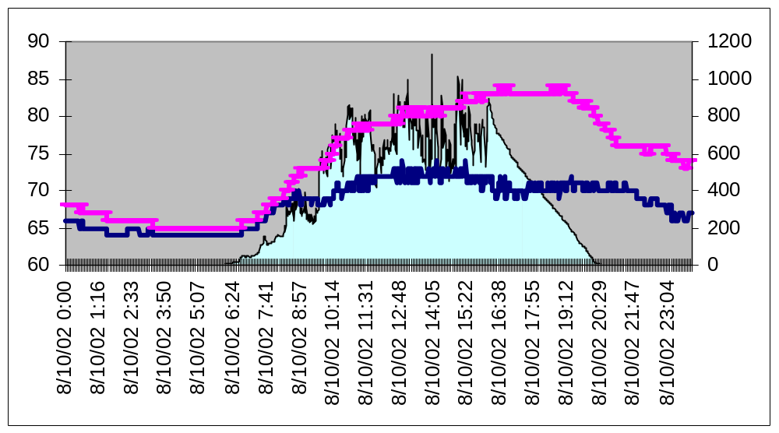
Minute Data
Temperature Dew Point Solar Radation

Slide 38
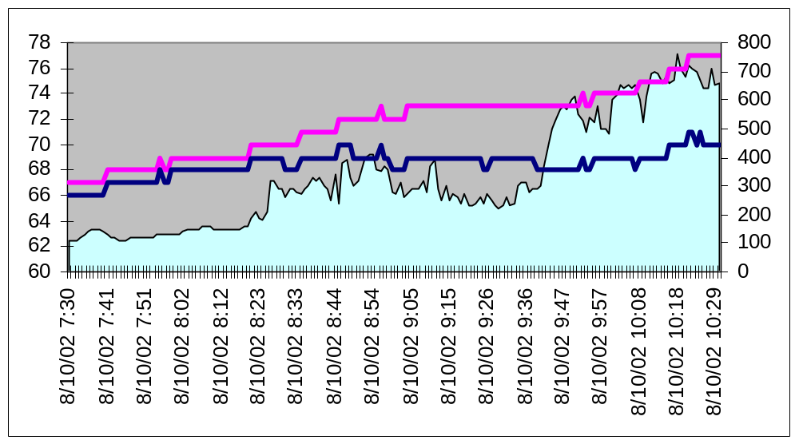
1 minute data!
Temperature Dew Point Solar Radation

Slide 39
IEM GIS Applications

Slide 40
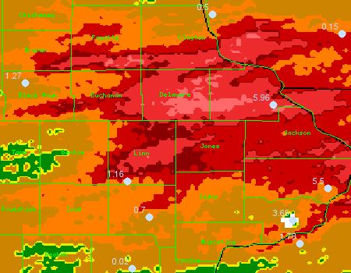
3-4 June 2002 Flooding
DBQ: 5.96 in
NEX: 7+ in
Downtown Cedar Rapids: < 9 in
NEX: 7+ in
CID Airport:
1.16 in
NEXRAD Est:
2 in

Slide 41
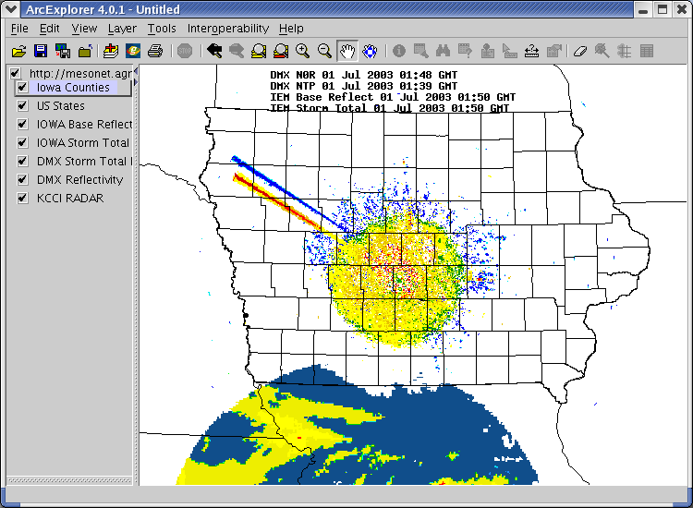
IEM RadView
Effort to provide real-time RADAR data into GIS
First publicly accessible NEXRAD WMS
Mapserver HOWTO

Slide 42
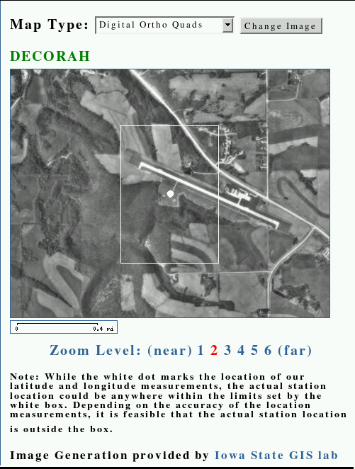
OGC Web Services
Open GIS Consortium (OGC) develops standards for GIS systems to inter-operate
  Web Map Service (WMS)
  Web Feature Service (WFS)
Dynamically bring in Ortho Quads from the ISU GIS Lab
All generated with Open-Source software and Open GIS standards

Slide 43
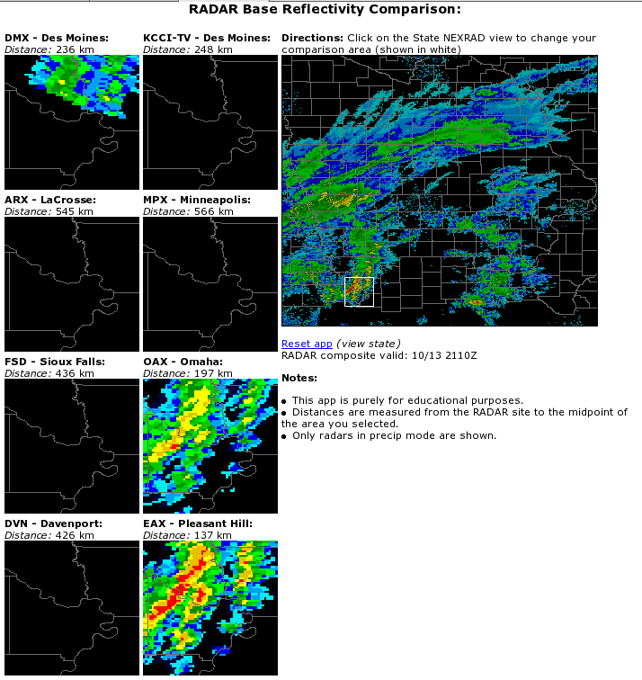
Iowa RADAR comparison
Compare base reflectivity from the 8 RADARs we collect data from
More GISish App
  Click interface
  Distance calculation
  KCCI reprojected

Slide 44
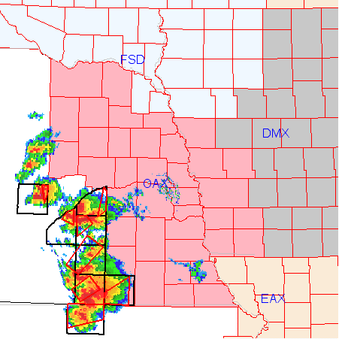
NWS Warnings + NEXRAD
Loop GIS layers to produce an interesting animation of warnings and NEXRAD product
Works nationwide!

Slide 45
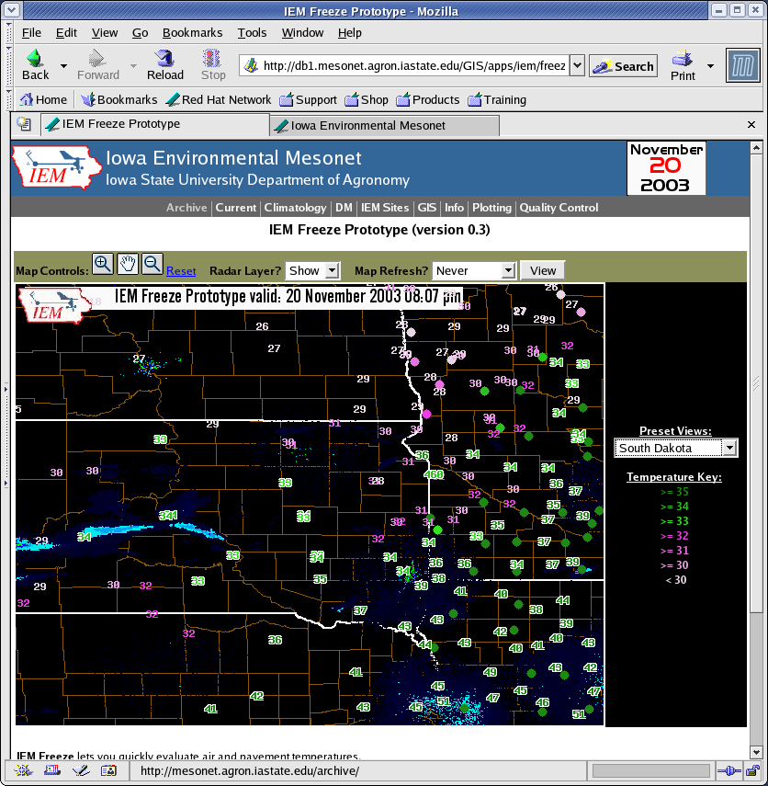
IEM Freeze
Combine
  RWIS pavement temperatures
  IEM air temperatures
  RADAR composite
A GIS interface for custom views
Feedback needed!

Slide 46
Fun with COOP data

Slide 47
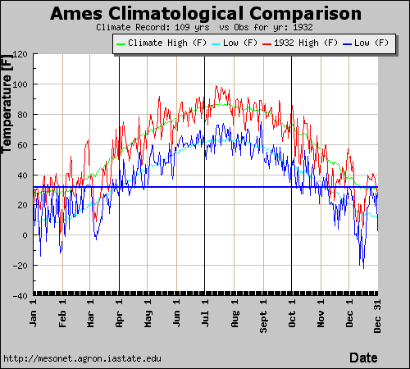
Climatological Differences
Interactively query the NWS COOP climate database.
Example, compare daily temperature climatology versus what actually happened that year!

Slide 48
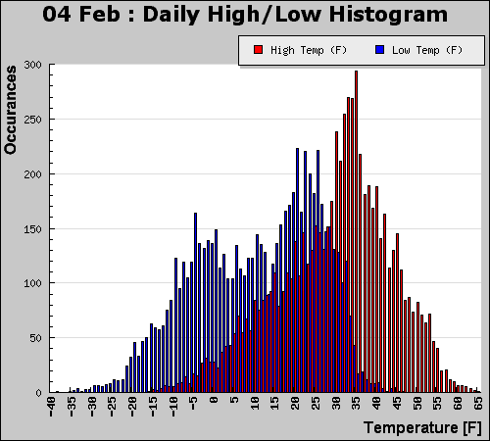
Daily Temperature Spreads
Accumulate all high / low temperatures for a day and produce a histogram
Dynamically generated on the website

Slide 49
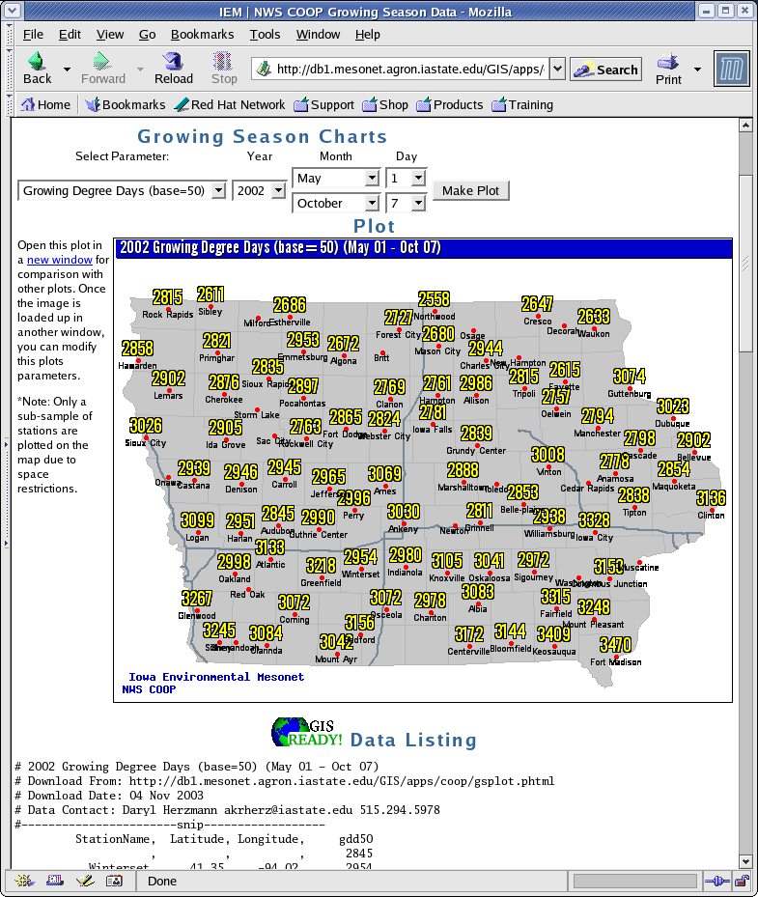
Historical GDD data
Dynamically generate GDD, SDD from the COOP climate archive
Customized Period
Dynamically generated output plot.
GIS Ready dataset presented immediately below

Slide 50
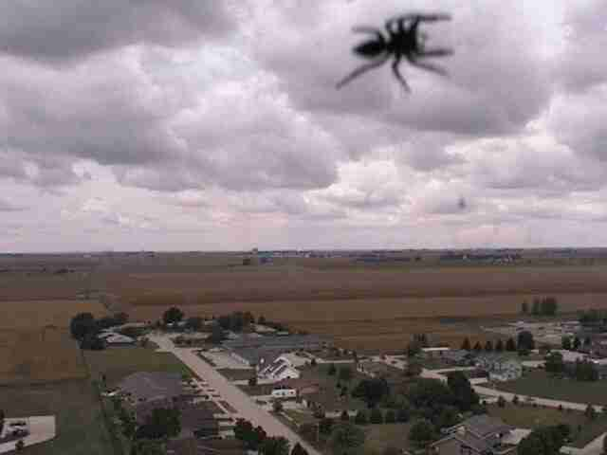
Time for WEB demos?

Slide 51

I'm done, questions?
Daryl Herzmann
3010 Agronomy
515-294-5978
akrherz@iastate.edu

