Slide 1
KCCI SchoolNet8 Workshop
Daryl Herzmann
Iowa Environmental Mesonet
Iowa State University

Slide 2
The Rundown
CIPCO/IEM/KCCI/NWS partnership
Who is using your data?
IEM Tracker (a.k.a. spam generator)
Downloading Data
Website Demo
Java Viewer Demo

Slide 3




Our Partnership
Process Feedback
IEM
NWS
Custom Data Products
Data Services
Operations Support
Project Support
Improved Products
KCCI -TV

Slide 4
Iowa Environmental Mesonet 411
What does ‘mesonet’ mean?
  ‘meso’ - Spatial scale, ‘net’ - network
Why ‘environmental’?
  We are interested in air quality, water quality and other non-weather datasets
Where is ‘Iowa’?
  It is the current state you are in, soon you will all be asleep.
Abbreviated 'IEM'

Slide 5
More on the IEM
Project of the Department of Agronomy at Iowa State University
We are data pigs.
Look to meet the growing data needs of users in the State and elsewhere.
KCCI SchoolNet is one of the many networks that send data to us.

Slide 6
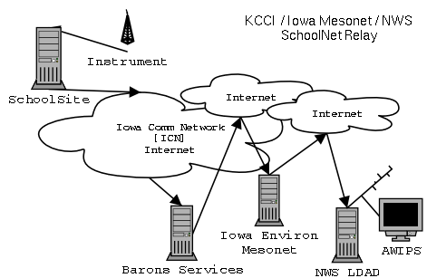
Data Flow

Slide 7
Data Formatting
C 074 Min 02/17/03 ENE 00MPH 000K 460F 007F 084% 30.08" 00.00"D 00.07"M 00.00"R
D 074 Max 02/17/03 ENE 10MPH 050K 460F 021F 100% 30.20" 00.00"D 00.07"M 00.00"R
E 074 12:01 02/17/03 ENE 03MPH 046K 460F 020F 099% 30.09F 00.00"D 00.07"M 00.00"R
Your site produces roughly 6 obs per minute!

Slide 8
Converted Data Formats
METAR
SAUS43 KDMX 171536
METAR
QJEI 171535Z 05004KT M13/M14 A3009 RMK T11281144 P0000 70000=
Comma Delimited
SAEI4,2003/02/17 15:35:00,-11.7, 13.3,2,180,0.0,0.0,30.09
SHEF
.B DMX 0221 C DH22/TA/PPH/PPT/PPQRS/PPDRS/PCIRP
SADI4 35 / 0.00 / 0.00 / 0.00 / 0.00 / 0.68

Slide 9
SchoolNet8 Data Users

Slide 10
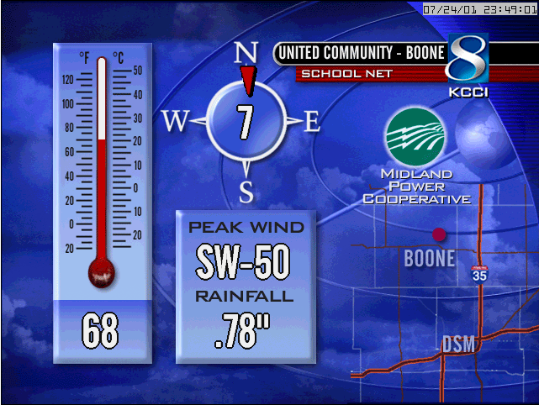
KCCI uses it!

Slide 11
SchoolNet8 Data Users
Storm Prediction Center [SPC]
  Norman, Oklahoma
  In charge of providing timely forecasts of extreme weather.
  Use schoolNet8 data to help identify mesoscale boundaries critical in severe weather forecasting

Slide 12
SchoolNet8 Data Users
River Forecast Center [RFC]
  Chanhassen, MN
  In charge of analyzing and forecasting river flood conditions. Hydrological data.
  Use SchoolNet8 precipitation totals for their water analysis.
  The SchoolNet8 network has doubled the hydrological observing sensors in Central Iowa.

Slide 13
SchoolNet8 Data Users
Forecast Systems Laboratory [FSL]
  Boulder, Colorado
  Data collected under the MADIS project.
  Data is used in very detailed and heavily quality controlled surface analysis programs.
  This data is then included in some operational weather forecasting models run in D.C.

Slide 14
SchoolNet8 Data Users
National Weather Service [NWS]
  Des Moines, IA
  Receiving data in three different formats
  Use data in hydrological applications, surface analysis, severe weather awareness, winter weather awareness.
  Are automatically alerted of 50+ MPH wind gusts and heavy rainfall.

Slide 15
NWS Auto Alerts
Previously, KCCI would have to manually relay observations to the weather service.
Now, the IEM automatically generates warnings that appear on forecaster workstations.

Slide 16
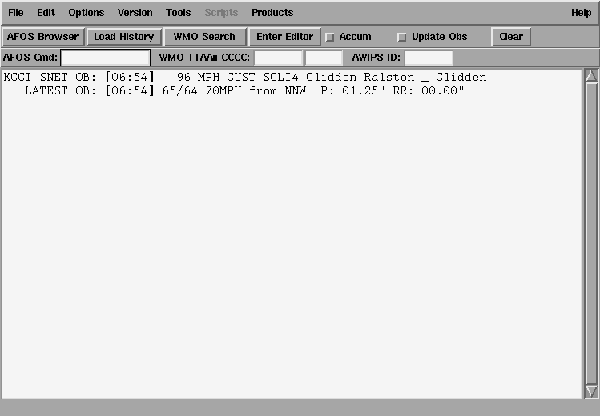
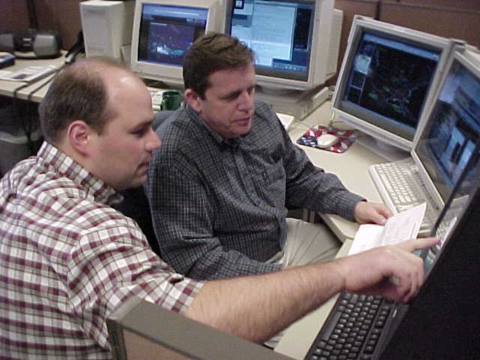
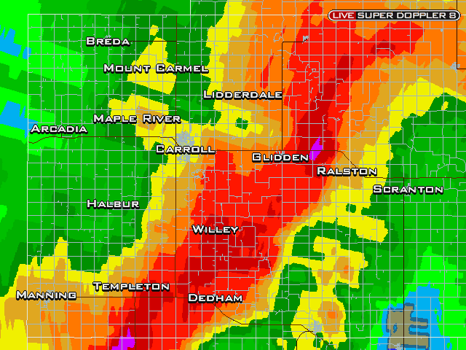
NWS AWIPS alerts

Slide 17
18 June 2003:
Nevada SchoolNet
A good example of how data from your school can make a difference in your community.

Slide 18
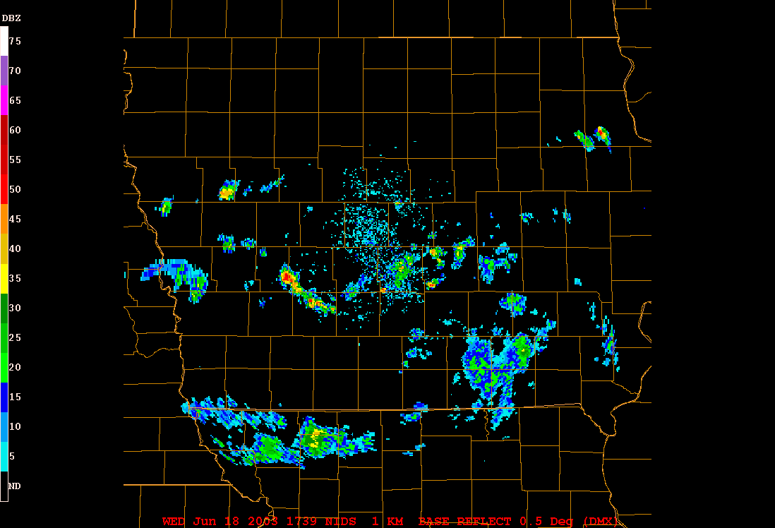
RADAR Loop

Slide 19
At 1:34 PM, an alert is generated
=======================
KCCI SchoolNet8 Wind Gust Alert
-------------------------------
Time: 01:34 pm -- 18 June 2003
Site: NEVADA COMMUN
Gust: 58 MPH

Slide 20
At 1:37 PM, the NWS warns
137 PM CDT WED JUN 18 2003
THE NATIONAL WEATHER SERVICE IN DES MOINES HAS ISSUED A
* SEVERE THUNDERSTORM WARNING FOR...
EASTERN STORY COUNTY IN CENTRAL IOWA
* UNTIL 230 PM CDT
7 MILES WEST OF COLLINS AROUND 150 PM AND
NEAR MAXWELL AROUND 155 PM.
DAMAGING WINDS OF 60 TO 70 MILES AN HOUR ARE LIKELY IN THE WARNED
AREA. THE KCCI SCHOOLNET SITE IN NEVADA REPORTED 58 MPH WINDS AT 134
PM.

Slide 21
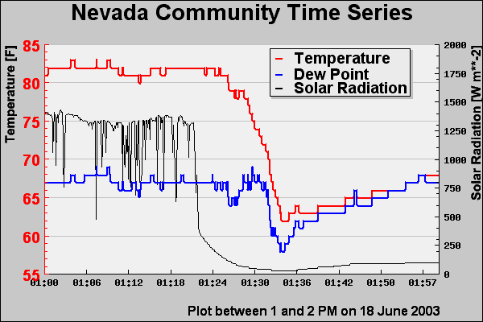
Temperature Trace

Slide 22
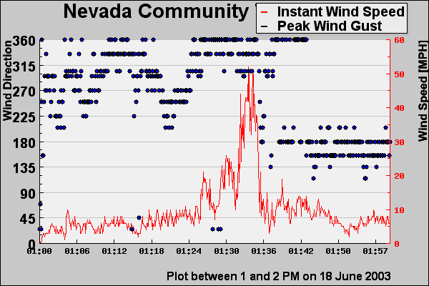
Wind Trace

Slide 23
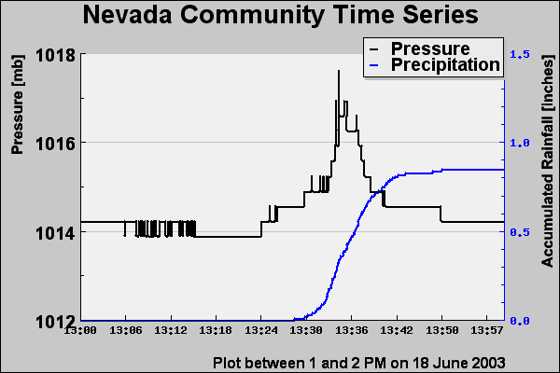
Pressure/Rainfall Trace

Slide 24
IEM Tracker

Slide 25
IEM Tracker
System to manage metadata about sites
Most of you have probably gotten the emails from “Iowa Environ Mesonet”
Since the system came online on 25 June 2002, it has generated over 11,000 tickets
Most of these tickets are generated from the automated data tracking system

Slide 26
What are offline alerts?
When ‘online’, your site is streaming observations to the Internet at roughly 6 obs per minute.
A process on the IEM server monitors this feed and once the most recent ob is 30 minutes old, a trouble ticket is generated and site contacts are emailed.

Slide 27
Understanding the Ticket.
---------------------------------
| *** IEM TRACKER REPORT *** |
------------------------------------------------------------
ID : SCOI4
Station Name : COLO ELEM _ COLO
Status Change : [OFFLINE] Site is NOT reporting to the IEM
Trouble Ticket# : 3704
Last Observation : 2003-02-17 23:53:00.00

Slide 28
More about the tickets
Probably 50% of the tickets are network related and out of your hands.
5% of the tickets are responded to with further information
IEM tracker has improved network performance for each of the networks it monitors.

Slide 29
SchoolNet8 Performance
Fewest Tickets
  5 Bedford
  5 Bloomfield
  10 NW Webster
Highest Online %
  93 Jefferson Scranton
  92 Afton
  92 River Woods DSM
Most Tickets
  89 Colo
  88 Adel
  70 Panora
Lowest Online %
  61 Clarion
  69 Murray
  73 Pella

Slide 30
Keep those clocks set!
Data on the IEM website is given a timestamp of the current IEM system clock and NOT the timestamp on the observation.
The precipitation counters are adversely impacted by drifting clocks.
It makes it a bit more difficult to calculate daily precipitation totals.

Slide 31
Download Data Archive

Slide 32
Data Archives
1 minute data archive exists since 12 Feb 2002, this is available on-line
Since 10 Jul 2002, every observation is archived, but not readily available. I can fill these data requests if you send me an email.

Slide 33
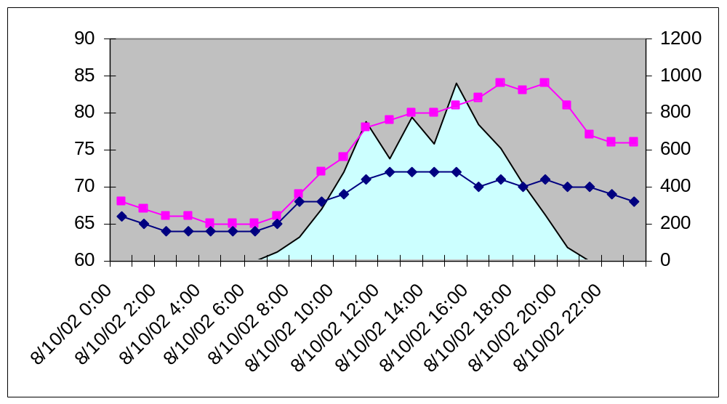
Hourly data
Temperature Dew Point Solar Radation

Slide 34
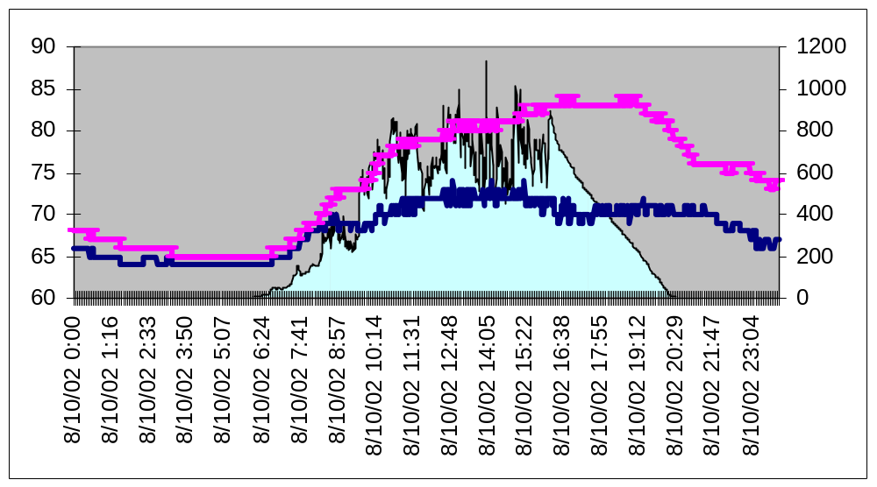
Minute Data
Temperature Dew Point Solar Radation

Slide 35
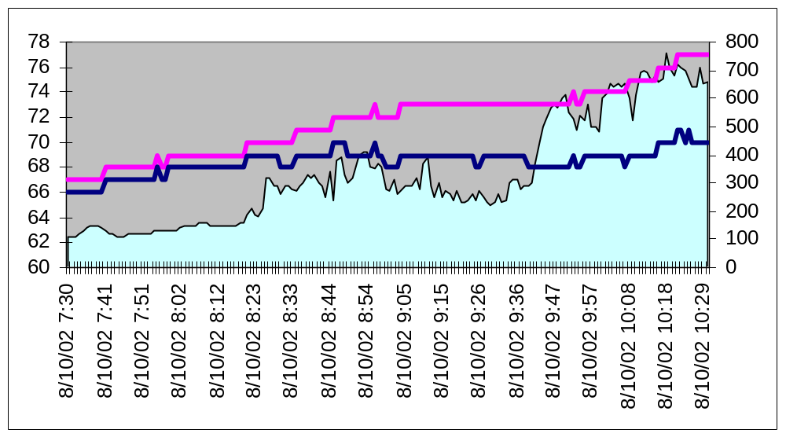
10 second data!
Temperature Dew Point Solar Radation

Slide 36
WWW Resources

Slide 37
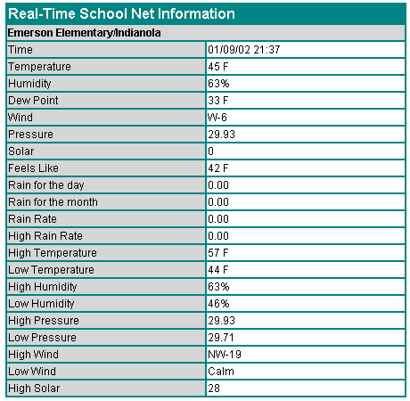
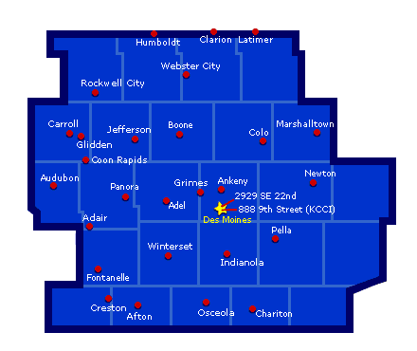
Circa 2001

Slide 38
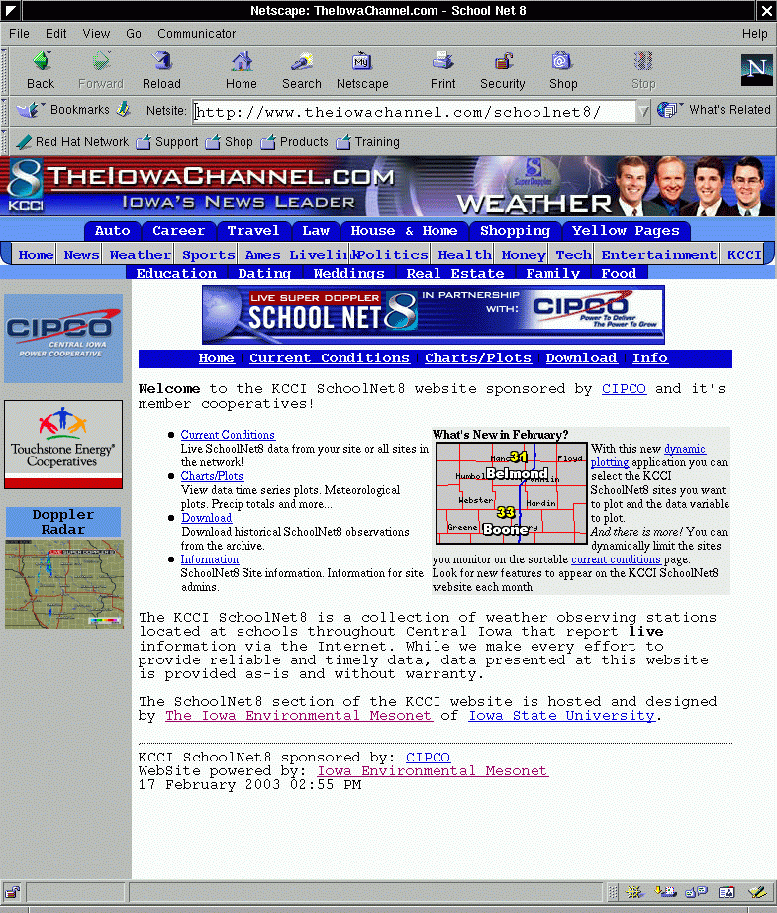
Circa 2002

Slide 39
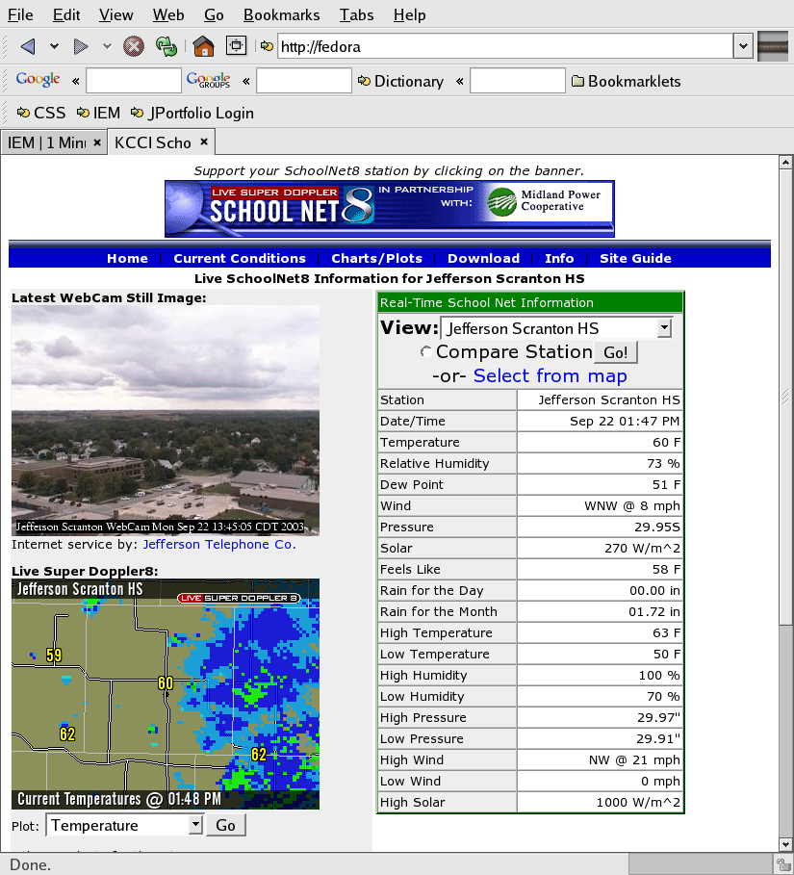
Circa
2003

Slide 40
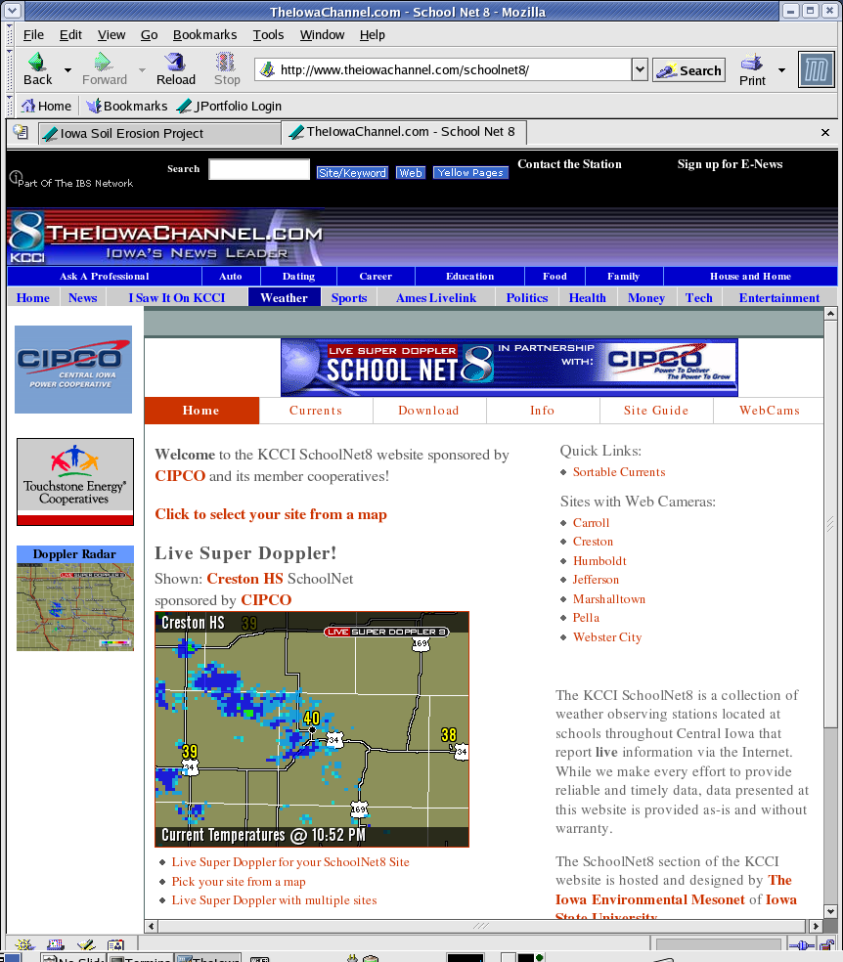
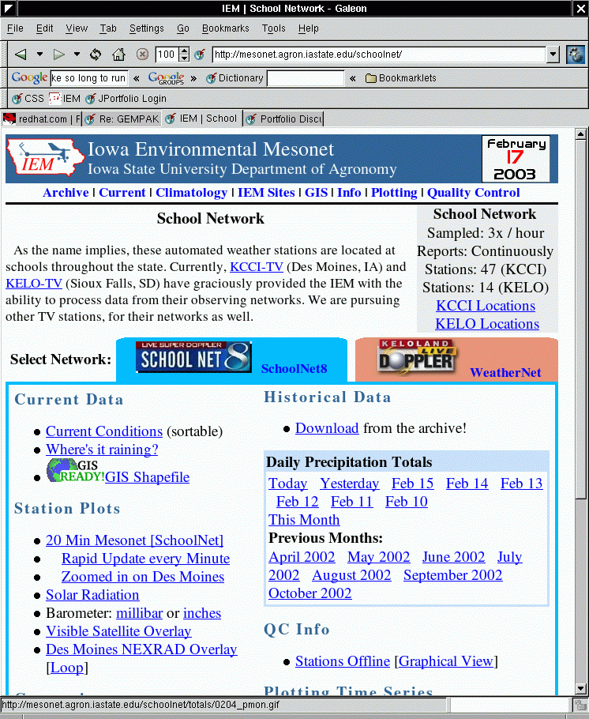
Which website is which?

Slide 41

Questions?
Daryl Herzmann
3010 Agronomy Hall
Ames, IA 50010
515.294.5978
Cell: 515.451.9249
akrherz@iastate.edu

