Slide 1
12.3 Using Open GIS web services to serve environmental data
Daryl Herzmann
Raymond Arritt
Iowa Environmental Mesonet (IEM)
Department of Agronomy, Iowa State University

Slide 2
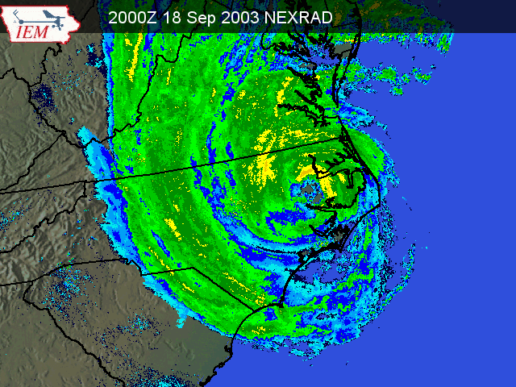
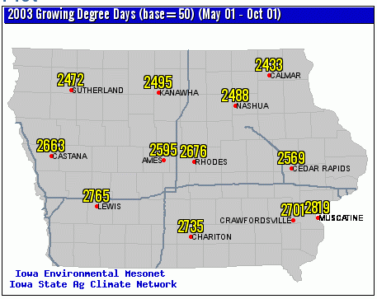
Our GIS Session History
2003: Getting our data into GIS accessible formats. Spatial Databases
2004: GIS Web Mapping. Applications with NEXRAD information.

Slide 3
The rundown for 2005!
Motivation
Overview of OGC web services (WMS,WFS,WCS)
IEM web service offerings
Example implementations
What we have learned

Slide 4
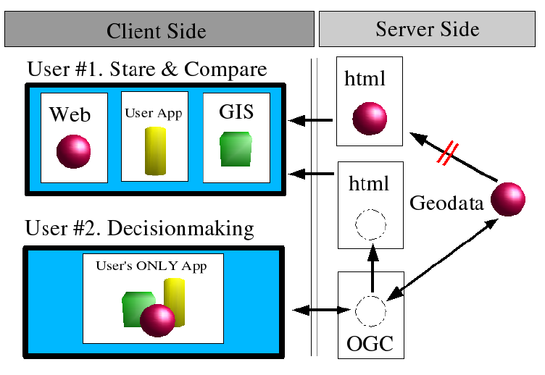
Motivation

Slide 5



The Software Components
PostGIS – Spatial datablade for the PostgreSQL RDBM
MapServer – Extremely fast and capable internet mapping server also supporting WFS,WMS,WCS
Linux – What else would you build your enterprise data system on?

Slide 6
WMS: Web Map Service
“A WMS produces maps of spatially referenced data dynamically from geographic information.” - from OGC WMS 1.3
WMS defines three operations protocols
  GetCapabilities
    Get server capabilities
  GetMap
    Returns a map or an exception
  GetFeatureInfo (Optional)
    Mechanism to do pixel queries on GetMap generated maps

Slide 7
WFS: Web Feature Service
“[WFS] proposes interfaces for describing data manipulation operations on geographic features using HTTP” – OGC WFS 1.0
Data manipulation operations include
  Create a new feature instance
  Delete a feature instance
  Update a feature instance
  Get or query features based on spatial constraint

Slide 8
WCS: Web Coverage Service
“WCS supports electronic exchange of geospatial data as ‘coverages’ ” – OGC WCS 1.0
A WCS provides three operations
  GetCapabilities
  GetCoverage
  DescribeCoverage

Slide 9
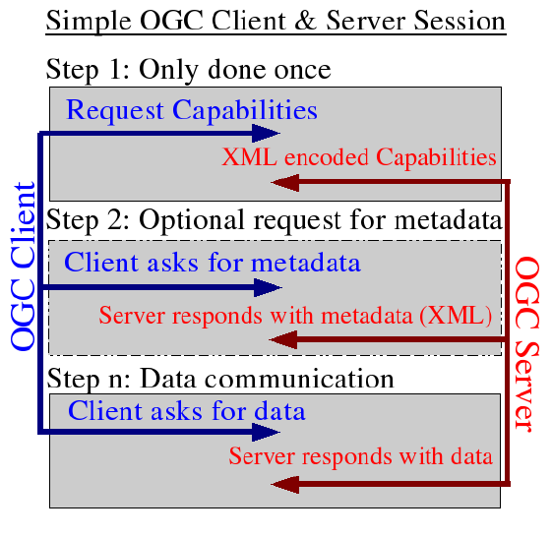

Slide 10
IEM OGC Offerings http://mesonet.agron.iastate.edu/ogc/
 | WMS | WFS | WCS
CONUS NEXRAD (Base Reflect, Storm Precip) | X |  | ? X ?
NCEP Stage4 Precip (Iowa) | X | X
Iowa Road Conditions | X | X
NWS Current/Archived Warnings (County + Polygon) | X | X

Slide 11
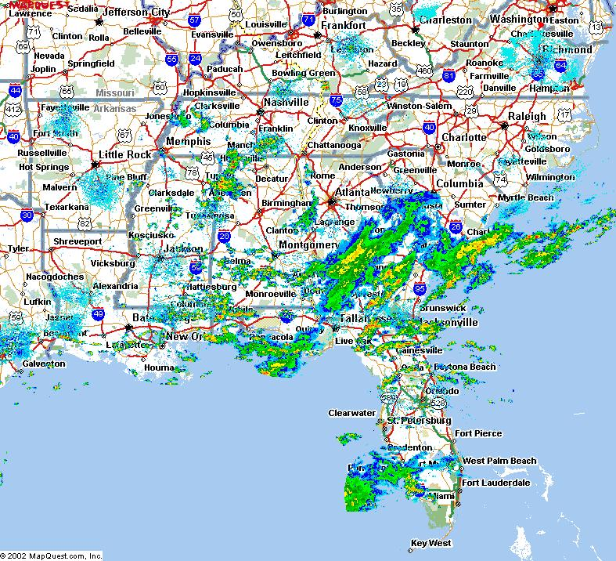
Supporting 2004 Hurricanes
Provided Disaster Management Interoperability Services a RADAR WMS to support their decision support software
http://www.cmi-services.org

Slide 12
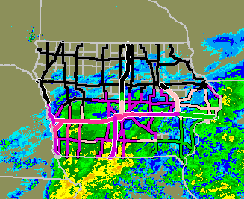
Providing Road Conditions to Media Outlets
WFS and WMS support generation of images for display in TV Weather graphics systems

Slide 13
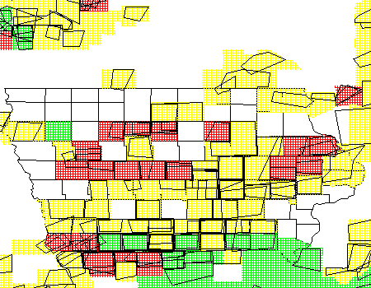
NWS Warnings WFS
Retrieve current and historical NWS warnings (polygon and county based).
Archive begins Jul 2002

Slide 14
Lessons Learned
OGC webservices greatly reduced chaos on our server. Chaos being:
  Redundantly storing data for different apps
  Versioning issues with redundant data
  Redundant code to simply add a RADAR layer to a map
The application development time reduced
Performance hit was remarkably small

Slide 15
More Lessons Learned
Often, the performance bottleneck is the overhead of HTTP
The client application/implementation is absolutely key
  Example: No WFS support for ArcGIS9 (?)
(Daryl’s 2 cents) The OSS community needs to generate some killer OGC desktop interfaces and scripting libraries. [PyOGCLib a start?]

Slide 16

Time for Questions?
mesonet.agron.iastate.edu
Daryl Herzmann
515.294.5978
Akrherz@iastate.edu

