Slide 1
Using Open GIS web services to serve environmental data
Daryl Herzmann
Raymond Arritt
Iowa Environmental Mesonet (IEM)
Department of Agronomy, Iowa State University
http://mesonet.agron.iastate.edu

Slide 2
The Rundown
Motivation
Overview of OGC web services (WMS,WFS,WCS)
IEM web service offerings
Example implementations
What we have learned

Slide 3
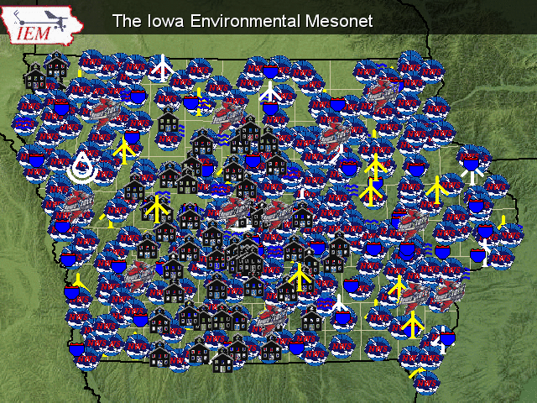
The Iowa Environmental Mesonet
Data collection and collaboration project based at Iowa State.
Focused on collecting any environmental data from the Upper Midwest.
We don’t own any of the observing sites, but collect from others that have them.

Slide 4
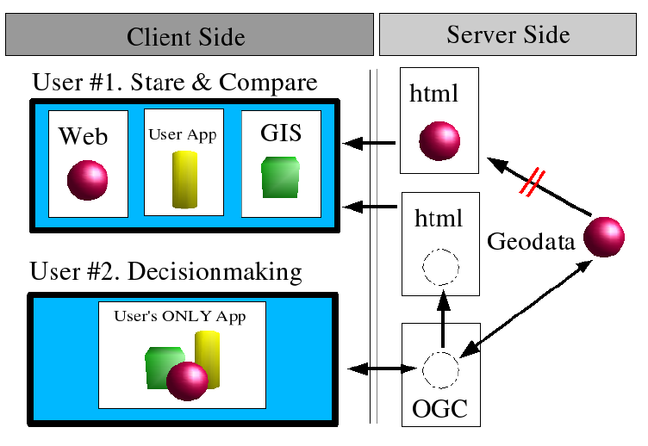
Motivation

Slide 5


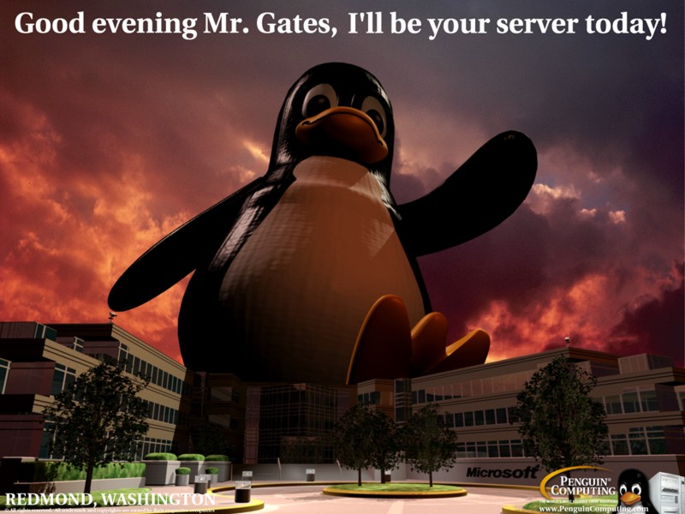
The Software Components
PostGIS – Spatial datablade for the PostgreSQL RDBM
MapServer – Extremely fast and capable internet mapping server also supporting WFS,WMS,WCS
Linux – What else would you build your enterprise data system on?

Slide 6
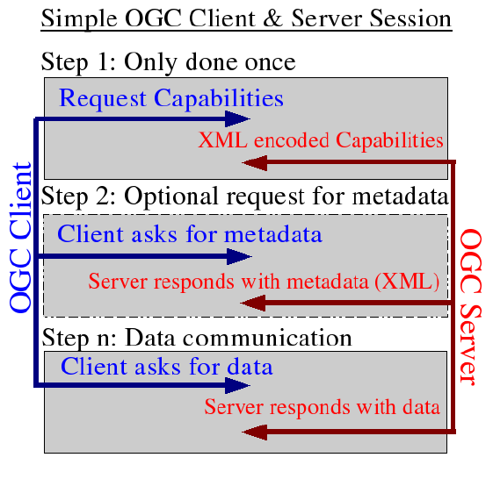

Slide 7
Some of IEM OGC Offerings http://mesonet.agron.iastate.edu/ogc/
 | WMS | WFS | WCS
CONUS NEXRAD (Base Reflect, Storm Precip) | X |  | ? X ?
NCEP Stage4 Precip (Iowa) | X | X
Iowa Road Conditions | X | X
NWS Current/Archived Warnings (County + Polygon) | X | X

Slide 8
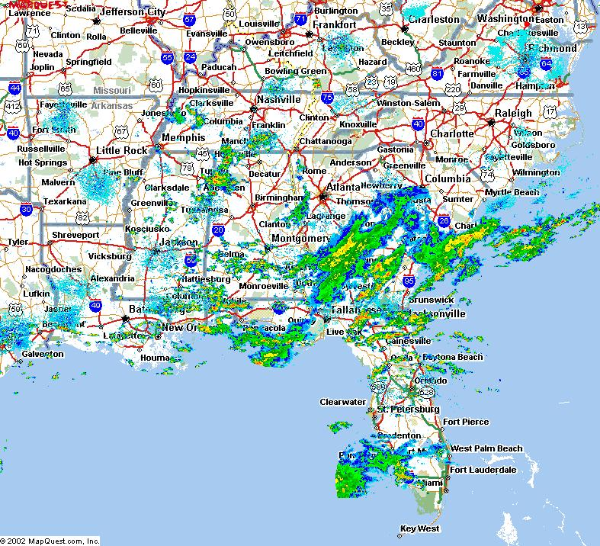
Supporting 2004 Hurricanes
Provided Disaster Management Interoperability Services a RADAR WMS to support their decision support software
http://www.cmi-services.org

Slide 9
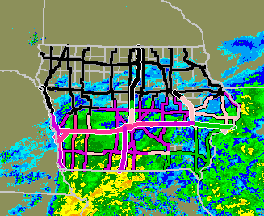
Providing Road Conditions to Media Outlets
WFS and WMS support generation of images for display in TV Weather graphics systems

Slide 10
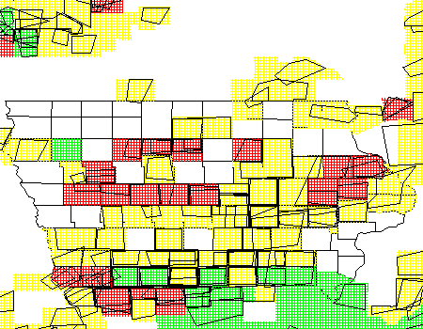
NWS Warnings WFS
Retrieve current and historical NWS warnings (polygon and county based).
Archive begins Jul 2002

Slide 11
Lessons Learned
OGC webservices greatly reduced chaos on our server. Chaos being:
  Redundantly storing data for different apps
  Versioning issues with redundant data
  Redundant code to simply add a RADAR layer to a map
The application development time reduced
Performance hit was remarkably small

Slide 12
More Lessons Learned
Often, the performance bottleneck is the overhead of HTTP
The client application/implementation is absolutely key
(Daryl’s 2 cents) The OSS community needs to generate some killer OGC desktop interfaces and scripting libraries.

Slide 13

Time for Questions?
mesonet.agron.iastate.edu
Daryl Herzmann
515.294.5978
Akrherz@iastate.edu

