Slide 1

Why can’t we all get along?
A New Template for Public-Private Cooperation.
John McLaughlin
Chief Meteorologist KCCI-TV
Bradley Small
Senior Forecaster NWS Des Moines
Daryl Herzmann
Iowa Mesonet, Iowa State University

Slide 2
Today’s Agenda
We all have resources, how do we maximize their use?
We all have needs, how do we meet them with almost no budget?
We all have bosses, how do we keep them happy?
We all would like to get along, how do we do it politically?

Slide 3
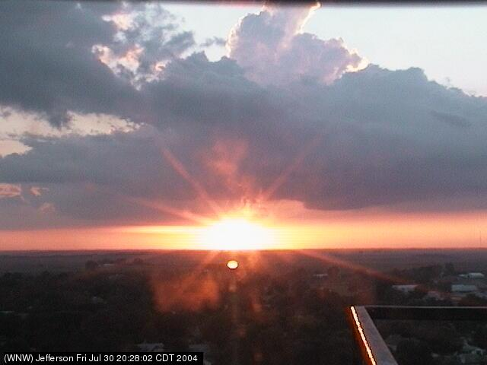
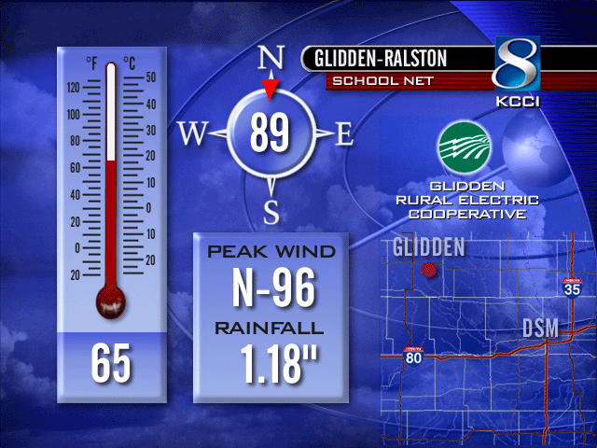
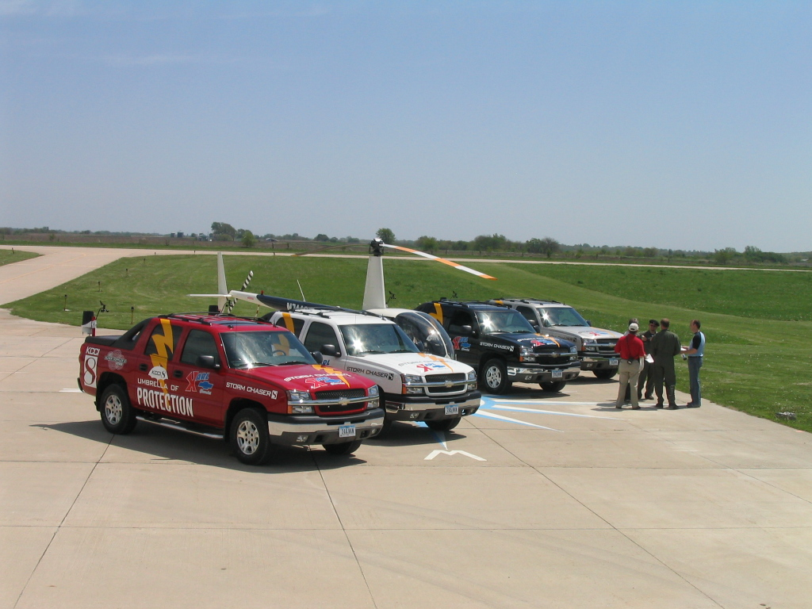

KCCI has resources

Slide 4
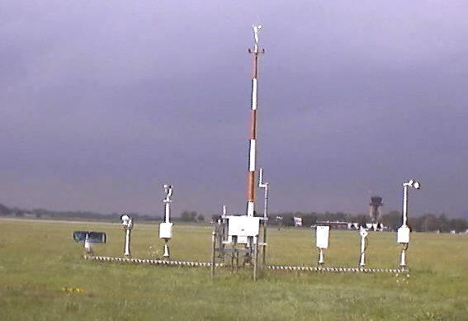
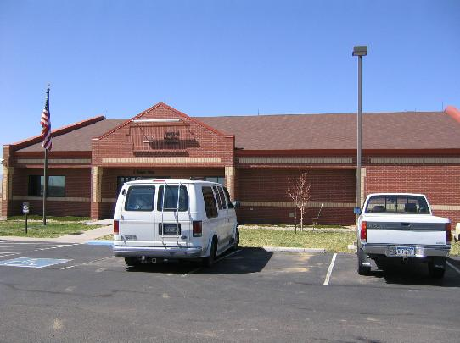
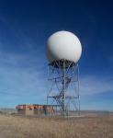
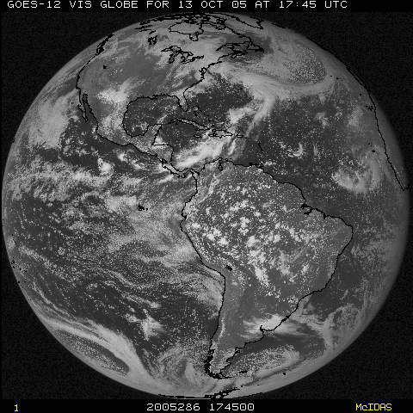
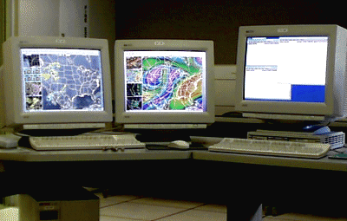
The NWS has resources

Slide 5
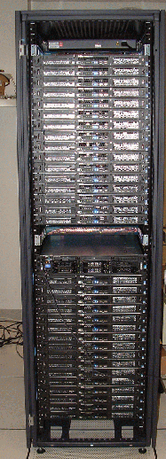
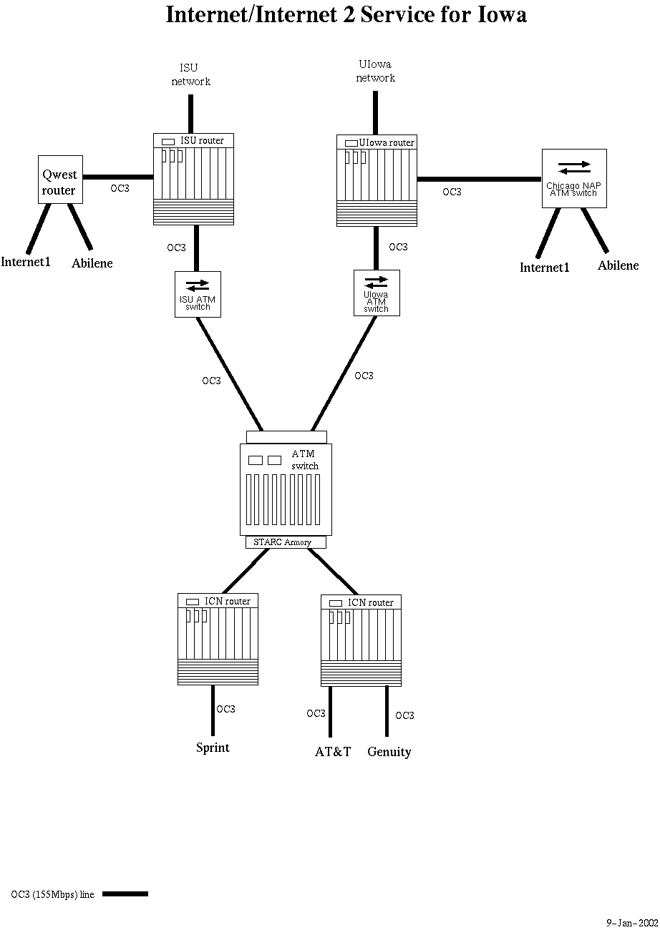
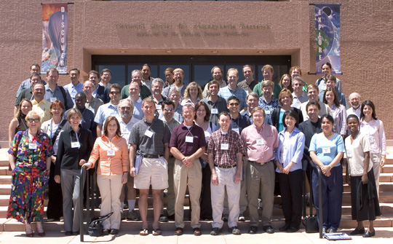
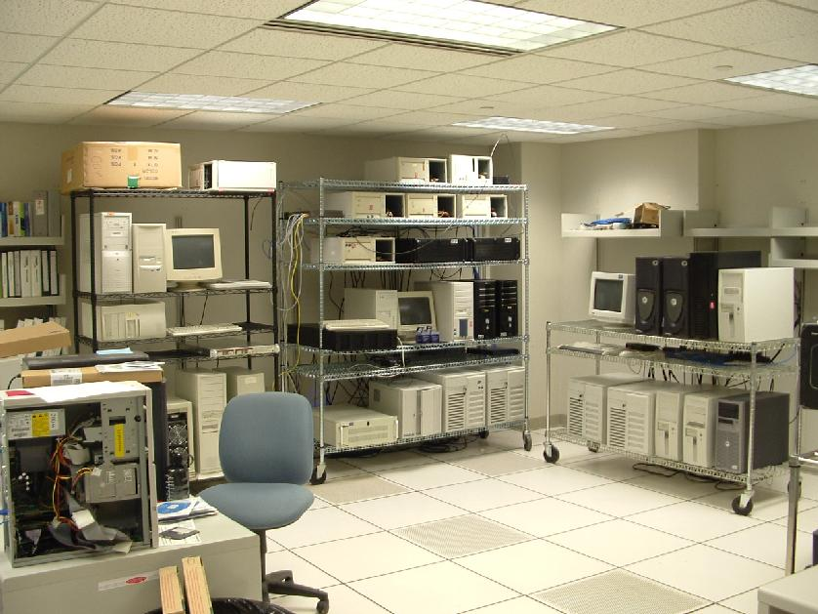
Iowa State has resources

Slide 6
What do we need?
KCCI-TV
  Methods/software to utilize tools, operations support, timely and accurate products
NWS
  Data, data, more data, public reports, science tools, communications help
Iowa State / Iowa Mesonet
  Data, support, collaborators, a hug

Slide 7
How do we get along?
We all have a common goal, produce products to better serve the public.
  KCCI – ratings, NWS – Mission, IEM - Outreach
Enter the Iowa Environmental Mesonet collaboration
  Venue to make our formal cooperation politically doable
  The mesonet is built on the partnerships
  Placing the university in the middle of the data flows prevents many issues.

Slide 8
Example Collaboration
KCCI provides the IEM with a live feed of school based weather sensors.
The IEM processes this feed and provides custom products including wind alerts to the NWS.
The NWS uses this information to enhance the accuracy and timeliness of their products.
KCCI benefits from improved NWS products
The IEM benefits from having another dataset to process.
The NWS benefits from having a high resolution network to supplement ASOS/AWOS and NEXRAD.

Slide 9
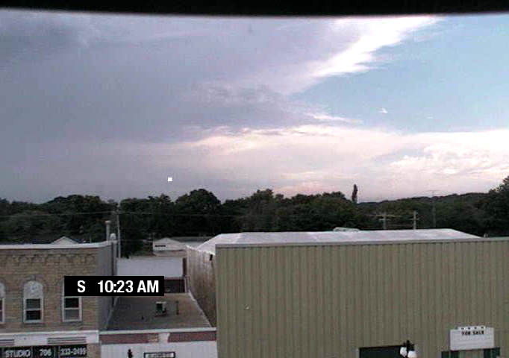
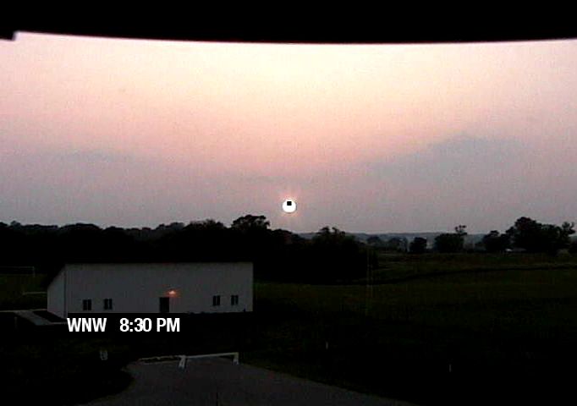
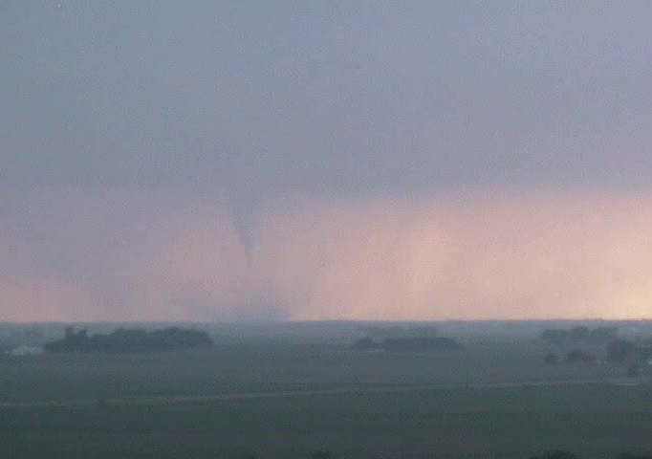
Utilizing Live WebCameras
KCCI shares access to a network of web cameras
The IEM builds software to have cameras guided by NWS shared NEXRAD storm attributes
The NWS benefits from having 16+ automated eyes on the sky
KCCI benefits from the tools developed by the IEM
The IEM collects the data building an unique archive.

Slide 10
Benefiting KCCI’s competition?
The honest answer is ‘YES’, but....
  outside of voice, they lack the ability to get the products on-air visually.
  the key is situational awareness. If you are nowcasting off these tools, you are doing a disservice to the public.
Benefiting the entire public and saving lives should be the bottom line. Keeping these tools proprietary is not a sustainable system. Need to build up large and diverse user bases -> ratings.

Slide 11

Switching Gears

Slide 12
Instant messaging background
Lots of NWS WFOs and their partners are instant messaging in one form or another.
In Iowa, we began using Yahoo! IM in spring 2004 with good success.
Winter 2005, we began to look for alternatives to Yahoo. Why you ask?

Slide 13
Problems with Yahoo!
The Yahoo! provided client is adware.
Chat rooms are limited to 50 users (?)
Yahoo! Protocol only supports participation in 1 chat room at once.
Yahoo! Chat not allowed on some WANs
Securing chat rooms from unauthorized access. How? Dealing with chat rooms in general....
Nobody likes getting Yahooooo’d!!!
And now Yahoo + MSN have joined. This smells of a more efficient method to spread windows viruses.

Slide 14
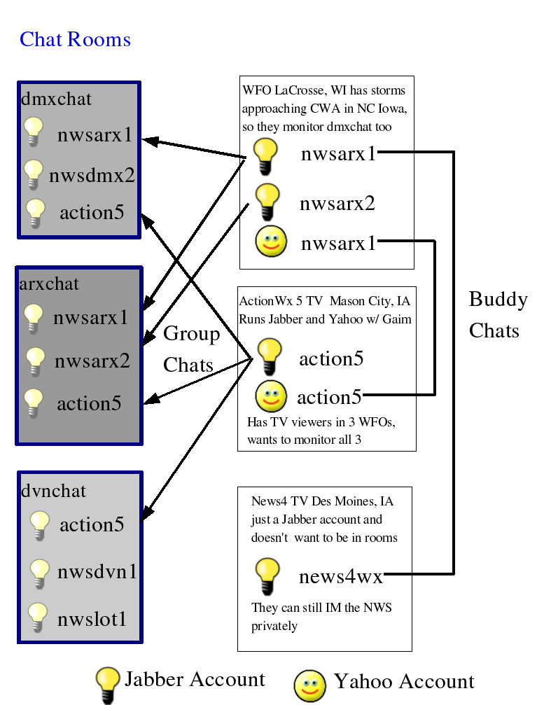
New Chatting System
Secure
Simple
Scalable
Sustainable
Sexy (why migrate?)
Support legacy Yahoo! clients

Slide 15
IEMChat Project Features
End to end encryption (logins, chats)
∞ users in a chat room
Users can join multiple rooms (multiple WFOs)
Rooms have recent history when you join them. Can get caught up quickly.
Standards based XML protocol (Jabber). Open Source client (Gaim).
Same technology has Google Talk.

Slide 16
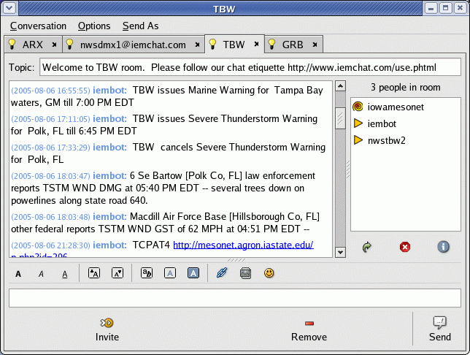
Screen shot

Slide 17

Hello, iembot!
Iembot is the code name for a chat “bot”
A bot is a program that participates in chats and acts like another user
Iembot is a good bot!

Slide 18
iembot is smart and fast.
TBW issues Marine Warning for Tampa Bay waters, GM till 8:45 PM EDT
MHX issues Severe Thunderstorm Warning for Onslow, NC till 11:15 AM EDT
GGW cancels Lake Wind Advisory for Central and Southern Valley, MT and Garfield, MT and McCone, MT
TULSA,OK (KTUL) ASOS reports gust of 41 knots from NNW @ 0919Z
MCD! http://www.spc.noaa.gov/products/md/md2046.html
2 W Harrison [Douglas Co, SD] public reports HAIL of 1.75 INCH at 06:58 PM CDT --
TCPAT1 http://mesonet.agron.iastate.edu/p.php?id=505
SPC issues TORNADO watch till 06:00Z http://www.spc.noaa.gov/products/watch/ww0821.html, new watch replaces WW 819, WW 820

Slide 19

Of course, you don't have to take my word for it.
SchoolNet8 Website
http://www.schoolnet8.com
KCCI-TV Website
http://www.kcci.com
IEM Chat Project Website
http://www.iemchat.com
Iowa Mesonet Website
http://mesonet.agron.iastate.edu
NWS Des Moines
http://www.crh.noaa.gov/dmx/

