Slide 1
IEM Chat: A New Platform for Building NWS and Media Partnerships
Daryl Herzmann, Iowa State University
Darone Jones, NWS Birmingham, AL
John McLaughlin, KCCI-TV Des Moines
Brad Small and Shane Searcy,
NWS Des Moines

Slide 2
From DOC service assessment of:
Veterans Day Weekend Tornado
Outbreak of November 9-11, 2002
Comments on Birmingham's use of Instant Messaging:
“This [instant messaging] has been the biggest thing to happen in our relationship with the NWS,” said FOX 6 Meteorologist David Neal.
Birmingham’s ABC 33/40 chief meteorologist James Spann commented, “This is the greatest thing that ever happened between the private sector and the National Weather Service. The greatest ever.”

Slide 3
NWS Use of Instant Messaging
Believed to have originated with Birmingham WFO in 2000 (Borden 2005)
Sporadically used throughout NWS
  Protocol varies: Yahoo, MSN, AOL, Website
  Some create 'chat rooms', others only do private messaging
  Some only use for high end weather, others will chat over everyday weather
WFO has discretion for implementation

Slide 4

So in 2005, Des Moines folks start chat collaboration
Implemented a Yahoo! chat room with good success.
Had media from Des Moines, Waterloo, and Cedar Rapids using the chat.
Started to look into how media with a DMA covering multiple CWAs could chat with multiple WFOs at once. (more acronyms please!)

Slide 5
Problems with Yahoo!
The Yahoo! supported chat client is adware.
Chat rooms are limited to 50 users (?)
Yahoo! protocol only supports participation in 1 chat room at once.
Yahoo! chat not allowed on some WANs
Securing chat rooms from unauthorized access. How? Dealing with chat rooms in general.....
Nobody likes getting Yahoooooo'd!!!!
NWS having to administer the chatroom is tedious

Slide 6
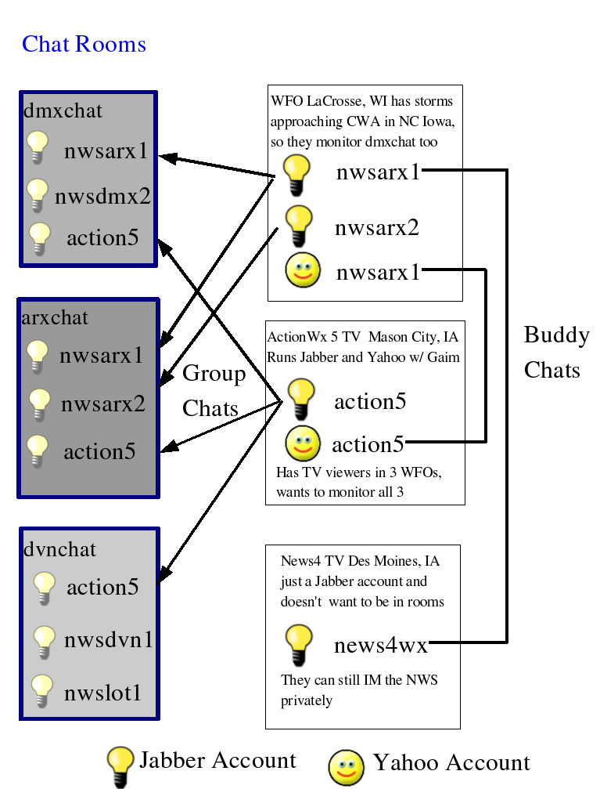
Our ideal chat setup
Secure
Simple
Scalable
Sustainable
Sexy (why migrate?)
Standards
Support legacy Yahoo! clients

Slide 7
IEM Chat Project Features
End to end encryption (logins, chats)
∞ number of users in a chat room
Users can join multiple rooms (multiple WFOs)
Rooms have recent history when you join them. Can get caught up quickly.
Standards based XML protocol (Jabber). Open Source client (Gaim).
Same technology has Google Talk.

Slide 8
iemchat.com website features
Good (?) documentation on installation and configuration of Gaim
Documentation and tools specifically for the setup of IEM Chat on typical NWS office network configurations
Automatic chat room logging, available on website for download. Great resource for case studies.
Java applet based chat client

Slide 9
IEMChat 10 minute log from 12 Nov 2005
[22:52:16] kcciwhite viewer confirms funnel/tor. report in luther area
[22:52:19] iowamesonet 2 mile south of luther, farm house heavily damaged
[22:52:44] nwsdmx6 ham radio reports luther tornado has begun to rope out
[22:53:23] iembot 3 S Stratford [Hamilton Co, IA] trained spotter reports
TORNADO at 04:36 PM CST --
[22:55:19] iembot 1 E Woodward [Dallas Co, IA] county official reports TORNADO
at 04:41 PM CST --
[22:55:34] iowamesonet ISU spotters say former Luther tornado has dissipated
[22:56:06] nwsdmx6 tor wrng for story co coming
[22:56:24] iembot DMX issues Tornado Warning for Story [IA] till 5:30 PM
CST
[22:57:58] iembot DMX issues Tornado Warning for Franklin, Hamilton, Hardin,
Wright [IA] till 5:45 PM CST
[22:59:09] iowamesonet funnel on Ames cam
[22:59:52] iowamesonet almost down
[23:00:34] iembot Webster City [Hamilton Co, IA] public reports HAIL of 0.75
INCH at 04:50 PM CST --
[23:02:00] wmt_am got a citizens report of a tornado that touched down briefly
just north of lincoln way in ames

Slide 10

My name is … iembot!
Iembot is the code name for a chat “bot”
A bot is a program that participates in chats and acts like just another user
Iembot is a good bot! He relays NWS text products into WFO specific chat rooms.

Slide 11
Why is a chat bot needed?
NWS forecasters shouldn't have to redundantly generate a warning in Warngen and then retype it in a chatroom
Iembot provides near instant verification that a product is going out and is being ingested by a computer.
On-air media can simply read from the chatroom and not get lost in other displays or paper printouts.
Helps with complex VTEC products.

Slide 12
Iembot is smart and fast!
TBW issues Marine Warning for Tampa Bay waters, GM till 8:45 PM EDT
MHX issues Severe Thunderstorm Warning for Onslow, NC till 11:15 AM EDT
GGW cancels Lake Wind Advisory for Central and Southern Valley, MT and Garfield, MT and McCone, MT
TULSA,OK (KTUL) ASOS reports gust of 41 knots from NNW @ 0919Z
MCD! http://www.spc.noaa.gov/products/md/md2046.html
2 W Harrison [Douglas Co, SD] public reports HAIL of 1.75 INCH at 06:58 PM CDT --
TCPAT1 http://mesonet.agron.iastate.edu/p.php?id=505
SPC issues TORNADO watch till 06:00Z http://www.spc.noaa.gov/products/watch/ww0821.html, new watch replaces WW 819, WW 820

Slide 13
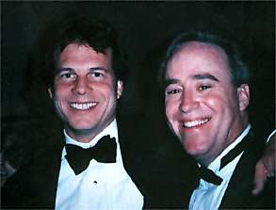
The future of iembot
Continue to learn about other products
Become county centric (currently WFO)
Customizable with private chats
Answer user requests for products
Stop smoking and procreate
  Reportbot is in beta-test now
  Boustead-bot, Donavon-bot
  “Hey Buddy”-bot

Slide 14
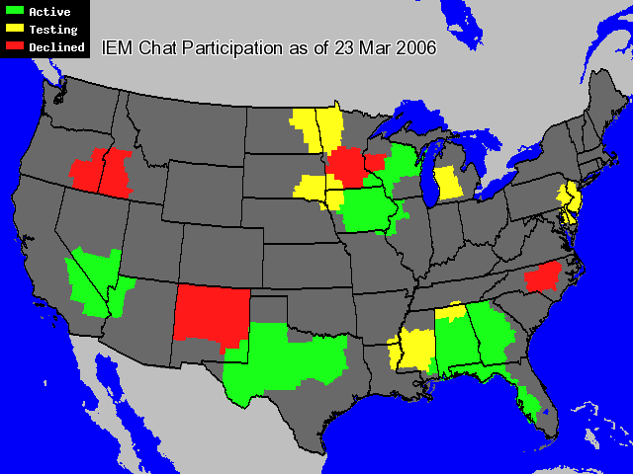

Slide 15
Birmingham is extending...
Invited up to 4 EM users per county
Have a dedicated room for EM users to communicate with. Main room is read-only for EM users.
Great success during 13 Mar 2006 event. The speed of reporting was outstanding.
Alabama EM group is looking at use statewide for instant communication.

Slide 16
Quote from Darone Jones, BMX
Being from the office that pioneered instant messaging within the NWS, I have had plenty of time to contemplate what I would want in a "dream" chat client. The new IEM Chat is my dream come true. Since we've made the switch, it's been nothing but positive feedback all the way around. Our media partners love the fact that the chat is always there. Our forecast staff love the fact of how much time is being saved by the ‘bot’…. All we do now is talk about the storm trends. There is no more fumbling to make sure everyone is invited and re-invited. No more having to repeat yourself. No more struggling to type in every warning or storm report. The ‘bot’ does it all.
- NWA Electronic Journal 2005-EJ8

Slide 17

Boring slides are done! Elise, is there time for a demo?
Daryl Herzmann
Office: 515.294.5978
Cell: 515.451.9249
akrherz@iastate.edu
https://iemchat.com

