Slide 1
166-7: Modeling Out Crossing Probabilities for Maize in Iowa
Daryl Herzmann
Jeff Wolt
Raymond Arritt
Mark Westgate
Susana Goggi
Iowa State University

Slide 2
Motivation
Development of transgenic crops depends on successful isolation and confinement.
Maize presents a challenging confinement problem due to open pollination and prevalence in Iowa.
Directly monitoring Out Crossing (OC) at each field of interest is impractical.
Can a regulatory air dispersal model be utilized with Iowa Mesonet data and our knowledge of maize physiology to predict/analyze OC events?

Slide 3
AERMOD, Regulatory Model
Models air dispersal based on planetary boundary layer turbulence structure and scaling
Preferred model of the EPA replacing the ISC3 model on October 21, 2005.
Utilize the relatively new dry deposition algorithms of AERMOD to model pollen dispersal
Input weather data taken from the Iowa Environmental Mesonet

Slide 4
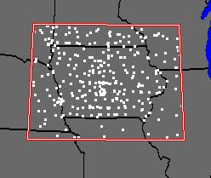
IEM Data Representativeness
The Iowa Mesonet collects, processes, checks and archives environmental data produced from disparate networks.
An analysis was performed to determine the spatial scales IEM data could be utilized at.

Slide 5
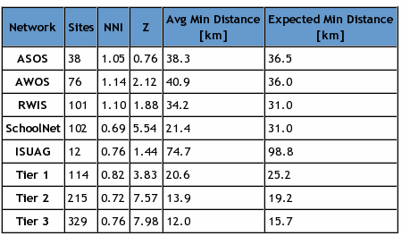
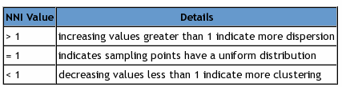
Nearest Neighbor Index
The NNI is a simple ratio between the mean minimum distance and expected distance by chance of sampling points over some sampling area.
Tier 1 is a combination of the ASOS and AWOS networks.

Slide 6
Representativity Results
The IEM is spatially representative at a scale of roughly 25-30 km.
Arbitrary combination of all data sources leads to clustering and degradation of data quality at finer scales.
http://mesonet.agron.iastate.edu/info/nni.phtml
or Google “IEM Representativity”
Representativity results are used to produce quality information to drive our OC modelling effort.

Slide 7
Developing OC knowledge
Measure OC for seed production in Iowa
Model OC with a regulatory compliant model (AERMOD) and validate result
Interface model with a regional weather monitoring network (IEM)
Develop retrospective and prospective tools for regionally based OC monitoring & Prediction

Slide 8
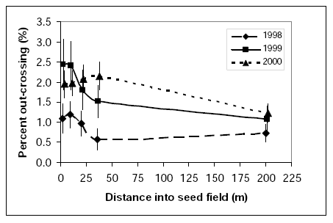
Measure OC for Seed Production
Data collected during a 3 year monitoring of commercial seed production fields
Out-crossing observations along in-field transects
Ireland, D.S., et al: 2006. Managing Reproductive Isolation in Hybrid Seed Corn Production. Crop Science, 46, 1445-1455.

Slide 9
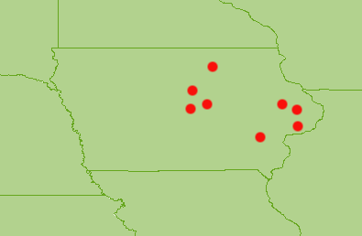
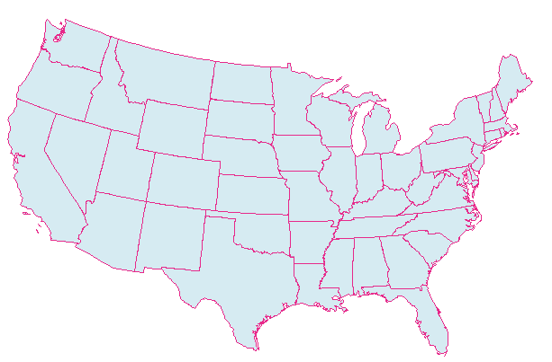
Model validation fields
Validate modelling approach using AERMOD and IEM data against an observed pollen out crossing dataset.
Selected 8 sites in Iowa from datasets with adequate meta-data

Slide 10
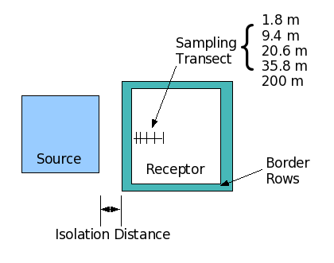
AERMOD “Field” Setup
Develop idealized representation of OC field studies

Slide 11
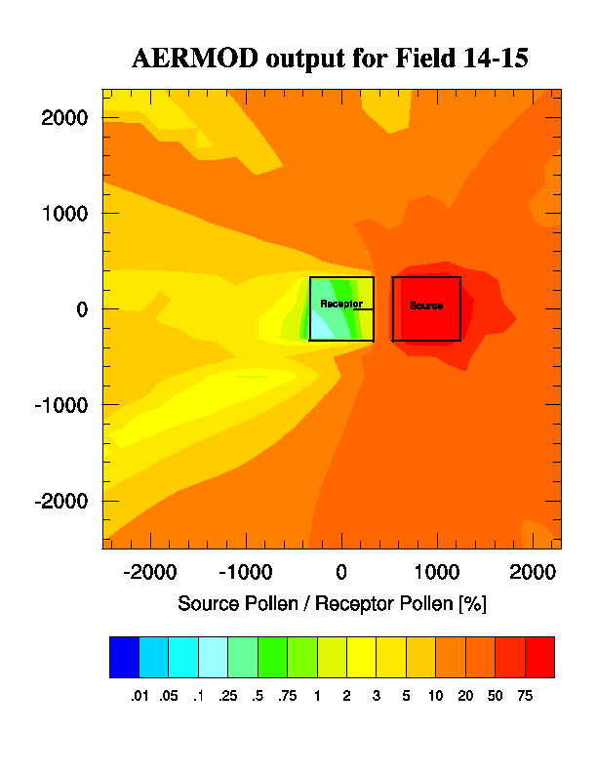
Receptor Field
Source Field
Presented is a simple ratio of pollen deposition from source (adventituous) versus receptor fields over a 7 day period of pollen shed.
The line in the receptor field is the transect used for validation.

Slide 12
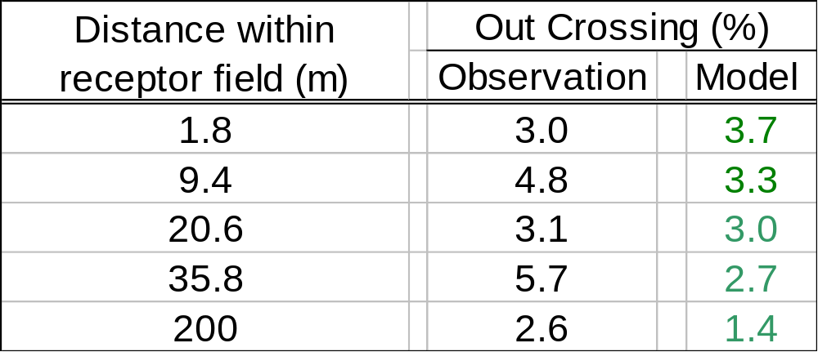
Validation of 8 fields
OC is estimated by a simple ratio of adventitious versus receptor field pollen.
With no major modification AERMOD predicts directionally correct, order of magnitude correspondence to field observations – Thus, with further calibration AERMOD can be adapted as a first tier model

Slide 13
Regional Modeling
Provide predictive and retrospective analyses of OC on a regional scale
Identify areas in Iowa that need more refined modeling and monitoring (first tier)

Slide 14
Link AERMOD with IEM
Configure a representative field setup based on the Ireland validation dataset.
Model is iterated over a 30km grid of points covering the state to produce an analysis
4 runs are made for each point. The adventitious source field is rotated in 4 directions from the receptor field (N,E,S,W)

Slide 15
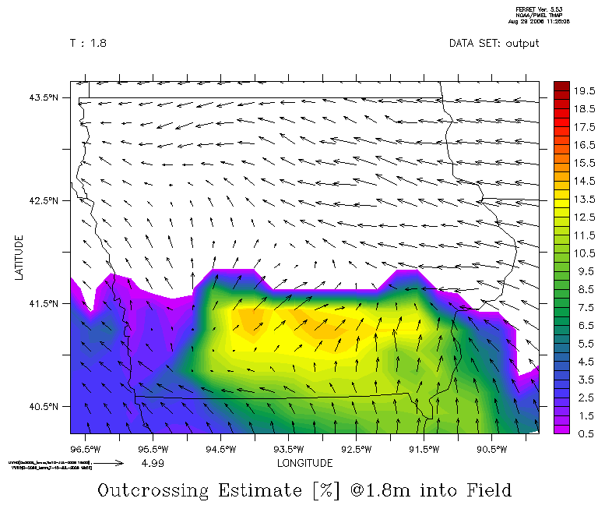
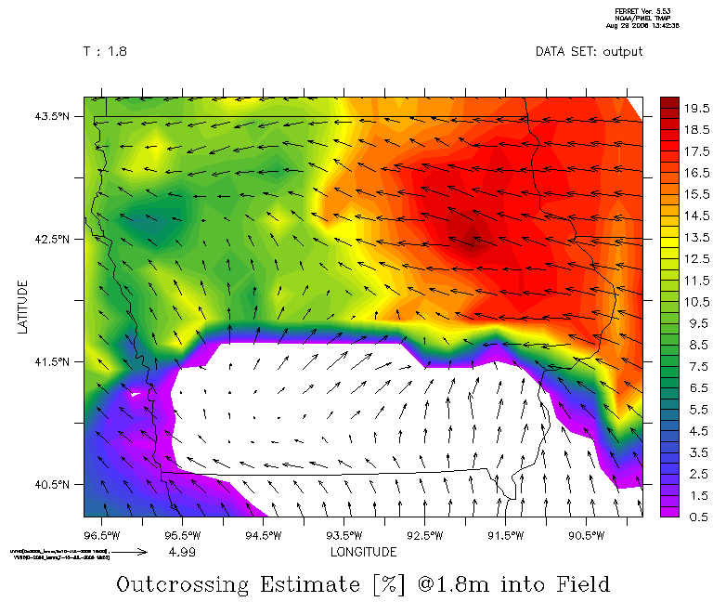
10 Jul 2006: Example Results
Outcrossing estimated at 1.8 meters into receptor field with 130 m isolation
Vectors are mid-afternoon winds
Field to the East
Field to the West

Slide 16
A work in progress...
Continue to test and refine AERMOD setup and post processing
Implement more advanced algorithms for local pollen competition/viability
Develop tools (online?) for others to use to access monitoring and response strategies.

Slide 17

All done, any questions?
Daryl Herzmann
akrherz@iastate.edu
3015 Agronomy
515.294.5978

