Slide 1
NWS VTEC/Polygon Stuff
Daryl Herzmann
Iowa Environmental Mesonet
Iowa State University

Slide 2

Let the audience beware.
Values presented on these slides are not official from the NWS.
There are some known known errors and known unknown errors. Others probably know of unknown known errors too. Hopefully there aren’t any unknown unknown errors.
Most of the numbers can be checked on the website in a transparent manner.

Slide 3
Our NWS data ingest system
Most raw data is provided by internet LDM feed from Unidata
Products hit LDM data queue and actions (pqact) are fired on those products
Various parsers convert the products:
  Flat files
  GEMPAK files
  NetCDF
  PostGIS database (my decoders)
  XMPP (Jabber) service named iembot (my decoders)

Slide 4
For each product ingested
Decoder processes product. If any error is found, an email is sent to me detailing the python code traceback and product.
Most common errors:
  Missing blank line between CI and MND (sect 3.6 of NWSI 10-1701)
  Hand editing LSRs or non LSR-GUI software generating poorly formatted LSRs (sect 5 of NWSI 10-517)

Slide 5



Storage and display
Free/free Software Components
PostGIS – Spatial datablade for the PostgreSQL RDBM
MapServer – Extremely fast and capable internet mapping server also supporting WFS,WMS,WCS
Linux – What else would you build your enterprise data system on?

Slide 6
The Open Source Approach:
What can be done to these polygons
Ingest and store them
  LDM can move the data, python can process it cleanly, Postgresql/PostGis can store it (all AWIPS tools already!!!)
Interactive website display
  PHP mapscript rendering dynamic/static maps
Geo - Processing
  PostGIS OGC SFSQL compliance, GEOS library extensions can handle most anything necessary
Conversion to other formats
  GDAL toolkit is the swiss army knife. Convert the PostGIS polygons to most anything.

Slide 7
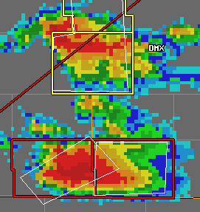
Displaying the Polygons
Mapserver renders the polygons on request (CGI scripts) or via scripts.
Data is dynamically rendered from the PostGIS database
All interactive with a 5 minute interval RADAR archive dating back to 2003

Slide 8
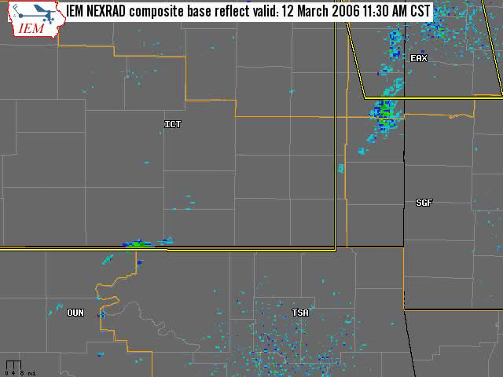

Slide 9

IEM Cow
Use LSRs and Storm Data to verify polygons in an interactive manner
Select 0.75 or 1 inch hail
15/15 rule not implemented
Actively used by many WFOs
Its as live as the data is

Slide 10
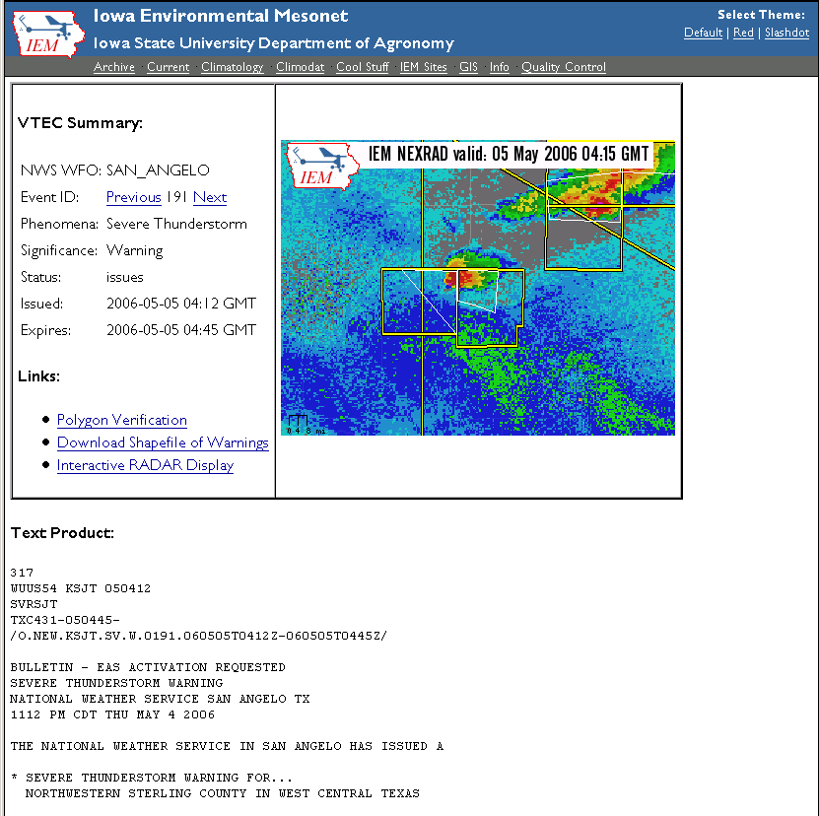
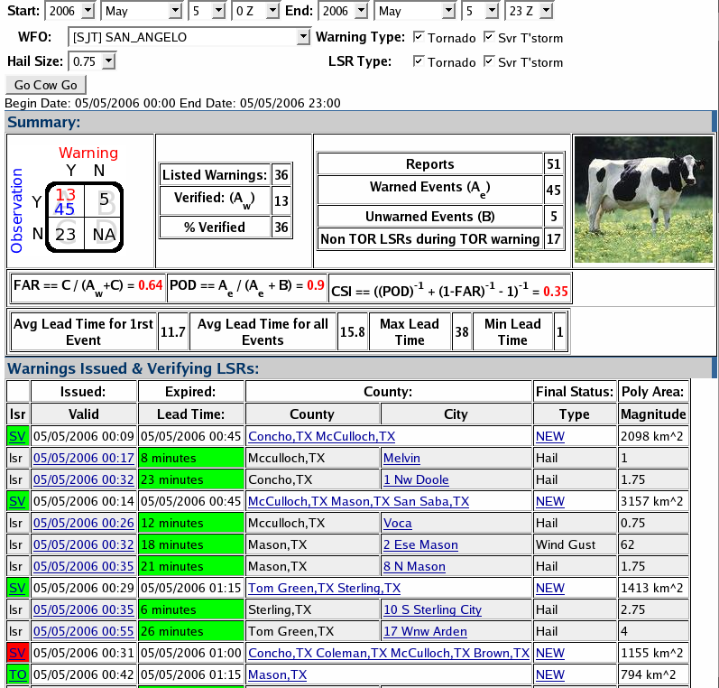
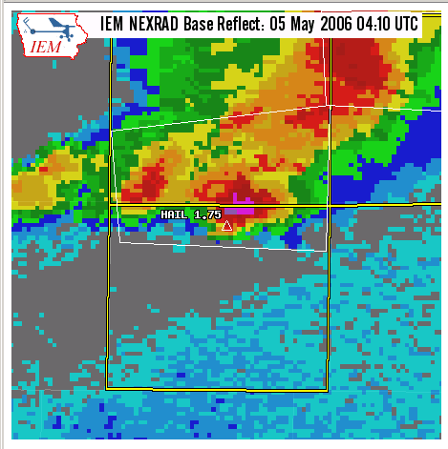

Slide 11
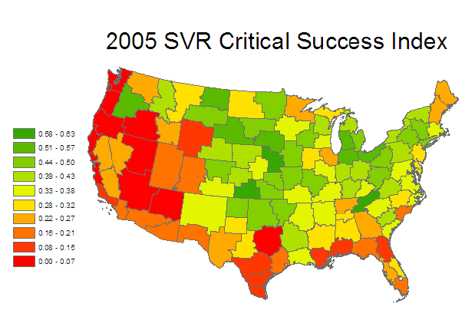

Slide 12
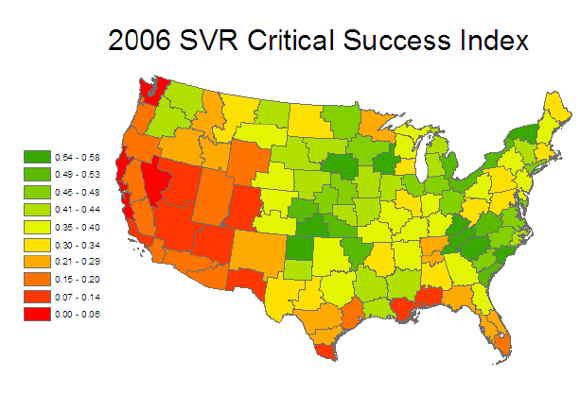

Slide 13
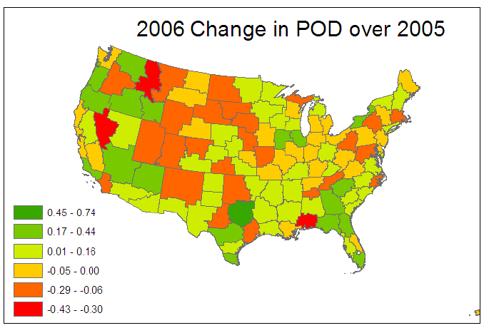

Slide 14
About polygon size

Slide 15
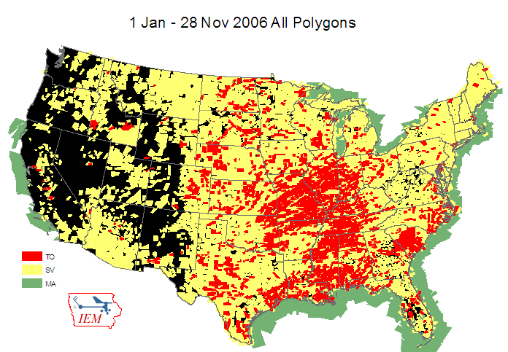

Slide 16
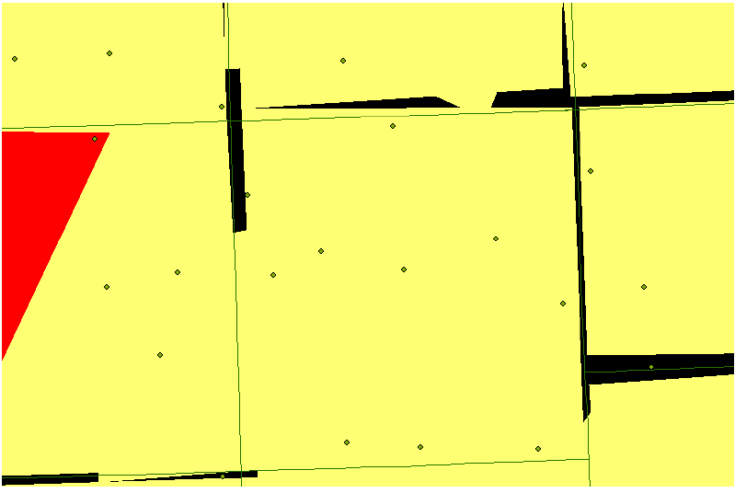
2006 Unwarned areas due to lat/lon precision and county borders

Slide 17
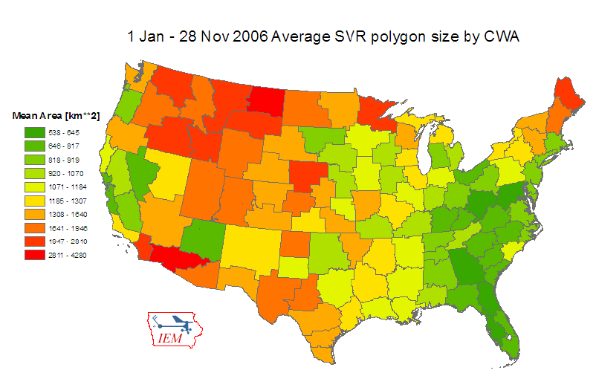

Slide 18
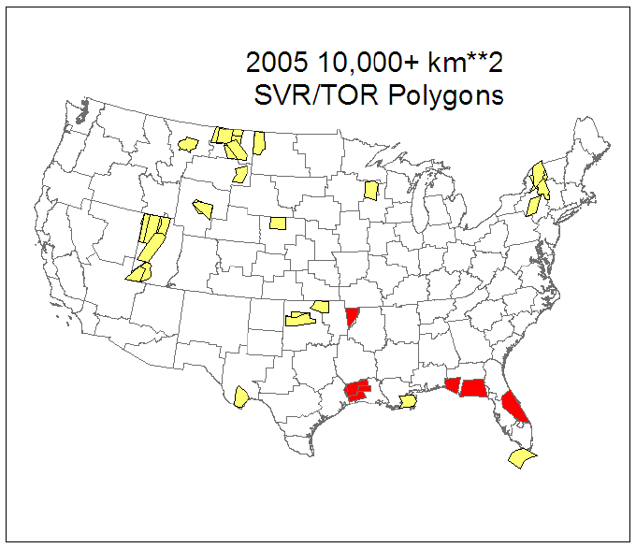

Slide 19
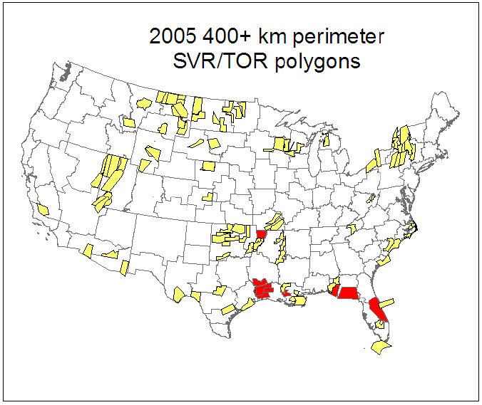

Slide 20
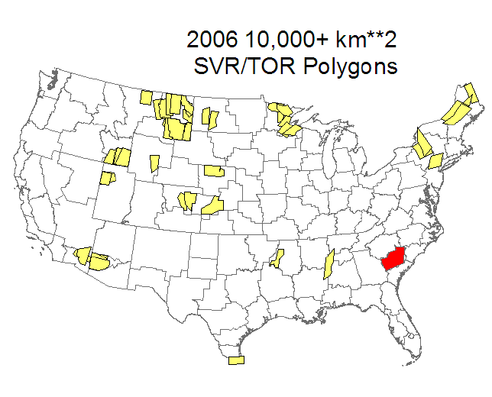

Slide 21
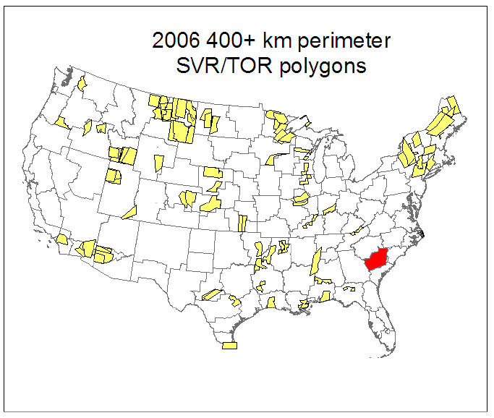

Slide 22
Average areas per warning
 | County Based | Polygon Based | Ratio
2005 SVR | 4,314 | 1,293 | 30.0%
2005 TOR | 3,564 | 1,037 | 29.1%
2006 SVR | 3,935 | 1,175 | 29.8%
2006 TOR | 3,078 | 897 | 29.1%
Values in square kilometers
For 2006, warnings from 1 Jan – 28 Nov
If a warning was for multiple counties, the total county
area is summed and then used in the average.

Slide 23
Last VTEC status value for 2006 county warnings
 | Severe T’storm | Tornado
Issues (NEW) | 17.9% | 17.0%
Continues (CON) | 25.9% | 29.5%
Expire (EXP) | 32.7% | 27.5%
Cancel (CAN) | 23.5% | 26.0%
 | 33,642 | 3,994
1 Jan – 1 Dec 2006 warnings included
Most disturbing number here is that roughly 17% of the counties warned
never get a follow-up statement (no SPS issued!).

Slide 24

All done, any questions?
Daryl Herzmann
akrherz@iastate.edu
3015 Agronomy Hall
Ames, IA 50010
515.294.5978

