Slide 1

Iowa Environmental Mesonet: “Where’s the Science?”
Daryl Herzmann
Iowa State
University

Slide 2
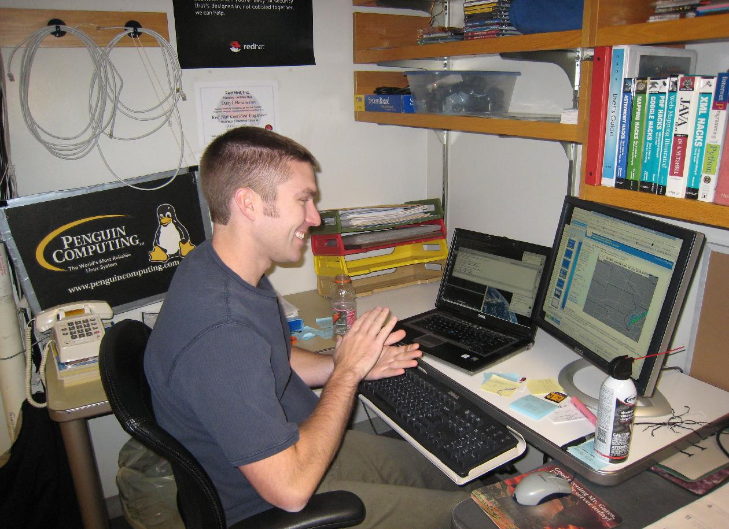
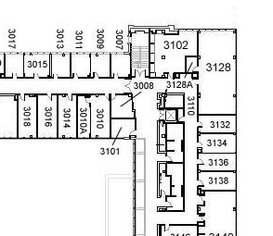
IEM Development Process
Step 1: Write the code.
Step 2: Go tell Flory about it.
Yippee!
Flory’s Office

Slide 3
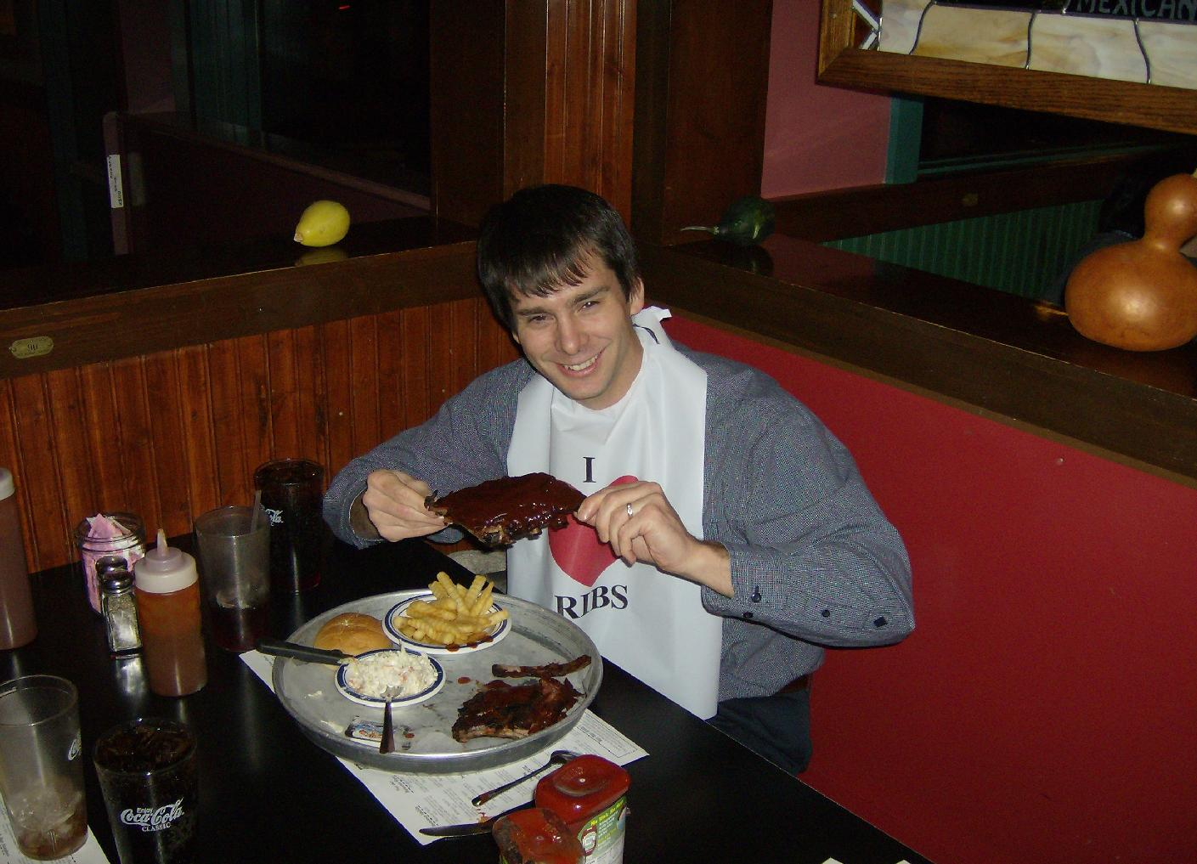
Yeah, that is nice, but where is the science?

Slide 4
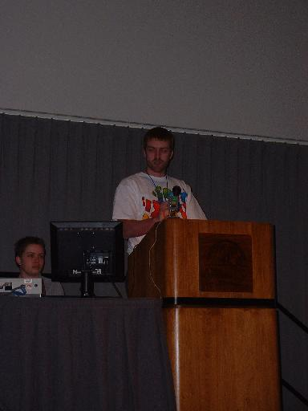
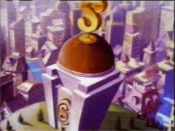
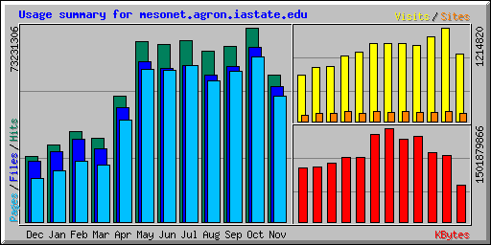
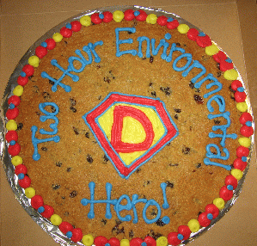
What the IEM does
We collect data!
We provide leadership!
We serve data out!
We collect awards!

Slide 5








Data, data, everywhere data

Slide 6
Observation Archive
 | Begins | Current Stations | Obs Stored
IA ASOS | 1945 | 15 | 12,725,000
IA AWOS | 1995 | 41 | 211,000,000
IA RWIS | 1994 | 57 | 17,500,000
SchoolNet | 2002 | 157 | 223,000,000
NWS COOP | 1893 | 185 | 3,500,000
Ag Climate | 1998 | 14 | 1,100,000
Other |  | Lots | ~25,000,000
 |  |  | ~500 million

Slide 7
Observing Phenomena

Slide 8
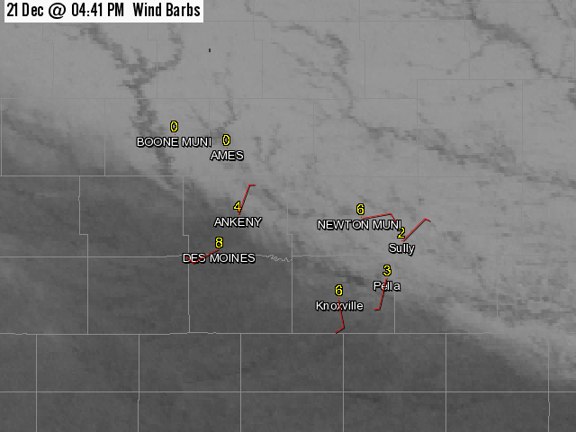
Snow Breeze
21 Dec 2005

Slide 9
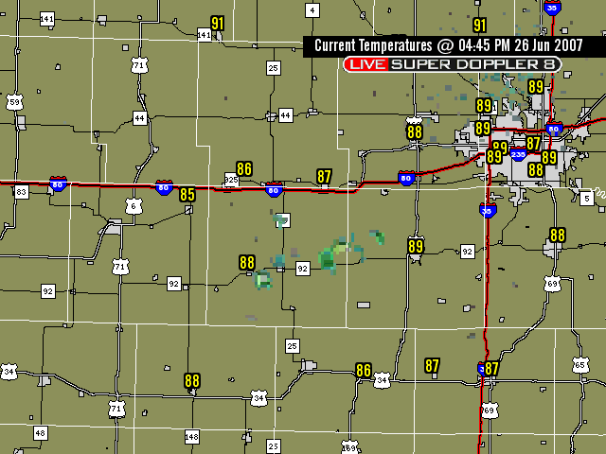
Cold Pool

Slide 10
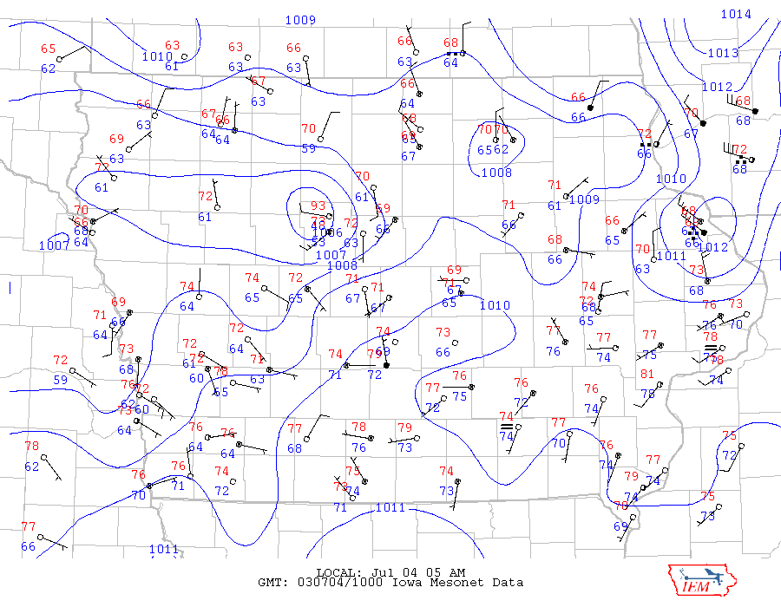
Wake Low
4 Jul 2003 5 AM

Slide 11
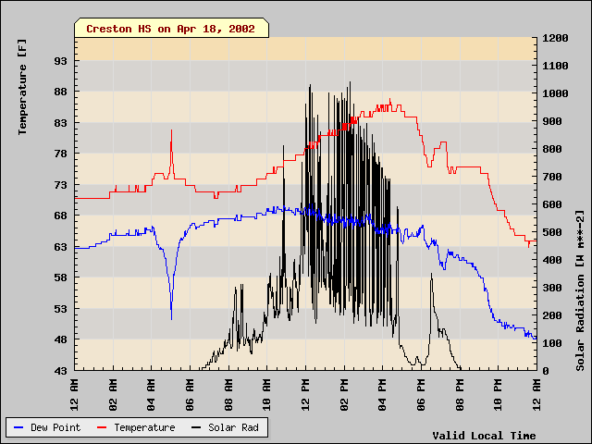
Heat Burst

Slide 12
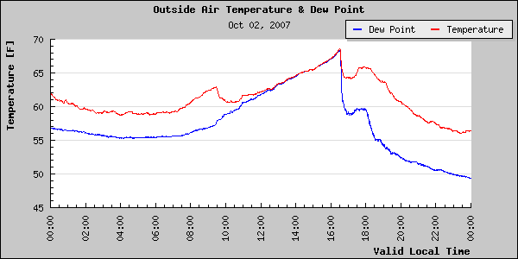
Cold front
Data from station on roof of Agronomy, Ames.

Slide 13
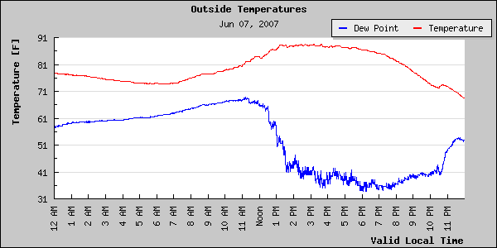
Dry Line
Data from station on roof of Agronomy, Ames.

Slide 14
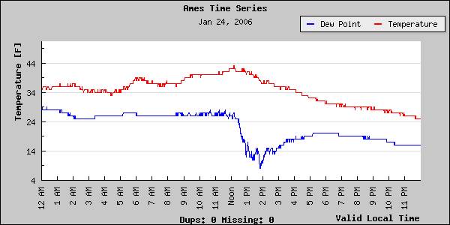
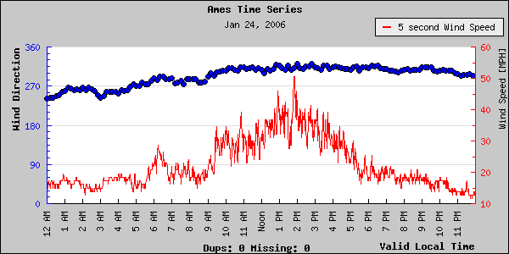
Troposphere fold

Slide 15
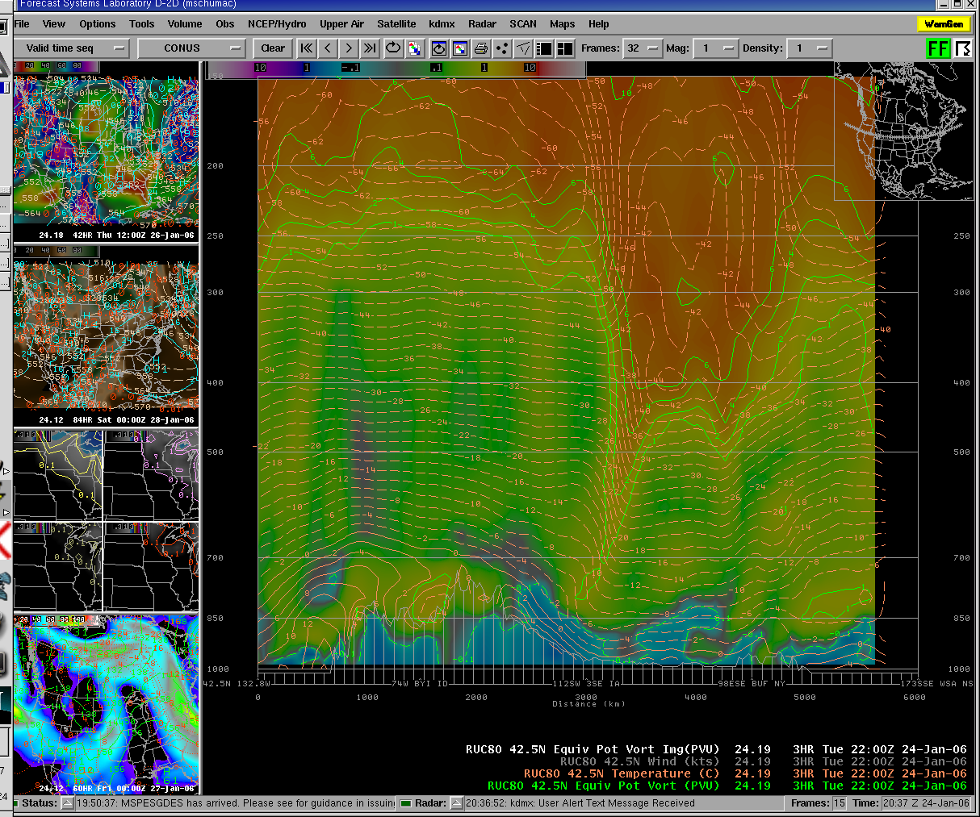

Slide 16
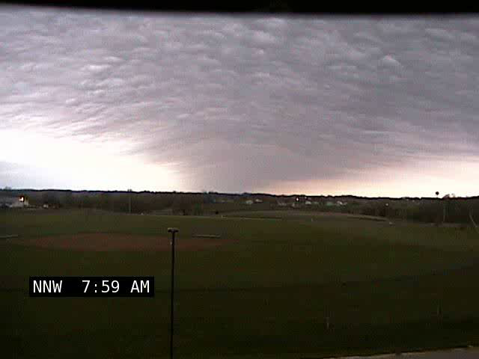
6 May 2007: Tama Gravity Wave

Slide 17
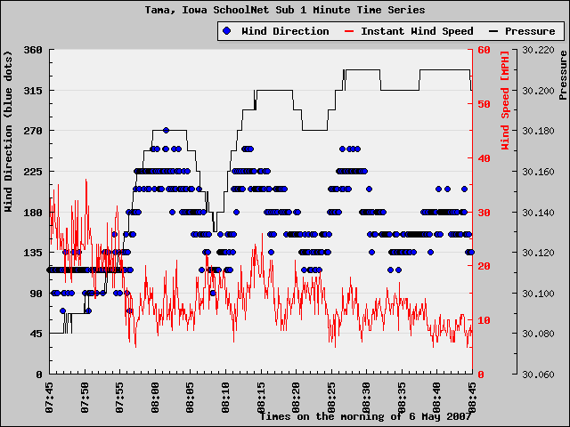

Slide 18
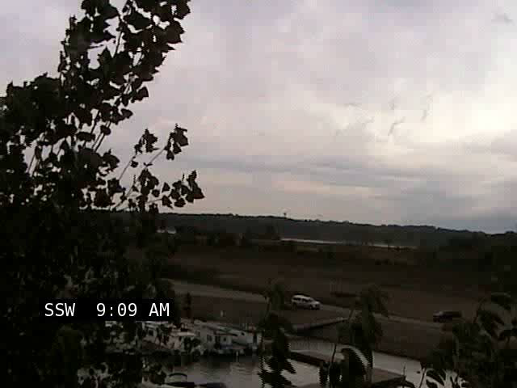
2 Oct 2007: Saylorville Lake
http://science.nasa.gov/headlines/y2007/11oct_undularbore.htm

Slide 19
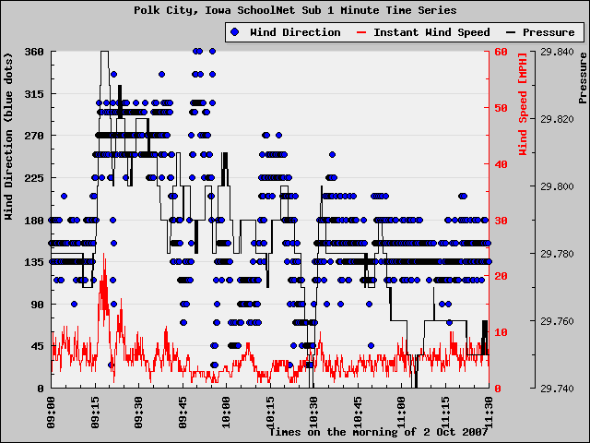

Slide 20
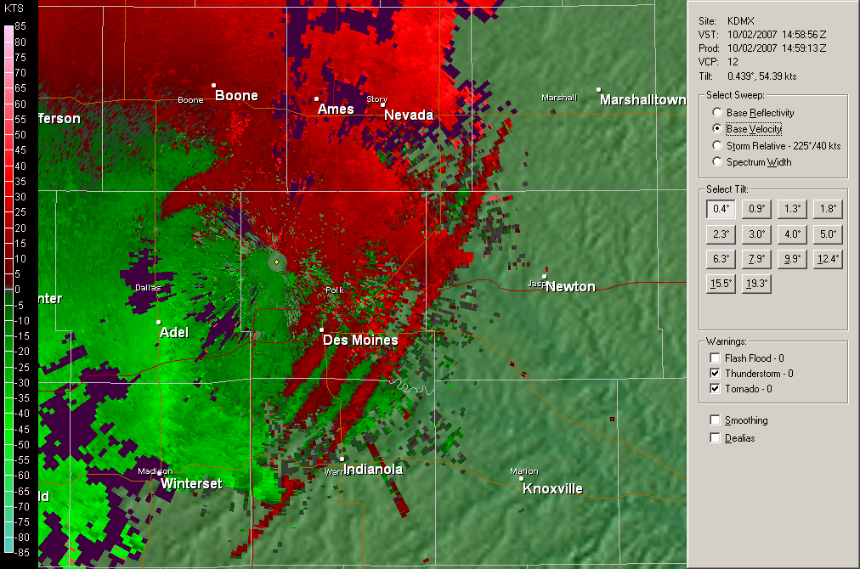
Des Moines NEXRAD

Slide 21
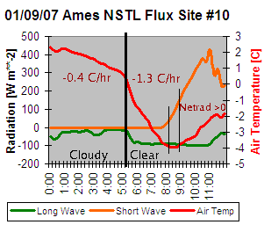
Radiation Processes

Slide 22
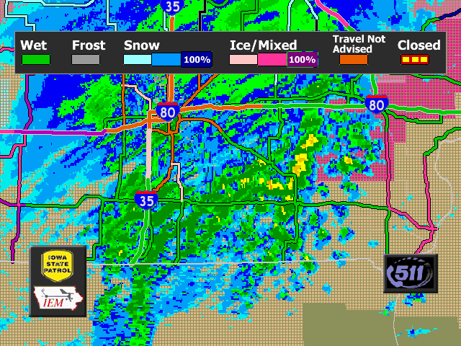
Winter Weather

Slide 23
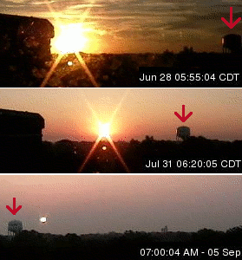
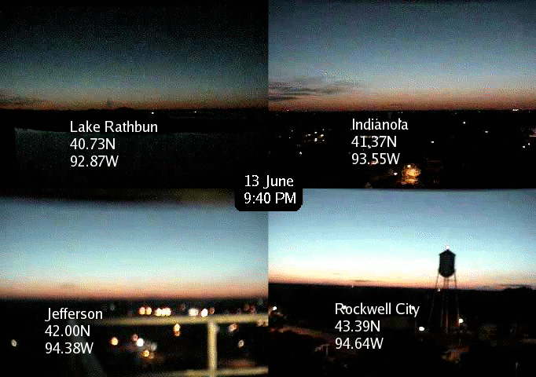
Science with the webcams?
From Madrid Webcam

Slide 24
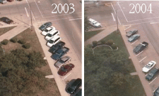
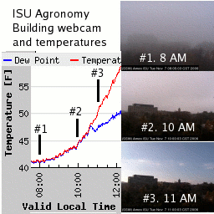
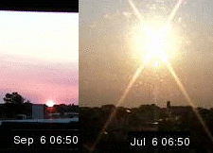
More webcam fun!

Slide 25
Iowa’s Climate

Slide 26
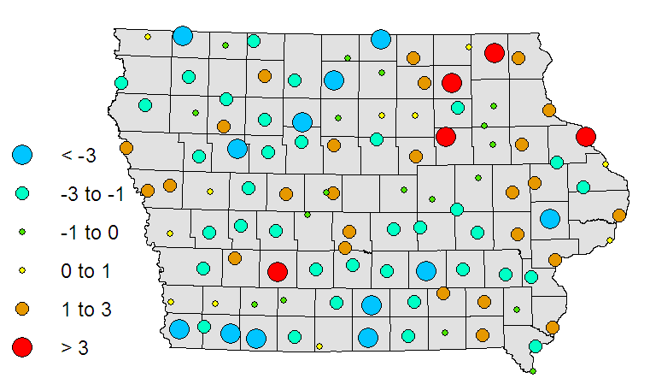
1951-2006 High Temperature
Annual Trend [degree F / 100 yrs]
Statewide Average: -0.5 F

Slide 27
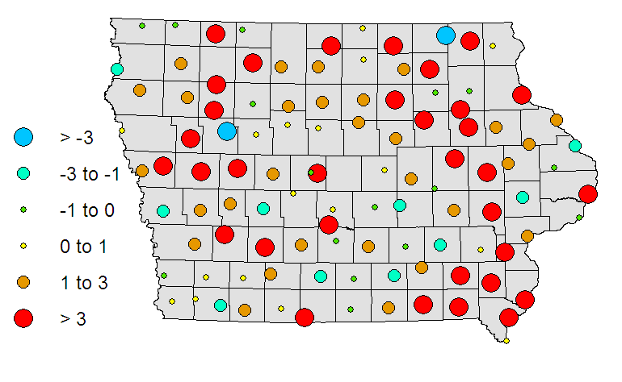
1951-2006 Low Temperature
Annual Trend [degree F / 100 yrs]
Statewide Average: +1.6 F

Slide 28
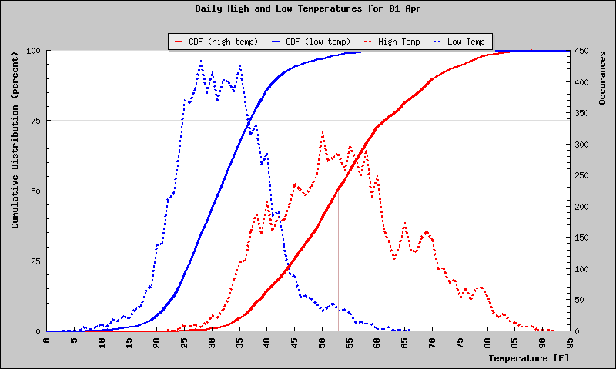
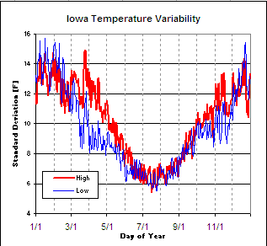
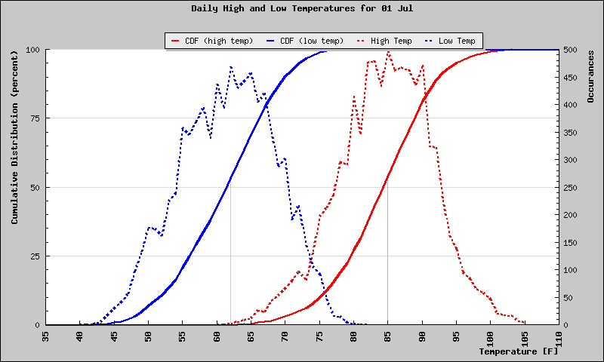
Daily Temperature Spreads
April 1
July 1

Slide 29
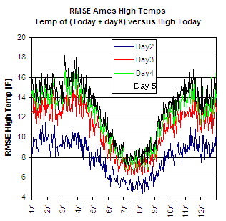
Day to Day Variability

Slide 30
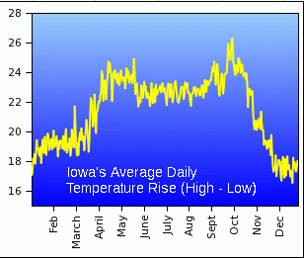
Daily Temperature Swing

Slide 31
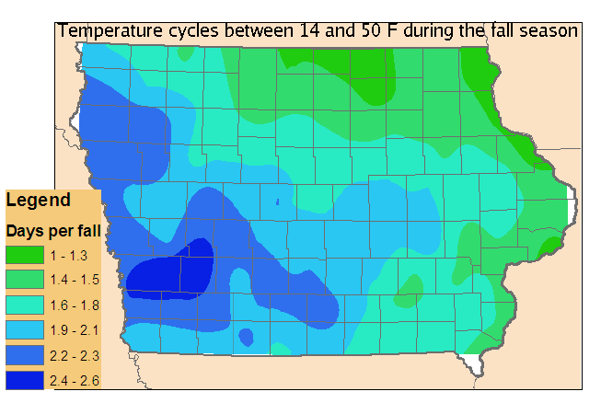
Temperature Cycles

Slide 32
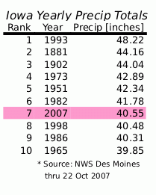
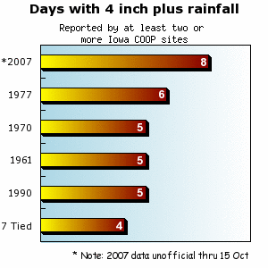
Extreme Rainfall of 2007

Slide 33
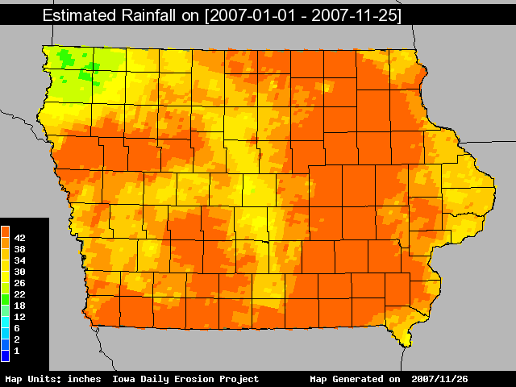
Heavy Rainfall of 2007

Slide 34
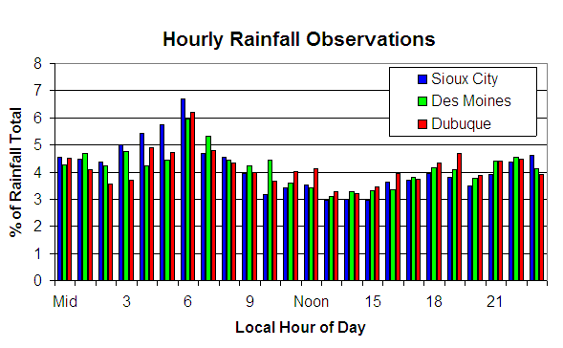
Sioux City
Des Moines
Dubuque

Slide 35
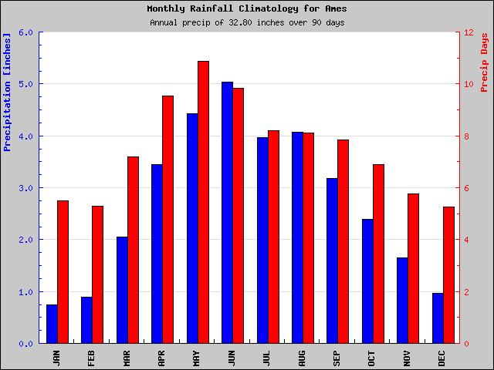
Ames Rainfall Climatology

Slide 36
Ames monthly rainfall reliability
1951-2007
 | 1 Month | 2 Months | 3 Months | 4 Months
Below Normal | 56% | 33% | 21% | 14%
25% below | 40% | 18% | 9% | 5%
1 inch below | 25% | 9% | 4% | 1%
1 std-dev below | 15% | 4% | 1% | 0.1%

Slide 37
NWS Storm Based Warnings

Slide 38
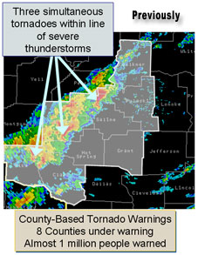
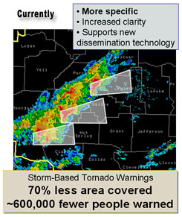
Motivation

Slide 39
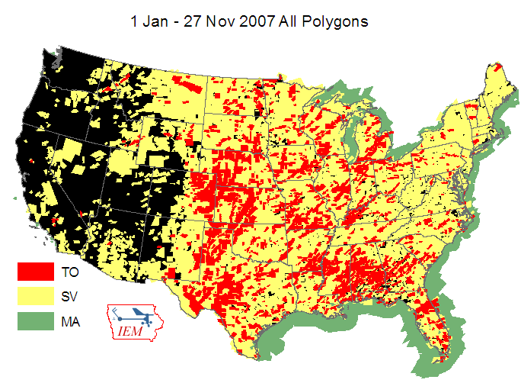

Slide 40
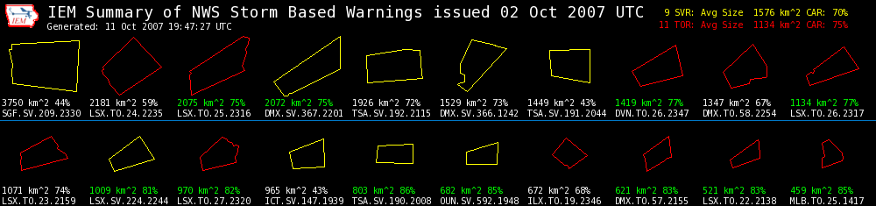

GIS plots and stats
Daily summary of all storm based warnings in one image
  Size of the warning
  Reduction in size of the warning versus county based warning
  Clickable to text and RADAR image
Do these warnings look like storm paths or outlines of political boundaries?

Slide 41
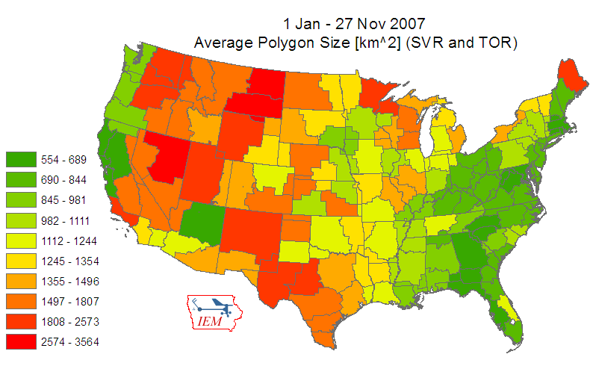

Slide 42
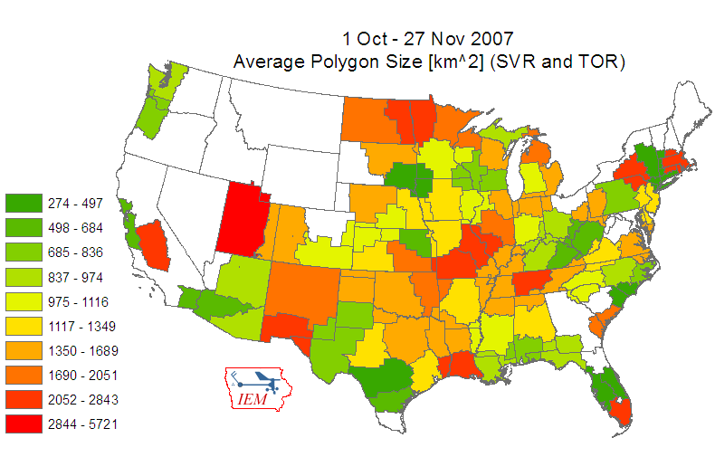

Slide 43
Conclusion
Always looking for more datasets
Keep looking for IEM related projects to keep me employed!
Future Work
Nothing, I have done all there is to do ☺

Slide 44
Seniors, Learn from my mistakes!
Avoid excessive slide animations
Use index cards for reference, not reading
NEVER USE BLUE ON BLACK
Don’t do things that distract from your message (nervous pointer, brushing hair, “ummmm”, “aahhhhh”)
“You probably can’t read this in the back (nor in the front of the room)”
All figures need units, axis labels, title, legend, reference, etc
Avoid a lengthy “Future Work” slide.
Test your presentation beforehand, come to practice session on Sunday evening beginning at 5 PM.

Slide 45

Time for Questions?
mesonet.agron.iastate.edu
Daryl Herzmann
515.294.5978
akrherz@iastate.edu

