Slide 1
KCCI SchoolNet8 Workshop
Daryl Herzmann
Iowa Environmental Mesonet
Iowa State University

Slide 2
Program
1:00 – 3:00 PM: SchoolNet8 Training
3:00 – 3:15 PM: Break
3:15 – 3:45 PM: SchoolNet8 Panel Discussion
3:45 – 4:45 PM: Character Counts in Iowa Presentation
4:45 – 5:00 PM: Break
5:00 – 6:30 PM: Balcony Networking

Slide 3
Motivation for SchoolNet8
CIPCO / Touchstone Energy COOPs:
  Community Outreach
  provide visibility for CIPCO and member cooperatives
KCCI-TV
  Interface with schools
  Provide local weather information to viewers
Iowa State University
  Outreach with schools on science education
  Provide a rich high resolution environmental dataset for research

Slide 4


Our Partnership
Process Feedback
ISU
NWS
Custom Data Products
Data Services
Operations Support
Project Support
Improved Products
KCCI -TV

Slide 5
Iowa Environmental Mesonet 411
What does ‘mesonet’ mean?
  ‘meso’ - Spatial scale, ‘net’ - network
Why ‘environmental’?
  We are interested in air quality, water quality and other non-weather datasets
Abbreviated 'IEM'

Slide 6
More on the IEM
Project of the Department of Agronomy at Iowa State University
We are data pigs.
Look to meet the growing data needs of users in the State and elsewhere.
KCCI SchoolNet is one of the many networks that send data to us.

Slide 7
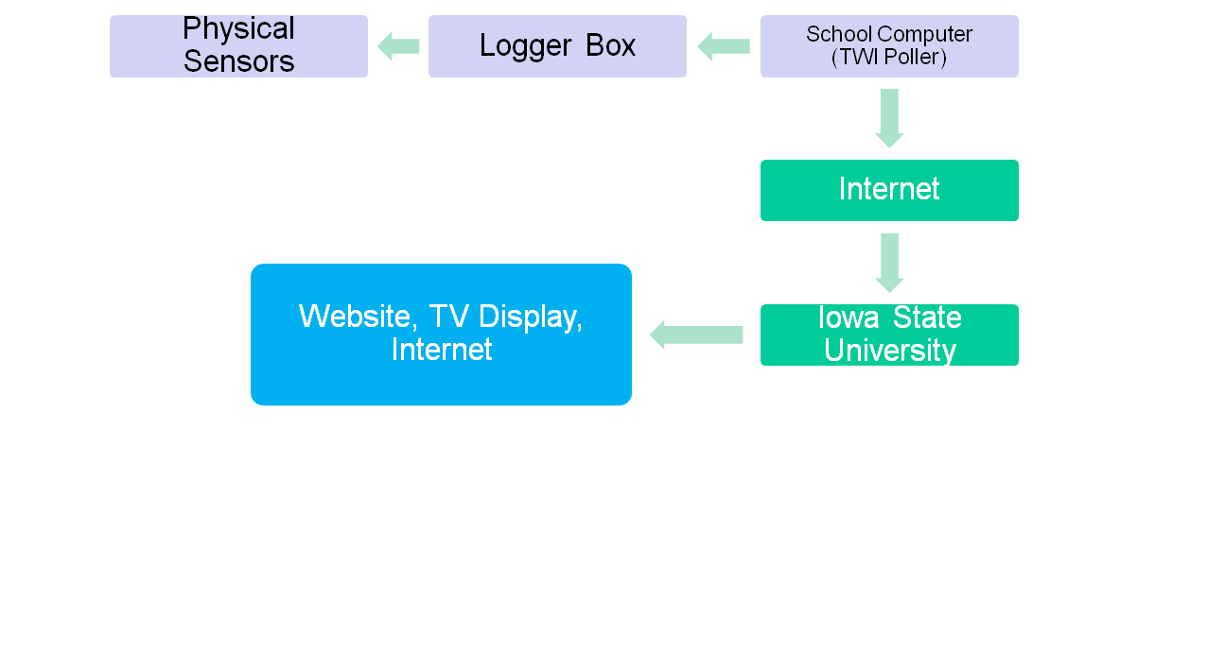
How your data is transmitted

Slide 8
Data Formatting
Displayed on “TWI Poller”
C 074 Min 02/17/10 ENE 00MPH 000K 460F 007F 084% 30.08" 00.00"D 00.07"M 00.00"R
D 074 Max 02/17/10 ENE 10MPH 050K 460F 021F 100% 30.20" 00.00"D 00.07"M 00.00"R
E 074 12:01 02/17/10 ENE 03MPH 046K 460F 020F 099% 30.09F 00.00"D 00.07"M 00.00"R
Your site produces roughly 6 obs per minute!

Slide 9
SCHOOLNET8 DATA USERS

Slide 10
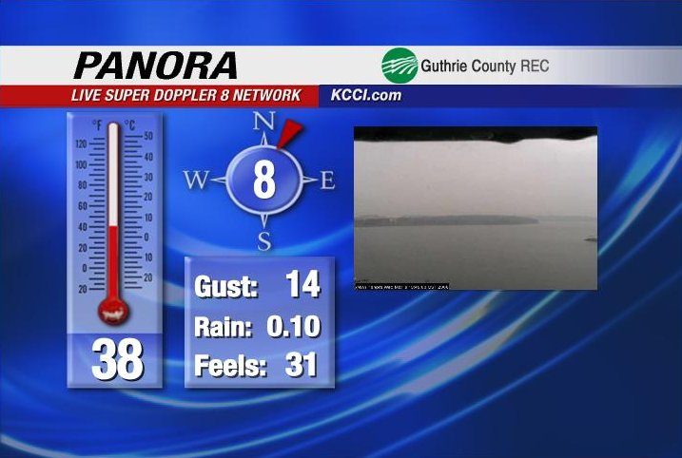
KCCI uses it!

Slide 11
SchoolNet8 Data Users
Storm Prediction Center [SPC]
  Norman, Oklahoma
  In charge of providing timely forecasts of extreme weather.
  Use SchoolNet8 data to help identify mesoscale boundaries critical in severe weather forecasting

Slide 12
SchoolNet8 Data Users
River Forecast Center [RFC]
  Chanhassen, MN
  In charge of analyzing and forecasting river flood conditions. Hydrological data.
  Use SchoolNet8 precipitation totals for their water analysis.
  The SchoolNet8 network has doubled the hydrological observing sensors in Central Iowa.

Slide 13
SchoolNet8 Data Users
Global Systems Division (GSD) [NOAA]
  Boulder, Colorado
  Data collected under the MADIS project.
  Data is used in very detailed and heavily quality controlled surface analysis programs.
  This data is then included in some operational weather forecasting models run in D.C.

Slide 14
SchoolNet8 Data Users
National Weather Service [NWS]
  Des Moines, IA
  Use data in hydrological applications, surface analysis, severe weather awareness, winter weather awareness.
  Are automatically alerted of 50+ MPH wind gusts and heavy rainfall.

Slide 15
NWS Auto Alerts
The IEM automates a process to instantly send the National Weather Service reports of severe wind and rain.
In many locations, the SchoolNet8 site is the only automated live sensor in the community.

Slide 16
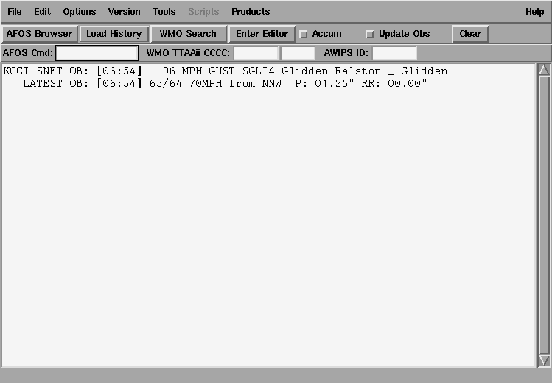
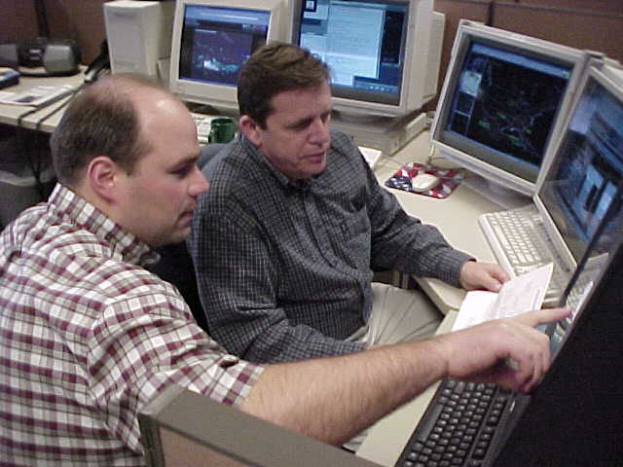
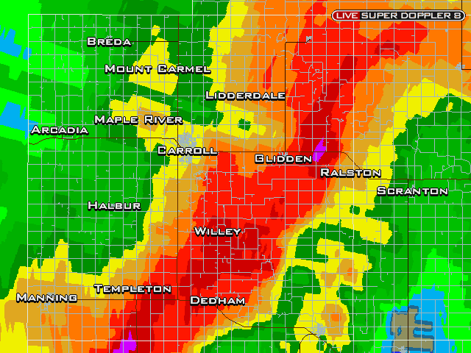
NWS AWIPS alerts

Slide 17
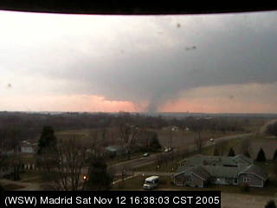
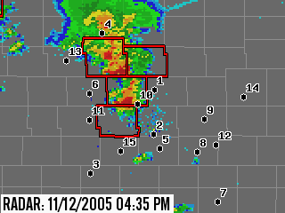
Web Cameras
Live images from all over Central Iowa
Many applications
Integrated on the website.

Slide 18
Uses of the Web Cameras
Spot high impact weather
Showcase community events
People with interest in the community can check in
There are even educational uses (that is coming up! )

Slide 19
IEM TRACKER

Slide 20
IEM Tracker
System to manage metadata about sites
Most of you have probably gotten the emails from “Iowa Environ Mesonet”
Since the system came online on 25 June 2002, it has generated over 17,000 tickets for SchoolNet
Most of these tickets are generated from the automated data tracking system

Slide 21
What are offline alerts?
When ‘online’, your site is streaming observations to the Internet at roughly 6 obs per minute.
A process on the IEM server monitors this feed and once the most recent ob is 30 minutes old, a trouble ticket is generated and site contacts are emailed.

Slide 22
More about the tickets
Probably 50% of the tickets are network related and out of your hands.
5% of the tickets are responded to with further information
IEM tracker has improved network performance for each of the networks it monitors.

Slide 23
Site Online Reliability
  Year Sites Online %
2002 46 85%
2003 53 87%
2004 63 91%
2005 67 93%
2006 67 97%
2007 72 94%
2008 72 92%
2009 71 89%
2010(ytd) 72 92%

Slide 24
Monthly Website Stats
Each month I send out an email update with website access statistics. These stats include:
  Hits – Number of page loads with information for that site on it.
  Hosts – Estimated number of people visiting the site
  Click Thrus – Times people clicked on sponsor logo

Slide 25
WWW OVERVIEW

Slide 26
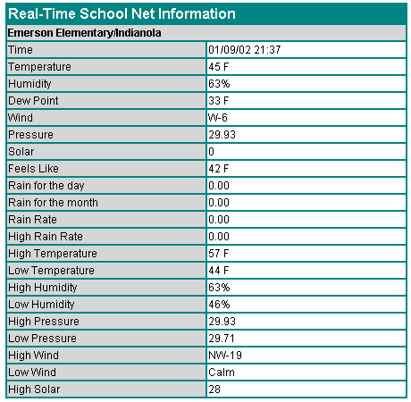
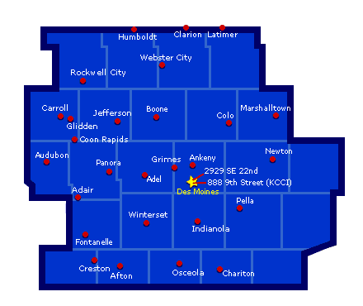
Circa 2001

Slide 27
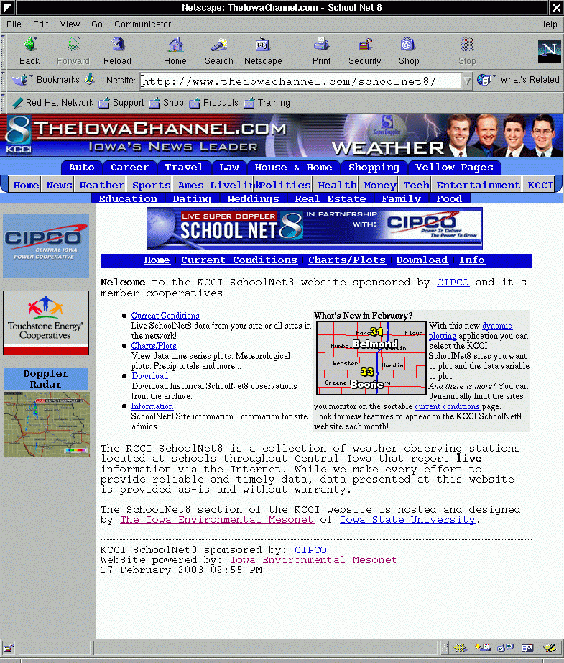
Circa 2002

Slide 28
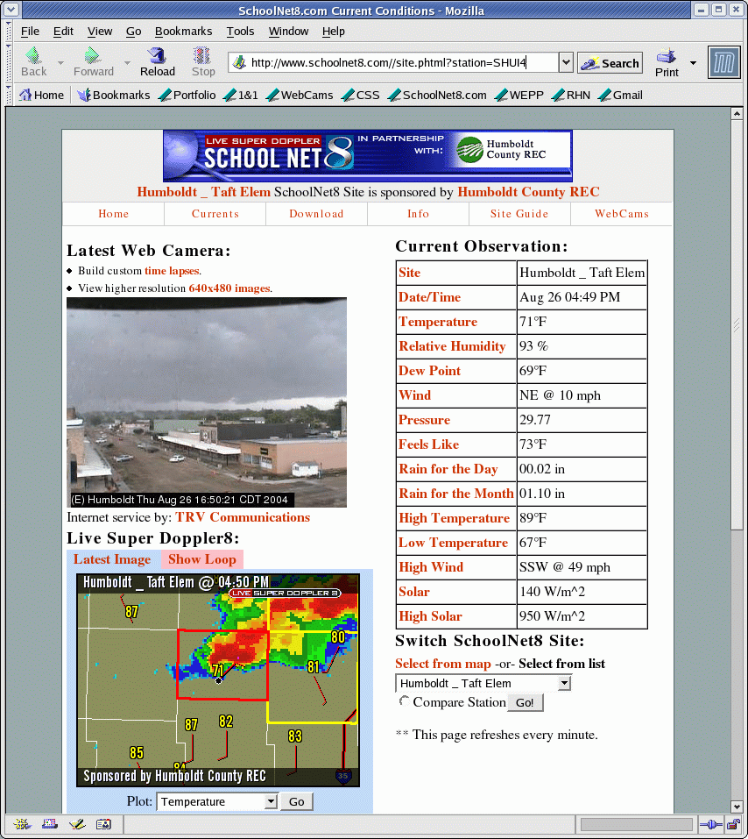
Circa
2004

Slide 29
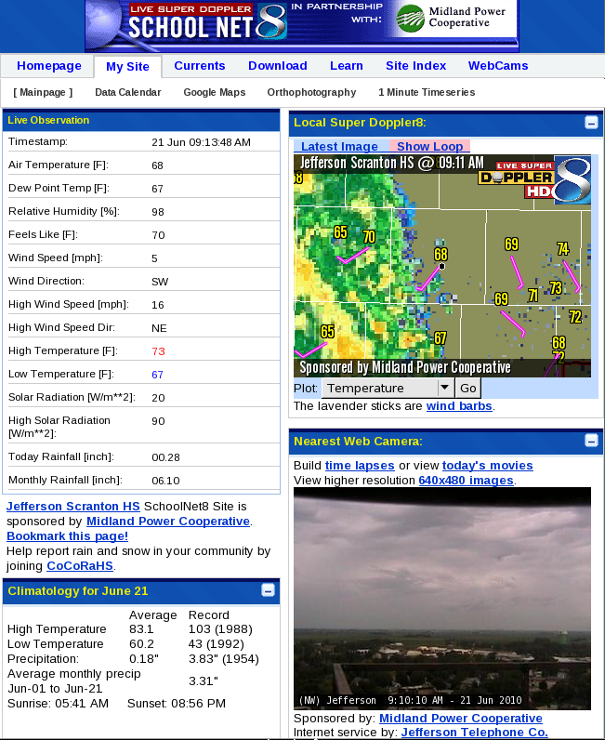
Today

Slide 30
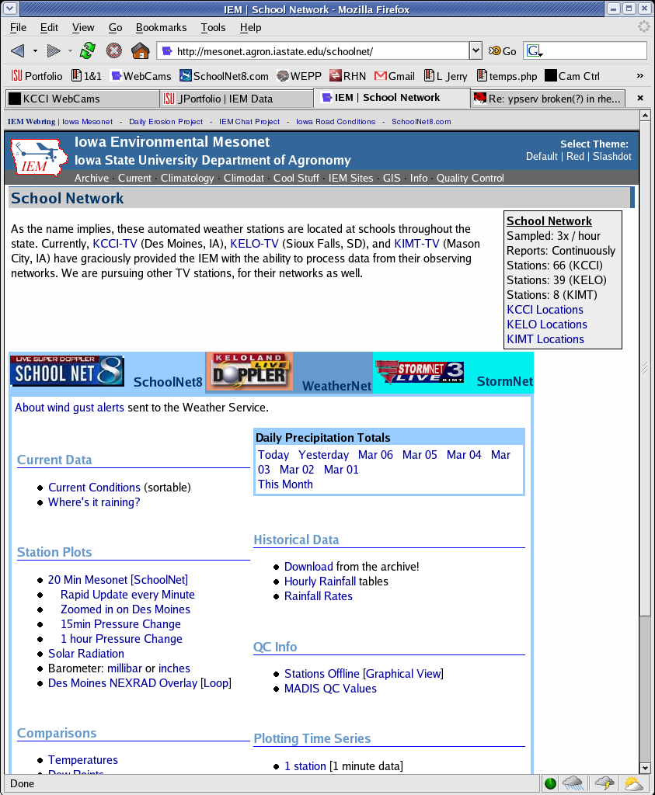
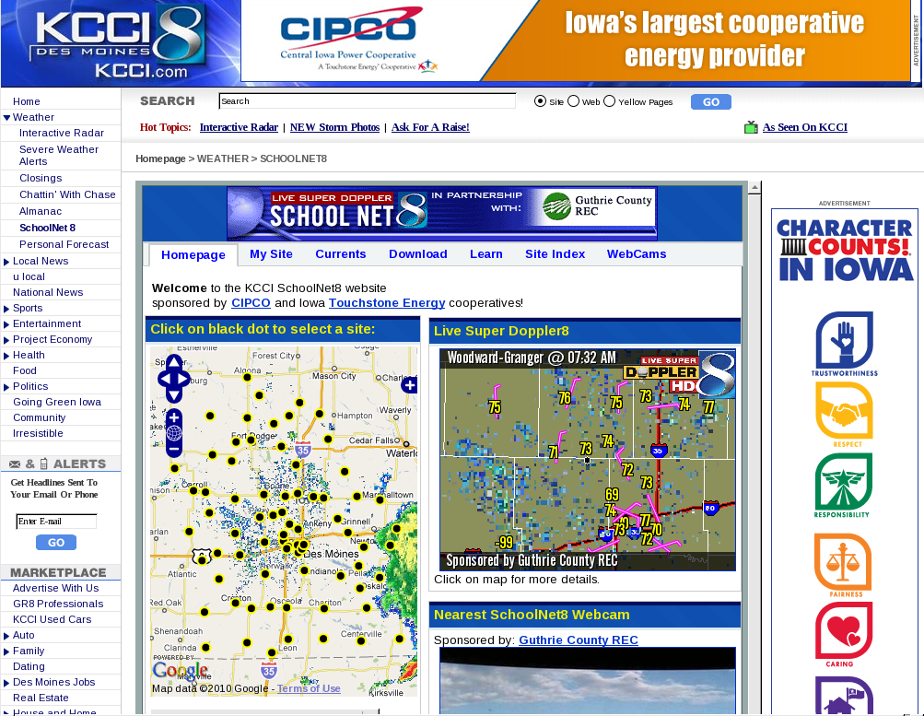
Which website is which?

Slide 31
FREQUENTLY ASKED QUESTIONS

Slide 32
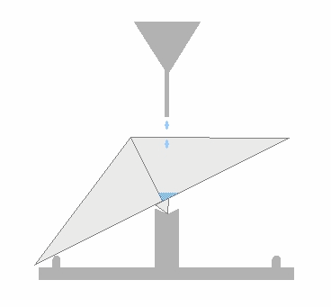
Why does our rain gauge under-report?
Tipping mechanism fails to “keep up”
Height of the gage above ground causes wind to blow away rain drops.
Sensor is not level
Figure from: http://www.derm.qld.gov.au/

Slide 33
Why do we need to update for daylight savings?
The logger box has its own internal clock.
This clock is not automatically synced from the computer.
This clock is used for observation time when reported to the Internet.
The logger resets values when it thinks it is midnight.

Slide 34
How do we tell if our site is working?
Check to see that data is scrolling by on the “TWI Poller” display.
Check the website for the last observation from your site.
If all else fails, please email / call me!

Slide 35

Questions?
Daryl Herzmann
3010 Agronomy Hall
Ames, IA 50010
515.294.5978
Cell: 515.451.9249
akrherz@iastate.edu

