Slide 1
KCCI SchoolNet8
Website Guide
Daryl Herzmann
Iowa Environmental Mesonet
Iowa State University

Slide 2
Motivation
Show what is available on the website
Provide some examples of how data can be used to illustrate science concepts

Slide 3
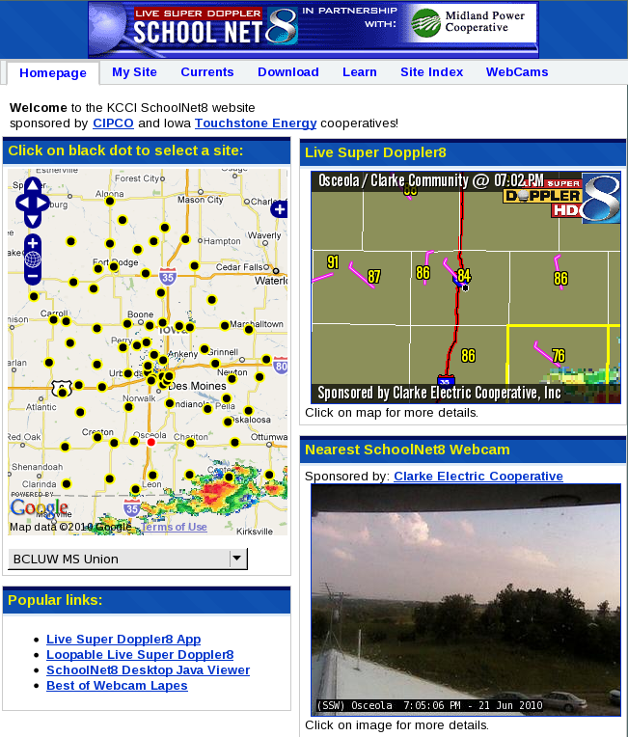
Homepage
Sections
My Site
Currents
Download
Learn
Site Index
Web Cams

Slide 4
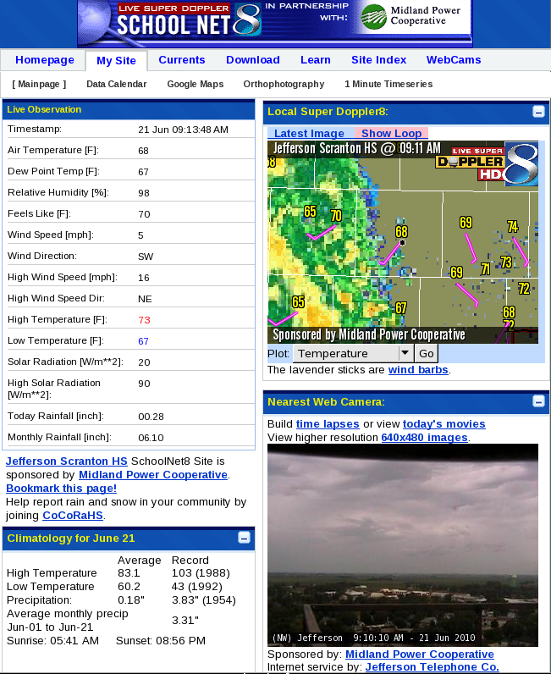
My Site
Sections
Calendar
Orthophotos
Time Series
NWS Forecast
Climatology

Slide 5
Data Download Options
“Observation Data”
These are the instantaneous reports available every minute.
“Daily Summary Data”
These are summarized by day, i.e. high and low temperature, rainfall.

Slide 6
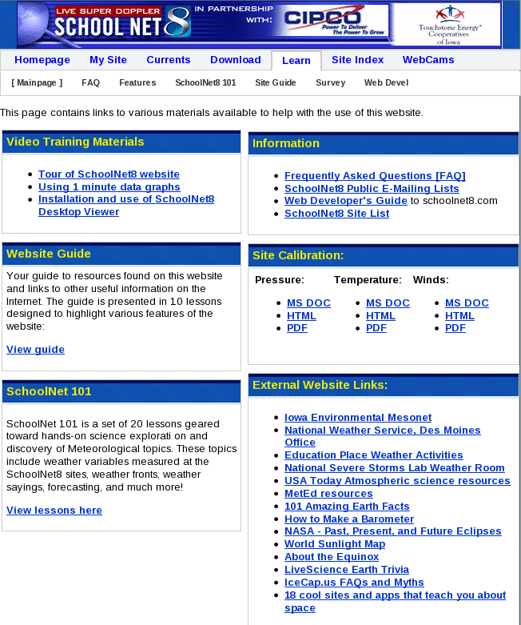
“Learn” section

Slide 7

Teacher’s Guide
Available for download on website.
Guide Goals:
1.To make weather (science) fun and interesting for kids.
2. To give the kids a basic understanding of how weather works.
3.To give children the ability and know-how to locate and utilize weather information on the Internet.

Slide 8
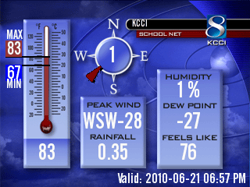
Web Developers Guide
Much of the website content can be placed on your local websites
Page contains documentation and examples

Slide 9
Web Guide Topics
Comparing Observations
Solar Radiation
Sortable Current Conditions
One Minute Data Traces
Web Cameras

Slide 10
Web Guide Topics
Live Super Doppler8 App
Using RADAR with Obs and Warnings
Orthophotography
Wind Barbs
Navigating SchoolNet8.com

Slide 11
2. SOLAR RADIATION

Slide 12
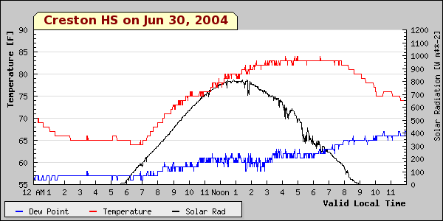
A Sunny Day

Slide 13
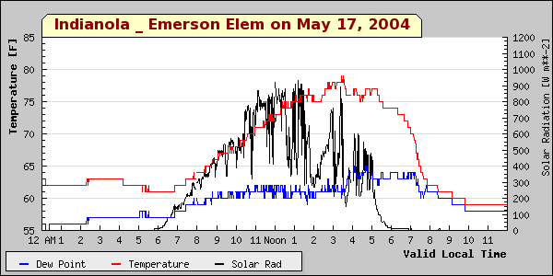
Sun, clouds, sun, clouds

Slide 14
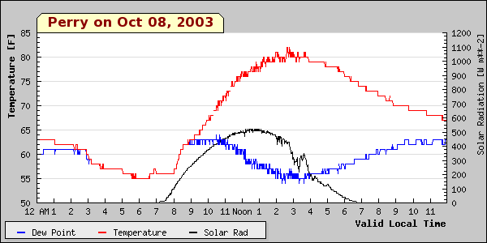
A sunny fall day

Slide 15
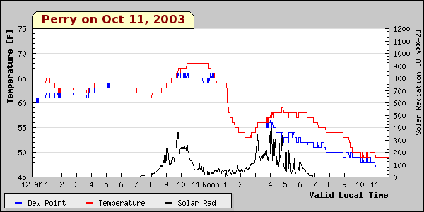
A cloudy fall day

Slide 16
5. WEB CAMERAS

Slide 17
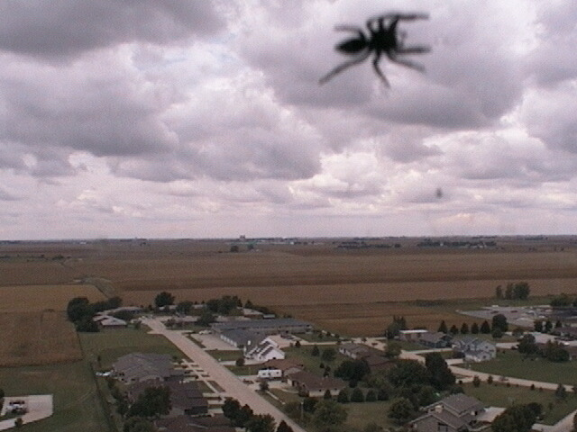
Can be used for Zoology

Slide 18
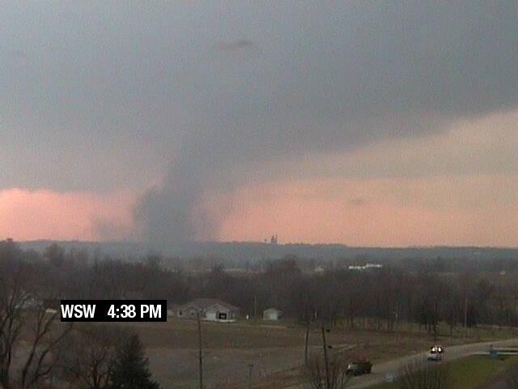
Show High Impact Weather

Slide 19
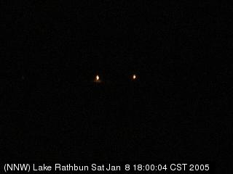
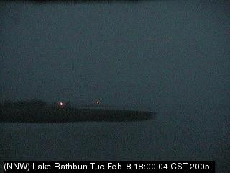
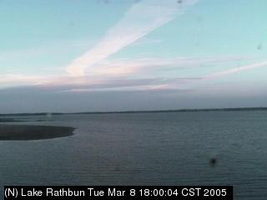
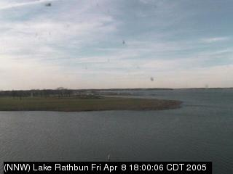
How the days lengthen...
JAN
FEB
MAR
APR
All images at 6 PM

Slide 20
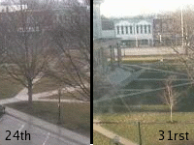
Spring green up!

Slide 21
Other suggestions
Use the historical function to observe differences in space and time
Look at how clouds change in form over a day
Look at winter images for signs of snow and how deep it may be (tire tracks)

Slide 22
9. WIND BARBS

Slide 23
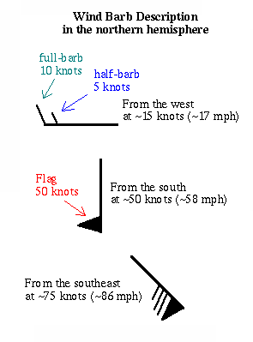
Wind barbs simultaneously display wind direction and speed.
Speed unit is “knot”, which is nautical mile per hour (1.15 MPH).
The wind direction can be confusing, think of shooting an arrow with the wind.

Slide 24
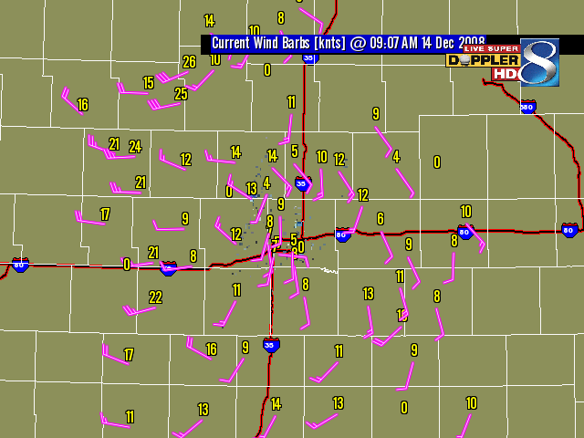

Slide 25
MORE WEBSITE STUFF

Slide 26

Questions?
Daryl Herzmann
3010 Agronomy Hall
Ames, IA 50010
515.294.5978
Cell: 515.451.9249
akrherz@iastate.edu

