Slide 1

Using the Mesonet
Daryl Herzmann
@akrherz
30 March 2015

Slide 2
Iowa Environmental Mesonet
Department of Agronomy Project
Started in 2001
Funded by collaborative research products (grants)
“Mesonet” -> Meso-scale Network
A collection of observation platforms intended to resolve phenomena on the meso-scale (10s of miles)
Daryl has created a hot mess of a website
Horribly complex, confusing and filled with technical jargon, but I am here to explain why!

Slide 3
http://mesonet.agron.iastate.edu
Collect data from existing observation networks
Iowa State’s Soil Moisture Network is the only one operated by Iowa State.
Primary focus is the corn belt, but data available for other places too!
Nearly all data is made immediately available for download.
Generate products and website applications to hopefully provide users with immediate answers.

Slide 4
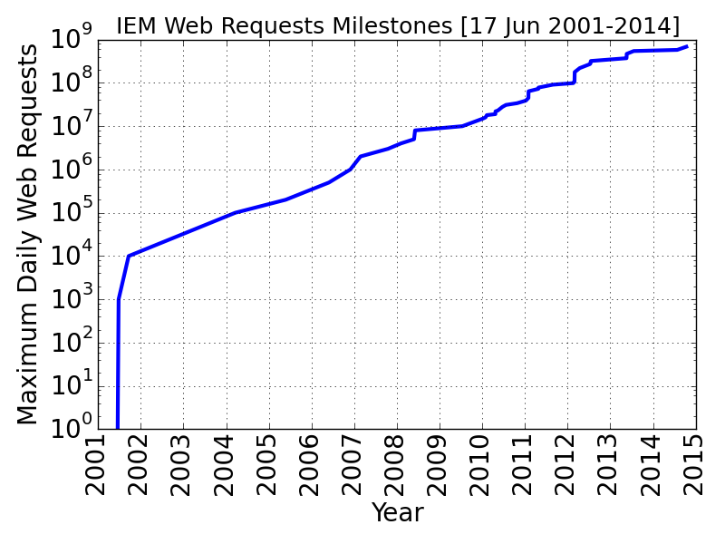
Nearing 1 billion web requests per day (daily average around 200 million)

Slide 5
So why is the website so confusing?

Slide 6
Observations of Weather and Climate are Messy
For daily (calendar day) needs, high quality temperature, precipitation, and snow data does not exist (for Iowa)!
Baseline / long term NWS Cooperative Observer network (humans) take 24 hour measurements at ~ 7 AM (but not all sites do that!)
Automated weather stations do a poor job at precipitation, do not report snowfall, and often provide summaries on standard time day (no DST)
Remotely sensed datasets often have coarse resolution, many biases, and require great technical understanding to use
Automated weather stations break.
Human observers make unreliable reports.
The highest quality data (NWS COOP) do not report wind, solar radiation, humidity, nor soil temperatures!
A lot of our data has been generated by physical + statistical models.

Slide 7

What do IEM data users want?
“Just tell me now much it rained in Ames yesterday”
“Don’t explain to me all of the lame things on the last slide”
“I want data for Gilbert, not Ames”
See my talk: “How much did it rain in Ames on 25 June 2010?”

Slide 8
The answer to: “How much did it rain in Ames on 25 June 2010?”
IEM QC COOP | 0.00 | SchoolNet | 0.57 | CoCoRaHS | ??? | Stage IV | 0.22
ASOS | 0.13 | RWIS | 0 ? | ISUAG AgFm | 0.25 | NARR | 0.19
ASOS DSM | 1.11 | Lincoln Way | 0 ? | Others | 0.53 | TRMM | 0.51
ASOS DSM Hr | 0.33 | Ada Hayden | 0.93 | DMX 1hr | 0.30
ASOS 1min | 0.36 | H2O Trtment | 0.47 | DMX Storm T | 0.25
We simply average and get: 0.36176470588 inches! What precision!

Slide 9
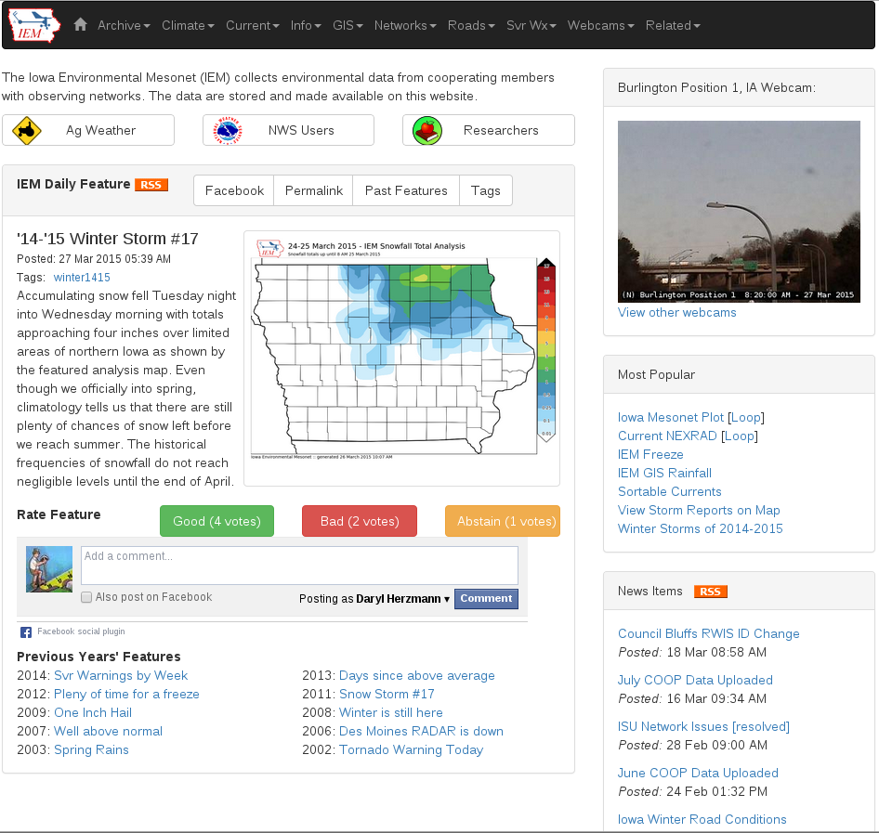
Let us go surf the website!
Daryl Herzmann
3015 Agronomy
515.294.5978
akrherz@iastate.edu @akrherz

