Slide 1
The Case for Relational Databases (make databases great again!)
daryl herzmann
@akrherz
Agronomy 590RD
12 Sept 2016

Slide 2
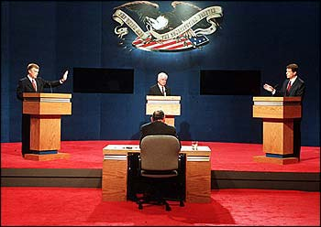
Who am I and why am I here?
Department of Agronomy since 2001, System Analyst III
Just a BS in Meteorology, #lazy
Relational Database user since 1998
Proprietor of Iowa Environmental Mesonet
Trainwreck of a website
300m hits per day
1m daily active users
Dr Dietzel tricked me into being here

Slide 3

Goal: The Iowa Environmental Mesonet [IEM] aims to gather, collect, compare, disseminate and archive observations made in Iowa on Earth.
Gather – search the interwebs for open content, build partnerships with those that have environmental data. ~15 real-time network data streams
Collect – bring this information in house for usage ~100m obs per day
Compare – by combining datasets, more information can be gleaned
Disseminate – don’t just sit on this information, have a fancy pants website to allow folks/computers to retrieve it
Archive – don’t throw things away! ~40TB files, 3TB in relational database (PostgreSQL)

Slide 4

Code Idea #1. Monolith
Create a ginormous script / Java application that writes data to local .CSV files
Problems:
Development timeline
Thread safety (simultaneous edits to single file -> bad)
How to scale to multiple machines?
UNIX philosophy, to something small and do it well. (Modular)
Speed of data access
© CBS

Slide 5
Code Idea #2. Break up Ma Bell
Create many scripts and programs to edit local .CSV files
Problems:
Development timeline
Thread safety (simultaneous edits to single file -> bad) lock files
How to scale to multiple machines?
UNIX philosophy, to something small and do it well. (Modular)
Speed of data access
© CBS

Slide 6

CSV IS NOT WORKING! Time to define requirements for data backend
“Simultaneous” dataset editing!
Simultaneous dataset viewing!
100s of concurrent users
I wanna go fast
Permissions model
Efficient/compressed on-disk storage
Accessible to colleagues, right Gio?
© memegen.com

Slide 7

Wait daryl, my goal is not world domination. I just want to graduate and earn cash money.
Database does more than just store information
Built in statistics functions
GIS extensions built in
Triggers
Constraints (data cleaning)
Can do versioning, like github
Faster data exploration/screening
Procedural Languages
Windowing Functions
Common Table Expressions
© http://quotesgram.com/

Slide 8
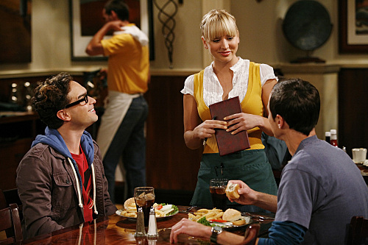
“Server” in Database Server scares me! What Is A Database Server?
Sheldon & Leonard are clients, making requests. [write SQL]
Penny is a server, she listens for requests. [network TCP socket]
She translates the request into notes, unseen by clients [blackbox]
She relays the notes to the cook, which materializes the food (backend), again [blackbox]
Penny returns the food results to the clients for consumption. [tuples]
© CBS Warner Brothers

Slide 9

Can we install a database server on my laptop?
Let us discuss the magic of “localhost”
Programming language’s database libraries default to “localhost” / file sockets
conn = dbconnect(“dbname”)
Defaults to connect to localhost
Defaults to connect as your username
Defaults to connect to localhost on the standard IANA TCP port for your database software
© http://mattcantdraw.deviantart.com/

Slide 10

SQLite is not a database server SQLite is a database engine, but that’s OK!
SQLite is OK if:
Only one process will be writing to the database at once
You are not worried about accessing the database over a network connection (quasi-lie)
Datasets that easily fit in memory
SQLite usage cases:
Replacing ad-hoc text files
Creating distributable software
Reproducible workflows
Personally, I worry about SQLite file corruption, not SQLite’s fault.

Slide 11
Enough Theory! How does daryl attempt to get work done?
Red Hat Linux
Github (@akrherz)
Travis-CI + Github integration
Eclipse
Python (Pandas, Numpy, Matplotlib)
PostgreSQL + PostGIS
~ “DevOps” Approach
Fast Iteration
My laptop runs development version of everything I do
Once happy, I commit to github and then pull changes into “production”
Code that fails emails me errors
Email is my triage system
I get lots of emails ☹
Always think “How can I automate this to prevent future tedium?”
Avoid guest lecturing. ☺

Slide 12
Some final thoughts, my 2 cents
Learn to love SQL. Do as much processing as you can within the database:
Faster
Fewer Errors
Whatever you write code with/in, enforce style checks
Limit your line width to 80 characters
Some documentation is good, but your code should document itself
If you need 25 lines of documentation to explain the next 1 line of code, something is not right with the world.
Find the domain experts in your field that are writing libraries and use them!

