Slide 1
2016 Russell L. DeSouza Award
daryl herzmann
26 September 2016
@akrherz

Slide 2
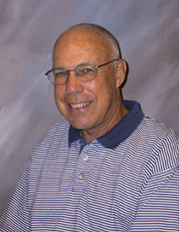
Dr Doug Yarger, 2002 Award Winner
His “forgetfulness” changed my life! (insert story here)
Strong supporter of Unidata and got me interested in it
A number of collaborative projects with Unidata for education related activities

Slide 3
16 June 1999, to: Unidata from: me (the ultimate email spam/scam, Holy Spell Check Batman)
Greetings,
I have a question for you. I am not exactly sure if I am allowed to recieve a data pipe from you. I am a junior in Meteorology with a deep interest in weather data processing. My department at Iowa State University allready receives data from you, but it is on a system that I can not stand to work with (IRIX 6.5.3), anyway...
I would like to set up my machine as a data chunker with your data. I am interested in database, web, and GUI products maintained in Linux 2.0 . My question is whether or not, I am allowed to do this...
If you would prefer not to do this, that would be fine as well... But I think that I can do things that would be mutually benificial to both parties..

Slide 4
17 June 1999, Ben Domenico kindly replies:
Daryl,
I'm not sure I understand your question. The way the IDD works, you would simply make arrangements within your department to have an IDD feed from the machine there (whether you can stand IRIX or not) into the machine you want to work with. It doesn't make sense to have multiple feeds of the same datastreams going into ISU from the outside. …snipped…
It's good to hear from you again. I hope this helps.
--Ben
(Big thanks to Mike Schmidt for resurrecting this email thread!)

Slide 5
Fast forward 17 years, Am I qualified for this award?
The Russell L. DeSouza Award honors individuals whose energy, expertise, and active involvement enable the Unidata Program to better serve geoscience. Honorees personify Unidata's ideal of a community that shares data, software, and ideas through computing and networking technologies.

Slide 6
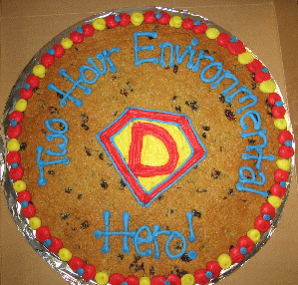
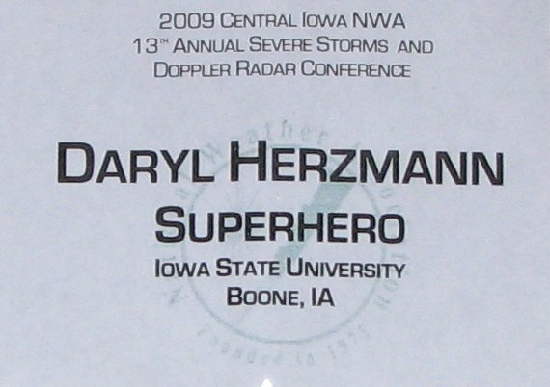
Individual?
I am an individual, yes. I have no known clones nor body doubles.
Previous Awards
2012 NOAA Non-Employee, Employee of the Month
2012 National Weather Association – Operational Achievement Award, Individual
2007 NOAA Environmental Hero
2002 National Weather Association – Larry R Johnson Award
1984 Kindergarten Showcase Student of the Week! ← Validation!

Slide 7
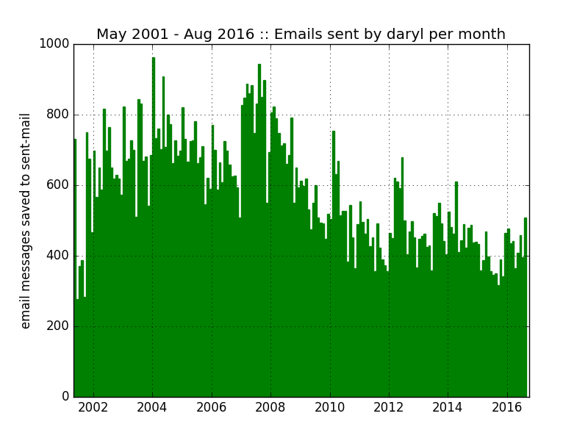
Energy?
Never felt like I was working for a day in my life.
I do fear daily that I am about to be fired for not doing a good job.
Doing other people’s work is more fun than my own
→ why I only have a BS!
Caffeine free since 2004! Energy comes from somewhere.
I have two kids under four with another arriving in January! ← Validation!

Slide 8
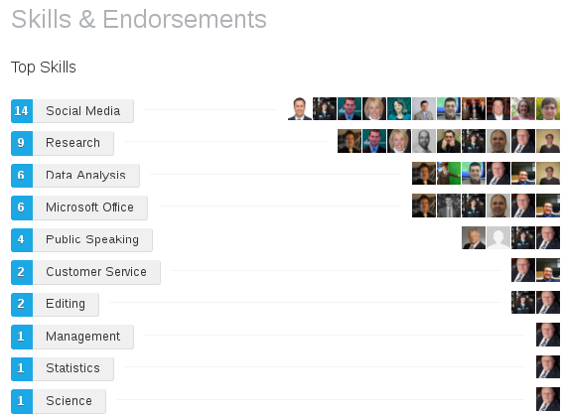
Expertise?
LinkedIn says this about me:
Microsoft Office? Uh oh….
Hmmm, I’ve been violently thrashing at this for 18 years, experience != expertise
I routinely solve puzzles on Wheel of Fortune, before the contestants do. ← Validation!

Slide 9
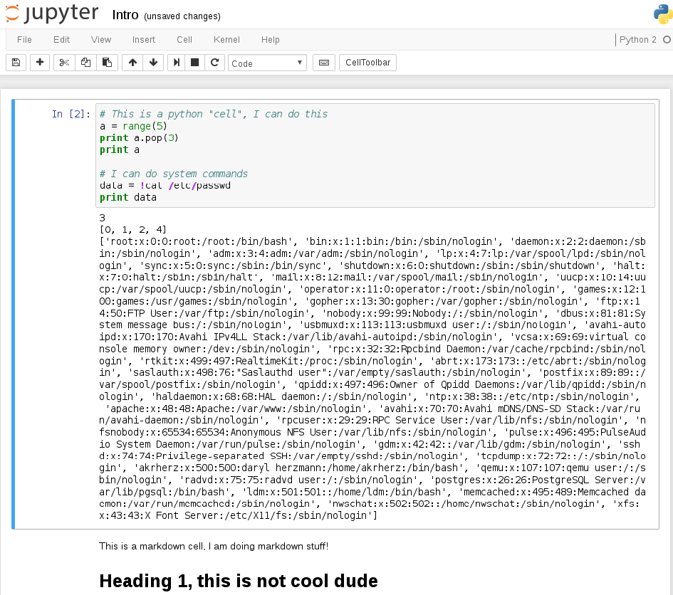
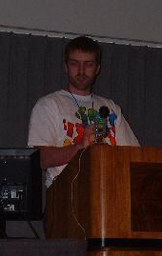
Active Involvement?
Brought IPython notebooks to Unidata in 2012! #amIright?
I troll the Unidata email lists when I can.
I troll Unidata employees more often.
Maintain an IDD LDM Node
Given talks at Unidata/NCAR events
At the first(?) IIPS/GIS AMS session in 2003, I ranted against the ESRI shapefile format, *cough*, in a colorful Fish Shirt ← Validation!

Slide 10
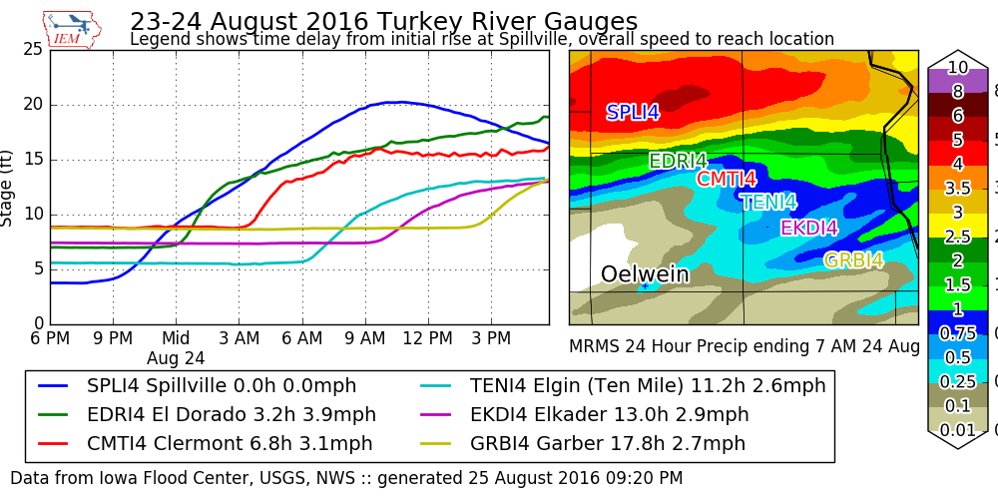
Serve Geosciences?
Is this codespeak for Meteorologists caring about Hydrology? ☺
I work on projects with the Iowa Flood Center @UofIowa
Meteorology program is with Geology @ISU
I’m in Agronomy and primarily support physical science modelling
Undergraduate job was with Physics and Astronomy ← Validation!

Slide 11
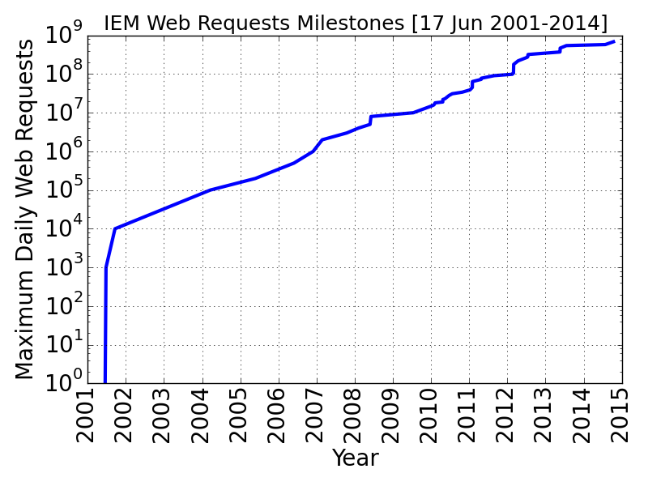
Shares Data?
The Iowa Environmental Mesonet website is a trainwreck, but crazy levels of functionality
Haven’t reached the mythical 1 billion requests per day, yet
Avg: 300m req/day 1m users
Mostly due to android apps ☹
This is one of a number of data sharing servers I admin!

Slide 12
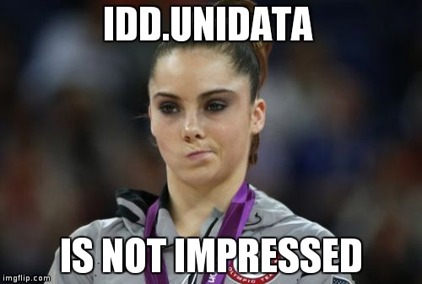
Average ~4 TB of web traffic per day
mesonet.agron.iastate.edu
Lots of random stuff
1.4 TB
mtarchive.geol.iastate.edu
1893-today GEMPAK, grib files, Thredds
300 GB
metfs1.agron.iastate.edu
IDD node /data over HTTP
400 GB
mesonet-nexrad.agron.iastate.edu
Open Level II Polling site
1.7 TB
If all this does not validate ‘Shares data’, I don’t know what would do it! ☺

Slide 13
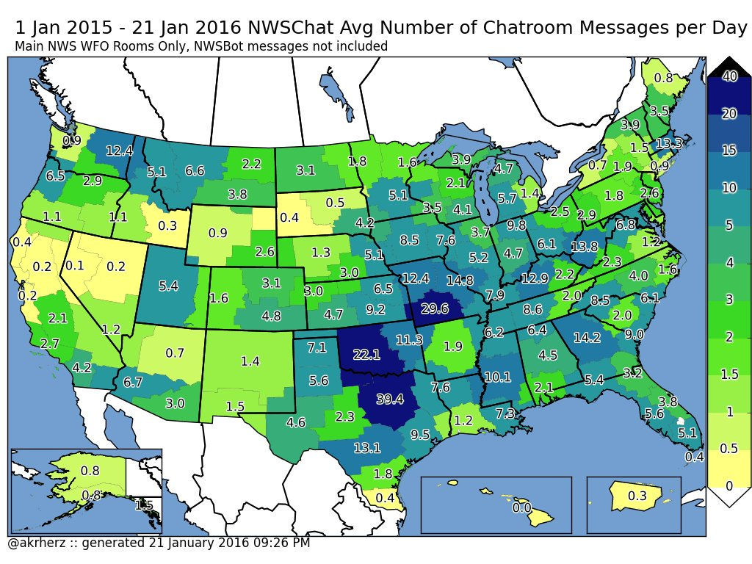
Shares Ideas?
IEMChat developed in 2005 to be a scalable+secure replacement for Yahoo Chat.
F/freely provided to the NWS and rebranded as NWSChat in 2008
I came along for the ride as a contractor to support it, till Jul 2016 ☹
weather.im is a for-public unofficial version of this project.
IEMBot/NWSBot is the coolest component, an async LDM/pqact processing bridge in twisted python ← Validation!

Slide 14
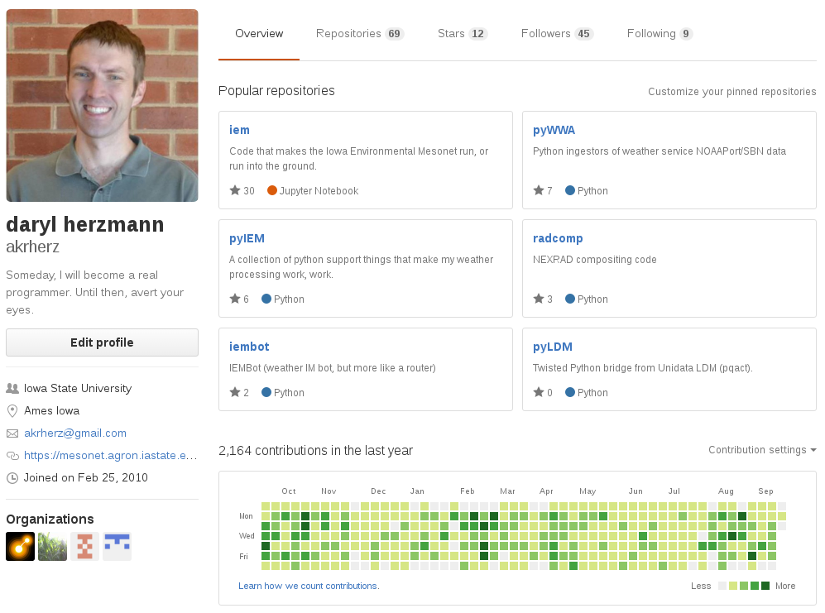
Shares Software?
While most/all of it is unusable cruft, it is all at github!
I like to wildly thrash at code.
Primary project: “iem”
11,500 commits, 0 releases ☹
Contributor to IgniteRealtime
Openfire, XMPP server
So a weak validation here.

Slide 15
Am I qualified? Conditional Pass! None of this would be possible without Unidata!
Equipment Grants
2005 to bolster IEM GIS services
2010 mtarchive thredds
2012 Edex / mtarchive support
Software
LDM (most important! ☺)
GEMPAK (close second)
Thredds (eh, maybe I shouldn’t have ranked the software)
Netcdf (uh oh, important too..)
List Messages by me | # | Direct Emails by me | #
support@ | 99 | Jeff Weber | 98
ldm-users@ | 79 | Anne Wilson | 61
support-ldm@ | 41 | Michael James | 33
support-thredds@ | 37 | Jo Hansen | 23
support-idd@ | 35 | Steve Emerson | 20
support-gempak@ | 34 | Ben Domenico | 16
gembud@ | 19 | Linda Miller | 15
 |  | Steve Chizwell | 12
 |  | Tom Yoksas | 10
* Since ~2001, actual totals are higher ☺

Slide 16
The story of GEMPAK’s nex2img
In July 2003, I was efforting getting RADAR composites into GIS. The `gdradr` and newly added `nex2gini` were not quite doing what I needed. I reached out to Jeff Weber and Steve Chiswell and a few days later, this email arrived:
Daryl,
I have a program called nex2img which you can download at
ftp://ftp.unidata.ucar.edu/nawips-5.6/contrib/nex2img.tar.gz
This program will create a GIF format output image of the radar mosaic
with a specified color lookup table in your desired projection.
Since the program does not write a GINI, you can use CED as the projection type.
…Steve Chiswell
The rest is history!

Slide 17

OK, enough of my rambling…. Questions?
@akrherz
akrherz@iastate.edu
515-451-9249 (cell phone ☺)

Slide 18
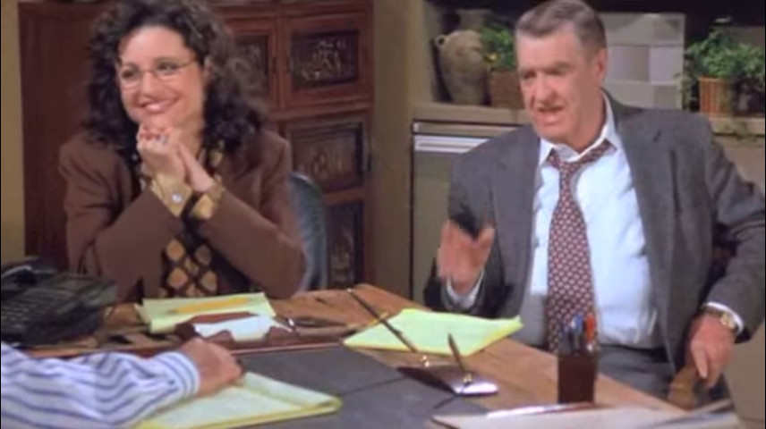
Bonus Material
“If we are going to stay here until all hours of the night, can we at get some food here!”

Slide 19
Neat datasets curated by the IEM
5 minute GIS-ready NEXRAD composites back to 1995
Different mechanisms to view NWS text data back to 2001
Yuge archive of SHEF data back to 2010
Complete? NWS WWA VTEC Archives
Downloadable Local Storm Reports
Decoded MOS data back to 2007 in
Downloadable NEXRAD Storm Attribute tables
Massive amounts of METAR data
BUFKIT archive back 2010
ASOS 1 minute data (Iowa + custom requests)
RAOB web service
GIS Ready GINI Satellite data
Various other GRIB products in on-demand URI based archives
90 TB of spinning disks

Slide 20
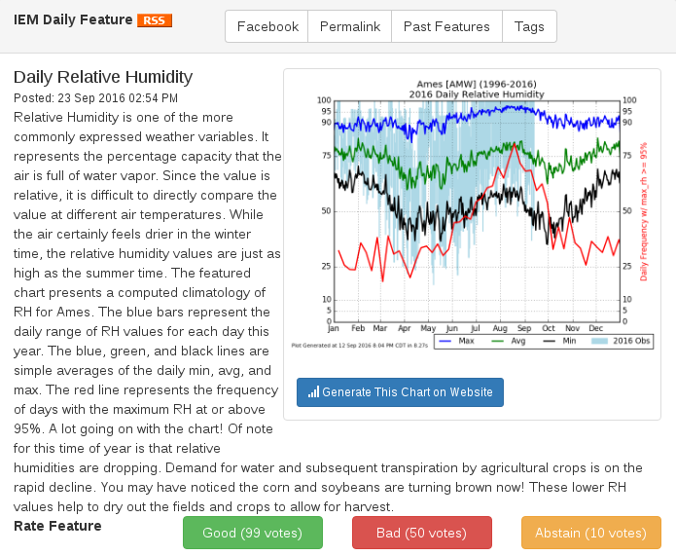
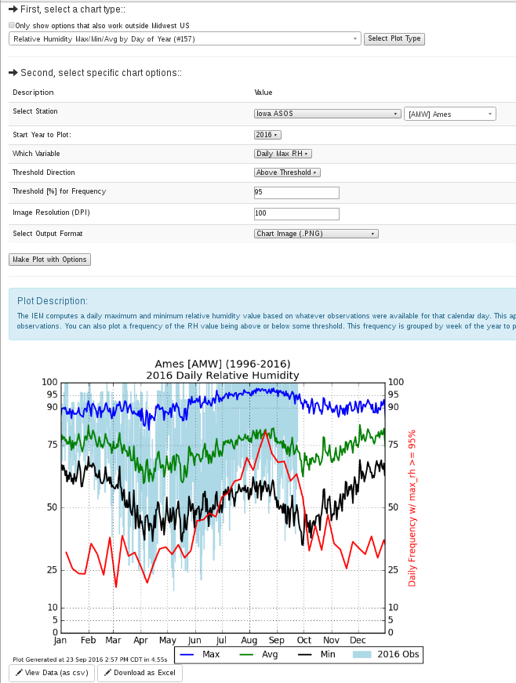
IEM Daily Feature as Reproducible Science

Slide 21
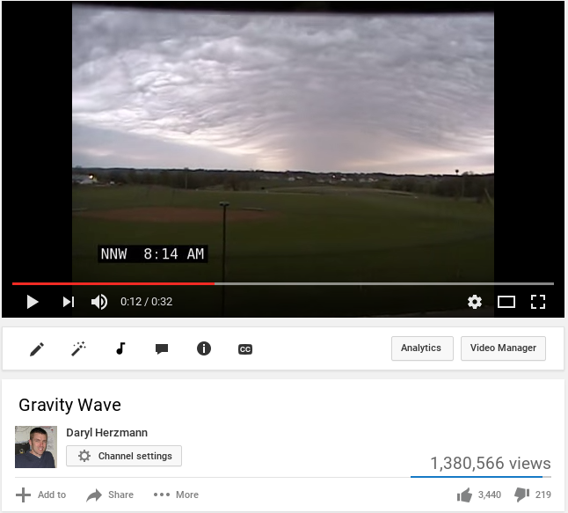
Having fun with webcams
Partner with 3 TV stations to build out a network of webcams
At least 5 minute image archived back to 2003.
PTZ allows virtual chasing
@akrherz YouTube channel has 400 videos now of fun stuff
Do we have time for a montage with 80s rock and roll music?

