Slide 1

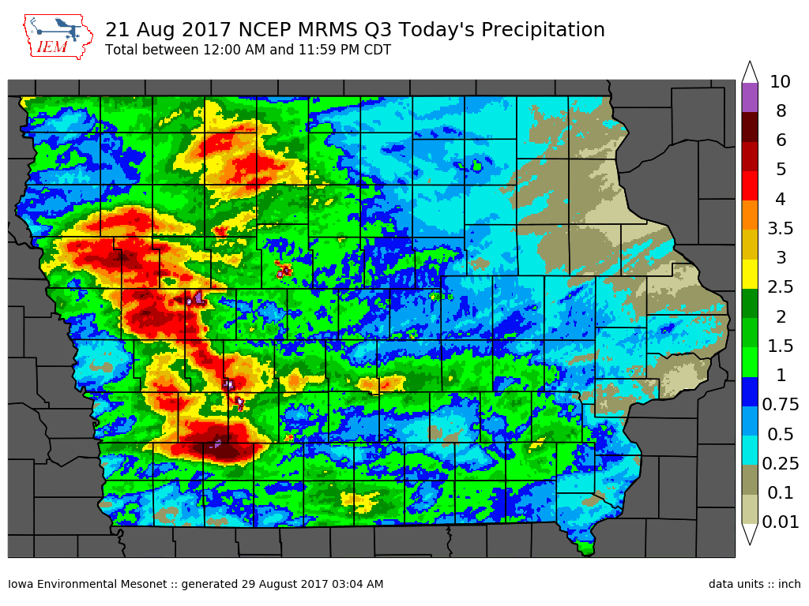
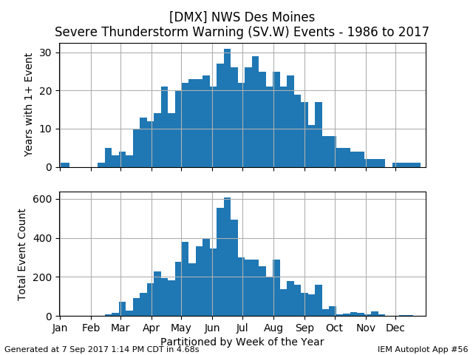
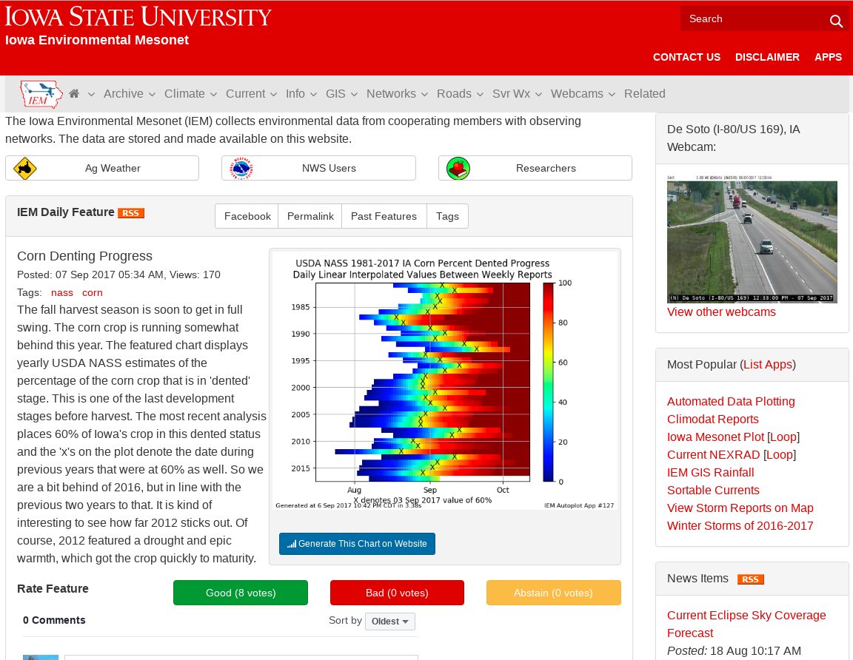




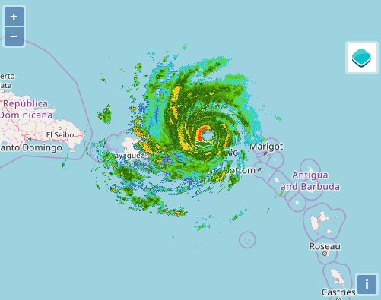
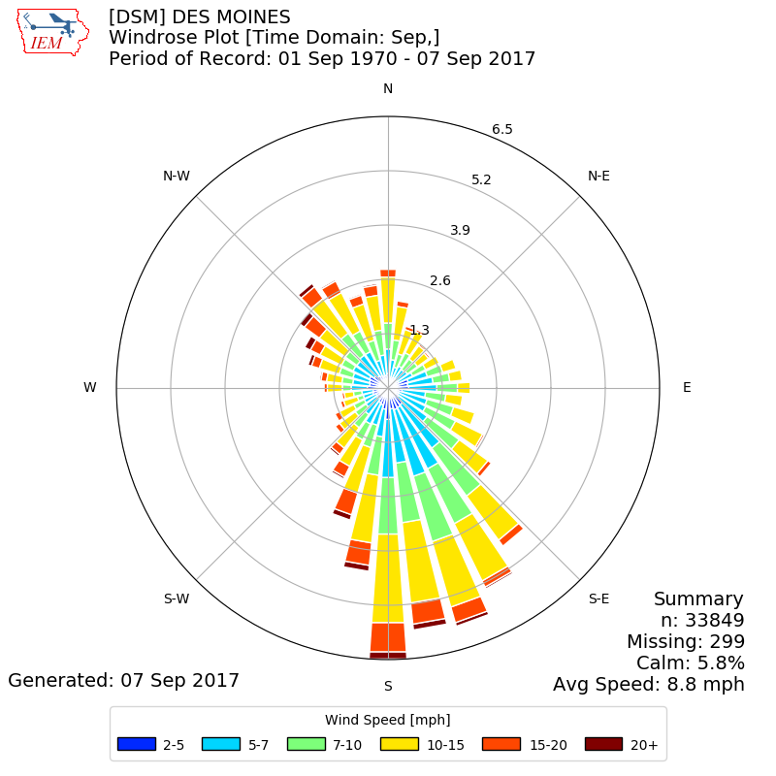






Iowa Environmental Mesonet (IEM): Making Weather Data Great Again
Daryl Herzmann and Raymond Arritt, Department of Agronomy
We process complex datasets
and make it all freely available on a website
We know these formats!
netCDF grib GINI
METAR SHEF HydroML
NIDS JSON GeoTIFF
High-Res Precip
Raw Data Download
Auto-Plotting
station,valid,tmpf, dwpf, relh, drct, sknt, p01i, alti, mslp, vsby, gust, skyc1, skyc2, skyc3, skyc4, skyl1, skyl2, skyl3, skyl4, presentwx, metar
DSM,1970-01-01 00:00,24.08,19.04,80.80,100.00,6.00,M,30.06,M,5.00,M,OVC, , ,M,M,M,M,M,M,METAR KDSM 010000Z 10006KT 5SM FG OVC/// M04/M07 A//// RMK SLP181 T10441072
DSM,1970-01-01 03:00,21.92,17.96,84.47,180.00,8.00,M,30.07,M,4.00,M,OVC, , ,M,M,M,M,M,M,METAR KDSM 010300Z 18008KT 4SM -SN FG OVC/// M06/M08 A//// RMK SLP182 T10561078
DSM,1970-01-01 06:00,19.94,15.98,84.33,170.00,5.00,0.00,30.05,M,3.00,M,OVC, , , ,M,M,M,M,M,KDSM 010600Z 17005KT 3SM -SN FG OVC/// M07/M09 A//// RMK SLP177 T10671089
DSM,1970-01-01 09:00,17.96,14.00,84.20,160.00,6.00,0.01,30.04,M,2.00,M,OVC, , , ,M,M,M,M,M,KDSM 010900Z 16006KT 2SM -SN FG OVC/// M08/M10 A//// RMK SLP172 P0001 T10781100
DSM,1970-01-01 12:00,15.98,12.02,84.06,160.00,4.00,0.00,30.02,M,3.00,M,BKN, , , ,M,M,M,M,M,KDSM 011200Z 16004KT 3SM FG BKN/// M09/M11 A//// RMK SLP165 T10891111
DSM,1970-01-01 15:00,17.06,12.92,83.47,150.00,3.00,0.00,30.05,M,3.00,M,OVC,BKN, , ,M,M,M,M,M,KDSM 011500Z 15003KT 3SM -SN FG OVC/// BKN/// M08/M11 A//// RMK SLP176 T10831106
DSM,1970-01-01 18:00,21.02,17.06,84.41,270.00,6.00,0.00,30.05,M,3.00,M,BKN,OVC, , ,M,M,M,M,M,KDSM 011800Z 27006KT 3SM -SN FG BKN/// OVC/// M06/M08 A//// RMK SLP176 T10611083
DSM,1970-01-01 21:00,21.92,15.98,77.54,320.00,7.00,0.00,30.03,M,4.00,M,BKN,OVC, , ,M,M,M,M,M,KDSM 012100Z 32007KT 4SM -SN FG BKN/// OVC/// M06/M09 A//// RMK SLP169 T10561089
DSM,1970-01-02 00:00,15.98,10.94,80.13,320.00,9.00,0.00,30.06,M,3.00,M,SCT,OVC, , ,M,M,M,M,M,KDSM 020000Z 32009KT 3SM FG SCT/// OVC/// M09/M12 A//// RMK SLP178 T10891117
DSM,1970-01-02 03:00,12.92,8.96,83.85,290.00,4.00,0.00,30.09,M,1.00,M,OVC, , , ,M,M,M,M,M,KDSM 020300Z 29004KT 1SM -SN FG OVC/// M11/M13 A//// RMK SLP188 T11061128
DSM,1970-01-02 06:00,12.92,8.96,83.85,270.00,5.00,0.00,30.08,M,1.50,M,OVC, , , ,M,M,M,M,M,KDSM 020600Z 27005KT 11/2SM -SN FG OVC/// M11/M13 A//// RMK SLP185 T11061128
We process them in real-time!
Over 50,000 global surface observation stations
NWS RADAR Ingest
Near full NWS Text Ingest
Non-NWS data sources too!
A train wreck of a website!
Hundreds of Apps
Billions of observations available for download
Crazy levels of interactivity and options
We partner with others with data!
RADAR Imagery
Wind Roses
NWS Text Archives
FXUS63 KDMX 122220
AFDDMX
AREA FORECAST DISCUSSION
NATIONAL WEATHER SERVICE DES MOINES IA
418 PM CST SAT NOV 12 2005
.DISCUSSION...
A MULTITUDE OF ISSUES SURROUNDING THIS FORECAST AS ACTIVE LATE
AUTUMN PATTERN DEVELOPS ACRS THE CENTRAL UNITED STATES.
CURRENTLY...SFC LOW PASSING THRU SE SOUTH DAKOTAS WITH DRY LINE
PUNCHING INTO WESTERN IA. INSTABILITY HAVING A HARD TIME INCREASING
WITH LOW LEVEL CLDS INHIBITING HEATING...HOWEVER MOST RECENTLY SOME
SUNSHINE HAS POKED THROUGH ACRS THE WESTERN THIRD OF THE STATE...SO
THINGS MAY HEAT A BIT MORE. WNDS STILL APPEAR TO REMAIN PRIMARY
THREAT BUT ENOUGH ENHANCED SHEAR AND INSTABILITY JUST ALONG DRY LINE
AXIS MAY PROVIDE THE NECESSARY INGREDIENTS FOR A BRIEF TORNADO OR
TWO. OTHERWISE...DRY LINE/BOUNDARY WL PASS THROUGH THIS EVENING
WITH TIGHTENING PRESSURE GRADIENT AND STRONG SUBSIDENCE. 45-55KTS
WL BE COMMON JUST OFF THE SFC FM THE WNW AND MOMENTUM TRANSPORT TO
THE SFC WL HELP TO SUSTAIN WINDS OVERNIGHT INTO SUNDAY. HAVE
EXPANDED THE WIND ADVISORY FARTHER SOUTH TO A CRESTON TO OSKALOOSA
LINE.
https://mesonet.agron.iastate.edu

