Slide 1
Providing the E in G x E x M (well, most of the E)
daryl herzmann
@akrherz
Agronomy 600B
5 Feb 2020

Slide 2
Genetics (G) x Environment (E) x Management (M)
Dr Jerry Hatfield’s et al review paper (Agronomy Journal 2015) introduces M into the G x E equation to increase actual yield vs just yield potential.
Knowledge of the Environment and Genetics can inform Management decisions.
Environmental variables relevant to G x E x M, our topics for today
Air Temperature, Humidity, and Wind
Solar Radiation
Precipitation
Soil Moisture and Temperature

Slide 3

Providing (most of) the E
https://mesonet.agron.iastate.edu (Google: “IEM ISU”)
Iowa Environmental Mesonet
ISU Agronomy project since 2001
“Mesonet” is a meteorology term describing a network of observations on a spatial scale ~10s km
Crazy website with all kinds of apps and portals to get lost in and cry over.
Please please please, the main point for today, if you have trouble:
Tweet me! @akrherz
Call me! 515 294 5978
Stop by my office! 3027 Agronomy
Email me! akrherz@iastate.edu

Slide 4
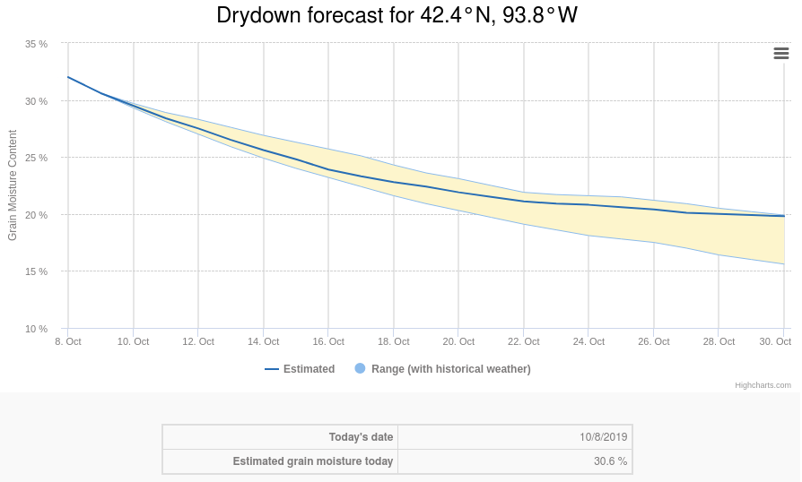

Slide 5
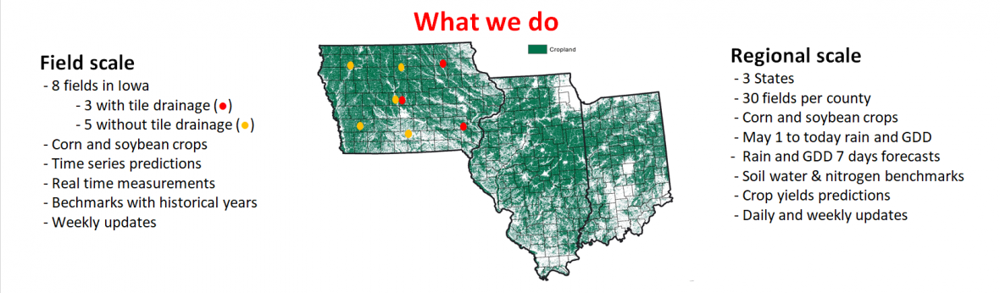

Slide 6
