Slide 1

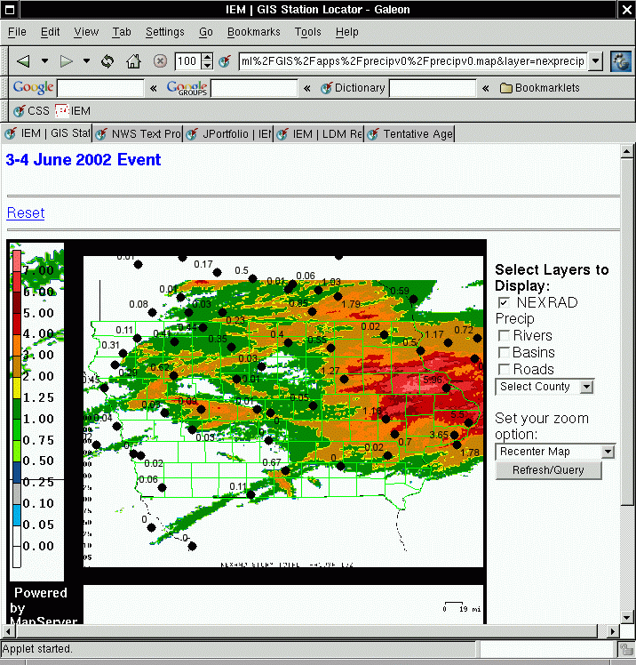
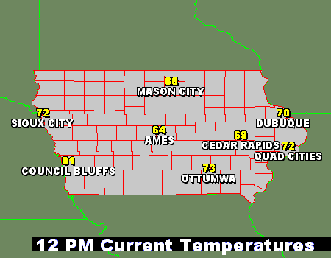
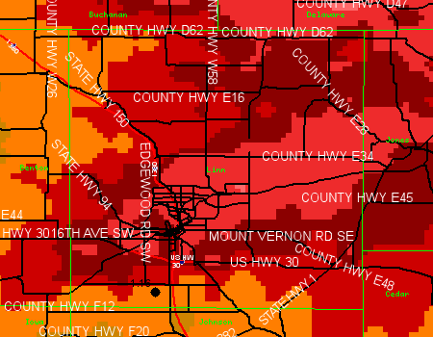
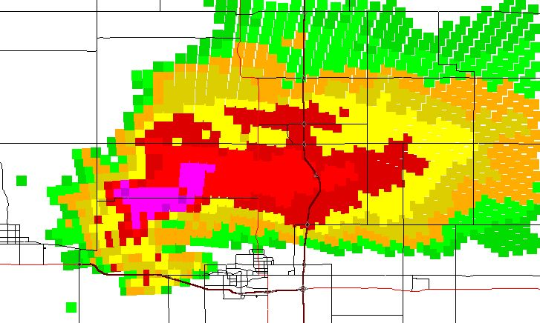
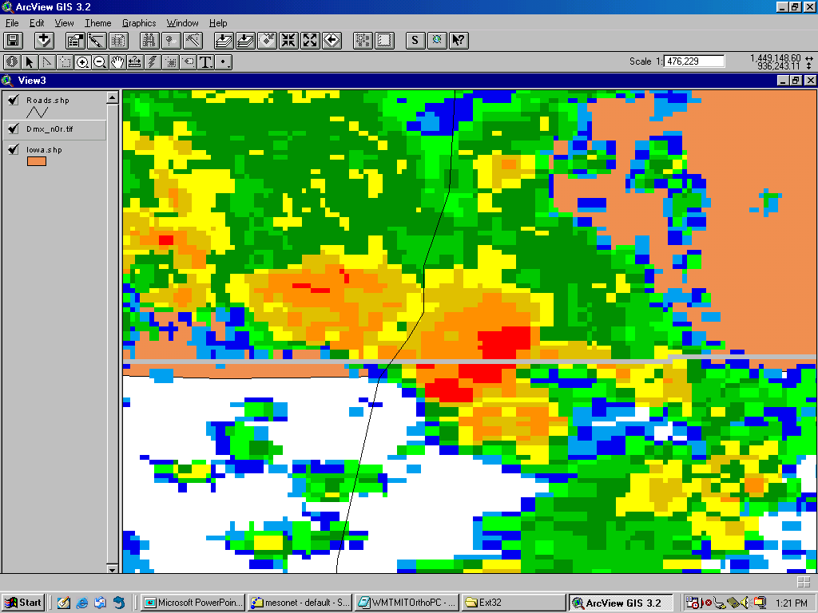
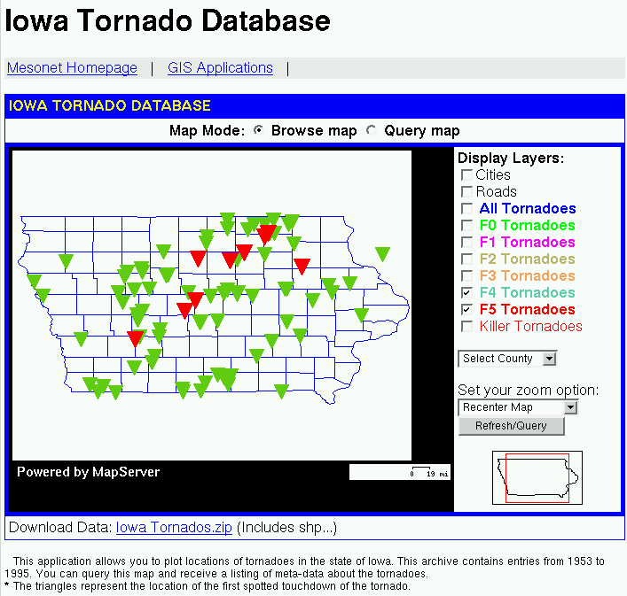

Using GIS to serve Iowa Environmental Mesonet data.
Dr. Dennis Todey (dptodey@iastate.edu) and Daryl Herzmann (akrherz@iastate.edu)
Department of Agronomy, Iowa State University
Internet Mapping Applications with MapServer
Using PHP Mapscript to create interactive plots
MapServer is an OpenSource environment for building spatially enabled Internet applications. The IEM has built a handful of MapServer applications. MapServer has a diverse global userbase and is actively developed and enhanced with many unique features.
Background Information:
The Iowa Environmental Mesonet [IEM] is a project of the Department of Agronomy at Iowa State University. The IEM is unlike many other mesonets in the country, since we own only 12 of the over 500 observing stations in Iowa. Instead, we gather, display, disseminate, and archive observations from existing networks in the state of Iowa, acting as a bridge between those with data and those that need data.
GIS provides an invaluable tool to visualize, compare, and disseminate IEM data sets. By leveraging OpenSource technologies like MapServer, we aim to meet the GIS data needs of users in the state.
This poster highlights some of the ways of using GIS to distribute IEM data.
PHP Mapscript is a module to access the MapServer API from PHP. PHP is a popular server-side scripting platform. The combination of PHP and MapServer produces very attractive and professional images.
Heavy rains occurred on the 3-4 June 2002 in Eastern Iowa. NEXRAD estimations of storm total precipitation are overlain with automated station measures of precipitation for the period. MapServer easily incorporated this product with other GIS layers to provide emergency management with a spatially detailed picture of the rainfall event.
This image is an example of the dynamic GIS data plotting that can be accomplished with the help of PHP Mapscript. Using the power of PHP, users can select which IEM sites they would like to plot. The plot is dynamically sized and scaled to fit their selected data points. The backend data is either in shapefile format or stored in the spatial database.
NEXRAD imagery shapefiles
Geo-referencing raster NEXRAD imagery
Spatial databases to store environmental data
Using an encoder written by Scott Shipley, NEXRAD imagery for the state of Iowa is converted into shapefile format.
NEXRAD reflectivity images are geo-referenced with a world-file and can then be easily integrated into GIS applications and servers with raster feature support.
PostGIS, a spatial enabling extension to the PostgreSQL database system, is used to store spatial datasets like the Iowa Tornado Database. MapServer is used to query this database and display the results.
An ArcView generated image of NEXRAD base reflectivity bins valid on 30 May 1998 (lines are roads and streets). Notice the radial orientation of the bins to match the nature of the NEXRAD reflectivity data. This supercell storm, seen with a classic “hook echo” passed directly over Ames, IA. A pronounced mesocyclone passed over the city without producing tornado.
NEXRAD imagery can easily be brought into ArcView with the help of MIT’s WMTOrtho extension. The extension allows ArcView to connect to the Iowa State GIS Lab image server to download the latest imagery for any location in the state. Shown above is a sample image visualized in ArcView.
Via the interactive MapServer web application, users can spatially query the Iowa Tornado Database, such as the sample image showing reported F4 and F5 tornadoes in the state. Users can select any number of the points to get meta-information about the tornado.
http://mesonet.agron.iastate.edu/GIS/

