Slide 1
Iowa Environmental Mesonet:
IEMChat and other tools for the NWS
Daryl Herzmann
Iowa State University
akrherz@iastate.edu
http://mesonet.agron.iastate.edu

Slide 2
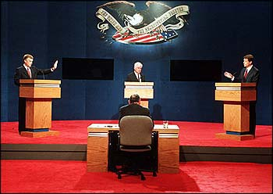
Who am I and Why am I here?
Bachelors in Meteorology 2001
Built and maintain the IEM since
Enjoy working with the NWS on the WFO level
Blame Andy

Slide 3
What will I talk about?
A whole bunch on Instant Messaging
  IEM Chat
  IEM Bot
Other Tools for the NWS
  Automated Polygon Verification
  Online applications
  GIS data
  Archives
Some eye candy: 2005 Watch/Warnings

Slide 4




Instant Messaging Background
NWS IM with media partners has been around for a while (2000?) and well regarded
Implementation / Policy widely varies with WFO
In 2004, we started a Yahoo! Chat between media, IEM, and DMX and had decent success, but...

Slide 5
Problems with Yahoo!
The Yahoo! supported chat client is adware.
Chat rooms are limited to 50 users (?)
Yahoo! protocol only supports participation in 1 chat room at once.
Yahoo! chat not allowed on some WANs
Securing chat rooms from unathorized access. How? Dealing with chat rooms in general.....
Nobody likes getting Yahoooooo'd!!!!
Commercial chat protocols are becoming a major vector for spam, viruses, and worms

Slide 6
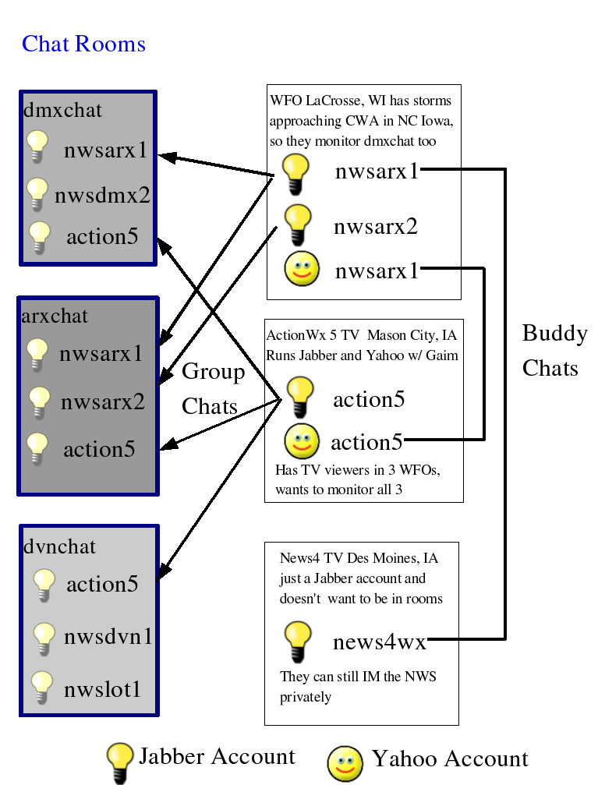
Our ideal chat setup
Secure
Simple
Scalable
Sustainable
Sexy (why migrate?)
Standards
Support legacy Yahoo! clients

Slide 8
IEM Chat Project Features
End to end encryption (logins, chats)
∞ users in a chat room
Users can join multiple rooms (multiple WFOs)
Rooms have recent history when you join them. Can get caught up quickly.
Standards based XML protocol (Jabber). Open Source client (Gaim).
Same technology has Google Talk.

Slide 9
iemchat.com website features
Good (?) documentation on installation and configuration of Gaim
Documentation and tools specifically for the setup of iemchat on typical NWS office network config
Automatic chat room logging, available on website for download
Java applet based chat client

Slide 10
IEM Chat Project Deficiencies
No support for webcams (will be coming thanks to Google)
Gaim (open source chat client) is somewhat clunky with fonts on windows
That is it! Well, at least the only two problems I will admit are problems.

Slide 11
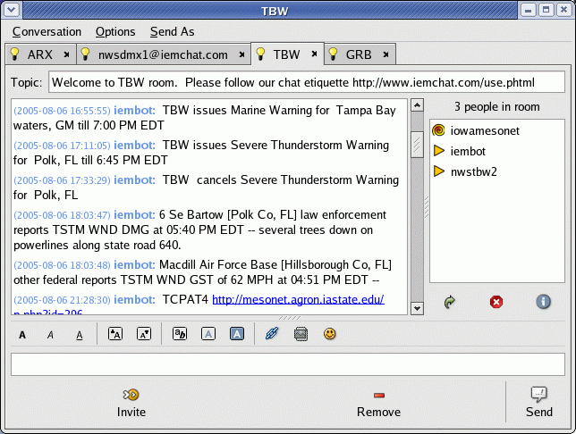

Slide 12

Hello, iembot!
Iembot is the code name for a chat “bot”
A bot is a program that participates in chats and acts like just another user
Iembot is a good bot! He relays NWS text products into WFO specific chat rooms.

Slide 13
Why is a chat bot needed?
NWS forecasters shouldn't have to redundantly generate a warning in Warngen and then retype it in a chatroom
Iembot provides near instant verification that a product is going out and is being ingested by a computer.
On-air media can simply read from the chatroom and not get lost in other displays or paper printouts.
Helps with complex VTEC products.

Slide 14
Iembot is smart and fast!
TBW issues Marine Warning for Tampa Bay waters, GM till 8:45 PM EDT
MHX issues Severe Thunderstorm Warning for Onslow, NC till 11:15 AM EDT
GGW cancels Lake Wind Advisory for Central and Southern Valley, MT and Garfield, MT and McCone, MT
TULSA,OK (KTUL) ASOS reports gust of 41 knots from NNW @ 0919Z
MCD! http://www.spc.noaa.gov/products/md/md2046.html
2 W Harrison [Douglas Co, SD] public reports HAIL of 1.75 INCH at 06:58 PM CDT --
TCPAT1 http://mesonet.agron.iastate.edu/p.php?id=505
SPC issues TORNADO watch till 06:00Z http://www.spc.noaa.gov/products/watch/ww0821.html, new watch replaces WW 819, WW 820

Slide 15
The future of iembot
Continue to learn about other products
Become county centric (currently WFO)
Customizable with private chats
Answer requests
  Active warnings
  NDFD products
  METARs
Stop smoking and procreate

Slide 16
Future of IEM Chat
Get any interested WFOs participating before severe weather season 2006 (8 running now, another 10 coming...)
Listen closely to end user feedback
Someday reach a critical mass
  Form a technical steering committee?
  Form a non-for-profit?
Someday have the NWS HQ formally embrace it or kill it. Current “policy” is that is it at WFO discretion (?).

Slide 17
Other Tools

Slide 18
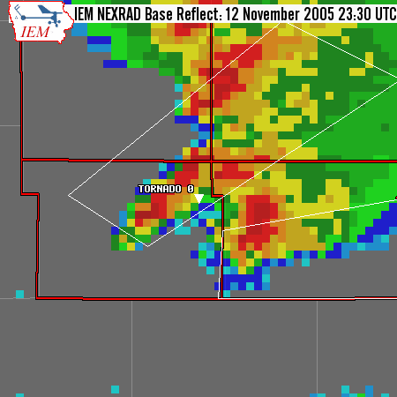
IEM Cow: Polygon Verification
Concept is simple. Lets merge:
  NEXRAD
  LSRs
  Polygon warnings
Produce verification stats
  POD, FAR, CSI and lead time

Slide 19
Caveats galore!!!
Yes, not many offices are issuing polygons operationally
Yes, LSR reporting is inaccurate and incomplete (Not my fault :) )
No, I am not trying to make certain WFOs look bad or advance agendas.
No, I am not fully following NWS verification “rules” like the 15/15 rule.

Slide 20
Live Demo?
http://mesonet.agron.iastate.edu/cow/

Slide 21
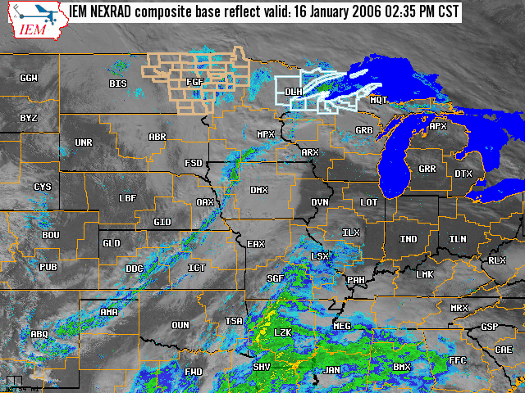
GIS based mapping
Combine realtime+archived imagery
Dynamically select layers to display
Automatically refreshes.
Supports multiple time zones.
Mostly used for weather wall displays within NWS.

Slide 22
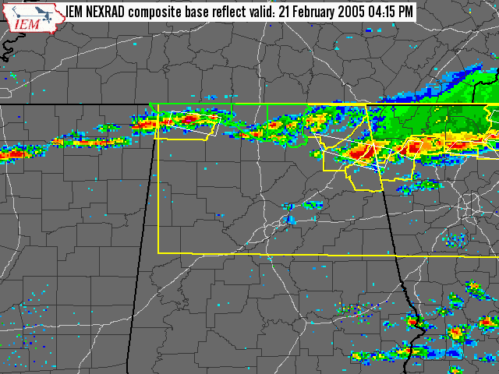
Static archived maps
Every 5 minutes dating back to 3 Nov 2004 (could backfill more)
Predictable URLs make it fairly easy to script and build movies for presentations.

Slide 23
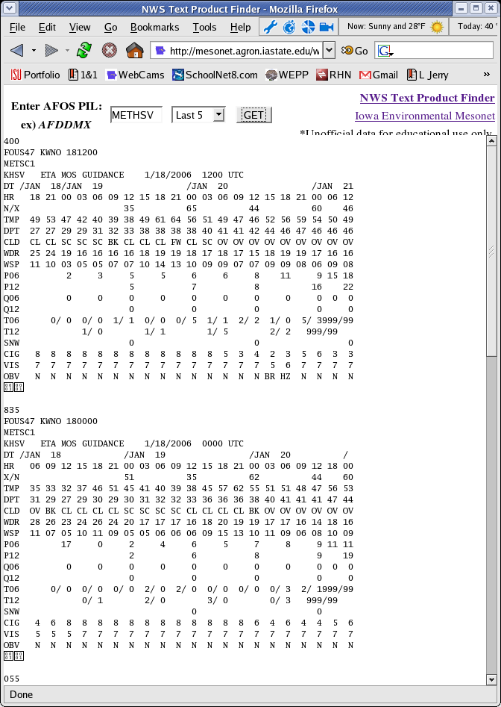
Text Product Finder
Find products by AFOS like PILs.
Also make MOS searchable by PILs like MAVHSV
14 day archive

Slide 24

Build lapses for presentations
Archived images have scriptable filenames, so you can pull down frames and build movies!
Or you can ask me and I can easily do it too.
Someday will be customizable from website.

Slide 25
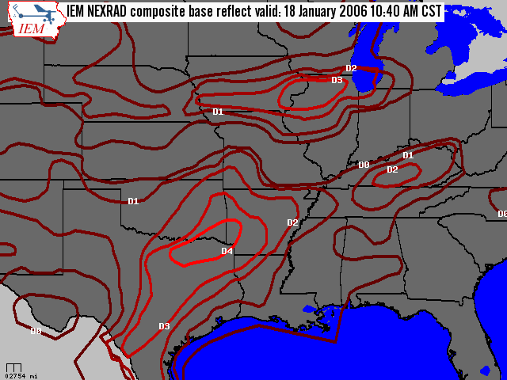
GIS: US Drought Monitor
Provide easy to use shapefiles with current US Drought Monitor polygons
Archive as well!

Slide 26
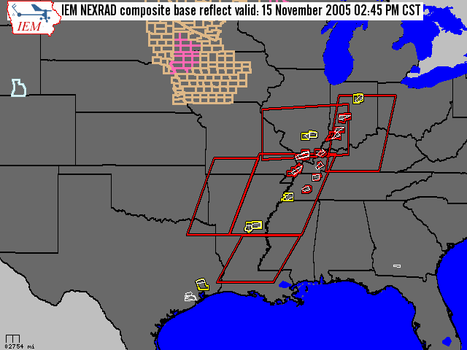
GIS: Watch/Warning Shapefiles
Generate a shapefile every 5 minutes with all VTEC products in it
Available via LDM, manual download, or OGC WFS
Archive available on request.

Slide 27
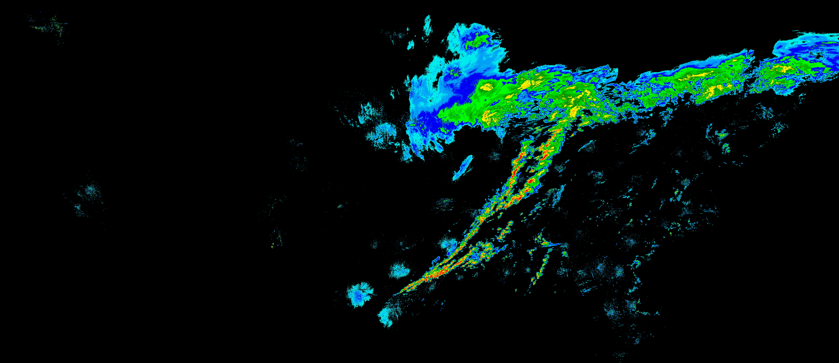
GIS: Raw NEXRAD composites
GIS Ready format (geo-referenced PNG)
Every 5 minutes dating back to 1 Aug 2003
Will have an easy to use download frontend soon

Slide 28
2005 Watch/Warning Summary

Slide 29
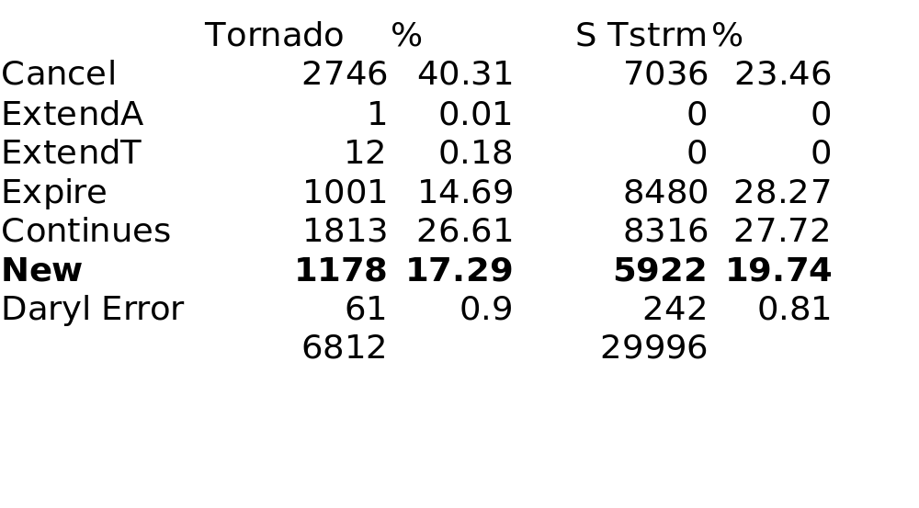
2005 Final VTEC status
(by County)

Slide 30
2005 Most Warned Counties
Svr Tstorm Warn
  67 Cherry, NE
  65 Maricopa, AZ
  57 Pima, AZ
  54 Lincoln, NE
  51 Hinds, MS
Tornado Warning
  24 Holmes, MS
  23 Smith, MS
  21 Baldwin, AL
  21 Warren, MS
  21 Rankin, MS

Slide 31
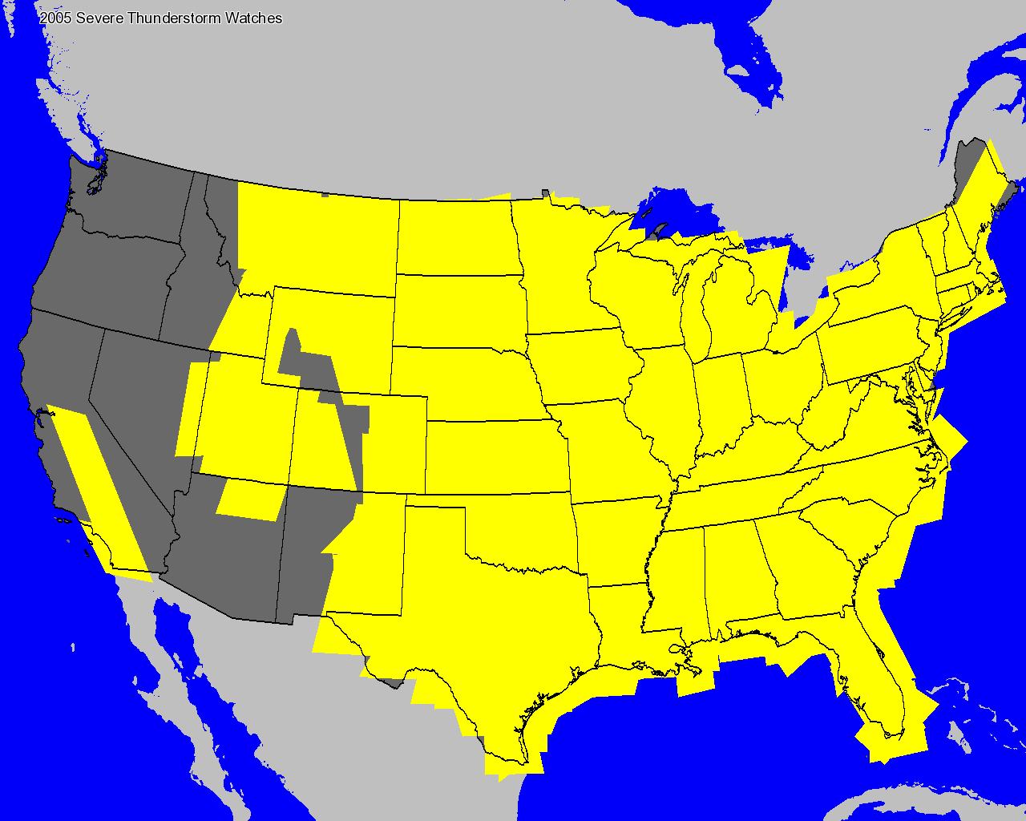

Slide 32
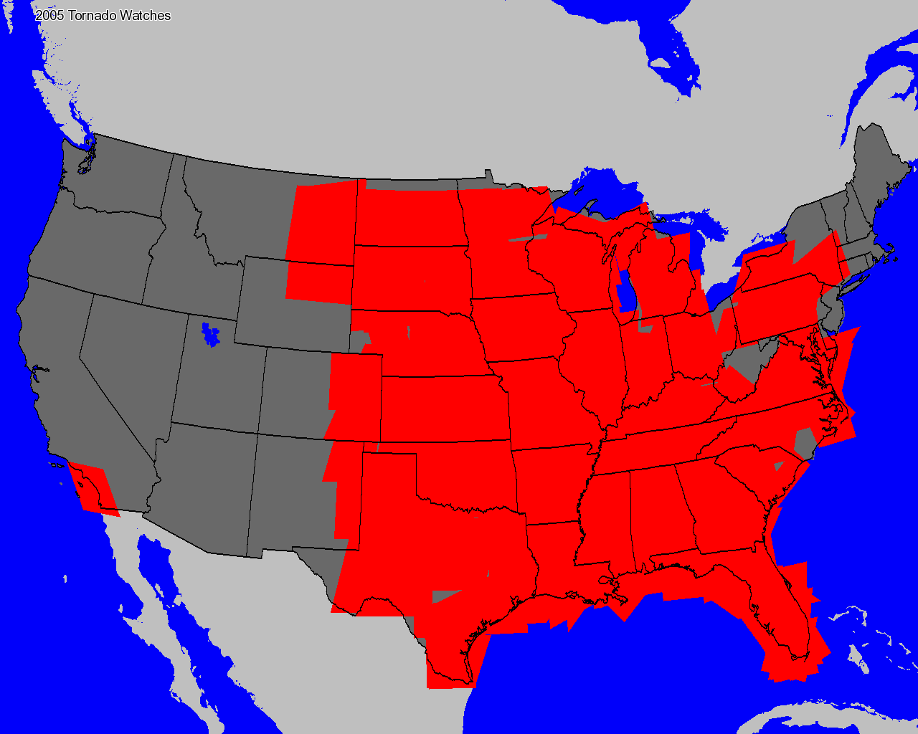

Slide 33
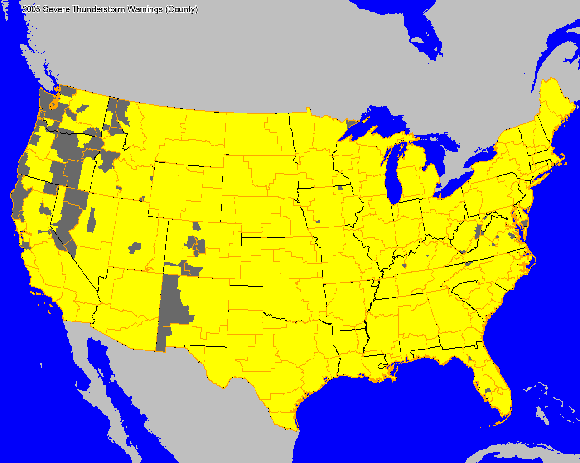

Slide 34
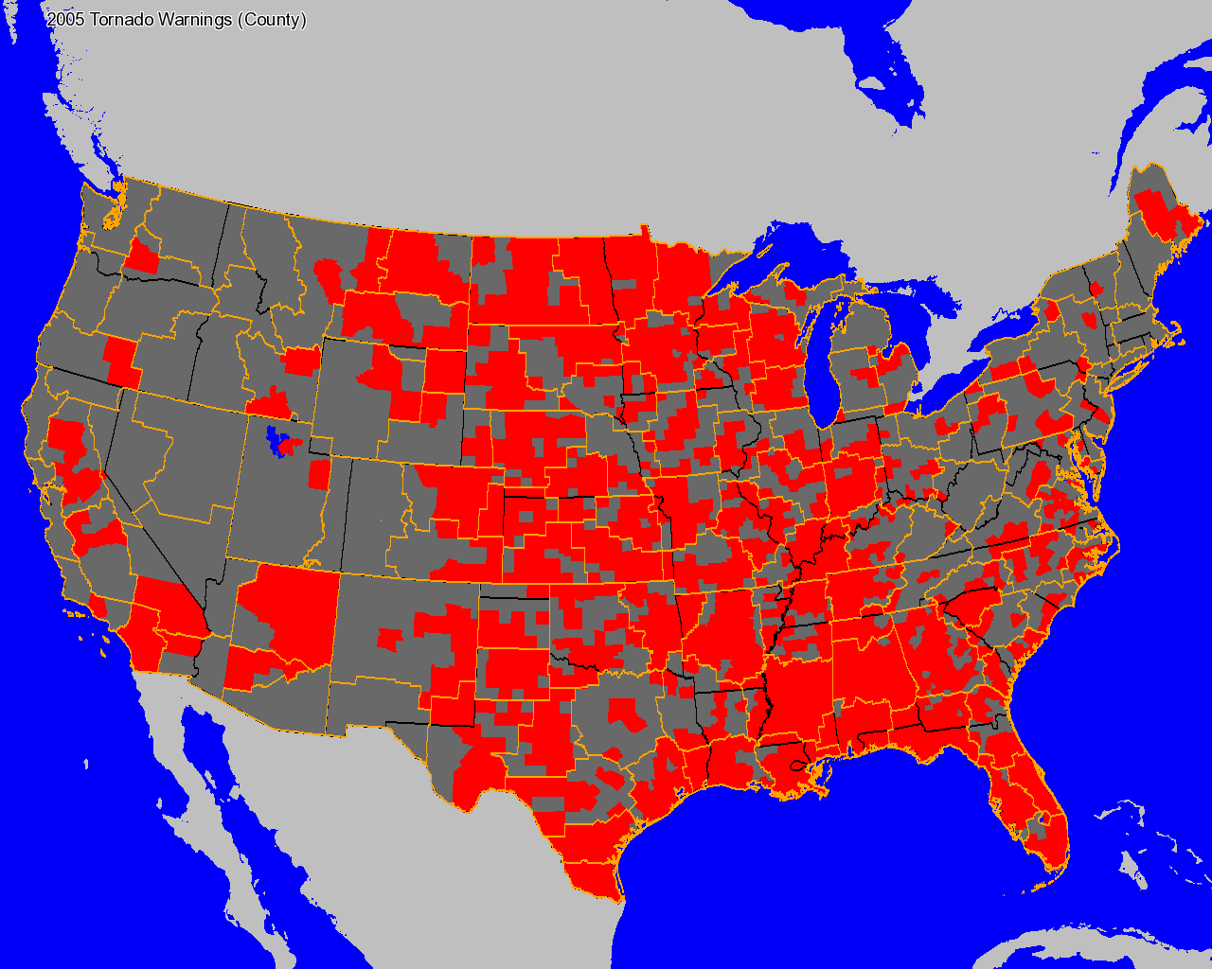

Slide 35

I'm done! Any questions?
Daryl Herzmann
Office: 515.294.5978
Cell: 515.451.9249
akrherz@iastate.edu
http://mesonet.agron.iastate.edu
http://www.iemchat.com

