Slide 1
Website, Climate Data, and Real Time Processing
25 Nov 2019
@akrherz

Slide 2
Breadth of Processing
522,864 hillslopes
4,086 HUC12s covered
282,281 climate files
Climate files are provided on a 0.01 x 0.01 degree analysis grid, so some spatially close hillslopes share a single climate file
Presently producing yesterday’s estimates at ~4:30 AM each morning

Slide 3
Computing Software
Generally a Python 3 stack
Github code projects https://github.com/dailyerosion
“dep” -> real time execution, WEPP mods
“depmap” -> website map application
“depbackend” -> API services for the map and others

Slide 4
Daily Processing Timeline
Start Time | Job
12:53 AM | Wake up and edit climate files (~35 minutes)
~1:30 AM | Proctor script enqueues hillslope tasks into RabbitMQ and runs made (~2.5 hours, ~ 60 WEPP runs per second).
~4:00 AM | Post-process the WEPP output files into the database (~30 minutes)
~4:30 AM | Spam twitter with post including summary image of results, wait for @realDonaldTrump to retweet the post. Done.
5:30 AM | Daryl awakens to see what fun failure may have happened with the above.

Slide 5
Climate File Generation
File every 0.01 x 0.01 degrees lat/lon for where we have hillslopes to model.
File every 0.25 x 0.25 degrees for land points “East of the Rockies, Hello.”
for future domain expansion.
Variable | Source
Max/Min Air Temperature | 0.125 deg grid analysis of airport weather stations
Average Dew Point | 0.125 grid, IEM computed average of airport stations
Average Wind Speed and Direction | 0.125 grid of airport stations, vector averaged direction
Total Solar Radiation | 0.125 sampled analysis of hourly 3km HRRR analysis
Precipitation | 0.01 grid of MRMS, Stage IV, NEXRAD Mosaics, and PRISM oh my. 2 minutes resolution in time.

Slide 6
Precipitation Acronym Soup
 | Spatial | Time
MRMS RADAR-Only | 0.01 deg | 2 minute | Realtime
IEM NEXRAD Mosiac | 0.005 deg | 5 minute | Realtime
MRMS Guage-Corr | 0.01 deg | Hourly | Hour + lag
NCEP Stage IV hourly | ~4km | Hourly | < Hour lag
NCEP Stage IV “daily” | ~4km | 12 UTC – 12 UTC | N/A for real time
PRISM | 0.04 deg | ~7 AM – 7 AM local | N/A for real time
Disparate data requires desperate measures!

Slide 7
10,000 foot summary of precipitation
MRMS “RADAR –Only” and NEXRAD Mosaic are providing the “wave form” of precipitation intensity over a given hour.
Whatever presently available 24 hour precip totals (Stage IV / PRISM) are used to bias correct the hourly totals.
Whatever presently available higher quality control hourly totals bias correct the sub-hourly intensities.
Reprocessing occurs days later once more data is available for usage.

Slide 8
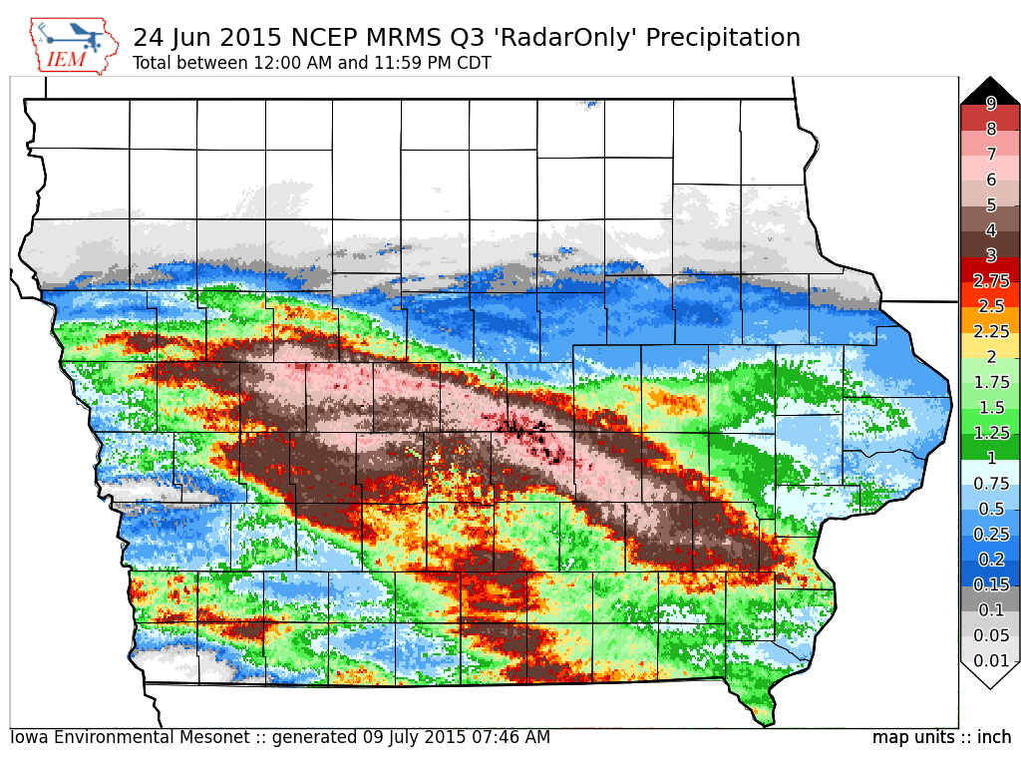
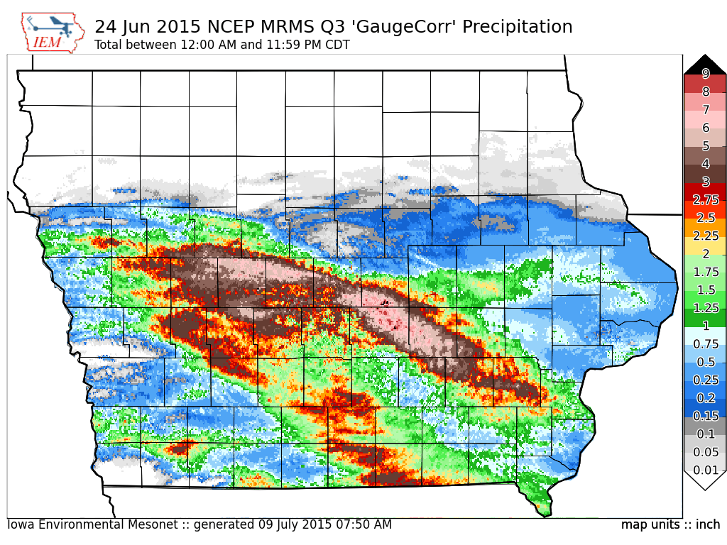
Enough Text, more Pictures Please

Slide 9
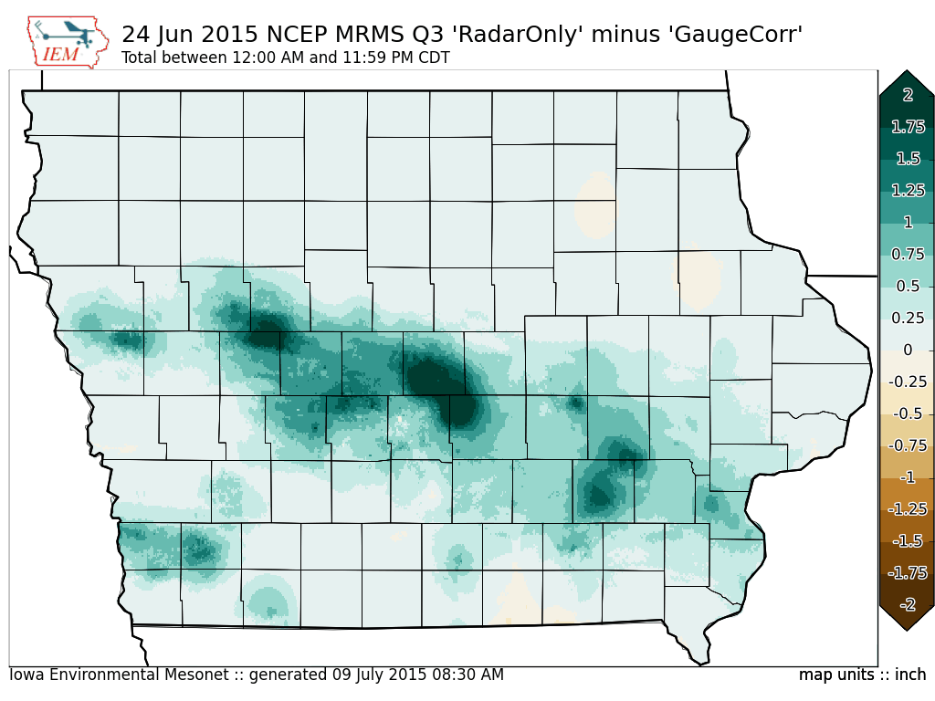
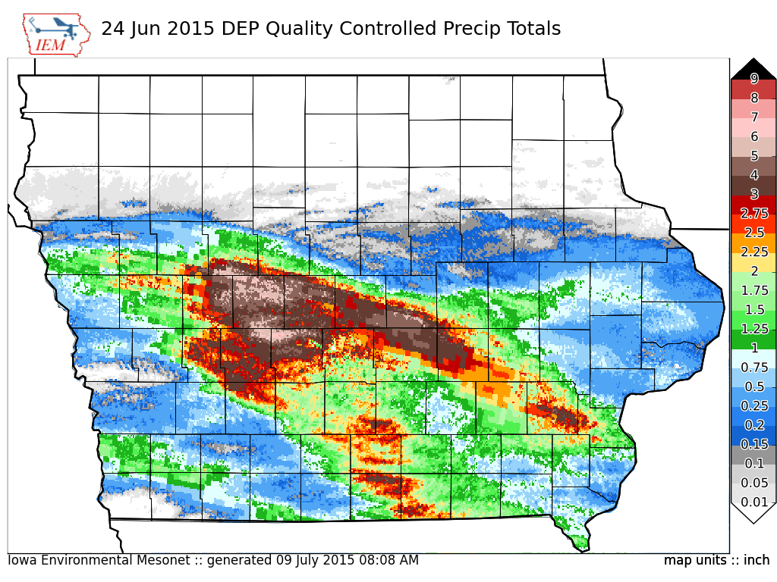
Enough Text, more Pictures Please

Slide 10
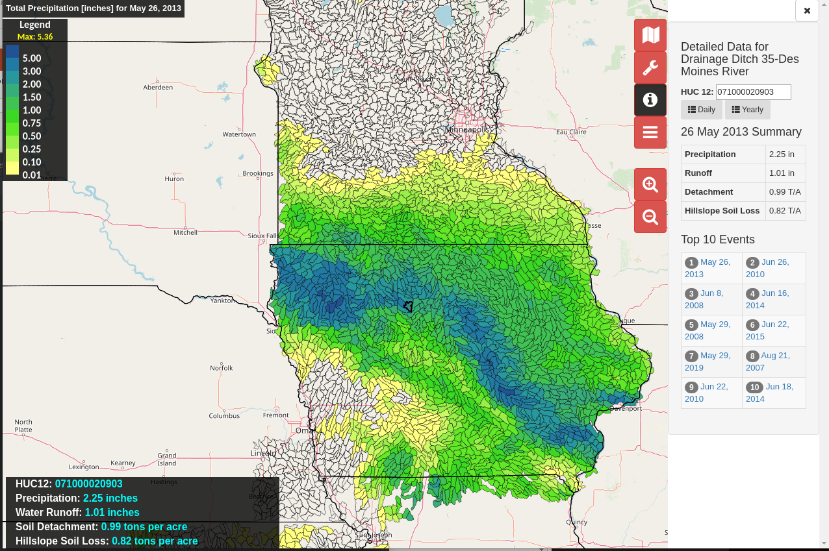
Dailyerosion.org/map/
Openlayers based slippy map
GeoJSON provided HUC12 data via web service
On-the-fly aggregation in time
Version 2 of map will be using mapbox-gl and have new UI layout

