Slide 1
Providing the E in G x E x M (well, most of the E)
daryl herzmann
@akrherz
Agronomy 600B
5 Feb 2020

Slide 2
Genetics (G) x Environment (E) x Management (M)
Dr Jerry Hatfield’s et al review paper (Agronomy Journal 2015) introduces M into the G x E equation to increase actual yield vs just yield potential.
Knowledge of the Environment and Genetics can inform Management decisions.
Environmental variables relevant to G x E x M, our topics for today
Air Temperature, Humidity, and Wind
Precipitation
Solar Radiation
Soil Moisture and Temperature

Slide 3

Providing (most of) the E Iowa Environmental Mesonet
https://mesonet.agron.iastate.edu (Google: “IEM ISU”)
ISU Agronomy project since 2001
“Mesonet” is a meteorology term describing a network of observations on a spatial scale ~10s km
Crazy website with all kinds of apps and portals to get lost in and cry over.
Please please please, the main point for today, if you have trouble:
Tweet me! @akrherz
Call me! 515 294 5978
Stop by my office! 3027 Agronomy
Email me! akrherz@iastate.edu

Slide 4
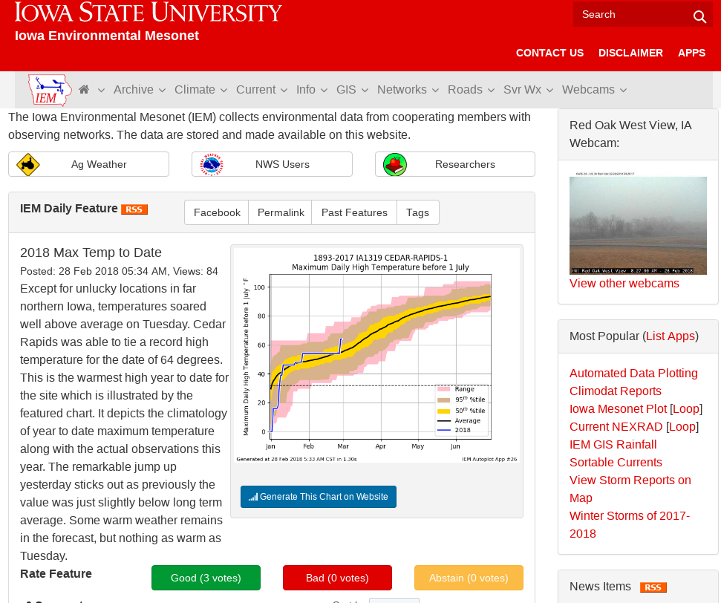
The website aggregates data from many different data sources.
Data is generally organized by acronym heavy “Networks”,
ISU Soil Moisture Network is one such network.
“Daily Feature” highlights some relevant and deep linked plot each day.

Slide 5
IEM Aggregated Networks
Acronym / Title | Description
ASOS / AWOS | General classification of Airport weather stations operated by the FAA, NWS, DoD, and state DOTs.
CoCoRaHS | Citizen science reporting “daily” snowfall, snow depth and precipitation.
NWS COOP | National Weather Service Cooperative Observers reporting “daily” high and low temperatures, precipitation, and snowfall.
DCP | General grouping of many different types of sensors that focus on hydrology.
ISU Soil Moisture | Iowa State operated network of weather stations focused on Agriculture weather data needs.
NLAE Flux | Advanced monitoring stations by the USDA NLAE monitoring various fluxes from agricultural landscapes.
RWIS | DOT Roadway Weather Information Systems monitoring weather and pavement state.
SCAN | USDA Soil Climate Analysis Network
Other | Various other stations.

Slide 6
Which network should I use?
Data Need | Time Interval | Recommendation
“Daily” High/Low Temps + Precipitation | Daily | NWS COOP IEM “Long Term Climate” / “Climodat”
Air Temperatures + Precipitation (not snow) | Hourly | ASOS/AWOS + ISU Soil Moisture
Wind | Daily + Hourly | ISU Soil Moisture ASOS / AWOS (Airport weather stations)
Solar Radiation | Daily + Hourly | ISU Soil Moisture
Soil Temperature/Moisture | Daily + Hourly | ISU Soil Moisture / SCAN
Humidity | Daily + Hourly | ISU Soil Moisture / ASOS / AWOS

Slide 7
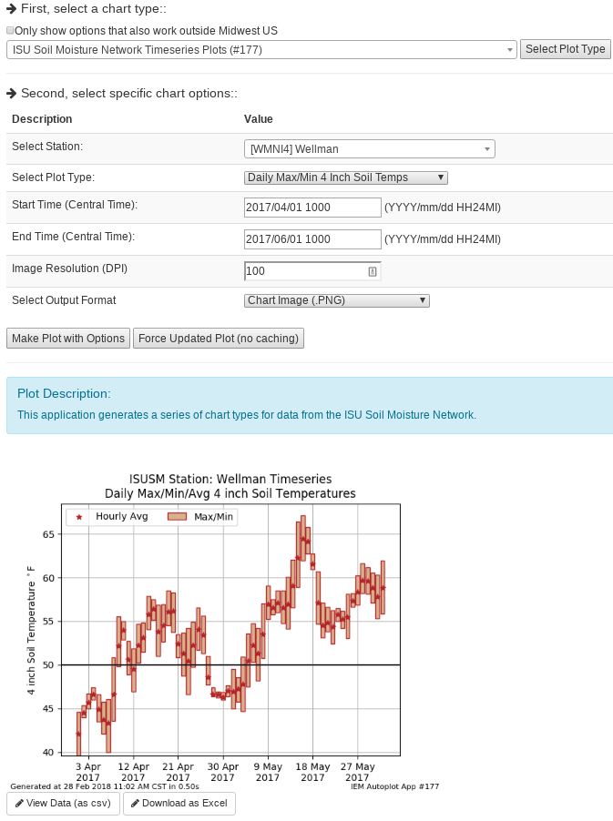
IEM Auto Plotting
Select Plot Type
Select Plot Options
Description
Custom Generated Plot
Download Raw Data (Excel)

Slide 8
Data Variables to Discuss
Air Temperature, Humidity, and Wind
Precipitation
Soil Moisture/Temperature
Solar Radiation

Slide 9
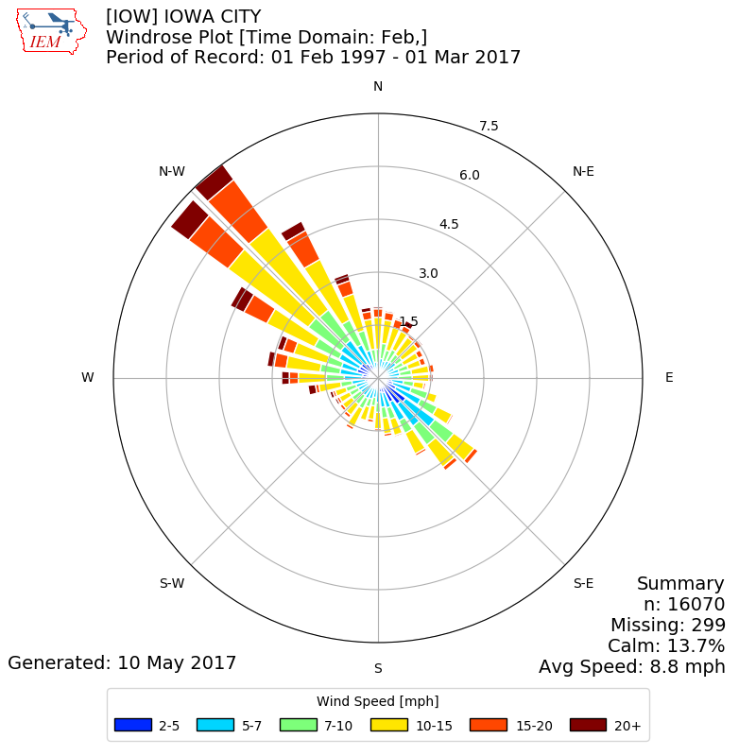
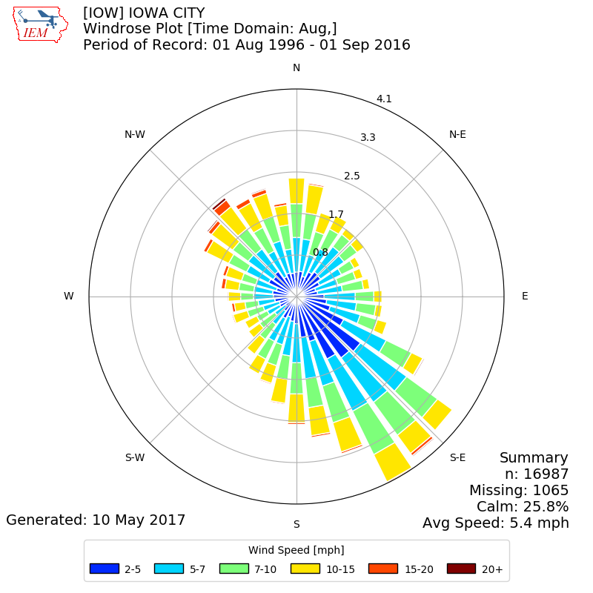
February vs August Wind Rose
Web Link

Slide 10
Data Variables to Discuss
Air Temperature, Humidity, and Wind
Precipitation
Soil Moisture/Temperature
Solar Radiation

Slide 11
The answer to: “How much did it rain in Ames on 25 June 2010?”
IEM QC COOP | 0.00 | SchoolNet | 0.57 | CoCoRaHS | ??? | Stage IV | 0.22
ASOS | 0.13 | RWIS | 0 ? | ISUAG AgFm | 0.25 | NARR | 0.19
ASOS DSM | 1.11 | Lincoln Way | 0 ? | Others | 0.53 | TRMM | 0.51
ASOS DSM Hr | 0.33 | Ada Hayden | 0.93 | DMX 1hr | 0.30
ASOS 1min | 0.36 | H2O Trtment | 0.47 | DMX Storm T | 0.25
We simply average and get: 0.36176470588 inches! What precision!

Slide 12
Data Variables to Discuss
Air Temperature, Humidity, and Wind
Precipitation
Soil Moisture/Temperature
Solar Radiation

Slide 13
ISU Soil Moisture Caveats Galore
Only 12, 24, and 50 inch depth readings for moisture
4 inch soil temperature is not in the crop field
Sensors don’t work properly when soil is frozen
We’ve had issues with lightning knocking out sensors
Newly installed sensors need time to find equilibrium

Slide 14
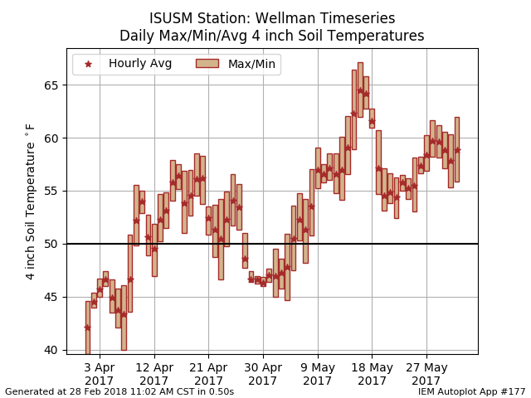
Web Link

Slide 15
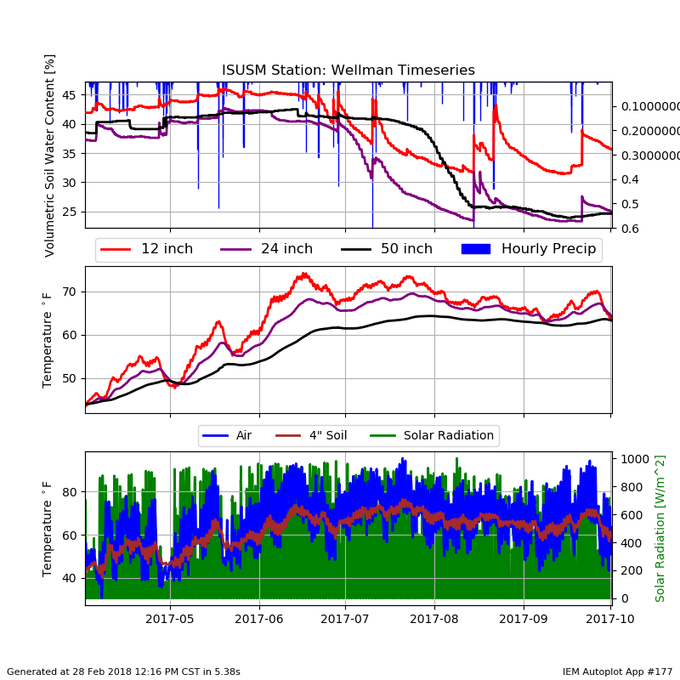
Web Link (Autoplot #177)

Slide 16
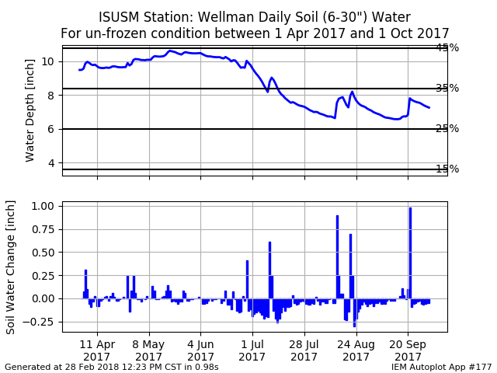
Web Link

Slide 17
Data Variables to Discuss
Air Temperature, Humidity, and Wind
Precipitation
Soil Moisture/Temperature
Solar Radiation

Slide 18
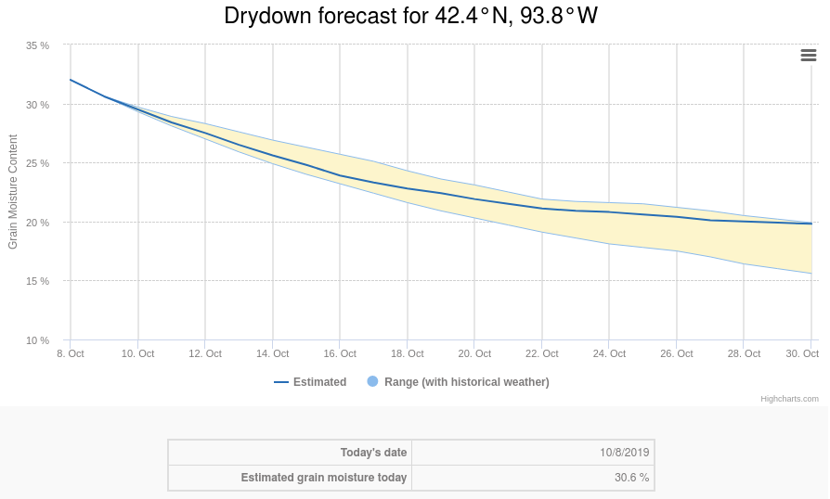

Slide 19
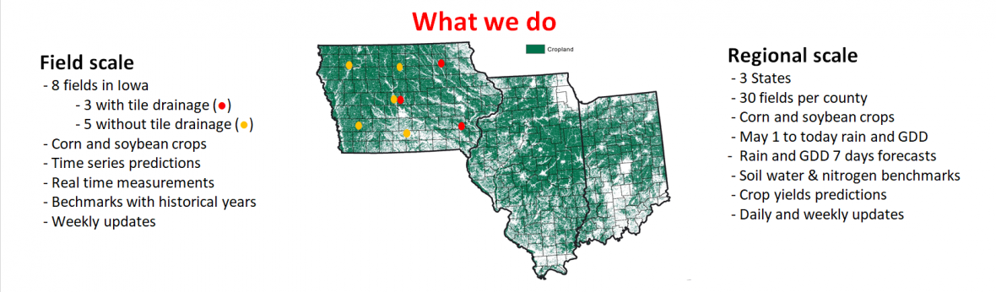

Slide 20
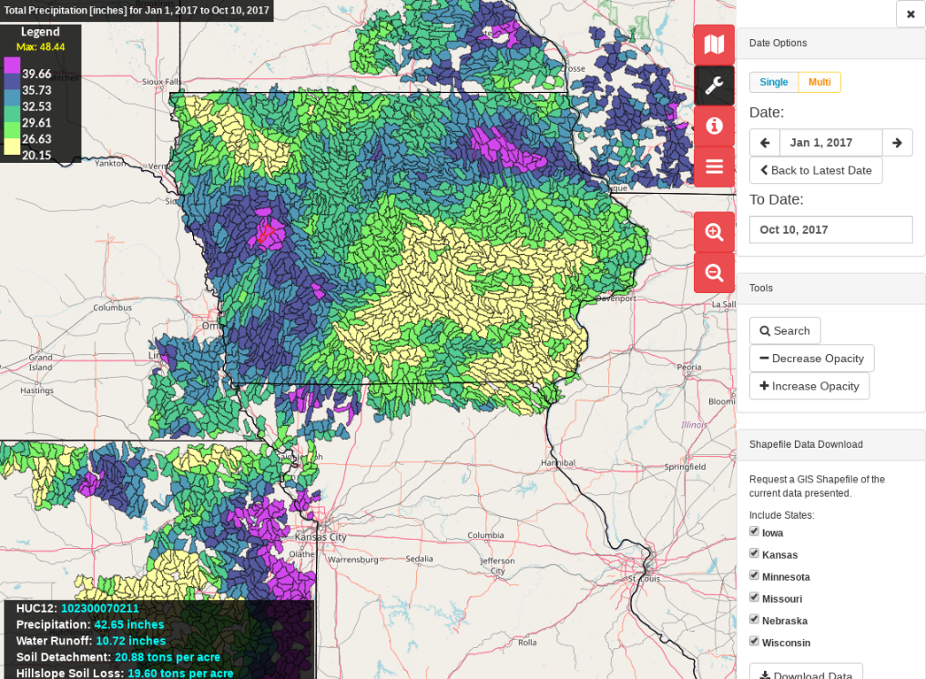

Slide 21

OK, enough of my rambling…. Questions? https://mesonet.agron.iastate.edu “Info” Tab -> Presentations
Twitter: @akrherz
akrherz@iastate.edu
515-451-9249

