Slide 1

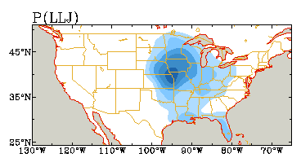
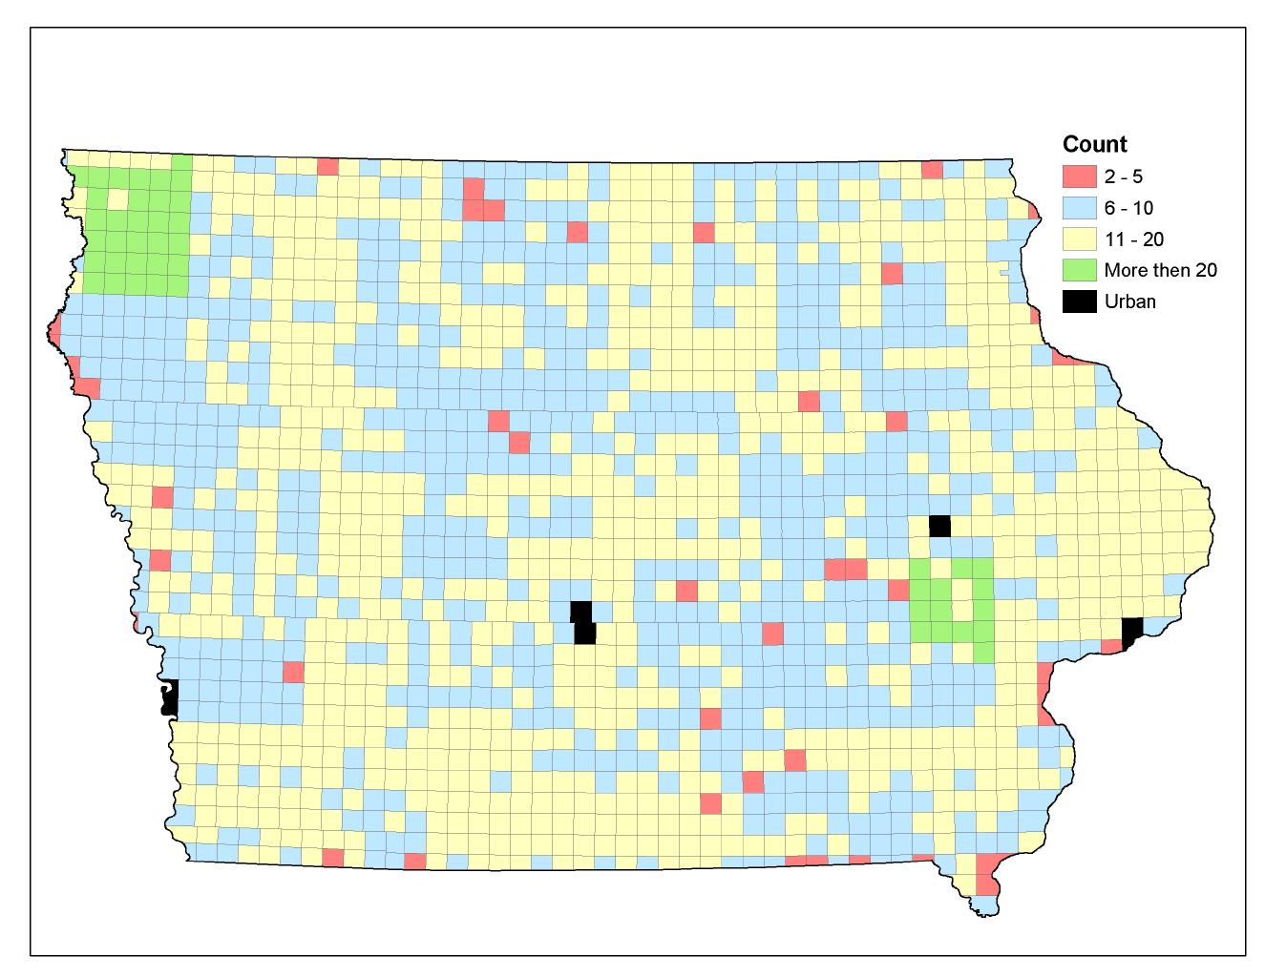
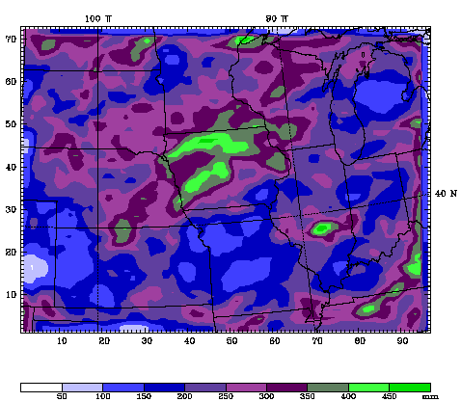
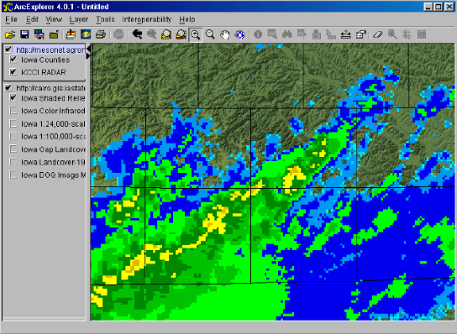

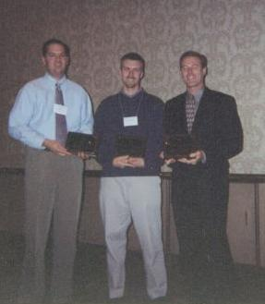
Interdisciplinary Projects
Development of the IEM has spurred research within the Agronomy Department, Iowa State University, and the research community as a whole. The IEM is currently working with the following Agronomy Endowment projects:
D11-FY03-2: Verification & Application
of Iowa Environmental Mesonet Data
D03-FY02-3: Daily Soil Erosion and
Water Runoff Estimates in Iowa
D01-FY02-3: An Agroecosystem Water
Management Model
Innovative Products
The web-site is only one of the ways the IEM provides its datasets for public use. By partnering with the Iowa State GIS lab, we are providing data for the large and diverse GIS community in Iowa. From our web-site, many GIS ready products can be downloaded for immediate use in GIS applications. These products are denoted by the ‘GIS Ready’ logo shown below.
Screenshot from ESRI ArcExplorer showing real-time RADAR information with other GIS layers provided by the Iowa State GIS lab.
Our products are routinely used and referenced by the National Weather Service.
ISU Extension makes active use of our agriculture-related plots.
Weather enthusiasts all over Iowa monitor the web-site during severe weather season.
Researchers download data from our archives for use in their projects.
Project Recognition
The IEM has been recognized nationwide as a leader in developing environmental observing networks using existing resources. Along with our partners at the National Weather Service in Johnston, IA and KCCI-TV in Des Moines, IA, we were awarded the Larry R Johnson Award for significant contributions to the field of operational meteorology at the 2002 National Weather Association annual meeting in Fort Worth, Texas. The IEM has also received publicity in numerous local newspapers, the Des Moines Register, various ISU newsletters, and on local television.
NWA Award Presentation Oct 2002.
Shown in picture (left to right)
Andy Kula National Weather Service,
Daryl Herzmann Iowa State University,
John McLaughlin, KCCI-TV Des Moines
The development of the Iowa Environmental Mesonet has been made possible by gracious and generous support of the Baker Council and Endowment Fund.
D05-FY02-2: Planning and Developing the Iowa Environmental Mesonet
Integrated Studies in Agro-ecosystems Initiative

