Slide 1
Big Weather Data for (sm)all Farmers

Slide 2
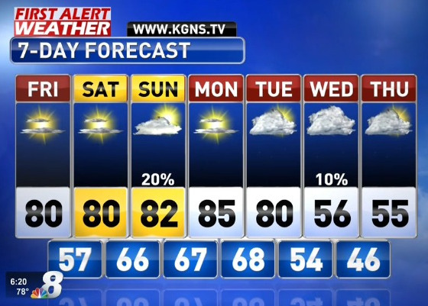
Why I got into Weather: Do we cut hay with that 20% forecast on day 3?
Source: http://www.kgns.tv/content/news/Colder-Air-Late-in-the-7-Day-Forecast-461142903.html

Slide 3
Forecasting is a Big Data Problem.
Forecast models suffer from Garbage In – Garbage Out
Global Models are initial value problems
Regional Models are boundary value problems
Ensembles of Models are producing probabilistic forecasts
Deterministic | Probabilistic
You will get 0.51 inches of rain tomorrow | You have an 80% chance of receiving between 0.4 and 0.6 inches tomorrow

Slide 4
Big Data Observations to Help Forecasting + Analysis

Slide 5
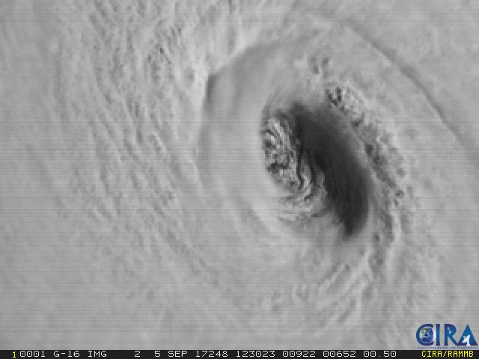
GOES R
(soon S too)
16 channels
30 second 500m sectors
Source: https://twitter.com/DanLindsey77/status/905072767720185856

Slide 6
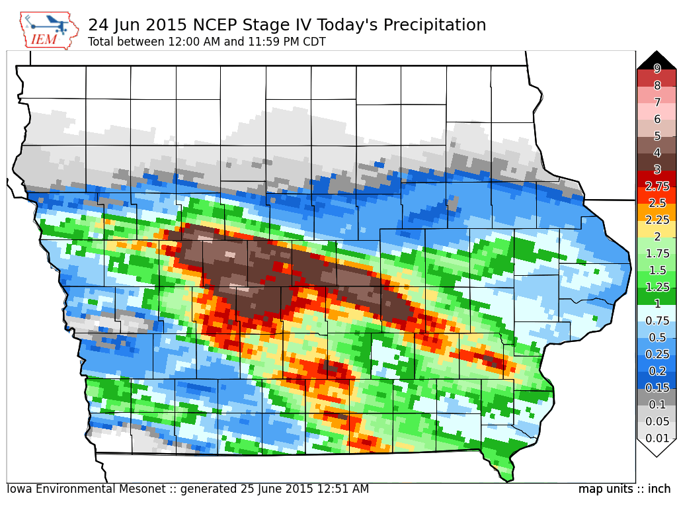

Slide 7
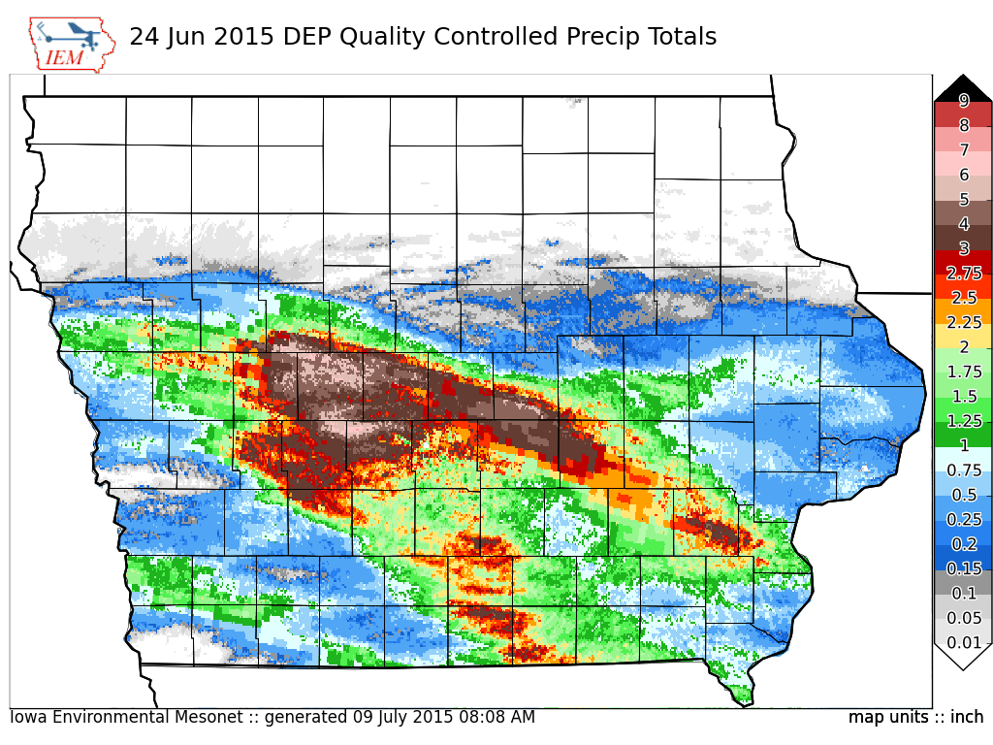
MRMS

Slide 8
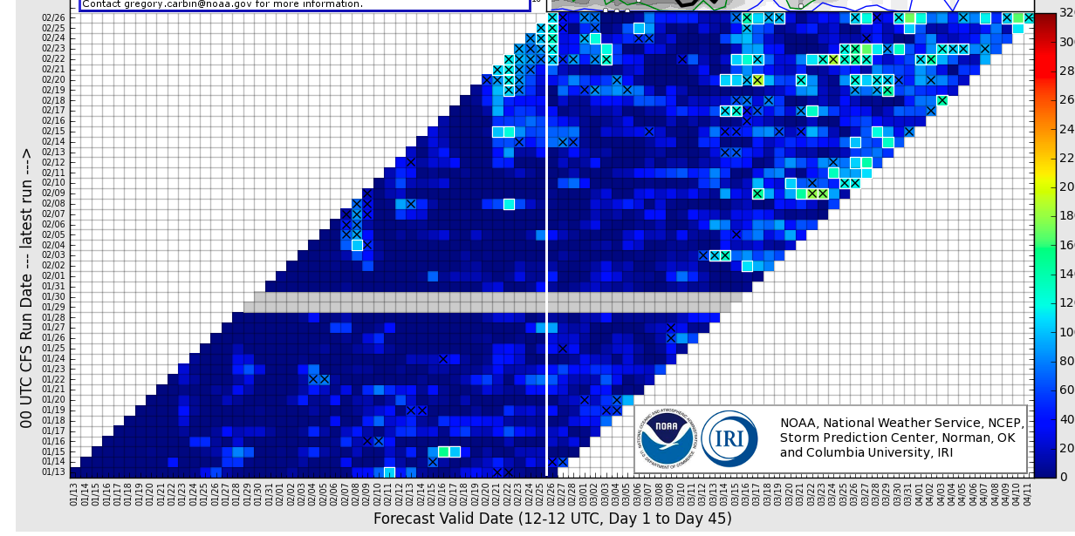
Climate Forecast System (CFS)

Slide 9
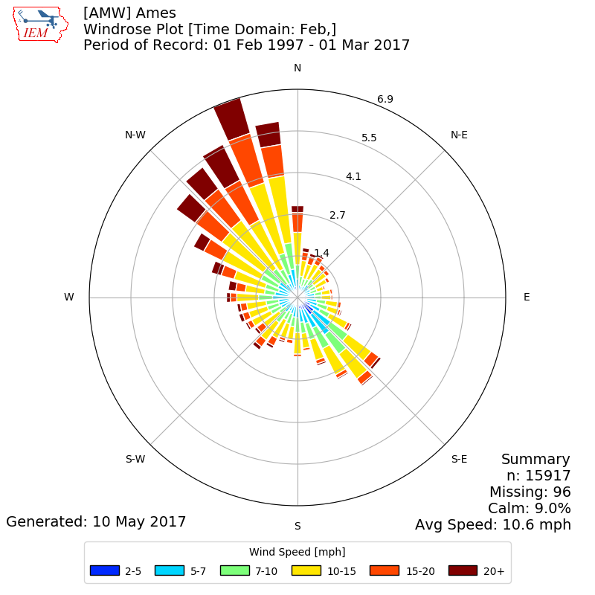
Iowa Environmental Mesonet
Attempt to process, archive and disseminate those Big Data weather datasets!
The website is wild and woolly, but always feel free to reach out to me!

