Slide 1
Iowa Environmental Mesonet
October 4, 2001
Dennis Todey
Iowa State University

Slide 2

Iowa Environmental Mesonet
History
IEM – What is it?
Assessment
Current Products & Web site
Input from YOU!

Slide 3
IEM – How is it different?
Other mesonets have been built from scratch at great cost.
The IEM attempts to capitalize on existing resources and supplement them. This can be a model for other states and the nation.

Slide 4
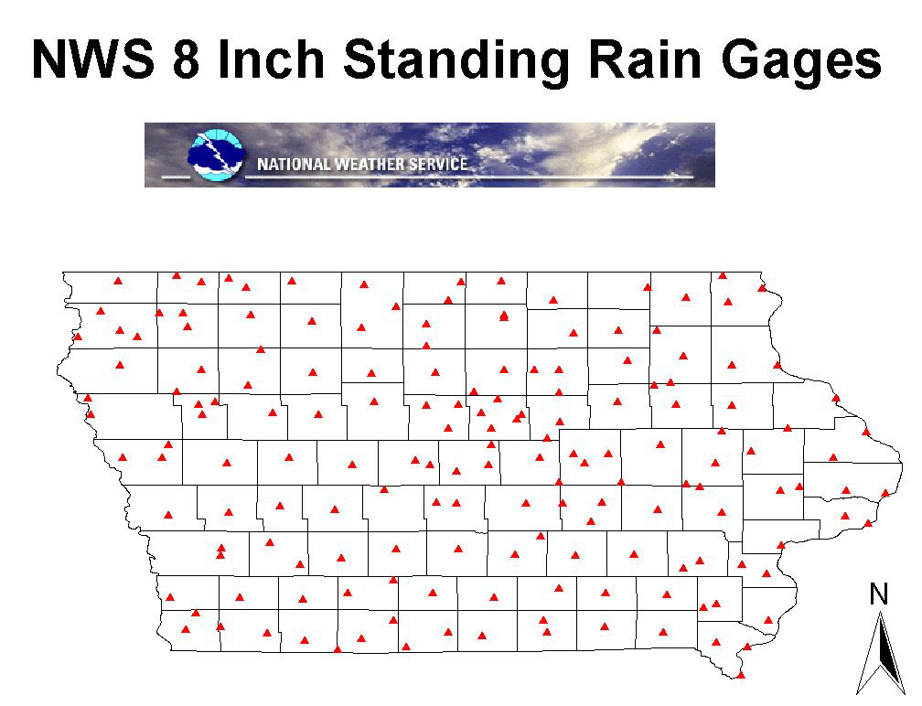

Slide 5
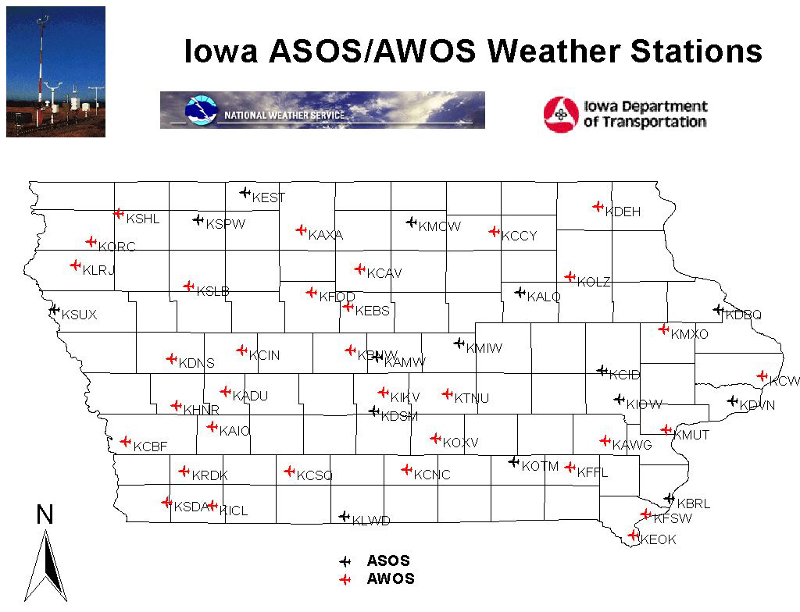

Slide 6
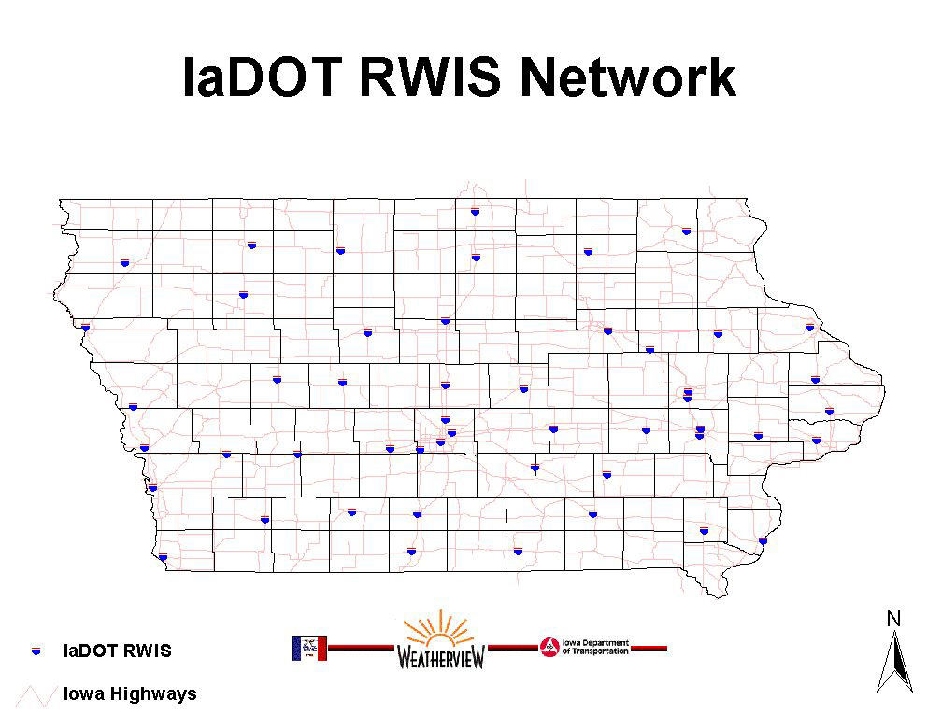

Slide 7
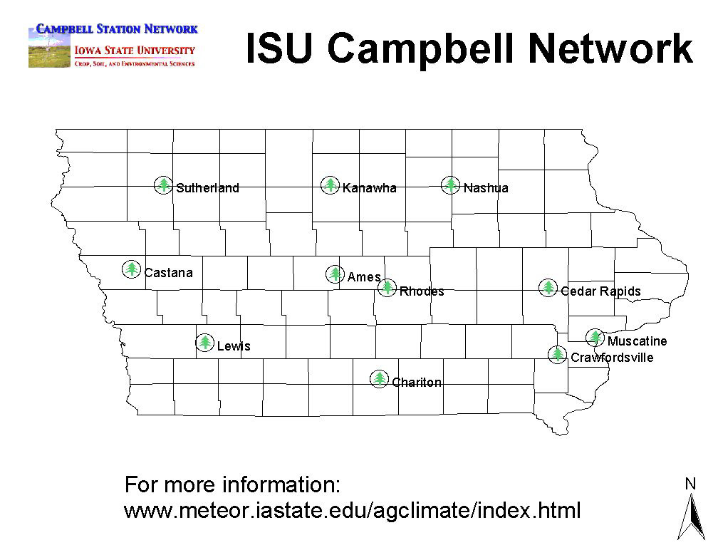

Slide 8
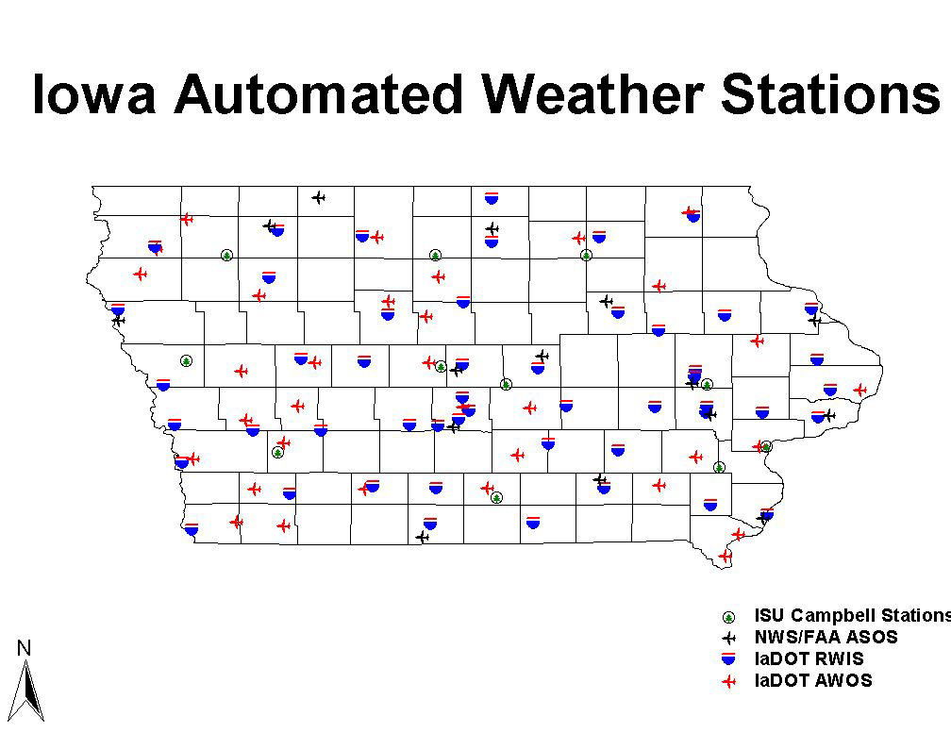

Slide 9
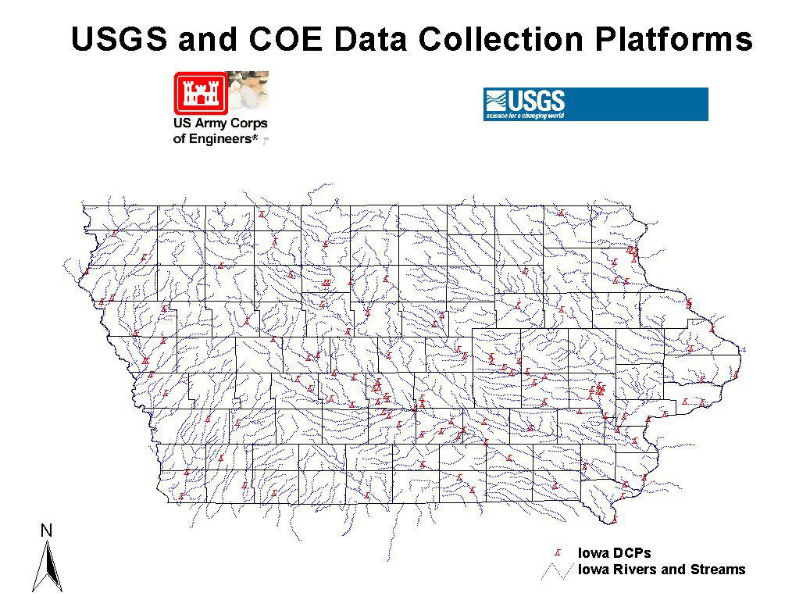

Slide 10
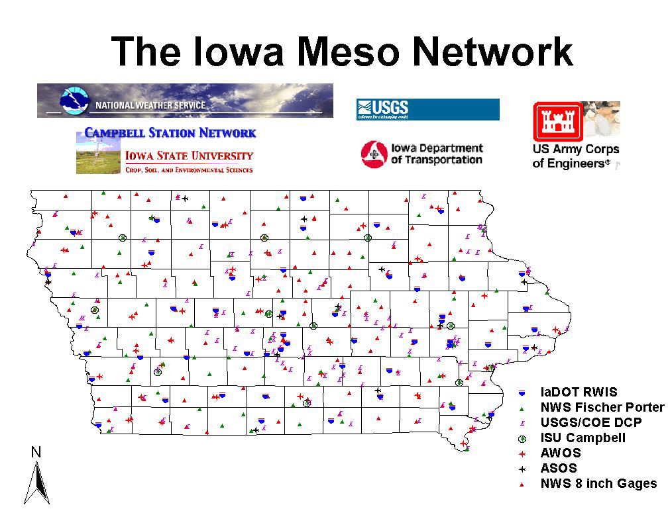

Slide 11
What we are lacking
Central data facility (archive)
Data comparison standards
Detailed soil temperature data
Regular soil moisture data
Complete state coverage
Short term data (from 2 days - 6 weeks)

Slide 12
Automated Stations

Slide 13
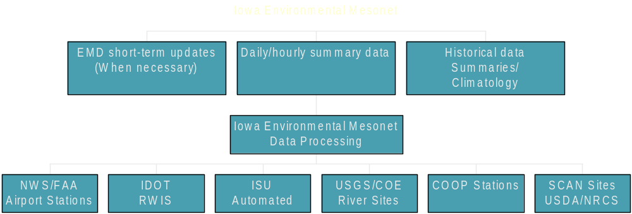
Iowa Environmental Mesonet

Slide 14
Potential Users
Farmers/Producers
Emergency managers
Citizenry
Industry
Education (K – graduate)
Climate/agricultural researchers
NWS

Slide 15
Cooperators/Supporters
National Weather Service
Iowa State University
Insurance Industry
USDA OCE
Iowa DOT
IDALS

Slide 16
Improve collaboration among scientists and managers to enhance the effectiveness of observation networks, monitoring, prediction, information delivery, and applied research and to foster public understanding of and preparedness for drought.
Goal 2 National Drought Policy Commission
“Preparing for Drought in the 21st Century”

Slide 17
Station density
Don’t we have enough??

Slide 18
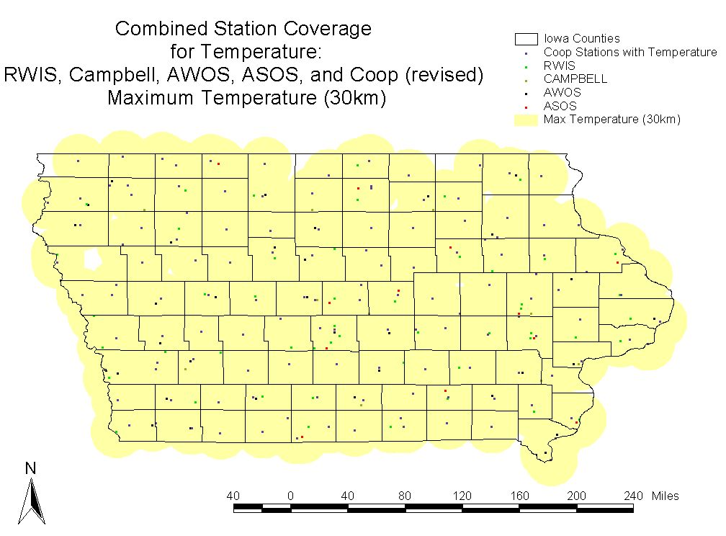
Maximum temperature

Slide 19
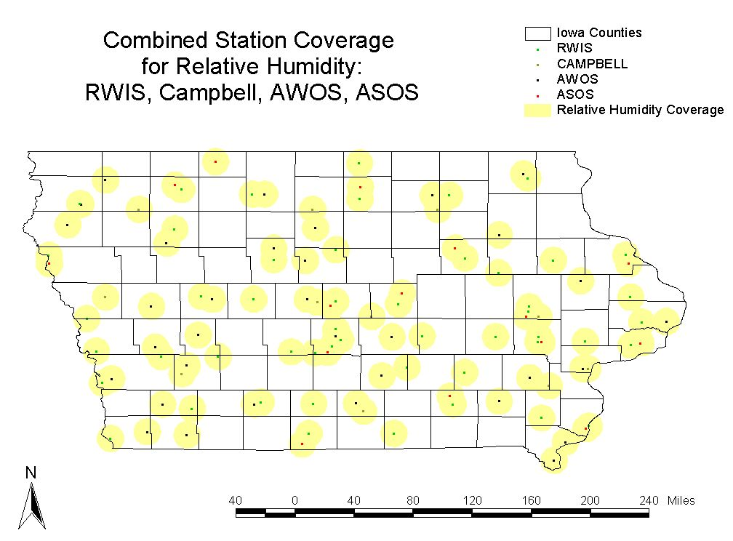
Relative humidity

Slide 20
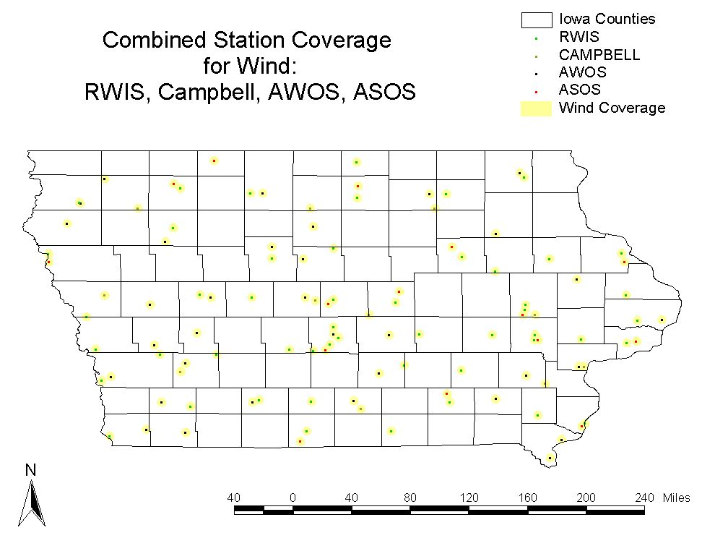
Wind

Slide 21
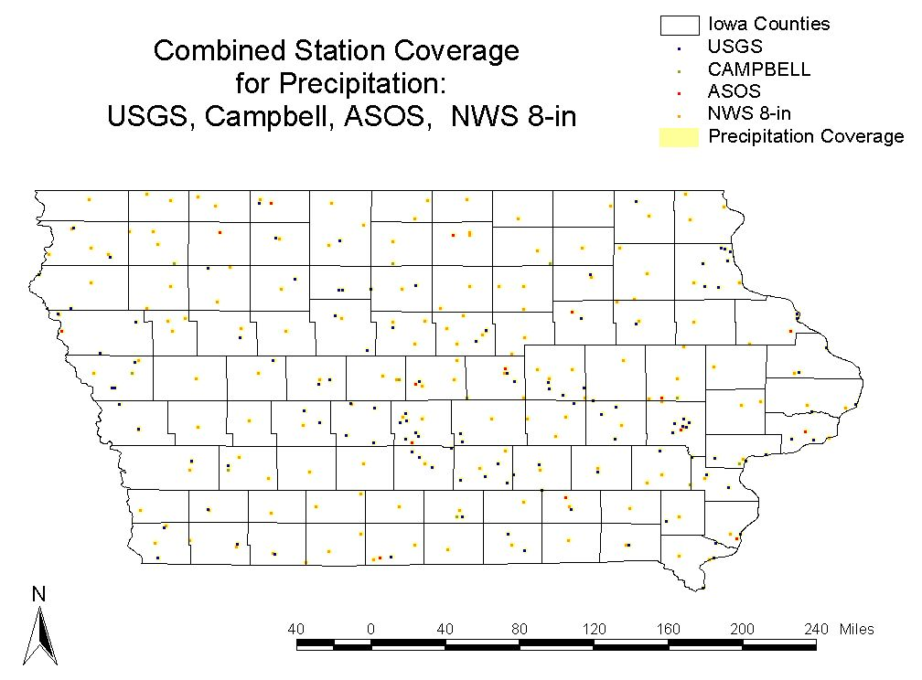
Precipitation

Slide 22
Current Products
What do we have now? http://mesonet.agron.iastate.edu

Slide 23
Current Products http://mesonet.agron.iastate.edu

Slide 24
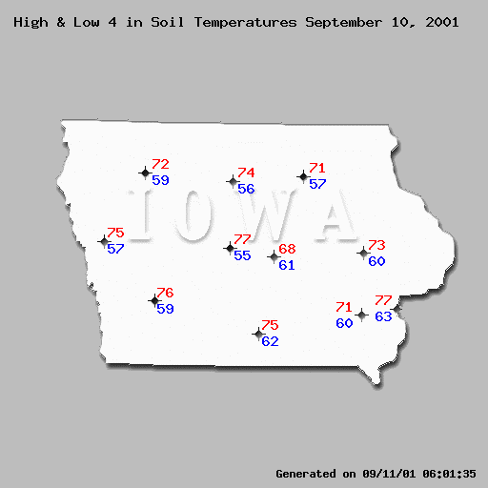
ISU Automated Network
Soil Temp.

Slide 25
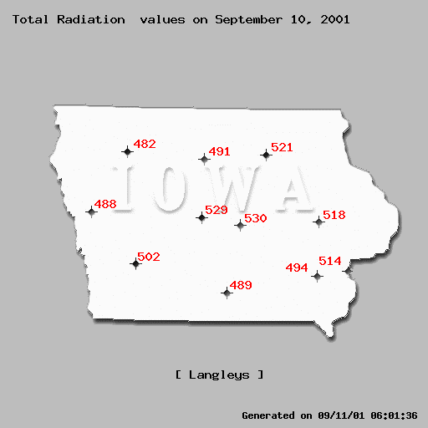
ISU Automated Network
Solar Rad.

Slide 26
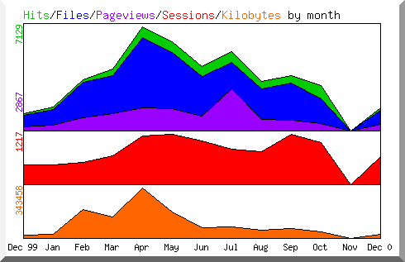
ISU Automated Network hits (2000)

Slide 27
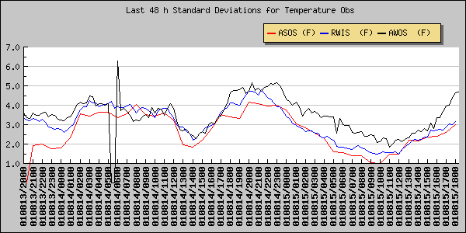
Products – Network comparison

Slide 28
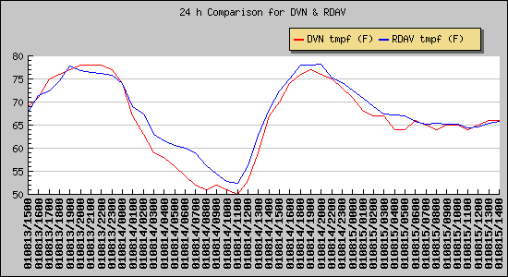
Products – Davenport AWOS-RWIS

Slide 29
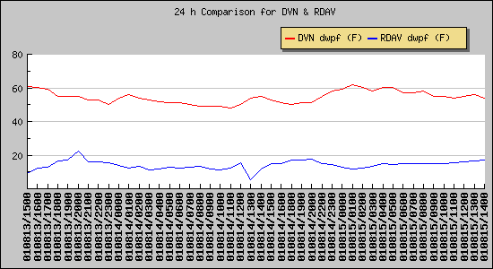
Products – Davenport AWOS-RWIS

Slide 30
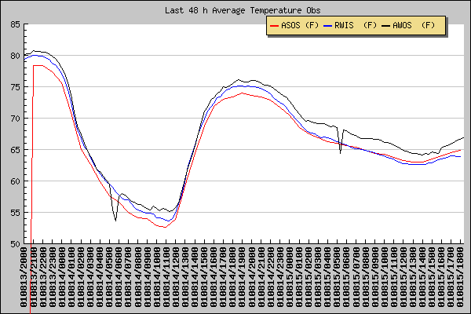
Products – Network comparison

Slide 31
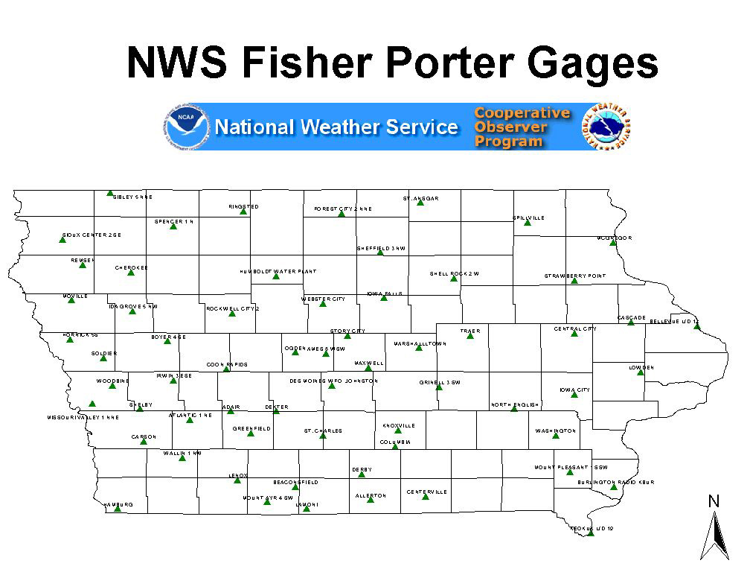

Slide 32
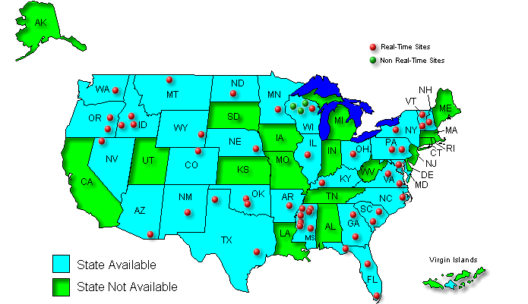
SCAN (Soil Climate Analysis Network)

Slide 33
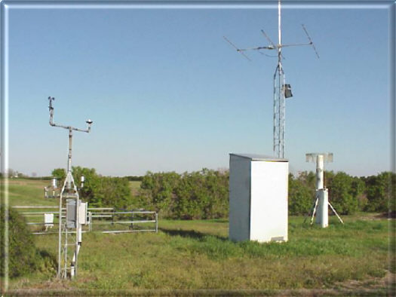
SCAN (Soil Climate Analysis Network)
Air and soil temperature
Wind
Relative humidity
Precipitation
Soil moisture
Solar radiation
Snowfall and depth

Slide 34
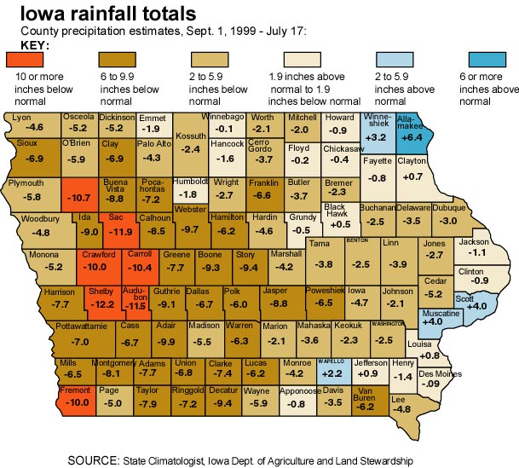
Could be created daily

