Slide 1
Iowa Environmental Mesonet
National Weather Association Conference
March 22, 2002
Dennis Todey
Iowa State University

Slide 2

IEM Timeline
Concept Conceived State Drought Task Force 10/00
Introduced to IDALS 12/00
USDA/WAOB Visit 1/01
Funding 4/01
Web Site on line 6/01

Slide 3
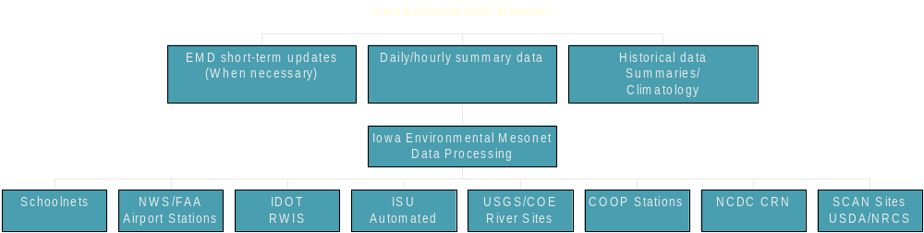
Iowa Environmental Mesonet

Slide 4

What we are lacking
Central data facility (archive) Achieved
Data comparison standards Proposed (some occurring)
Detailed soil temperature data
Regular soil moisture data Adding spring ‘02
Short term archive (2 days - 6 weeks) In progress
Improved spatial and temporal resolution In progress (SCAN/CRN Schoolnet)

Slide 5
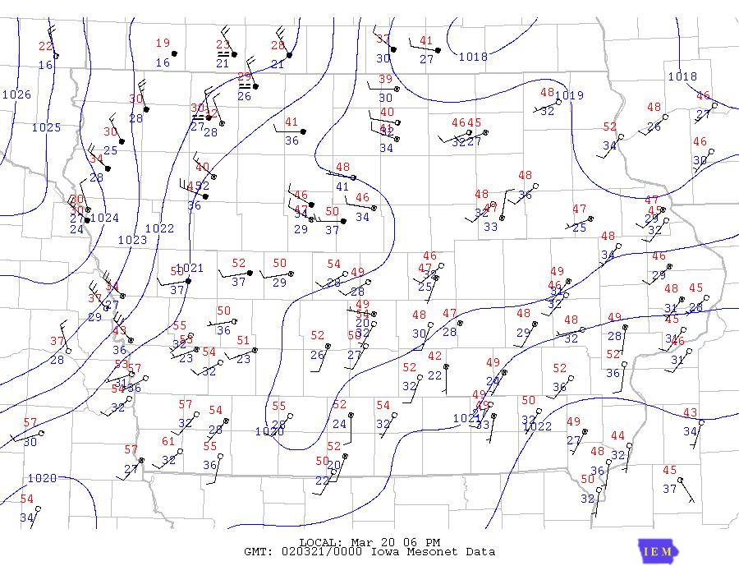

Slide 6
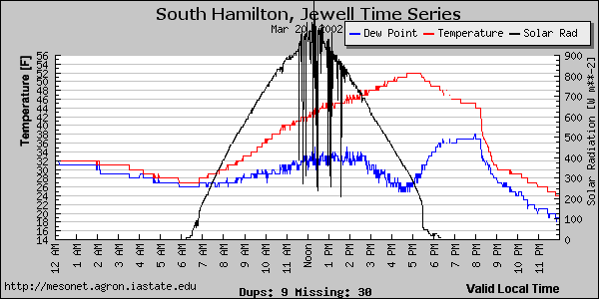

Slide 7
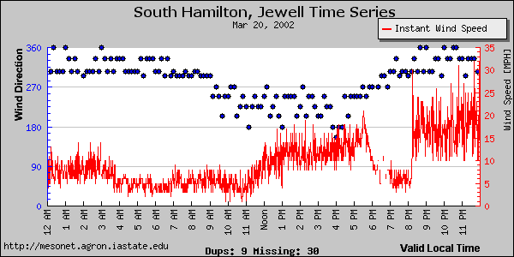

Slide 8
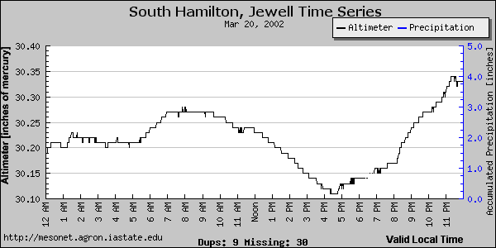

Slide 9
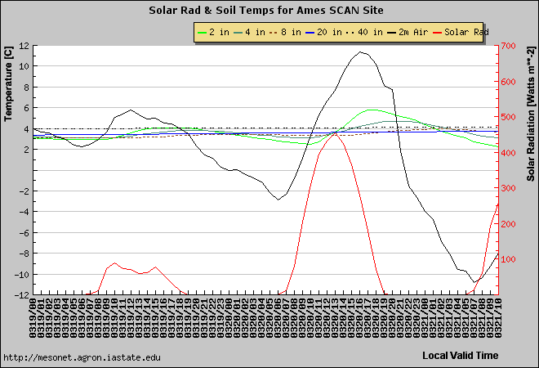

Slide 10
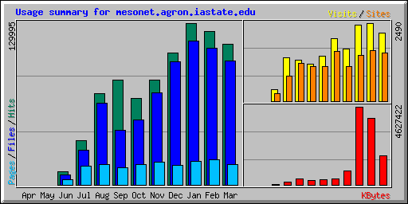
Web site Usage

Slide 11
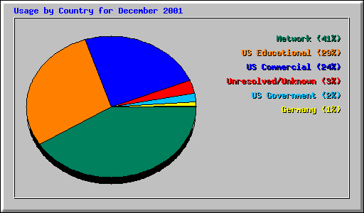
Types of users

Slide 12
Current Data Collection
ASOS 15 24
AWOS 33 72
RWIS 50 72
ISU Ag Climate 12 24
USGS/COE ~150 24 avg
Schoolnet 37 1200
SCAN 1 24
COOP ~150 1
Total: 448 Stations 44,772 obs/day
16.3 M obs/yr

Slide 13
Data reliability (since June 1)
ASOS 87% (99.6% Dec. 14-31)
AWOS 72% (90% Dec. 14-31)
RWIS 77% (of working stations)
ISU Ag Climate 100%
SCAN 100%
USGS/COE ???

Slide 14
Data storage
NEXRAD 7.5 MB/day (5 sites)
Products/plots 1.5 MB/day
GEMPAK surface data 7.5 MB/day
Raw surface data 12 MB/day
Daily Total 28.5 MB/day

Slide 15
Spurring research
Iowa Soil Erosion estimates
Detailed climate of Iowa
Maize Pollen dispersion
Pathogen transfer
Data Comparison standards
Part of Larger Agronomy Agro-ecosystem lab

Slide 16
Future of the IEM
Continue station development (fill holes)
Expand measurement of rainfall/soil moisture
Look for continued funding
Upper air development

Slide 17
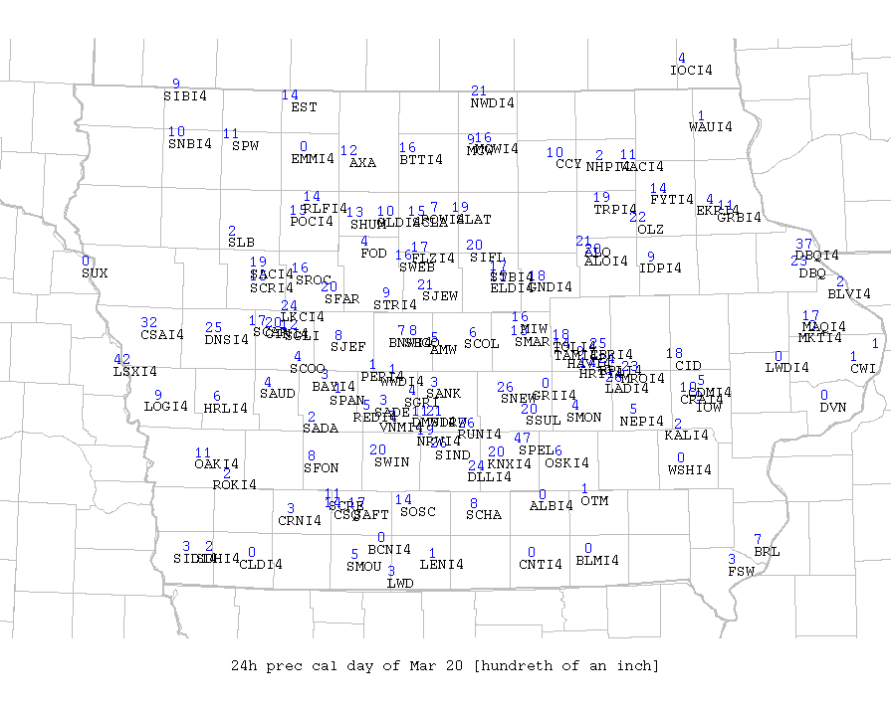

Slide 18
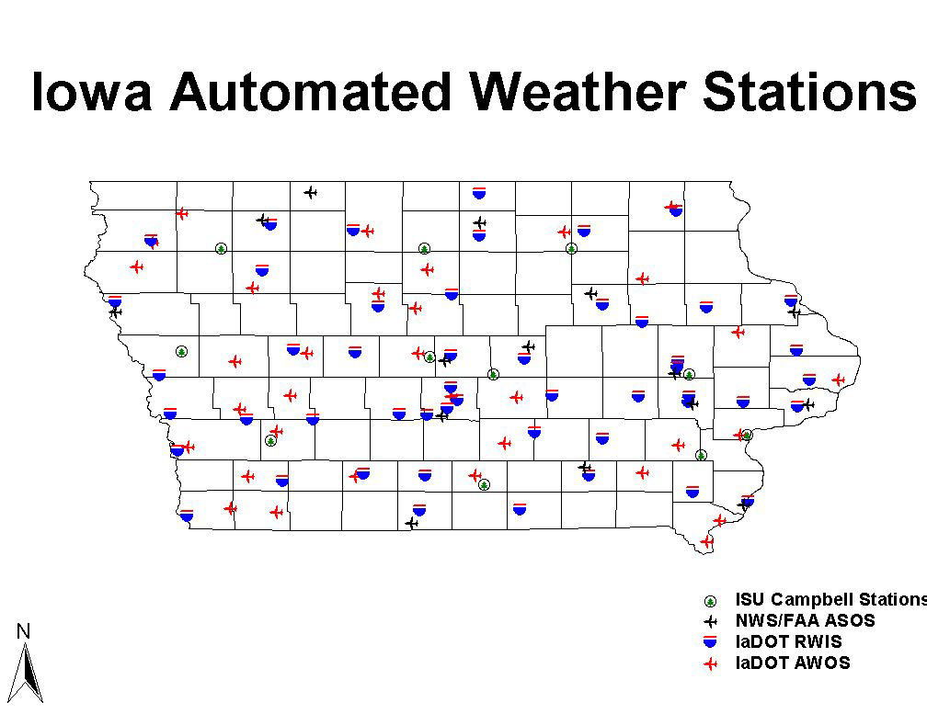

Slide 19
Automated Stations

Slide 20
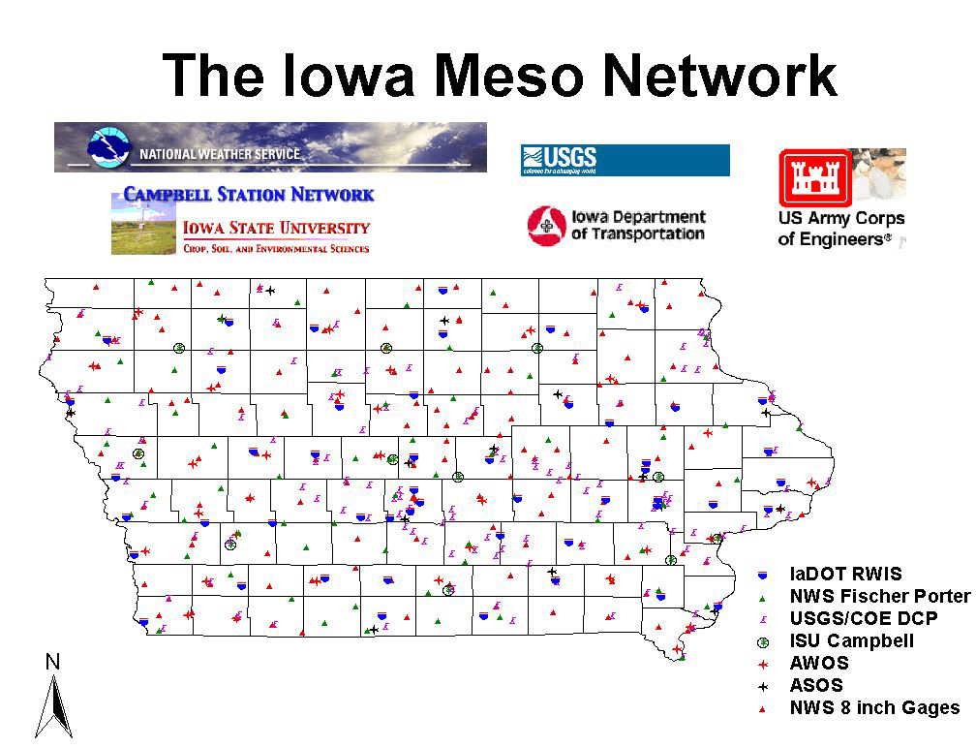

Slide 21
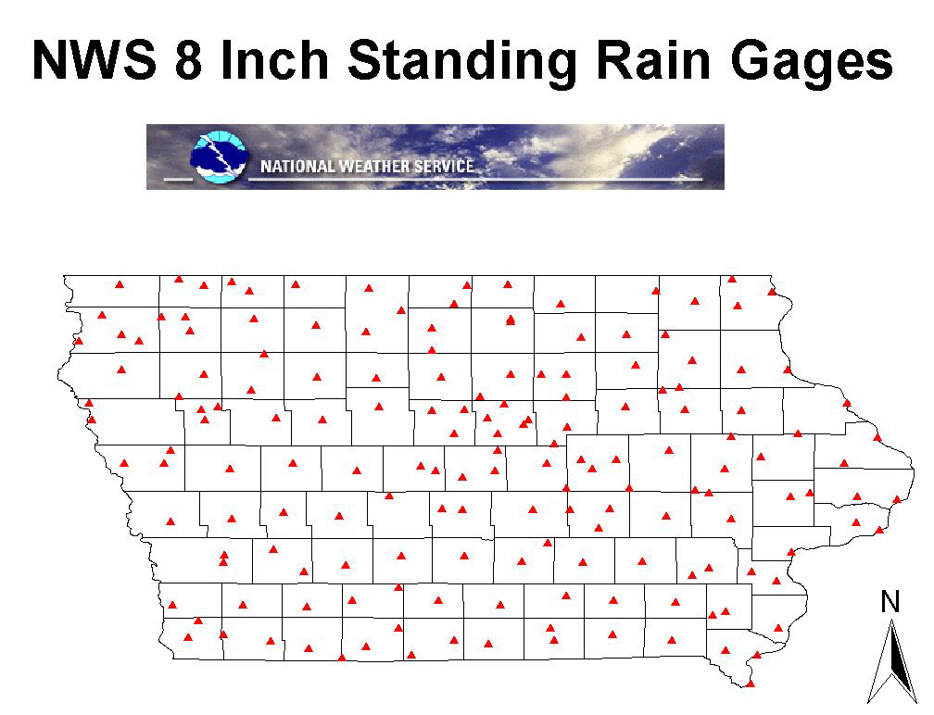

Slide 22
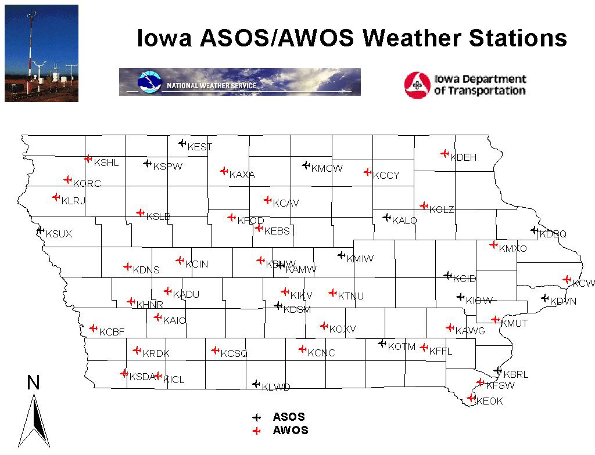

Slide 23
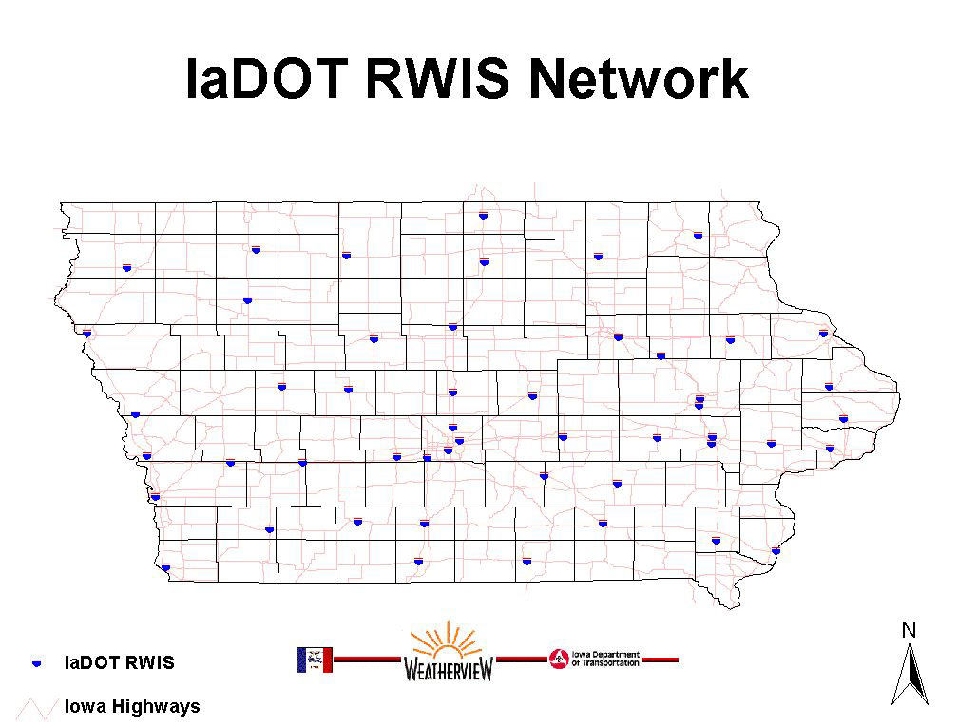

Slide 24
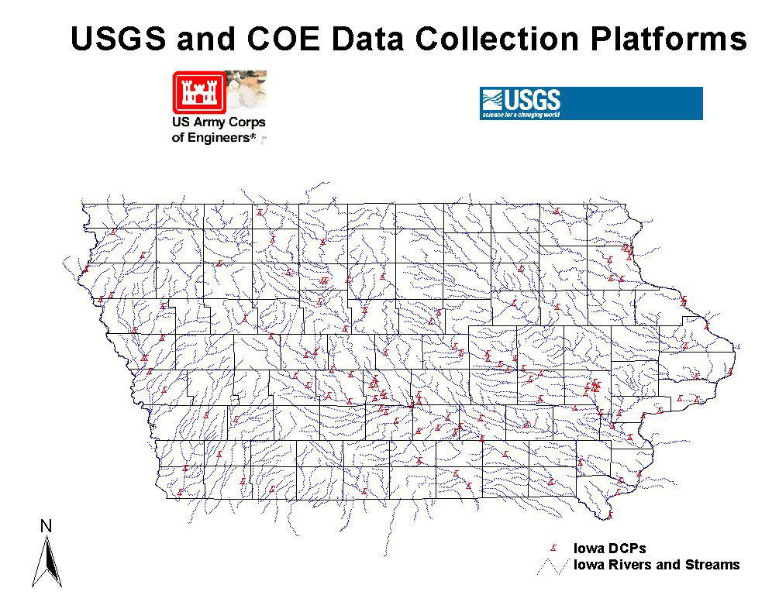

Slide 25
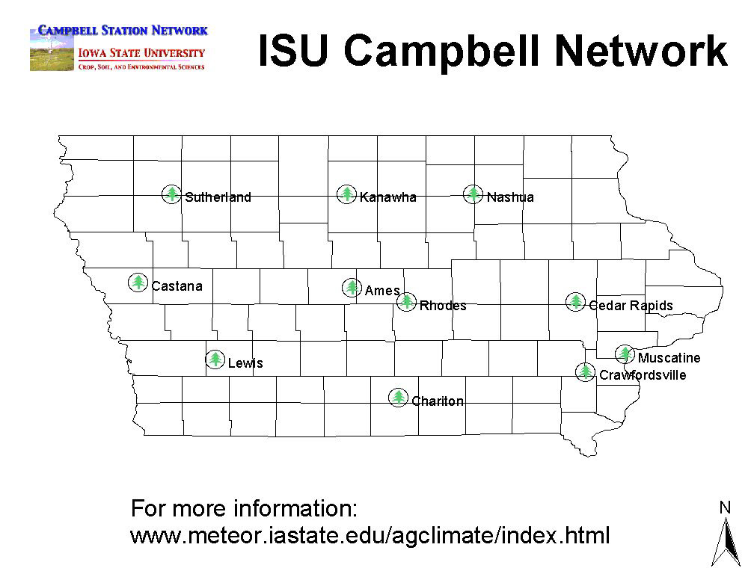

Slide 26
Spurring research (undergrad)
SW Iowa Heat/Moisture Pool
Comparison of RWIS AWOS/ASOS overnight temperatures
Wind speed comparisons
Frost Model Comparisons (Tina Greenfield)

Slide 27
Station density
Do we have enough??

Slide 28
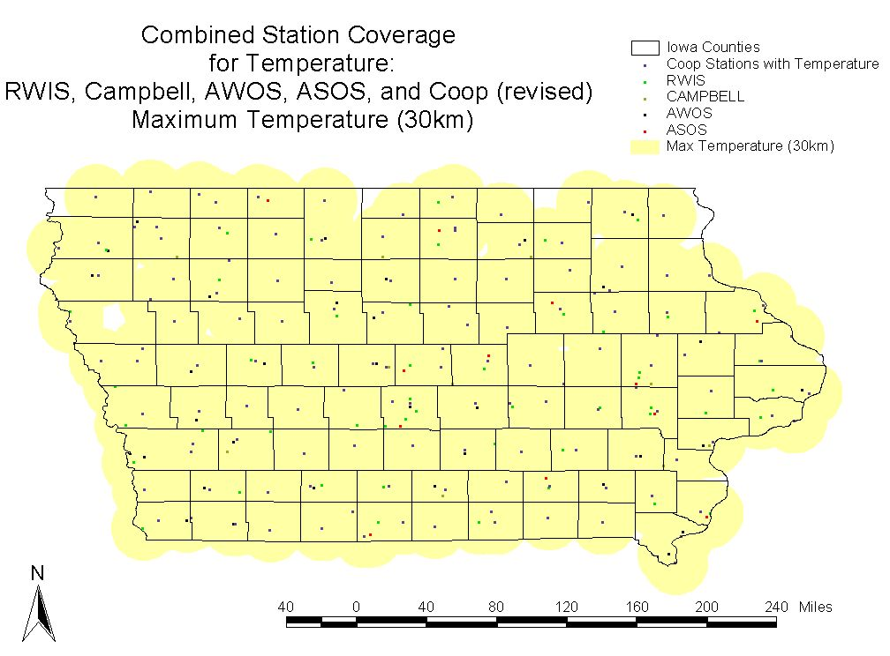
Maximum temperature

Slide 29
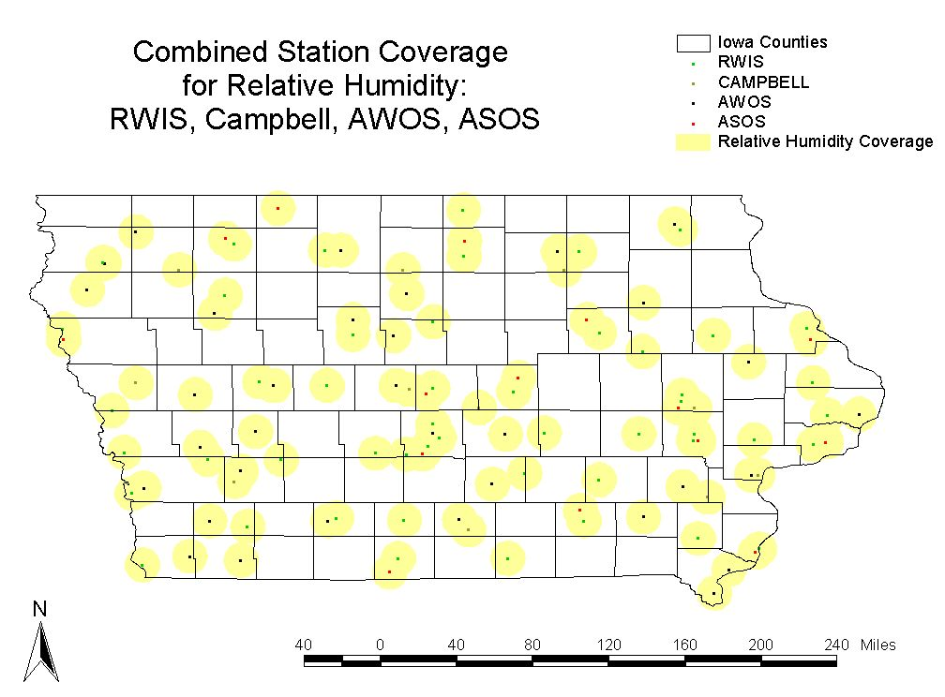
Relative humidity

Slide 30
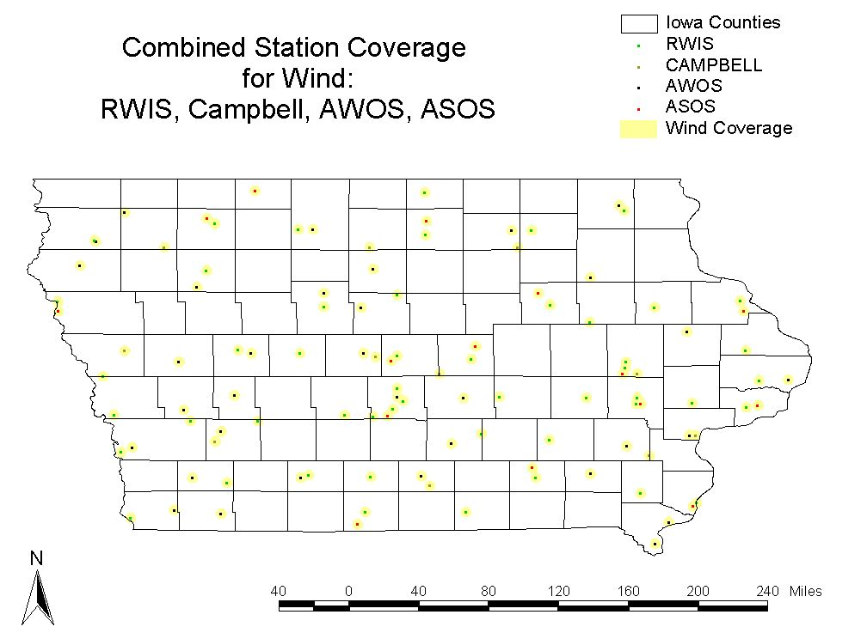
Wind

Slide 31
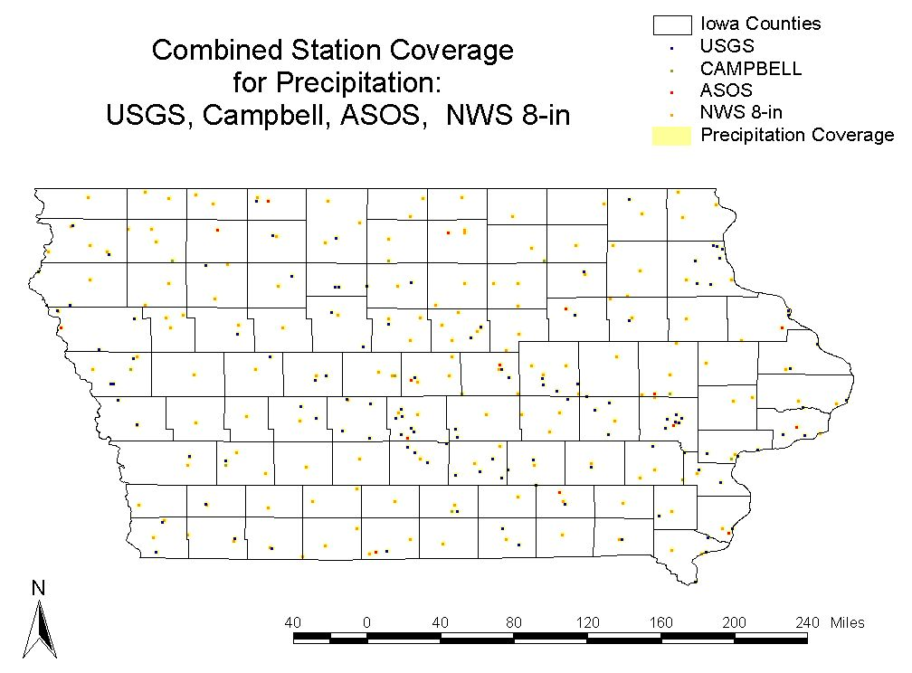
Precipitation

Slide 32
Potential Users
Farmers/Producers
Emergency managers
Citizenry
Ag/Insurance Industry
Education (K – graduate)
Climate/agricultural researchers
NWS

Slide 33
Cooperators/Supporters
National Weather Service
Iowa State University
USDA OCE
Iowa DOT
IDALS
Iowa Emergency Management
Ag Insurers

Slide 34
Improve collaboration among scientists and managers to enhance the effectiveness of observation networks, monitoring, prediction, information delivery, and applied research and to foster public understanding of and preparedness for drought.
Goal 2 National Drought Policy Commission
“Preparing for Drought in the 21st Century”

Slide 35
Current Products
What do we have now?

Slide 36
Data Requests/Issues
Freeze-Notice use of pavement temperatures
Request for advance soil moisture data
Usage fee/subscriptions
Cooperators/collaborators?
Federal discussion of including data
Lack of weather data for Iowa

Slide 37
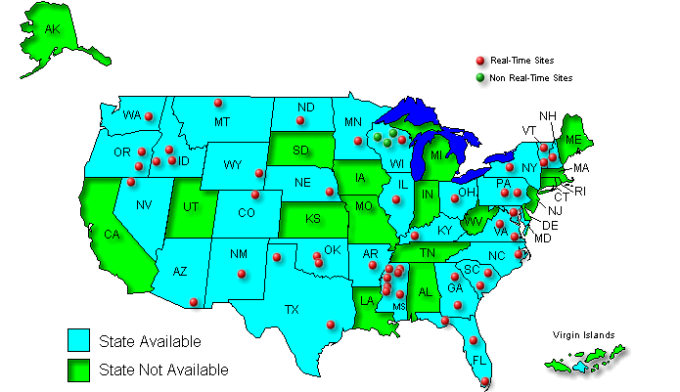
SCAN (Soil Climate Analysis Network)

Slide 38
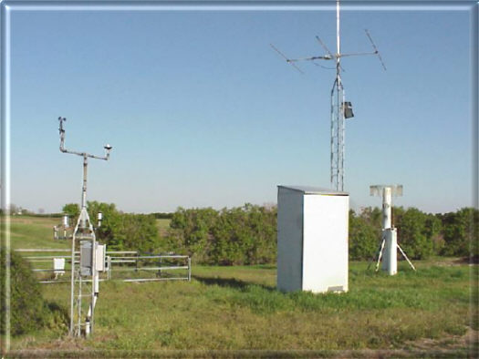
SCAN (Soil Climate Analysis Network)
Air and soil temperature
Wind
Relative humidity
Precipitation
Soil moisture
Solar radiation
Snowfall and depth

Slide 39
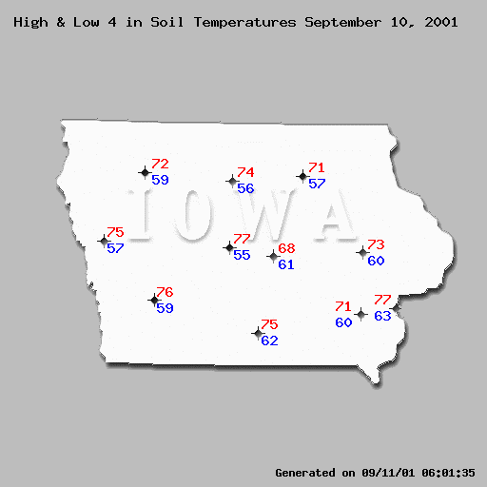
ISU Automated Network
Soil Temp.

Slide 40
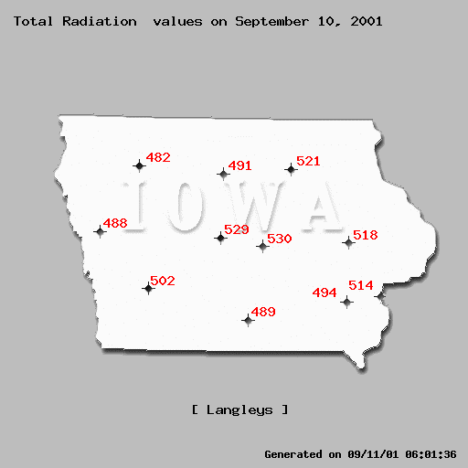
ISU Automated Network
Solar Rad.

